Slide 1

LAS 204
TECHNOLOGY, ETHICS AND GLOBAL SOCIETY
Dr. Pamela Krause
pamela.krause@lau.edu.lb

Slide 2
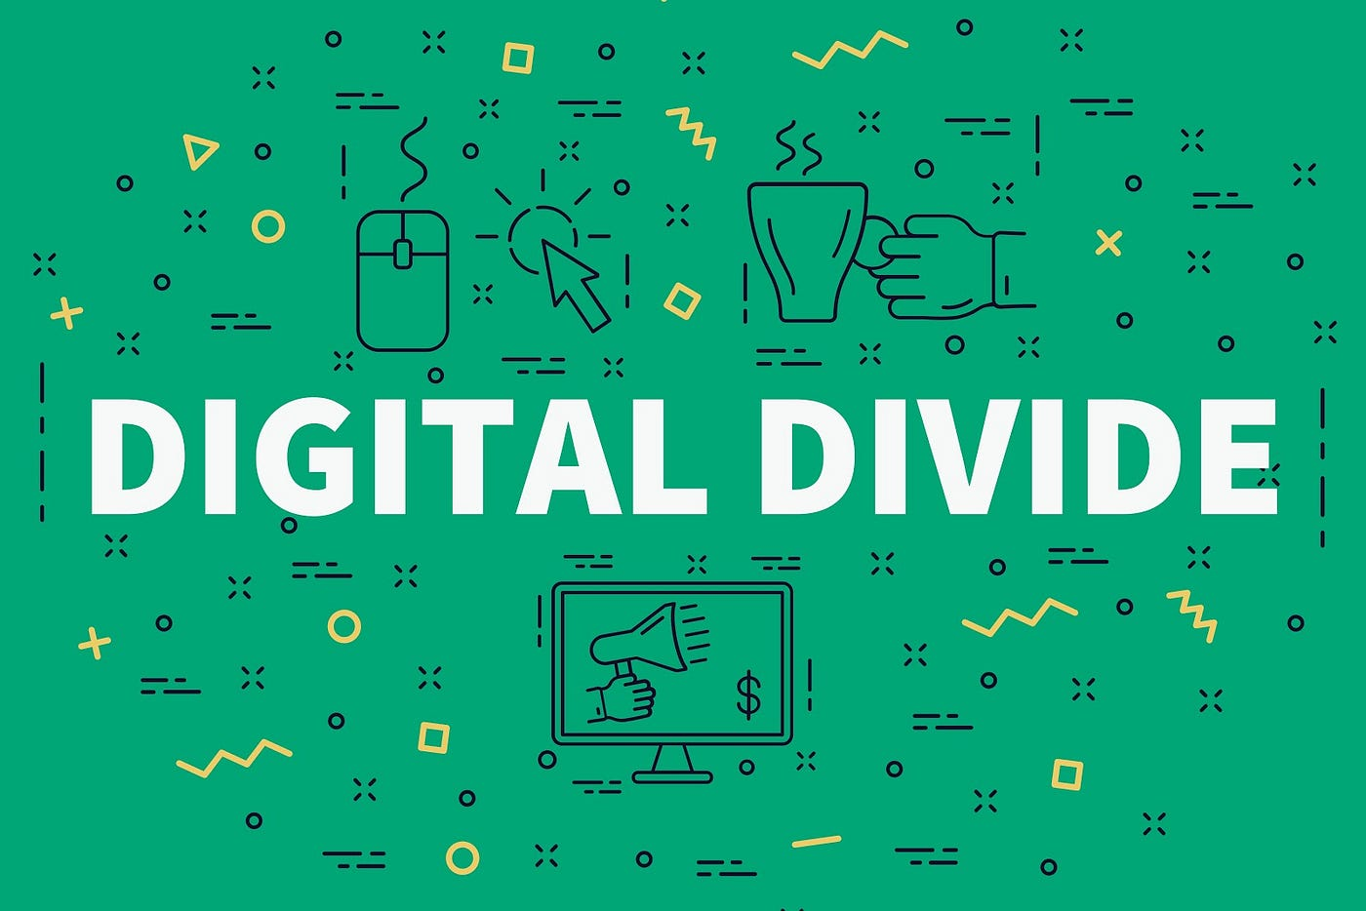

Slide 3
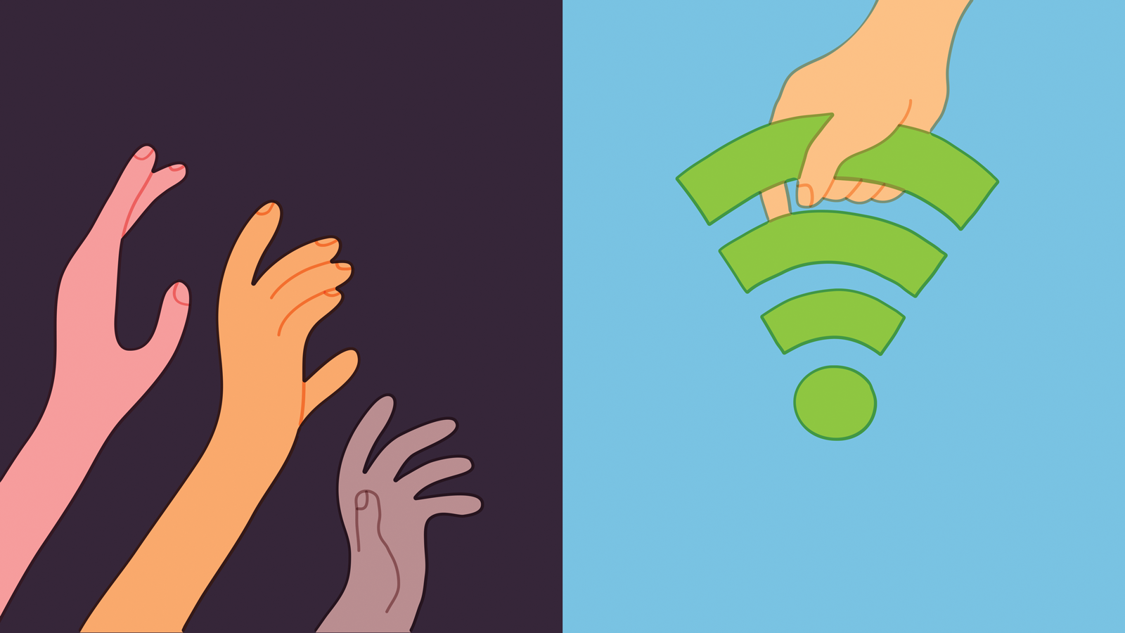
What is the digital divide?
Do we all have access to the same resources when it comes to technology?
If not, why do you think that is ?
How do you think we can improve social justice when it comes to technology?

Slide 4
Cybertechnology poses not only political, inter-personal problems, but also social issues.
Everyone doesn’t have equal access to technology: some groups are excluded, and this inclusion can reinforce and perpetuate gender inequalities and biases.
Therefore, some people have access + technological know-how, while others do not.
This is what we call the “digital divide”
The digital divide refers to the gap or disparity that exists between different groups of people in terms of their access to and use of information and communication technologies (ICTs), particularly the internet. This divide is primarily based on socioeconomic, geographic, demographic, and other factors that affect individuals' ability to participate in the digital world. In essence, it highlights the unequal distribution of digital resources and opportunities.

Slide 5
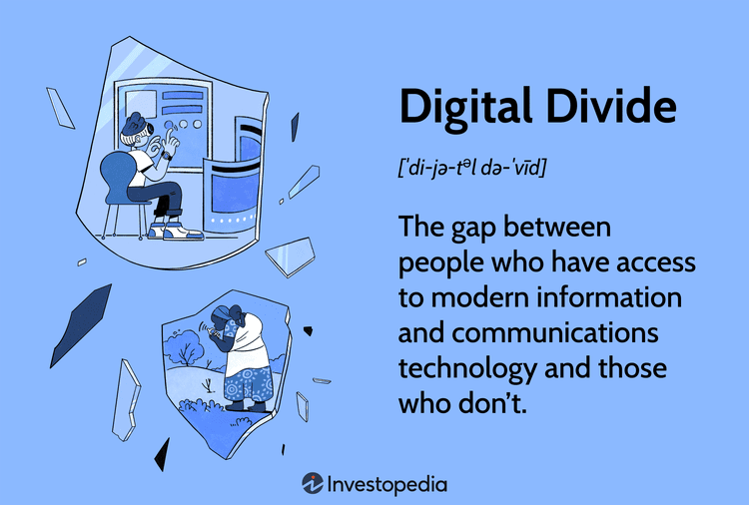

Slide 6
The divide comes in different forms:
Access Divide: availability of technological infrastructure, such as computers, smartphones, and internet connectivity. Some individuals and communities have easy access to these resources, while others do not due to factors like economic limitations, rural/urban location, and infrastructure development.
Economic Divide: Economic factors play a significant role in the digital divide. High costs associated with acquiring devices, internet plans, and data can limit access for those with lower incomes. Geographic Divide: Rural areas often face challenges in terms of infrastructure development, which can result in limited or unreliable internet access.
Usage/ literacy Divide: Even if individuals have access to technology, there can still be a divide in how they use it. This could be due to factors like lack of digital literacy, limited skills to navigate online platforms, or a lack of awareness about the potential benefits of using technology.
Gender Divide: There's a recognized gender dimension to the digital divide, where women may have less access to and control over technology due to societal norms, stereotypes, and economic disparities.
Political divide: Some dictatorships censor information found online or restrict access to information altogether (ex. North Korea)

Slide 7
Barriers to technology access :
Motivation: This is driven by the lack of interest and/or fear of new technologies, which deters people from even trying them out in the first place.
Physical access: Physical access goes beyond the lack of access to the internet and mobile phones, but is also about the quality of access.
Digital skills: Lack of digital skills include needing to learn how to operate technologies, and also the literacy to search, select, and process information from a variety of digital sources.
Usage: Finally, some may lack the opportunity to use digital tools, even if they have the motivation, access, and skills. For instance, even though someone may have picked up programming skills, the person may not have the chance to practice as his or her work does not require it.

Slide 8
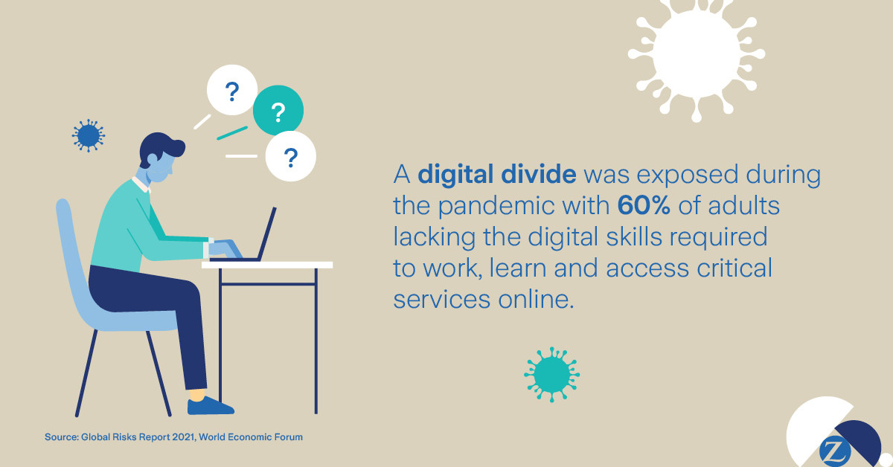

Slide 9
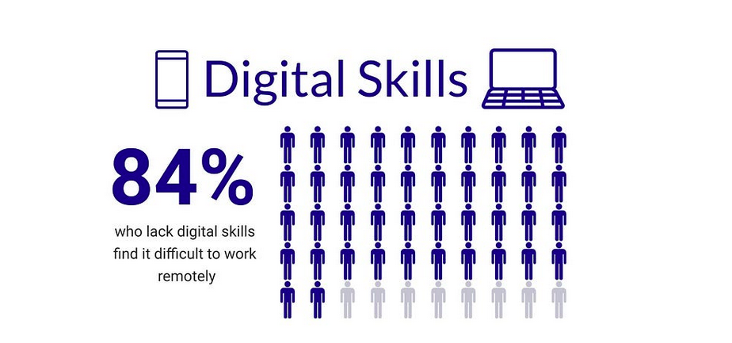

Slide 10
Is the digital divide an ethical issue?
If so, do we have to do something about it as a society?
Ethics is a branch of philosophy concerned with rational judgments about what is right or wrong.
Ethics is concerned with building a fair society, based on rational and universal judgments.

Slide 11
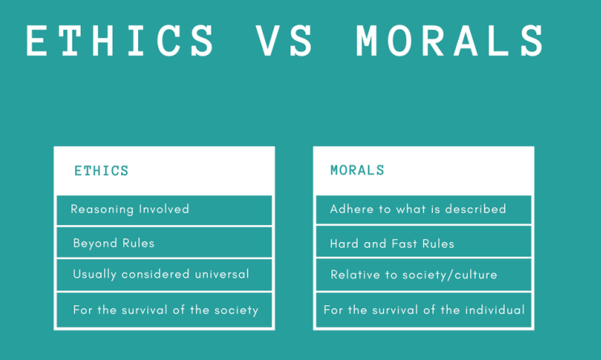

Slide 12
Thought experiment
Imagine not having access to the internet for one whole year.
How will your life be affected?
How disadvantaged would you be, compared to your peers at LAU?

Slide 13
Is the digital divide an ethical issue?
If inequality exists, does it necessarily become an ethical issue ? For example, if I cant buy a fancy
car, like a Porsche, does it mean that there is a Porsche divide?
I wish, but no. why? Because a Porsche is a luxury good, I can do without.
When it comes to basic human needs, like food, water, education, then inequalities become problematic and it becomes an ethical issue.
We ask ourselves: is the digital divide more of a Porsche problem or an ethical problem? Actually, the digital divide is an ethical problem, because it concerns what we distributive justice.
Distributive justice concerns the distribution of information, information services and infrastructures. There is concern about the uneven distribution, and access of new technology, new information wealth, both internationally and within nations. When it comes to tech, we are not all equal.
We miss out on job offers, on information, on knowledge. We miss out on a lot when we don’t have access to the internet. Imagine being Ukrainian and not knowing what Putin has been up to!

Slide 14
The digital divide is an ethical issue
In his book, A Theory of Justice, philosopher John Rawls talks about the notion of primary social goods, which are resources that satisfy basic human needs and have a special value or moral weight in society. Rawls notes that with these goods, humans “can generally be assured of greater success in carrying out their intentions and in advancing their needs.” We can argue that Rawls’ theory of justice in general, and his notion of a primary social good in particular, can be extended to include “information goods.”
Addressing the digital divide is essential for creating a more equitable and inclusive society.

