Slide 1
SCRUM and TETRIS
Sarah Borden, Kobie Cloud,
Danielle Fleming, Nick Paddock

Slide 2
Product Owner (Kobie)
Kobie
Decided what needed to go in to the product backlog
Prioritized
Added new things to the back log as he came up with them

Slide 3
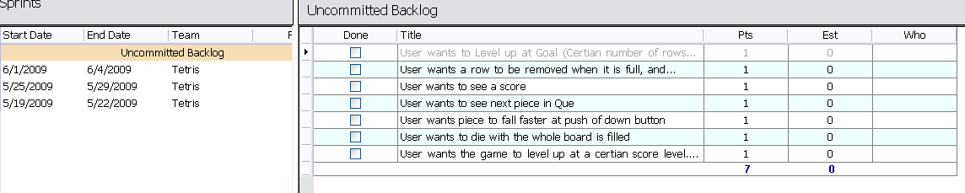
Product Backlog (Kobie)
Created most of the backlog at the beginning
Added more later

Slide 4
Sprint Planning Meeting (Nick)
Held at the beginning of each Sprint
The first day of the week for us
Customer has prioritized list in the backlog
Decided as a team what we could accomplish
Assigned effort to each task
Moved the selected work to the Sprint Backlog

Slide 5
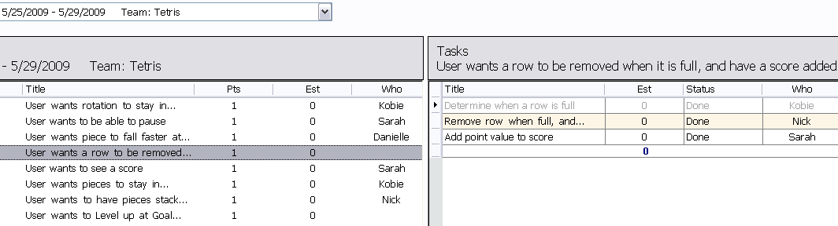
Sprint Backlog (Nick)
List of User Stories and Tasks to be completed in the sprint.
We did not allow the user to edit the sprint backlog – Anything new he wanted went to the product backlog

Slide 6
Scrum Master (Sarah)
Sarah
Made sure the team was productive
Encouraged team members to take on tasks
Made sure the daily stand up was efficient and short

Slide 7
Scrum Team (Sarah)
4 people
Everybody had the opportunity to work on what they wanted.
There were no formal roles
All worked to get the Sprint Backlog Done

Slide 8
Daily Stand Up (Danielle)
Held for 5 minutes at the beginning of everyday
Short and to the point
What I did yesterday
What I will do today
Any roadblocks I may have
Helped keep everyone on track and informed of what other team members were working on

Slide 9
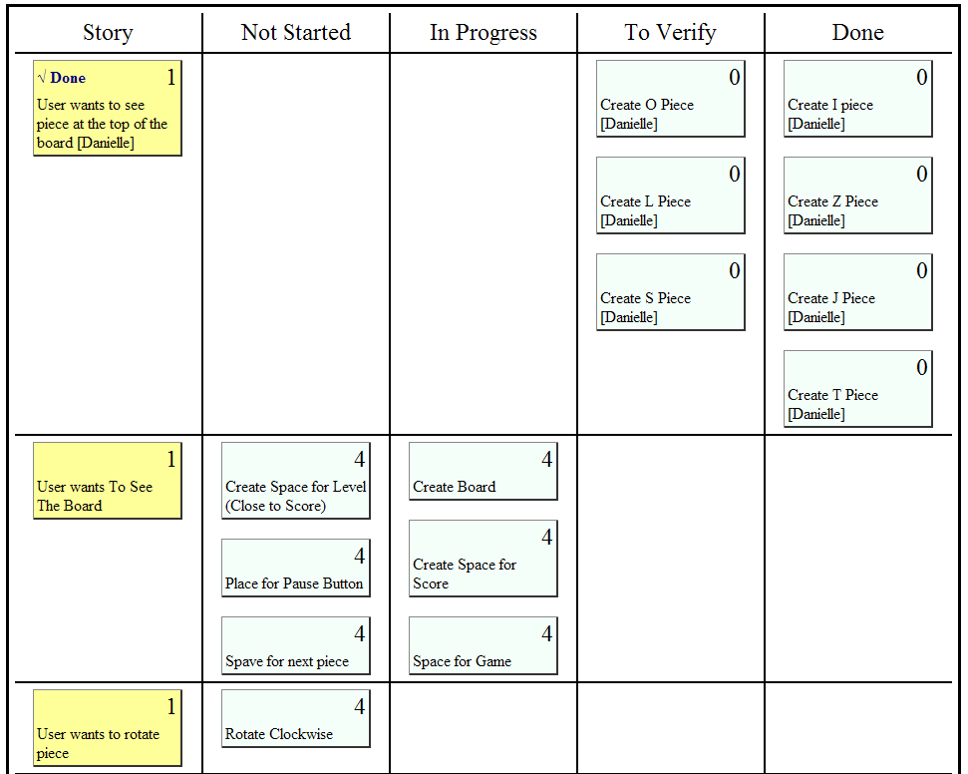
Task Board

Slide 10
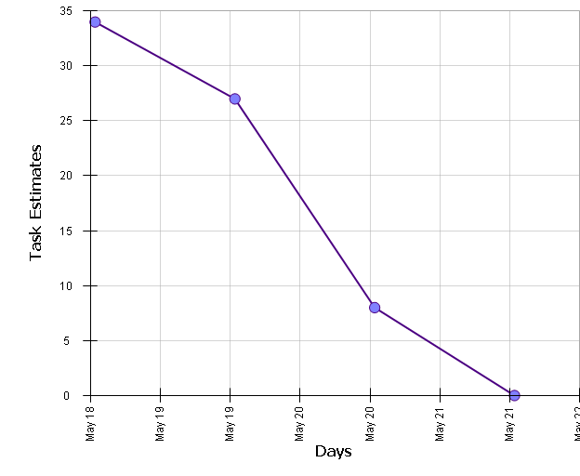
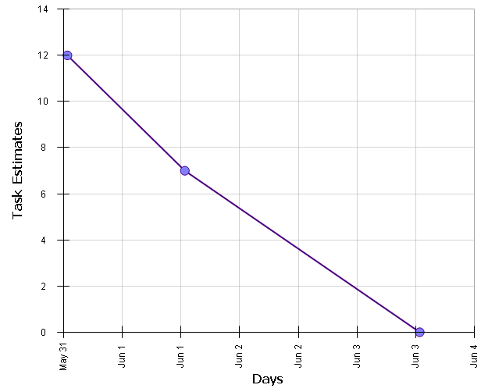
Release Burndown
Kept Track of the amount of work left in the sprint

Slide 11
Sprint Review Meeting (Danielle)
Held at the end of each sprint
Showed off functionality to the Product Owner
Owner provided suggestions to add to the product backlog

Slide 12
What we learned
Having a defined sprint is helpful in keeping on track and having goals that are accomplishable
Daily Stand Ups keep the team informed
Keeping requirements locked down during sprints makes changing things harder

