Slide 1

Have large-language models (LLMs) made previous AI tools obsolete?
AIRE’24 Joint Activity
by Chetan Arora, Fatma Başak Aydemir, and Julian Frattini
aire-ws/aire24-activity
Public

Slide 2






Goal
Pre-LLM era
LLM era
Conscious, specific design
Out-of-the-box usability
Manual data curation and training
Requiring a few examples
Decent results, but rarely
any adoption
Better/worse performance?
→ Have large-language models made previous AI tools obsolete?

Slide 3







Method Overview
Select a study that presents an AI-powered tool performing an RE task (e.g., from the AIRE or NLP4RE workshops)
Select data from the evaluation of that tool
Human output (ground truth)
/
Input Data
Tool output
/
LLM output
Engineer a prompt for the LLM of your choice that performs the same task
Reflect on the strengths and weaknesses of the LLM
Finally, we discuss the results

Slide 4
Preconditions
Minimum preconditions:
Access to an LLM/GenAI (e.g., ChatGPT) of your choice
Optional preconditions:
Account at GitHub for accessing the material
Working local git setup to store your solution

Slide 5
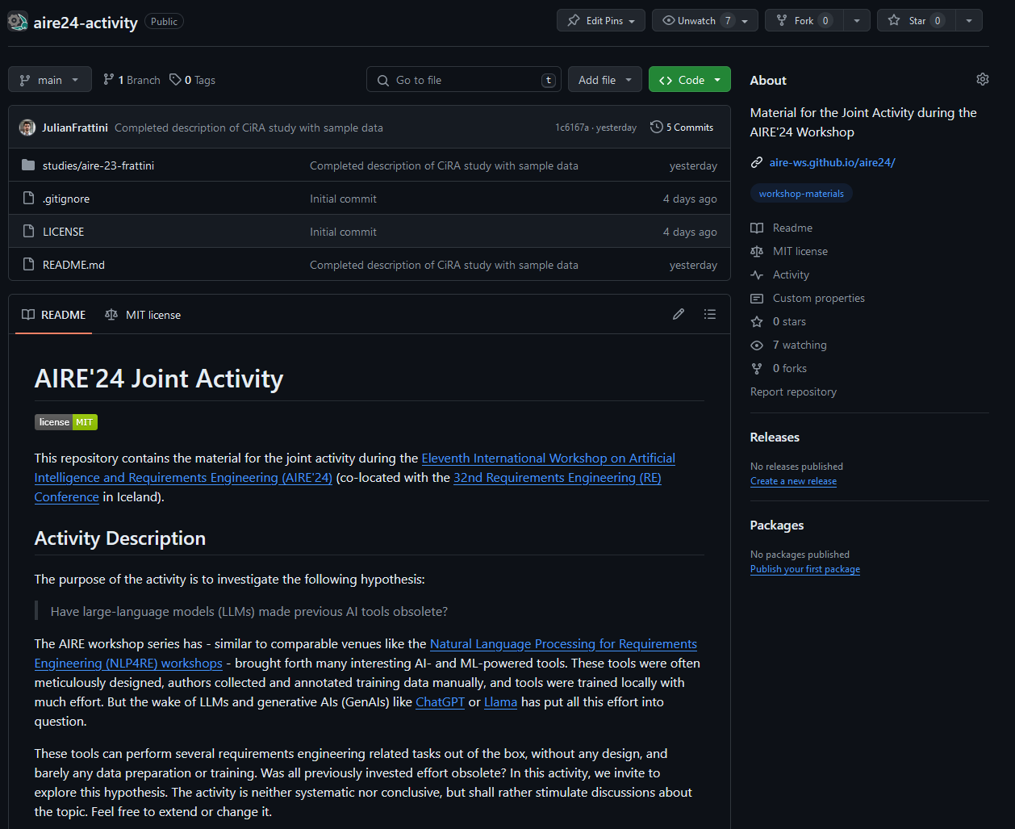
Material available on GitHub
aire-ws/aire24-activity
Public
5

Slide 6
Process
Fork the repository https://github.com/aire-ws/aire24-activity
Select a study presenting a tool
When selecting an unfamiliar, prepared tool from the repository: read the summary of its use case in the respective README.md file.
When selecting an own tool: copy the template/ directory under studies/ and name it after your study
Select an LLM and enter the name and version to the activity-report.md
Develop a prompt that performs the tool’s task with the input data in the data.md file
Report your prompt in the activity-report.md

Slide 7
Execute
Perform the task by following the steps (1) Select a study, (2) select data, (3) engineer a prompt, and (4) reflect.
The public material on GitHub also contains the activity description in more detail.
aire-ws/aire24-activity
Public
7

Slide 8
Discussion
Have large-language models made previous AI tools obsolete?
What were the strengths of the LLM?
What were the weaknesses of the LLM?

Slide 9
Thank you for your participation
We welcome constructive feedback
aire-ws/aire24-activity
Public

