Slide 1
Iris Dataset
Knn Algorithm
Hussein Issa

Slide 2
CONTENTS
Introduction
Data Preprocessing (exploration)
KNN Algorithm Explanation
Model Train & Evaluation
Results and Discussion
Conclusion

Slide 3
INTRODUCTION
The Iris dataset contains three species of Iris flowers, It consists of 150 data points which has four important features (length and width of the sepals and petals) and one target (species with three classes).
Data collection (iris) - Data preparation – Data cleaning – Handling missing values – Feature scaling - Train model (knn) – Test and evaluate the data - Prediction

Slide 4
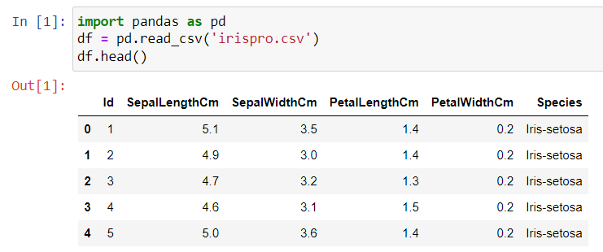
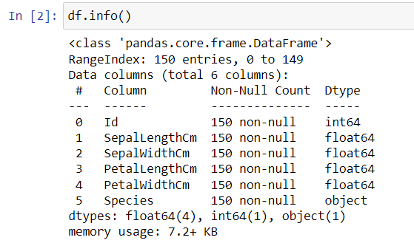
Importing the library pandas and reading the iris csv file from the desktop & printing the first 5 observations
The iris dataset info reveals that there isn’t any missing values (or using isnull().sum() ) and the target is an object

Slide 5
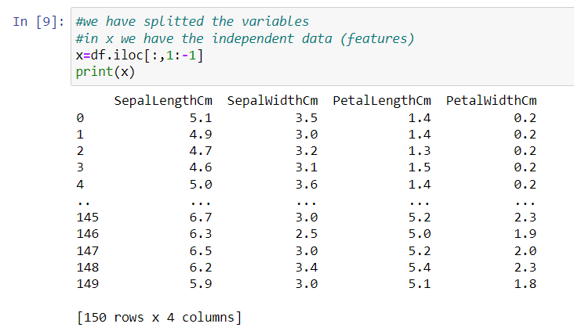
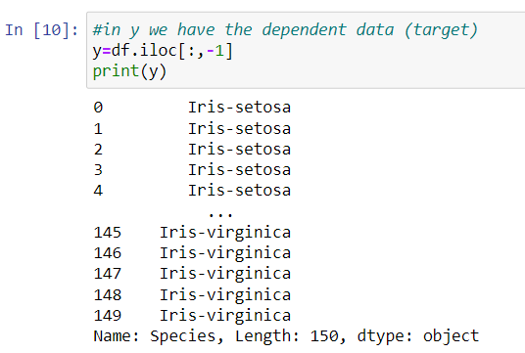
Splitted the dataset into x,y (note: we didn’t take the id column because its not a real feature that represent the data)

Slide 6
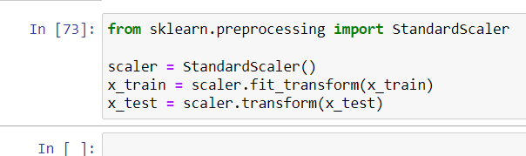
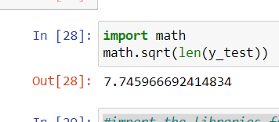
Training and Testing part with a 40% test set and 60% train set due to the purity of the dataset with a random state of 4 that repeats with a randomized observations
The reason feature scaling is important in KNN is that the algorithm makes predictions based on the distance between data points.
We calculated the square root of the length of test set which is the rule of thumb to conclude the max k to take it into consideration.
By taking all the odd values from 1 till the odd int value we got.

Slide 7
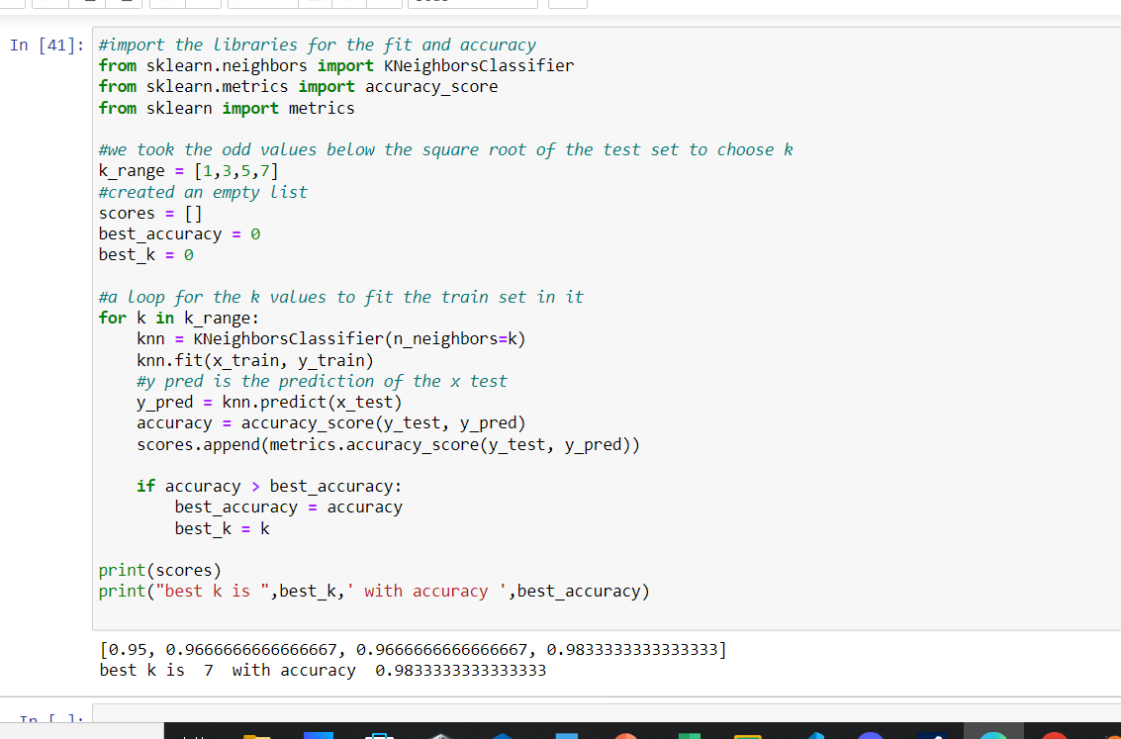
We imported the sklearn libraries to use it in metrics, classifier and accuracy.
We did a range between 1 and 7 that we got up.
With a loop :
We have fitted the train set in the model.
And got the accuracy by comparing the target test with the prediction of features test, and we added the accuracy score to the list within matrics.
By adding an if in the loop we deduced the best accuracy in the new list (scores) we created.
So the best k is 7 and the acc is 0.983

Slide 8
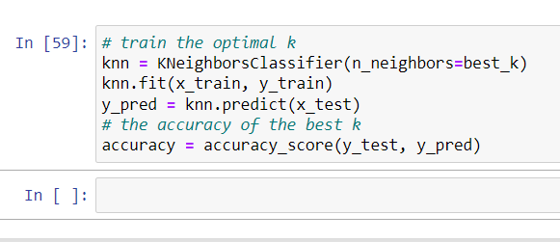
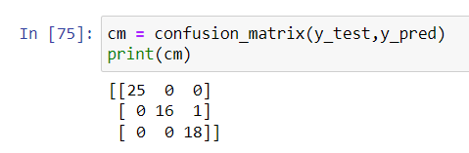
Training with the optimal k with is 7
#best_k = 7 because this k value has the highest accuracy score between the other k neighbors
Confusion matrix:
3 classes of species
Actual data and predicted data

Slide 9
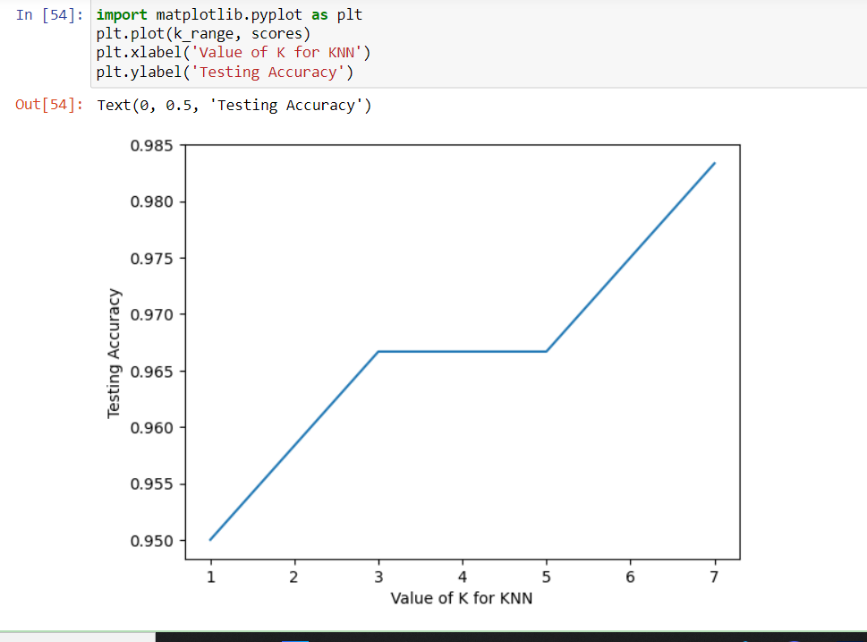
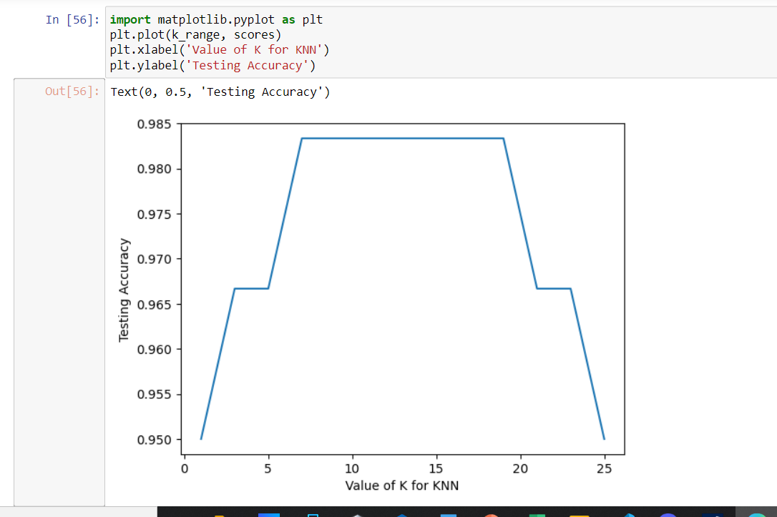
using the matplotlib library we can deduce the line plot (visualize).
Added to the plot the range of k (1 till 7) values and the list of scores (accuracy score)
Added to the plot the range of k (1 till 25) values and the list of scores (accuracy score)

Slide 10
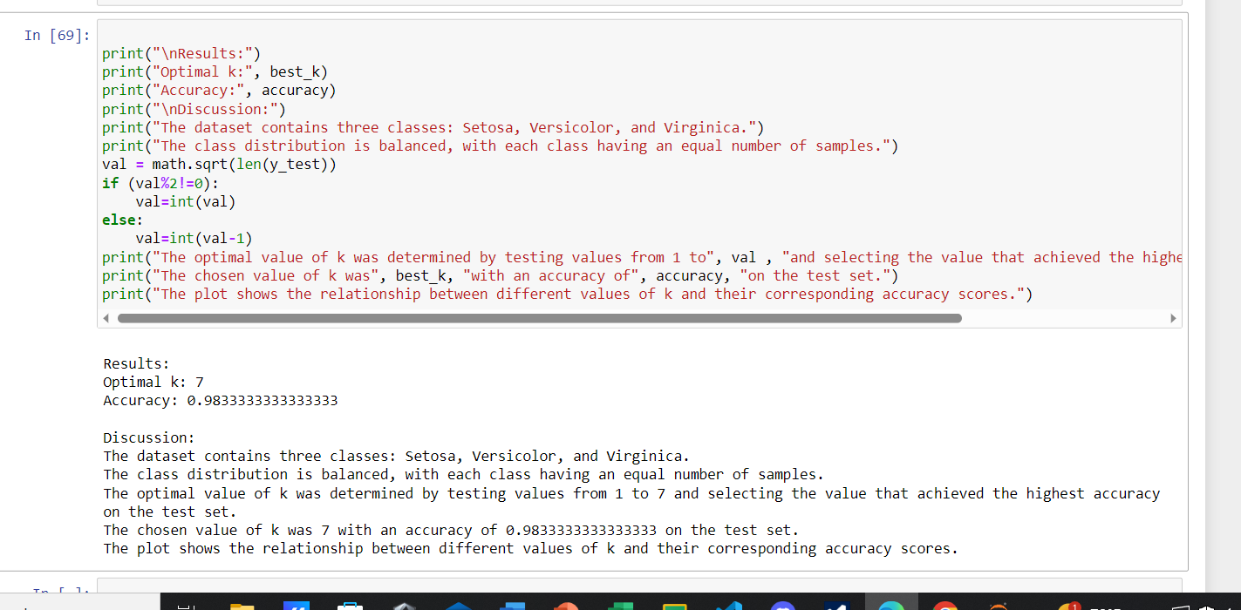

Slide 11
conclusion
To improve the performance of the knn model we could feature scale by normalizing the features , Also we could reduce the noise in the dataset irrelevant features such as outliers, we can handle the missing values by dropping or replacing them by mean, mode etc.
By adding more observations to the dataset to train and test the model with bigger data so it don’t memorize it. Noisy data can lead to misclassifications and reduce the overall accuracy of the algorithm.
In botany and plant science, the Iris dataset can be used to classify and study different species of Iris flowers, for understanding the taxonomy, ecology, and evolution of Iris flowers.

Slide 12
THANK YOU

