Slide 1
Rendez-vous Problem with target
The aim of this project is to design a Consensus based control of 5 robots, starting from initial position to a desired location.

Slide 2
Introduction
Multi-agent systems become a wide field of study and research.
A group of agents can achieve more tasks than having one agent.
Consensus is an important problem in cooperative control, where several agents have to be synchronized to a common target value.
The purpose of our project is to propose a consensus-based control law that lets the agents meet in the specified location (0,0), study the behavior of our system and simplify our graphical model.

Slide 3
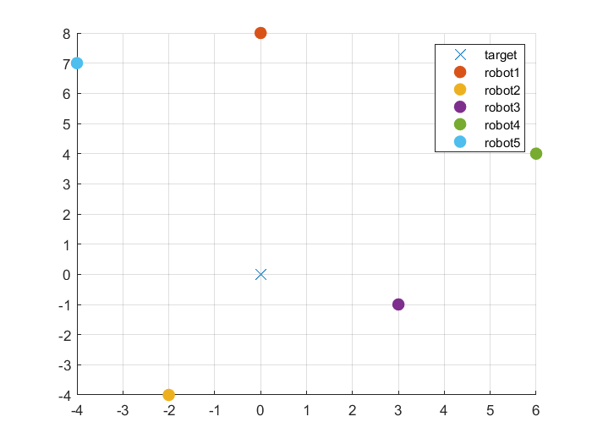
Graphical Model of the System
Initial positions:
We suppose that :
All robots can communicate with others
We can control their speeds directly

Slide 4
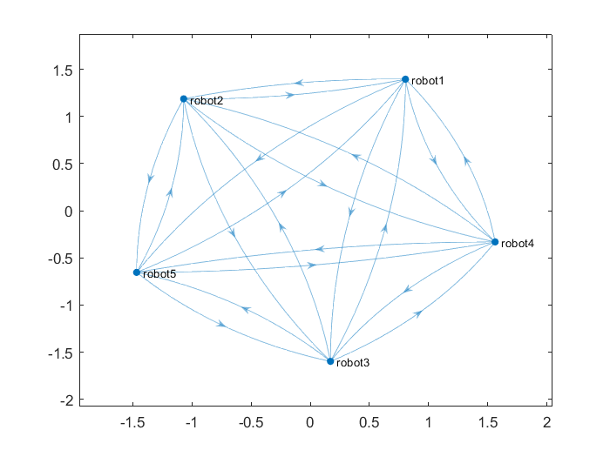
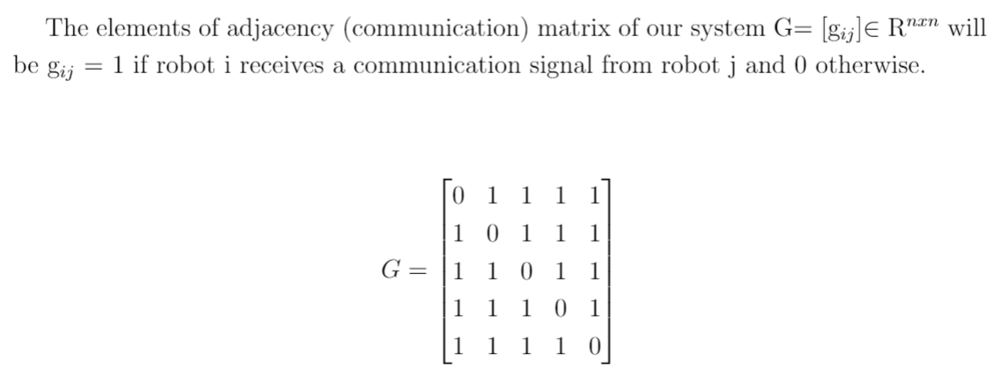
Graphical Model of the System
Graph of our system:
We model the simplest directed graph, where vertices will represent robots and edges are the information exchange links among robots.
In our case, we will have a strongly connected graph, because all robots communicate between themselves.

Slide 5
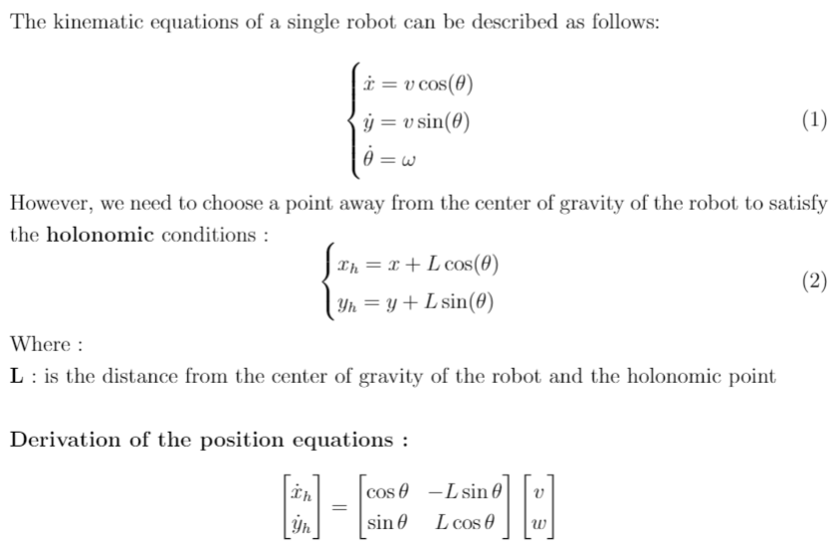
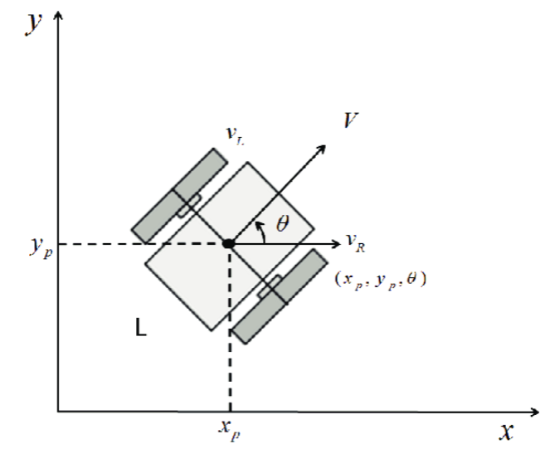
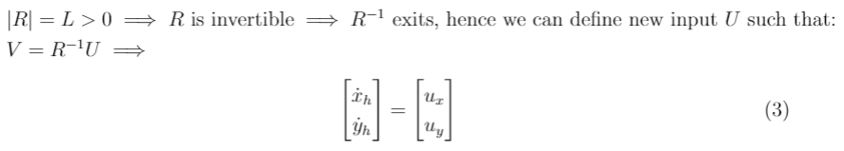
Model of Single a Robot:

Slide 6
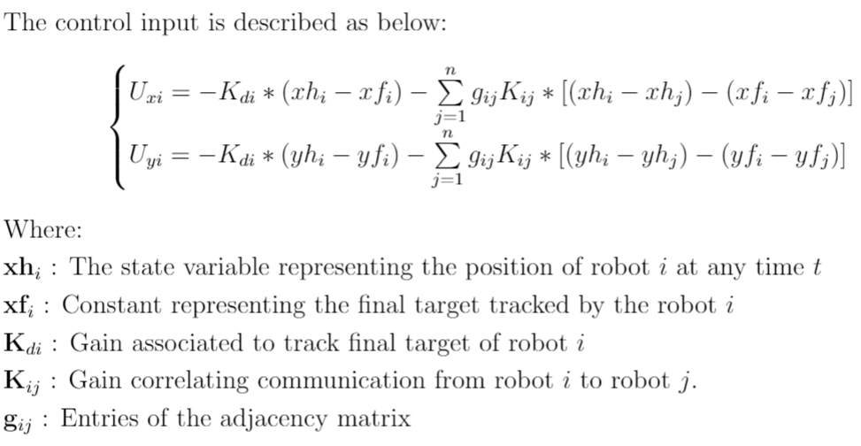
Consensus-based Control Law
In the cooperative control consensus, robots will share their information about positions or speeds with each other.
Each robot will regulate its position with respect to its neighbors.

Slide 7
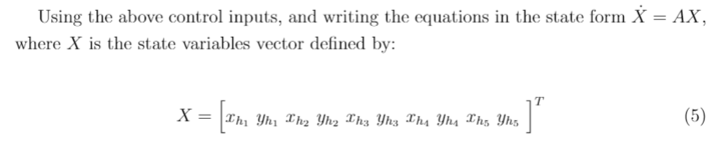
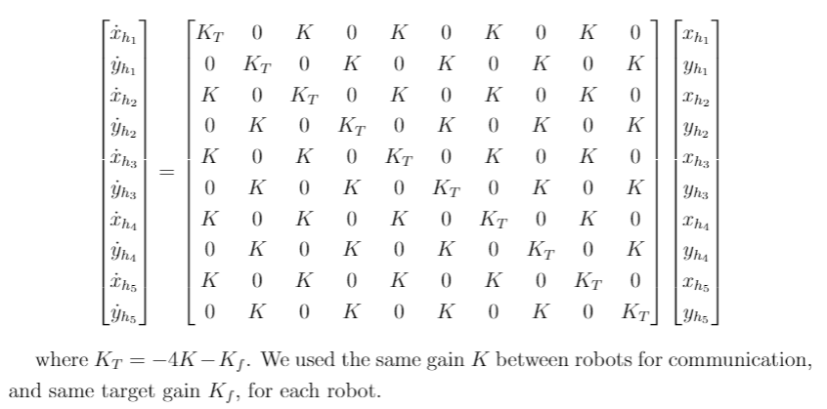
State Space of the Closed Loop

Slide 8
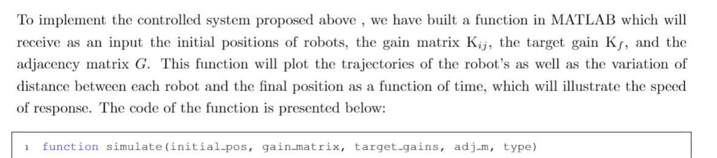
Implementation using MATLAB
Briefly, the function will build up the dynamic matrix of the system (A).

Slide 9
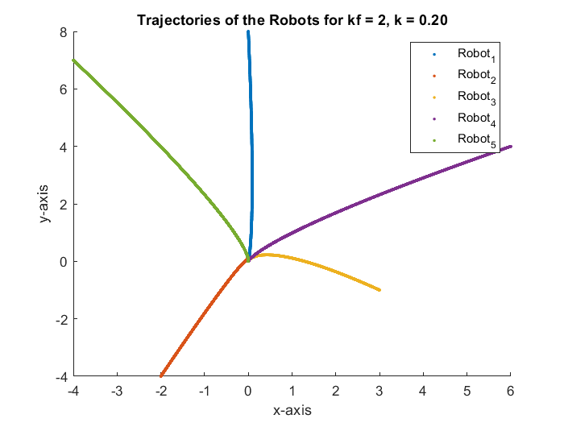
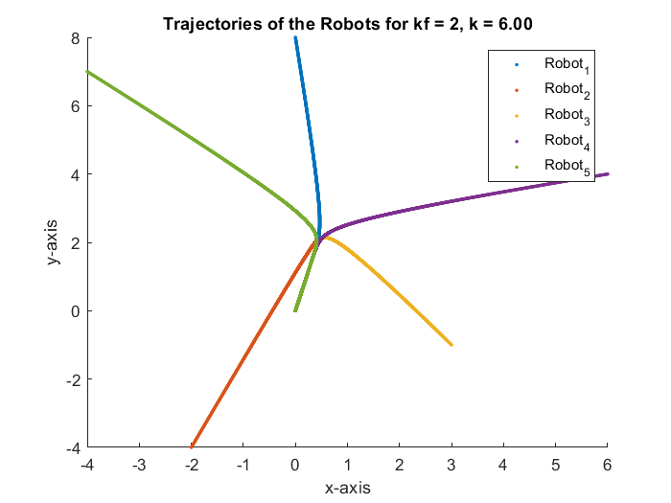
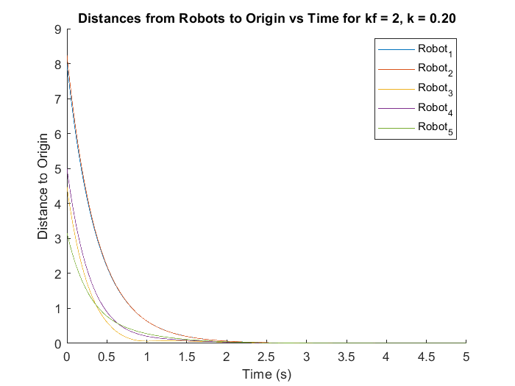
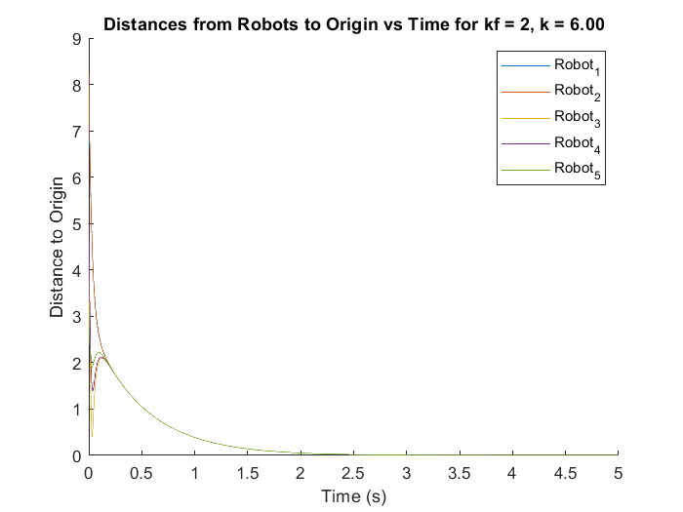
Results Analysis of Fully-Connected Robots
As the plots illustrate, bigger gain values result in faster response. However, changing the gains between the robots vs. gains corresponding to reaching the target results indifferent transient behavior. Bigger values of K let the robots give more emphasis to meet instead of reaching the final destination. In the same sense, when we increase the value of Kf the robots give more emphasis to reach the final destination instead. For example:

Slide 10
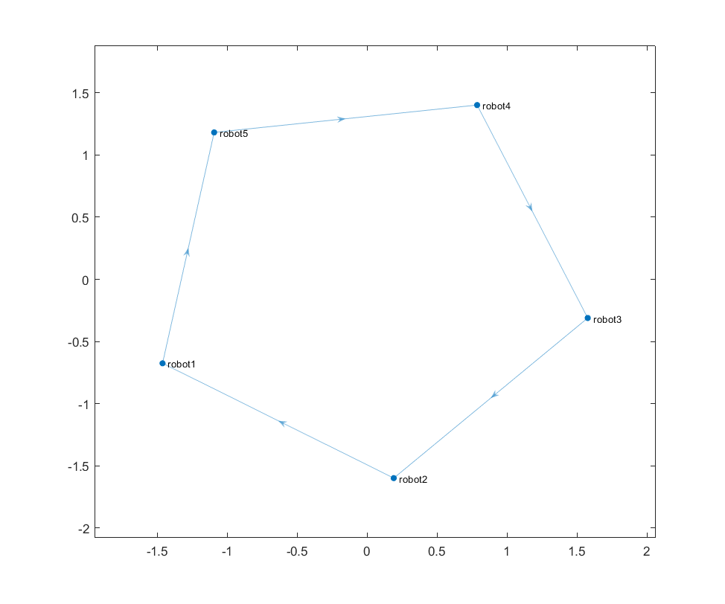
Simplified Graph
To enhance the efficiency of the system while maintaining essential communication information, we reduced the connections between the robots. The following figure represents the new system graph:

Slide 11
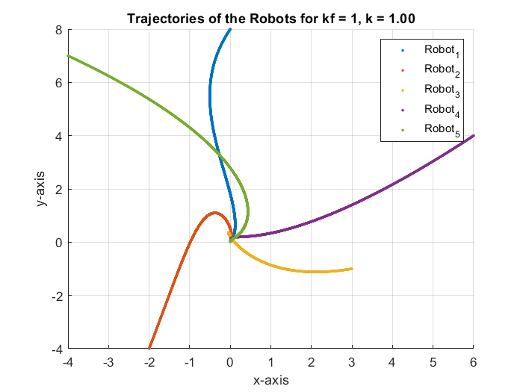
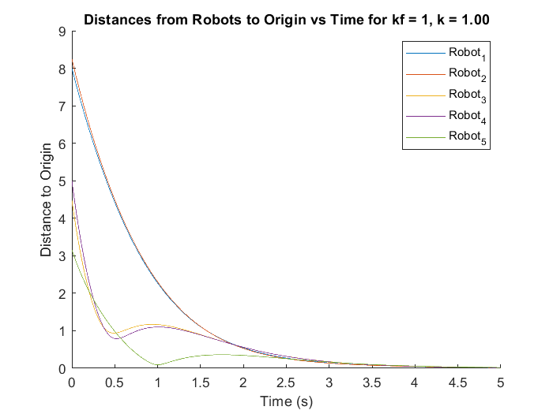
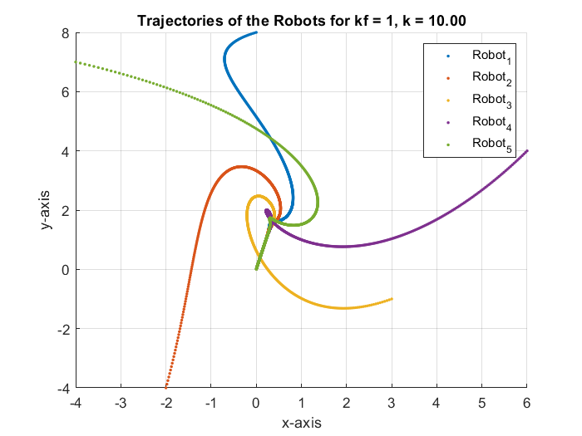
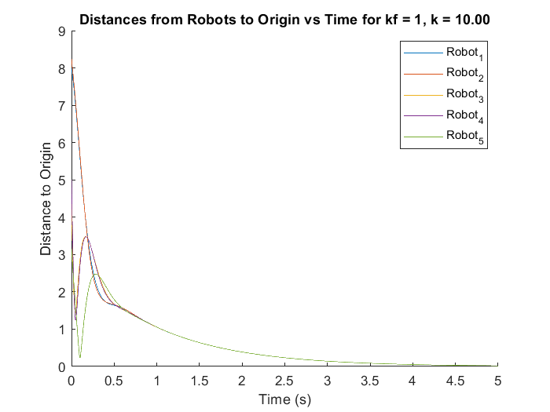
Result Analysis of Different Gains

Slide 12
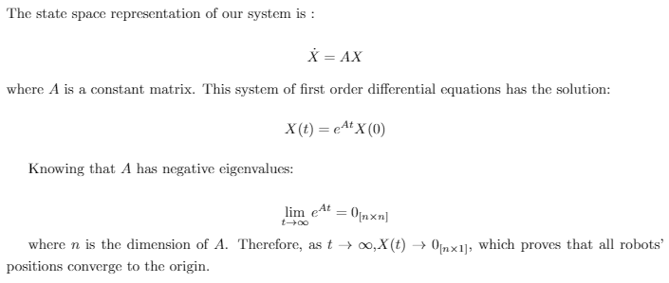
Convergence Proof

Slide 13
Conclusion
In this mini-project, we have worked on solving the Rendez-vous Problem for 5 robots using a collaborative controller. We have implemented our controller using MATLAB and simulated the performance for different gain values. We also proved the stability and the convergence of our controller , and finally proposed a simplified multi-agent system that achieves the same goal.

