Slide 1

Estimation for Robotic Navigation
Presented to: Prof. BONNIFAIT Philippe
Presented by: Ahmad SHOUR
Hasan KASSEM
Hussein LEZZAIK

Slide 2
Introduction
Determining the position of objects on the globe has been the subject of great interest, using stars.
GPS remains the most popular positioning system for open outdoor environments.
Multiple UV applications are gaining precedence over single vehicle missions since they reduce the risk of failure and increases robustness.
Cooperative localization as it presents several advantages over traditional single vehicle systems like robustness, increased efficiency.

Slide 3
Objective
Idea of Cooperative localization → Facilitate navigation
Study four data fusion methods
Loosely Coupled System
The Follower Knows The Leader’s Position
Introducing the Unscented Transform
Both Vehicles Exchange Data

Slide 4
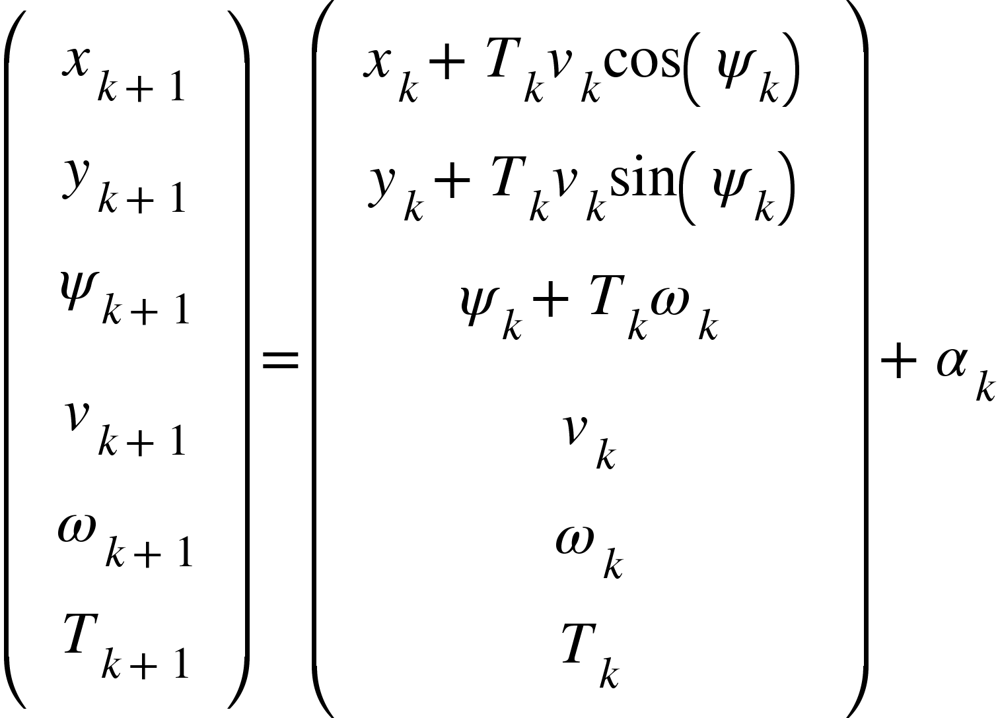
System Description
Sensors:
A low cost GNSS receiver
Dead-Reckoning sensors
A front looking lidar (only for follower)
IMU - SpanCPT
Discrete-time evolution model of the system:

Slide 5
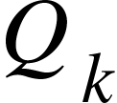
Filter Tuning
Unscented Transform weight
Covariance Intersection Ratio
Mahalanobis Test Threshold

Slide 6
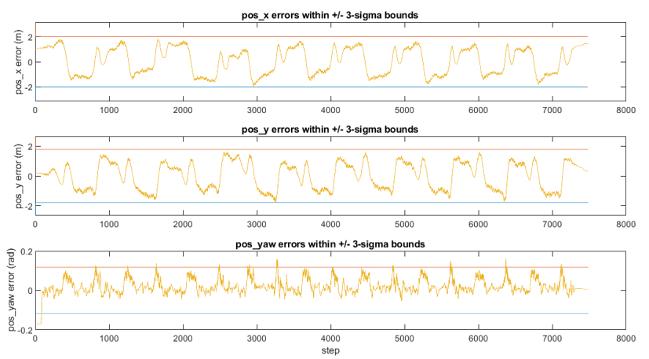
Scenario 1

Slide 7

New Observation

Slide 8
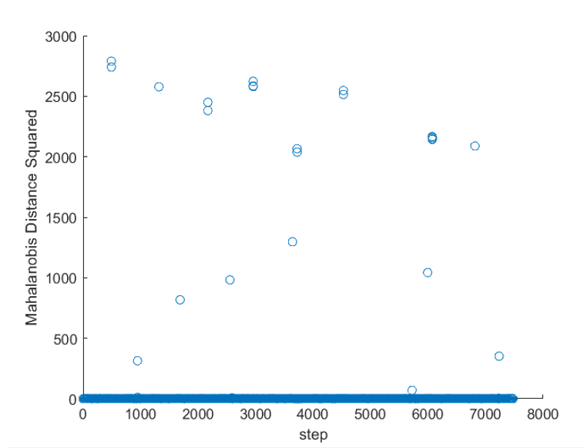
Lidar Data Outliers

Slide 9
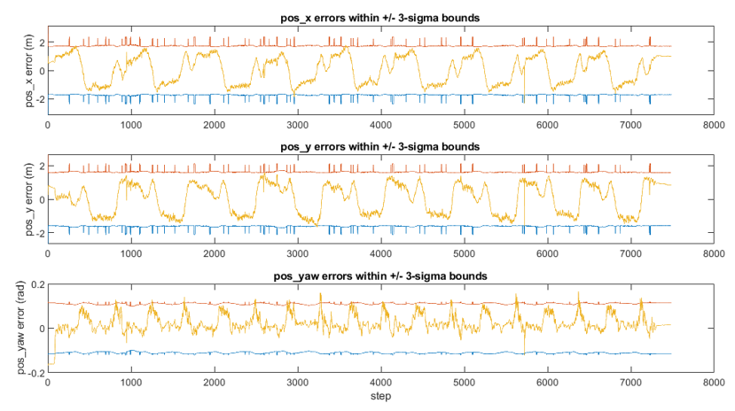
Scenario 2

Slide 10
Unscented Transform
R = a⊕b ↔️ Let q = Concatenation (a,b) ↔️ R = Transformation(q)
R = ⊖b ↔️ R = Transformation (b)

Slide 11
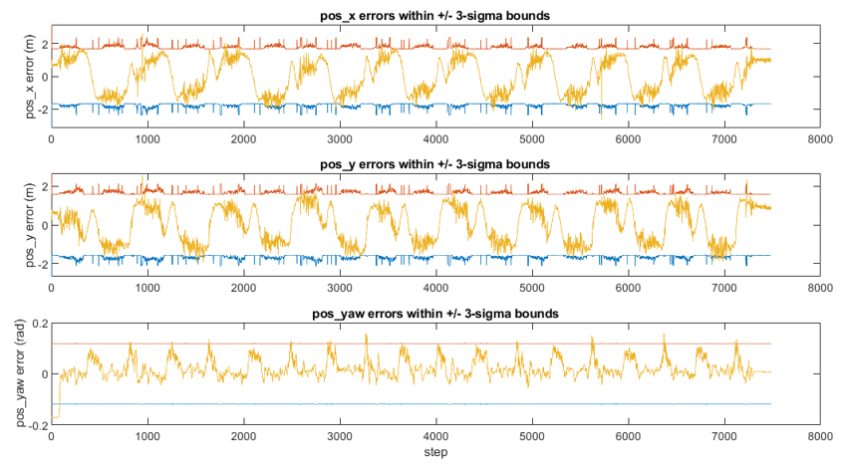
Scenario 3

Slide 12

Covariance Intersection
Vehicles exchange data ⟶ Introduced Correlations
Leader measurement from follower data:

Slide 13
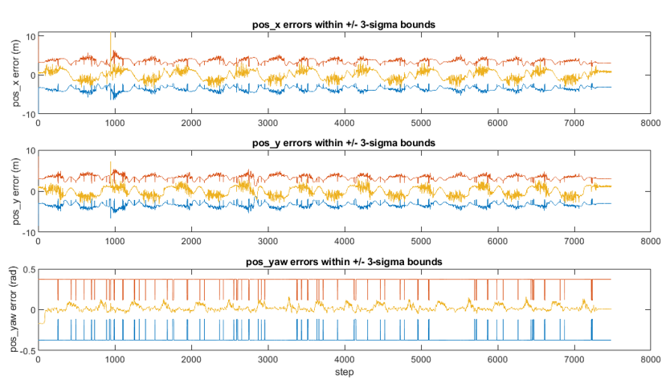
Scenario 4

Slide 14
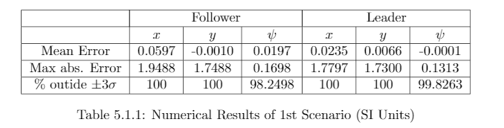
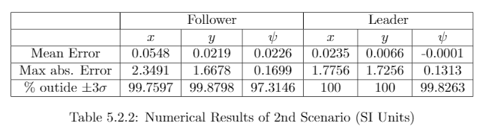
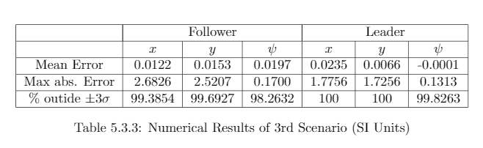
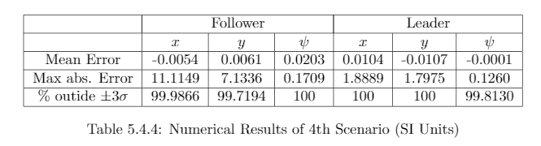
Comparison

Slide 15
Conclusion
Scenario 1, an acceptable result achieved and cooperation will most likely improve the performance of localization.
Scenario 1,2 and 3
- Lidar data without UT is similar results of scenario 1
- Accuracy was greatly improved with UT.
Scenario 4, showed very high accuracy with excellent consistency, however it showed very nervous plot of the system errors.
Results show that we reached to solve this project and success to reach a good cooperation between the vehicles.

Slide 16
End
Thank You For Attention!

