Slide 1


CS251 – Software Engineering I
Corona Store
A Design and Coding Example
Mohammad El-Ramly, PhD
2019 - 2020

Slide 2
دعاء
رب اشرح لى صدرى و يسر لى أمرى و احلل عقدة من لسانى يفقهوا قولى

Slide 3
Outline
Brief requirements for Corona Store (CS)
Use Case Model
Class Diagram for CS
Sequence Diagram for Main Method(s)

Slide 4
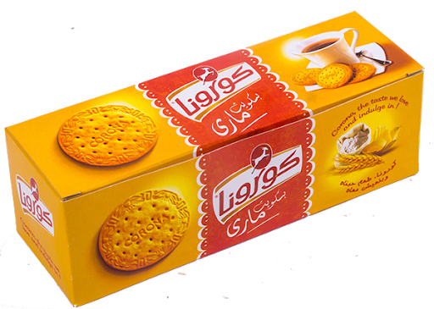
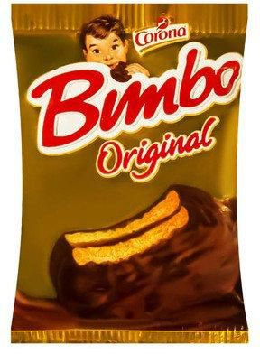
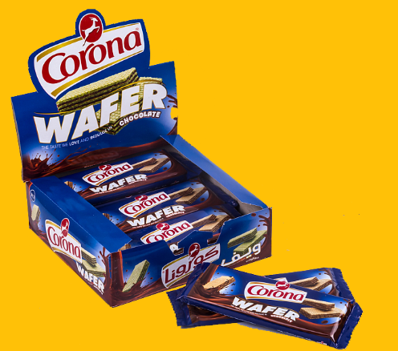
I. Corona Store (CS)
Due to the current health issues. Corona decided to develop an online store for customers to order biscuits and chocolate products that will be delivered to them.
Customers can pay by credit card or can pay with cash upon delivery.

Slide 5
CS Software Requirements Specifications
You were assigned the task of creating the system core business logic. UI will be done later.
System maintains a list of products. Each product has a code, name and unit price.
An order is made of a list of products, along with the quantity bought from each product. Also, an order includes the delivery address.
Each order is given an automatic order ID.
An order is open till it is paid for; then it is closed.

Slide 6
CS Software Requirements Specifications
Payments are made in cash or credit card.
Cash payments are made by giving a specific amount of money to delivery person and returning the change or posting. If insufficient money is given, a message is displayed and order is not closed.
A credit card can be valid, expired, invalid or having sufficient funds. In the first case, a payment is made and user is notified.
In all other cases, an error message is displayed indicating that payment was unsuccessful.

Slide 7
II. CS Use Case Model
Main actor is the buyer who makes the order and pays for it through the online store by credit card or in person with cash through the delivery person.
The two use cases we have are
  Create Order
  Pay for Order

Slide 8
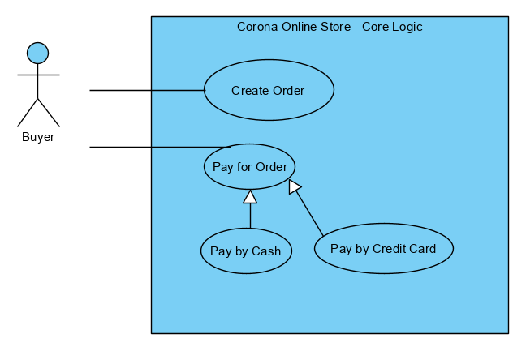


Slide 9
Design the flow of use cases …
UC1 – Create an Order

Slide 10
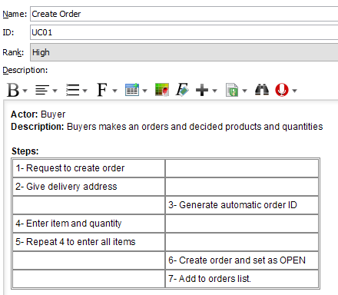

Slide 11
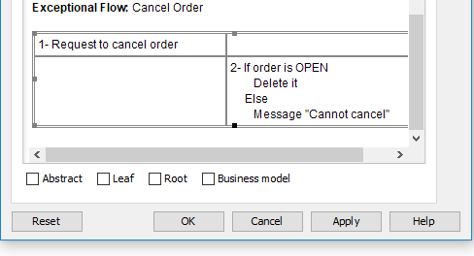

Slide 12
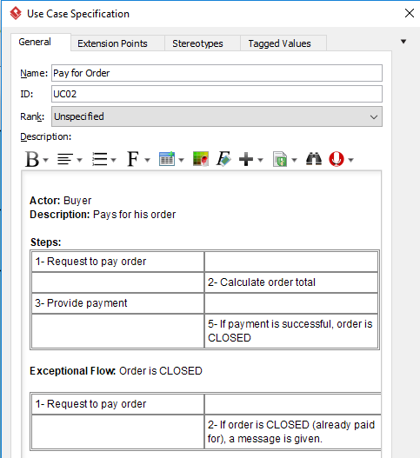

Slide 13
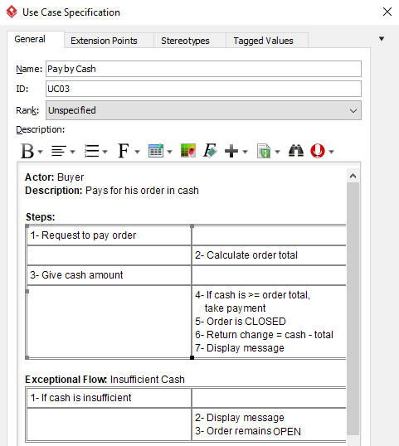

Slide 14
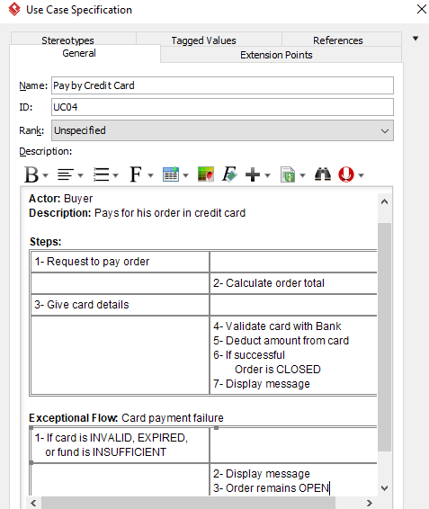

Slide 15
III. Class Diagram
Find nouns that may represent classes.
Due to the current health issues. Corona decided to develop an online store for customers to order biscuits and chocolate products that will be delivered to them.
Customers can pay by credit card or can pay with cash upon delivery.
You were assigned the task of creating the system core business logic. UI will be done later.
System maintains a list of products. Each product has a code, name and unit price.
An order is made of a list of products, along with the quantity bought from each product. Also, an order includes the delivery address.
Each order is given an automatic order ID.
An order is open till it is paid for; then it is closed.

Slide 16
Find nouns that may represent classes
Find nouns that may represent classes.
Decide the responsibility of each class.
Payments are made in cash or credit card.
Cash payments are made by giving a specific amount of money to delivery person and returning the change or posting. If insufficient money is given, a message is displayed and order is not closed.
A credit card can be valid, expired, invalid or having sufficient funds. In the first case, a payment is made and user is notified.
In all other cases, an error message is displayed indicating that payment was unsuccessful.

Slide 17
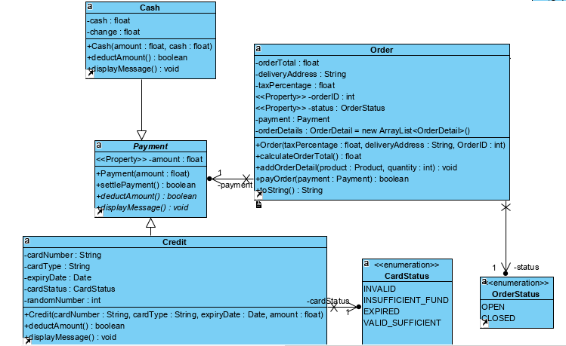
Class
Diagram

Slide 18
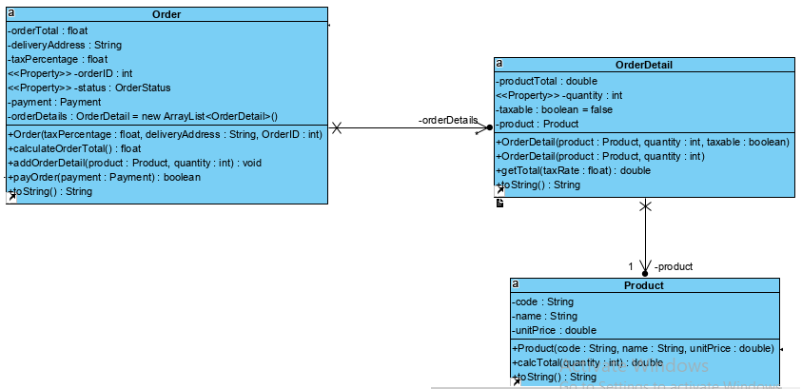
Class Diagram

Slide 19
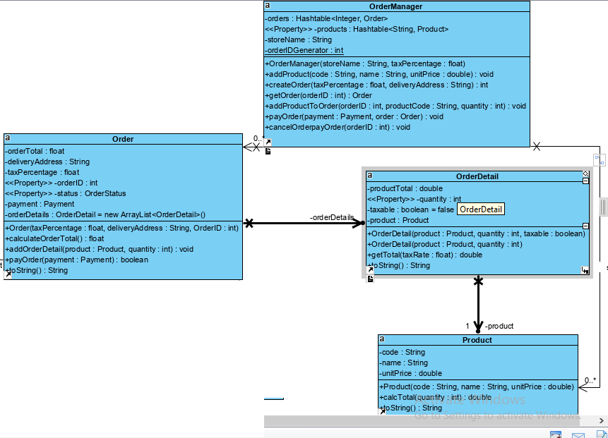
Class Diagram

Slide 20
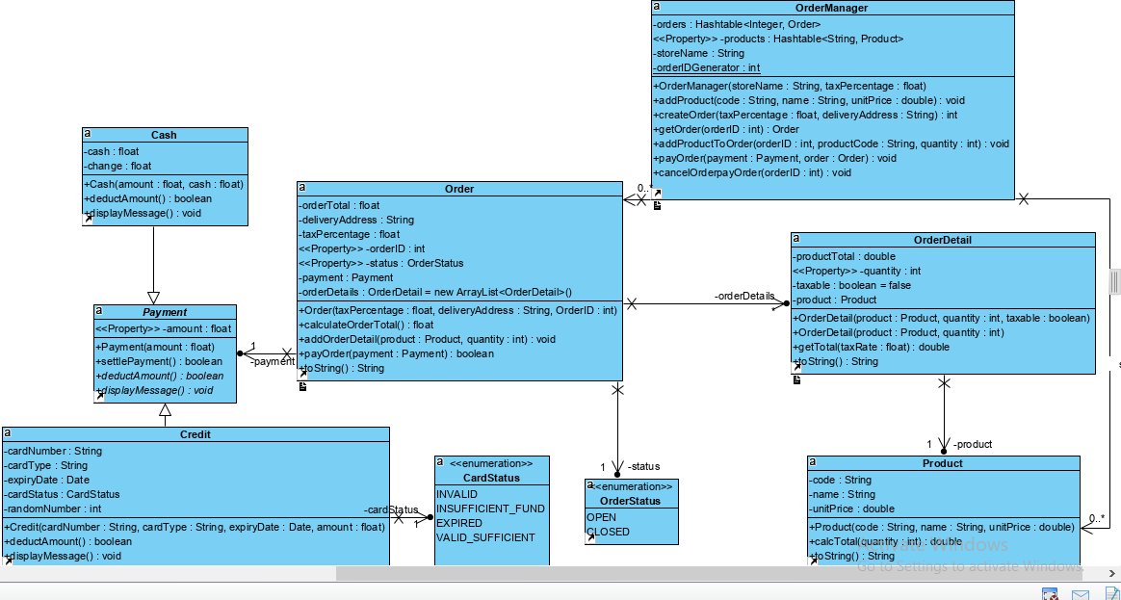
Class
Diagram

Slide 21
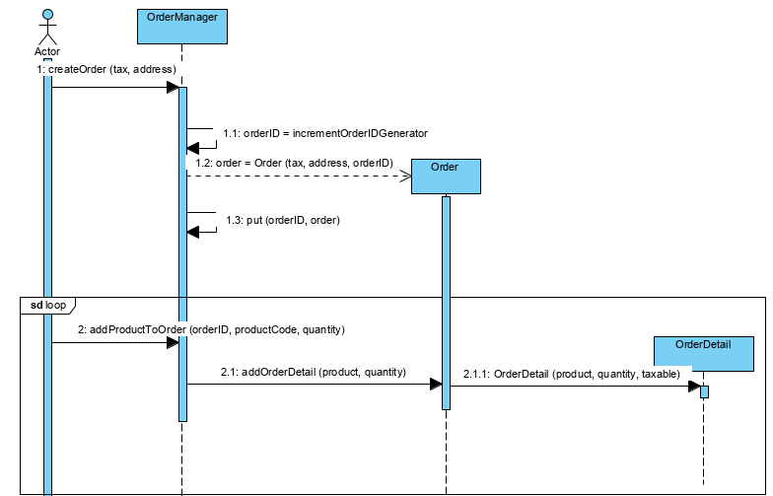
IV. Sequence Diagram for
Create Order
Develop a sequence of method calls to implement the Create Order

