Slide 1
USC ADRC Clinical Core · Aim 1 Metrics Dashboard
Reporting window: 1/1/2026 – 9/30/2026 · Mid-cycle RPPR-aligned view
Purpose. Single dashboard for programmatic and core leads—same visuals we use in RPPR, updated between formal milestone cycles so the center can communicate progress with less back-and-forth.
How to read colors. Black numbers = calendar year-to-date from the harmonized Data Core package and USC REDCap re-aggregates. Green = last RPPR / workbook cumulative context. Red = not yet in export (do not cite).
Highlights this period. ADRC 222 participants with ≥1 UDS visit; 24 new initial evaluations. GeneScreen registry 739 members (REDCap); 55 new and 87 online enrollments YTD. Specimen sharing: 7 biofluid requests, 568 plasma aliquots; 34 neurobank requests.
Verification. Automated validation ties on-screen metrics to source JSON/CSV (npm run validate:all). Attach USC_ADRC_Dashboard_Metric_Provenance.pdf for row-level sources.
Next. PeBRx workstream starting; dashboard refreshes when new harmonized exports and REDCap pulls are dropped in data/.
Generated 2026-10-08 20:21 UTC · Data: James & Xinhui Wang (harmonized package); Adrienne REDCap exports Oct 2026

Slide 2
Recruitment
GeneScreen, ADRC & BRS

Slide 3
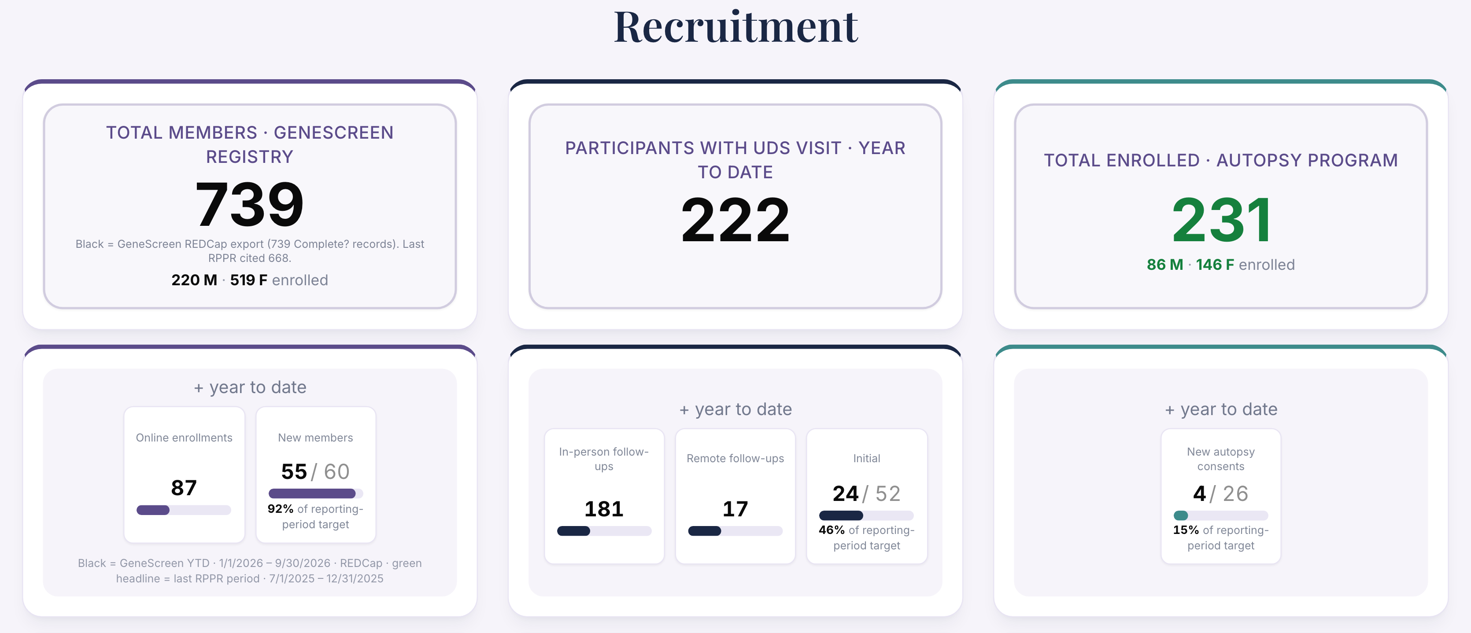
Recruitment · GeneScreen, ADRC & BRS (1 of 2)

Slide 4
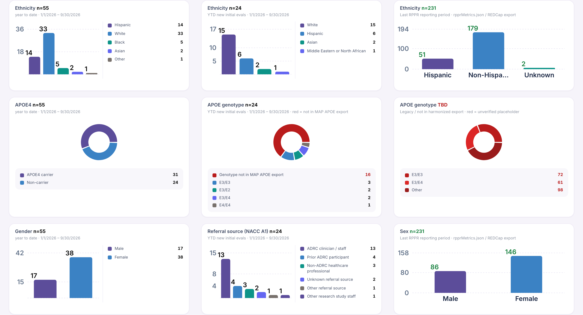
Recruitment · GeneScreen, ADRC & BRS (2 of 2)

Slide 5
Demographics
Table 1 · charts & cohort

Slide 6
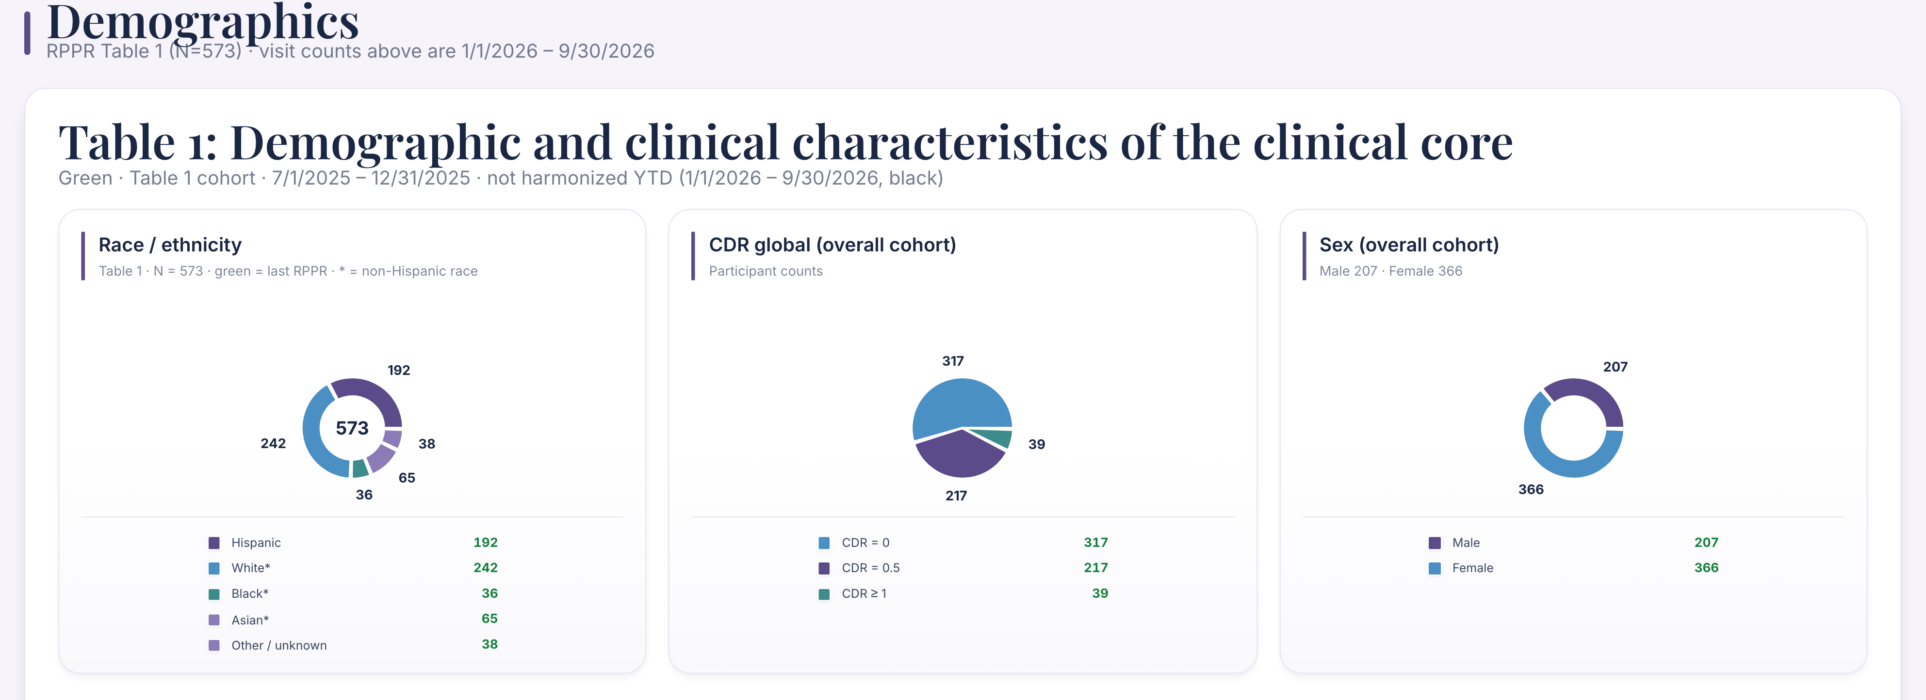
Demographics · Table 1 · charts & cohort (1 of 5)

Slide 7
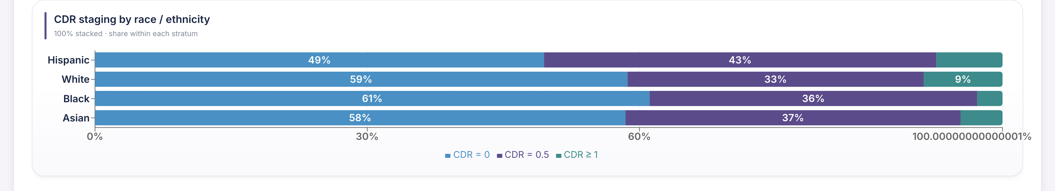
Demographics · Table 1 · charts & cohort (2 of 5)

Slide 8
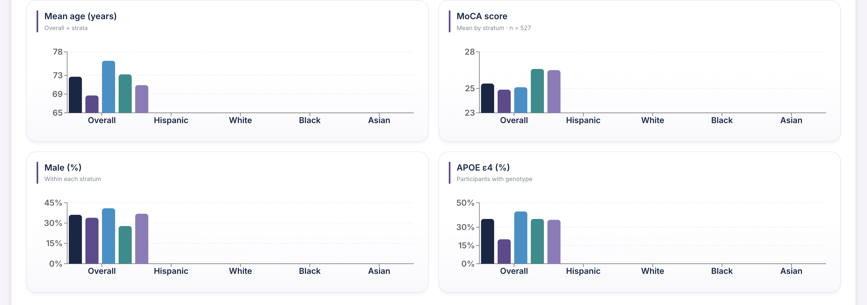
Demographics · Table 1 · charts & cohort (3 of 5)

Slide 9
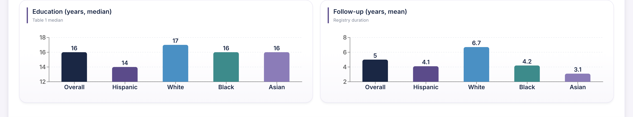
Demographics · Table 1 · charts & cohort (4 of 5)

Slide 10
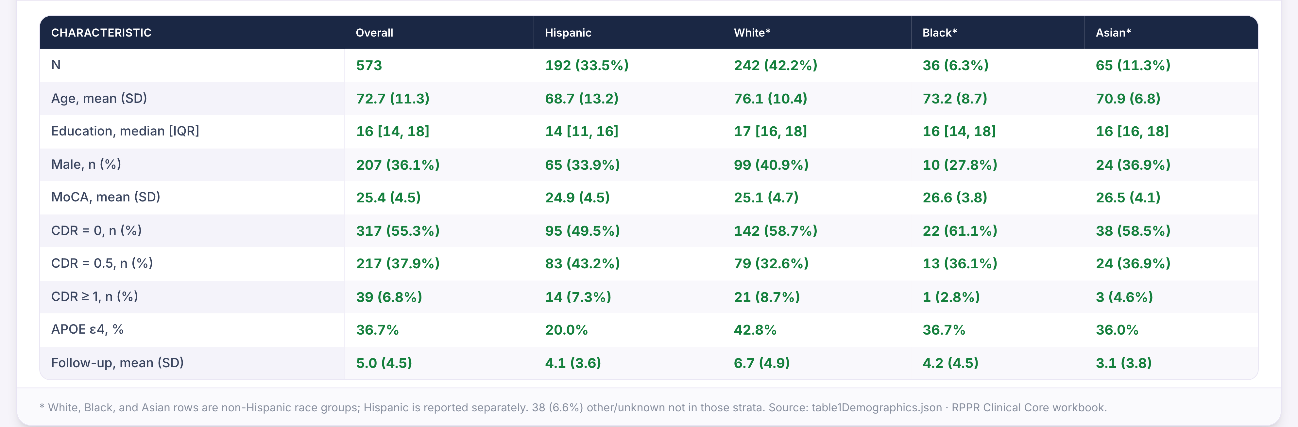
Demographics · Table 1 · charts & cohort (5 of 5)

Slide 11
Neuropathology
Autopsy metrics & tissue inquiries

Slide 12
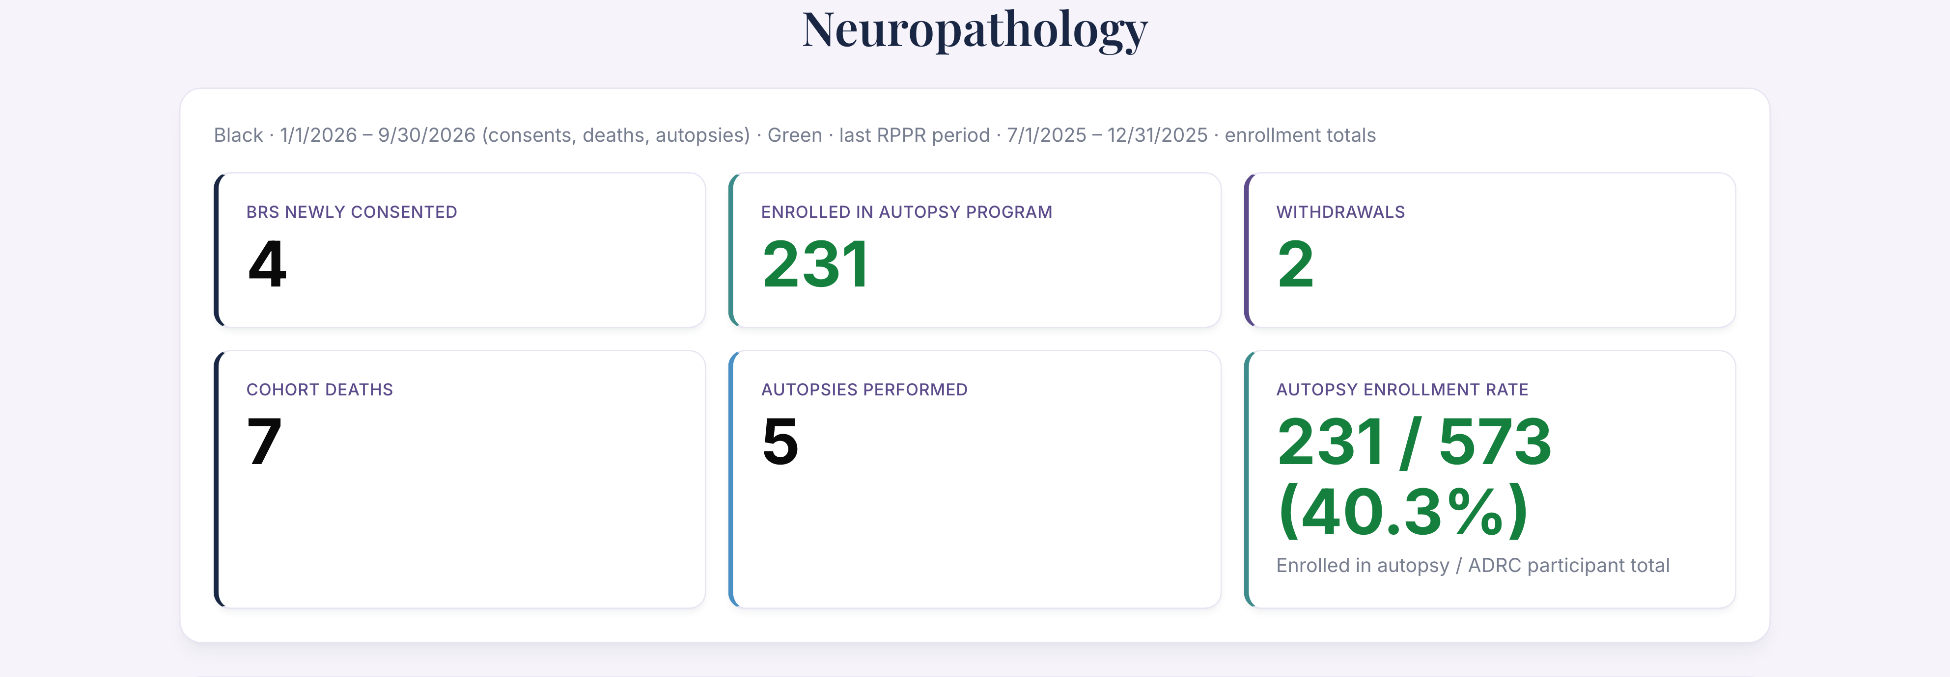
Neuropathology · Autopsy metrics & tissue inquiries (1 of 2)

Slide 13
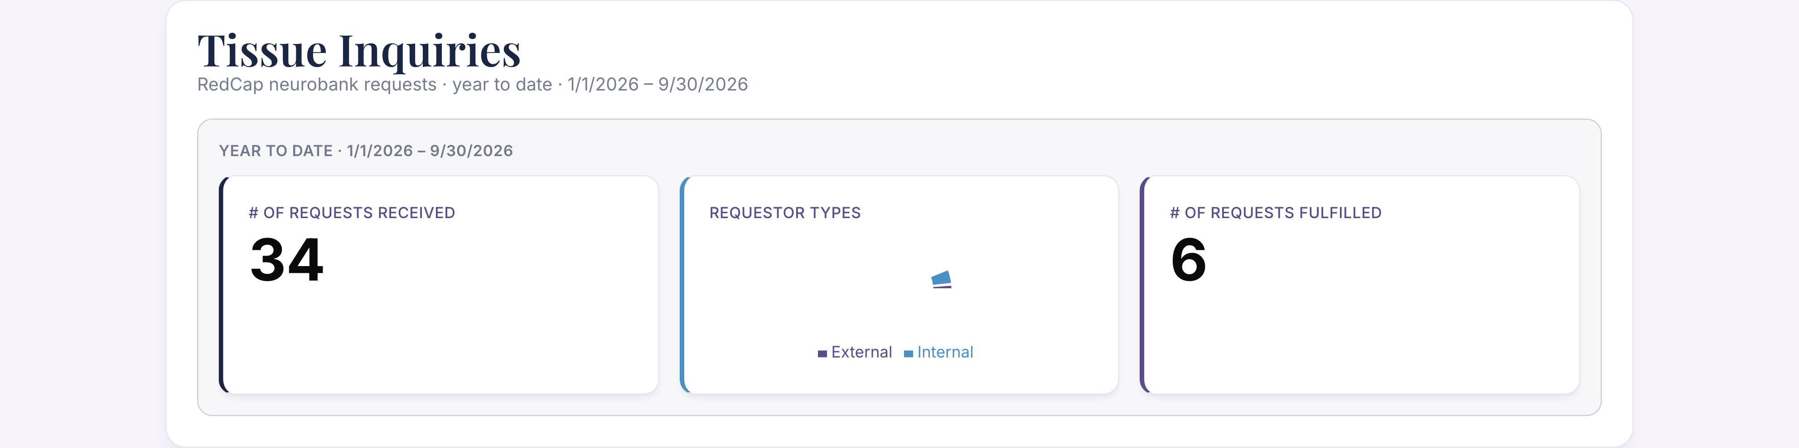
Neuropathology · Autopsy metrics & tissue inquiries (2 of 2)

Slide 14
ORE
Outreach, recruitment & engagement

Slide 15
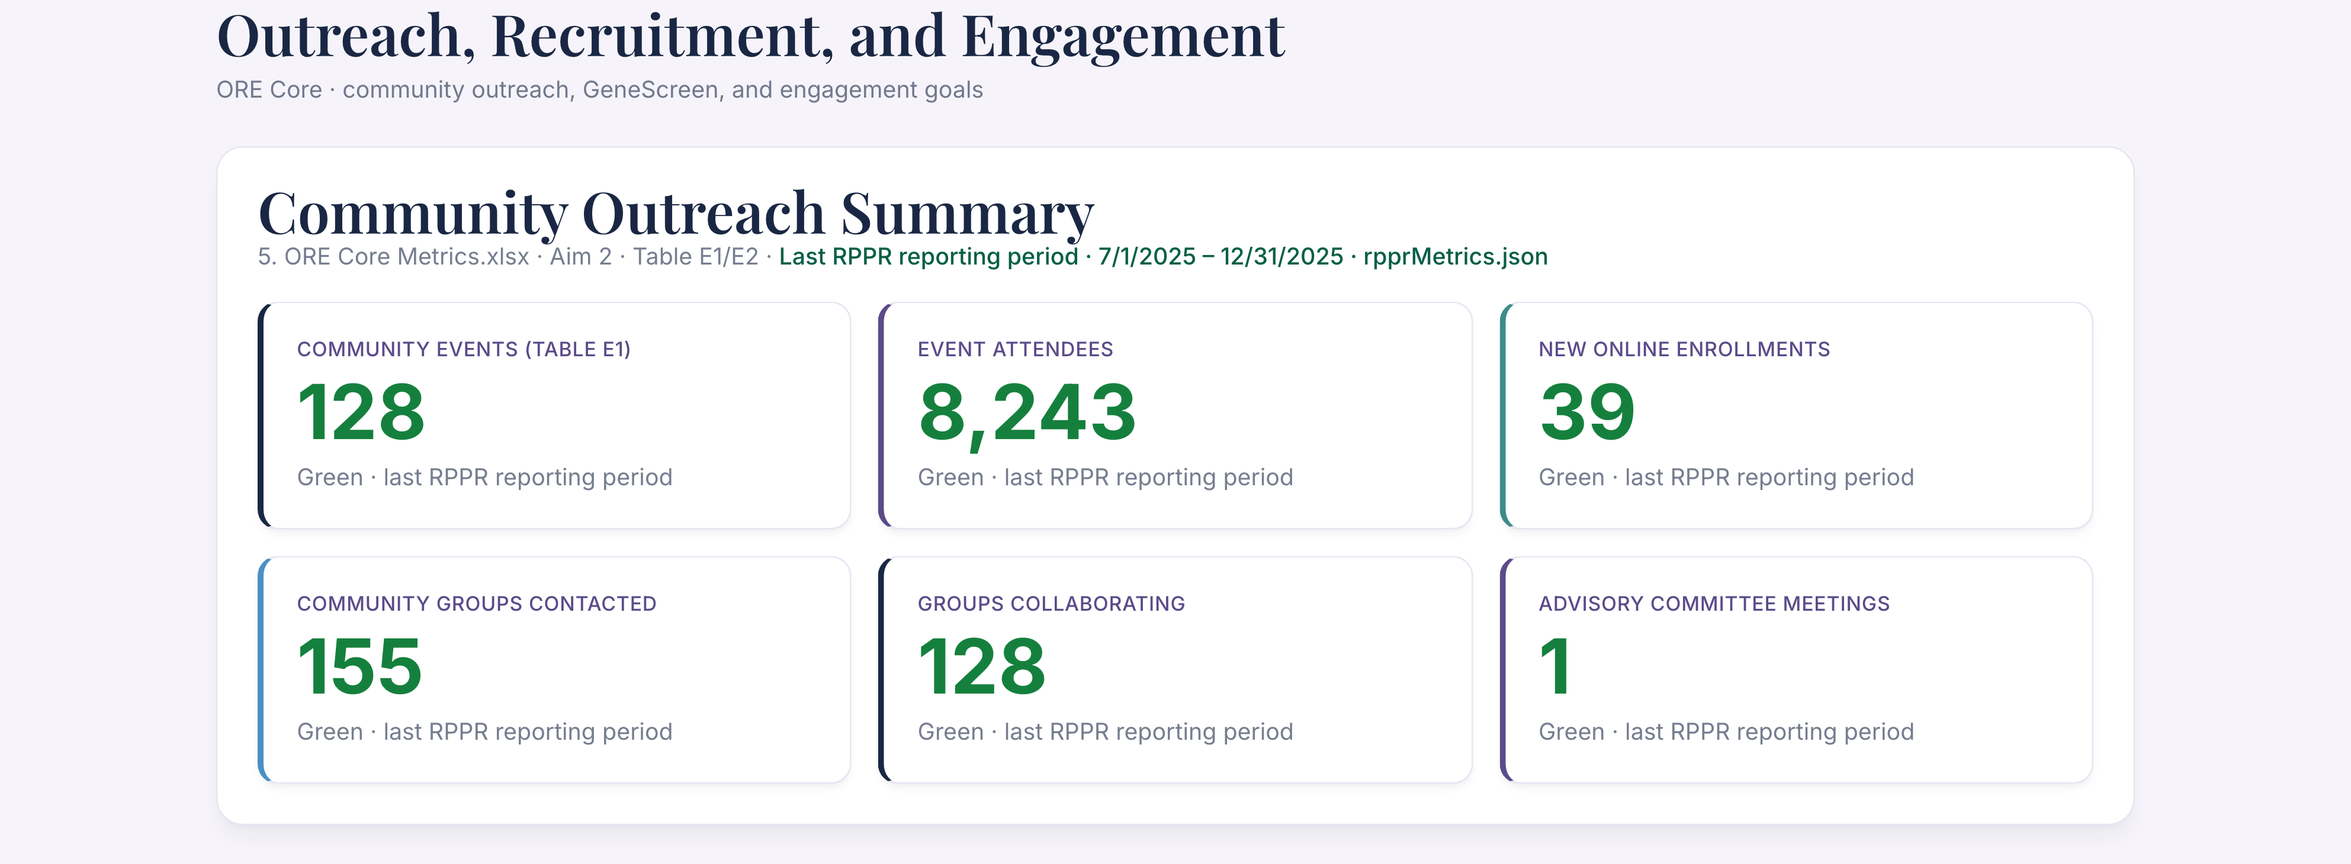
ORE · Outreach, recruitment & engagement (1 of 3)

Slide 16
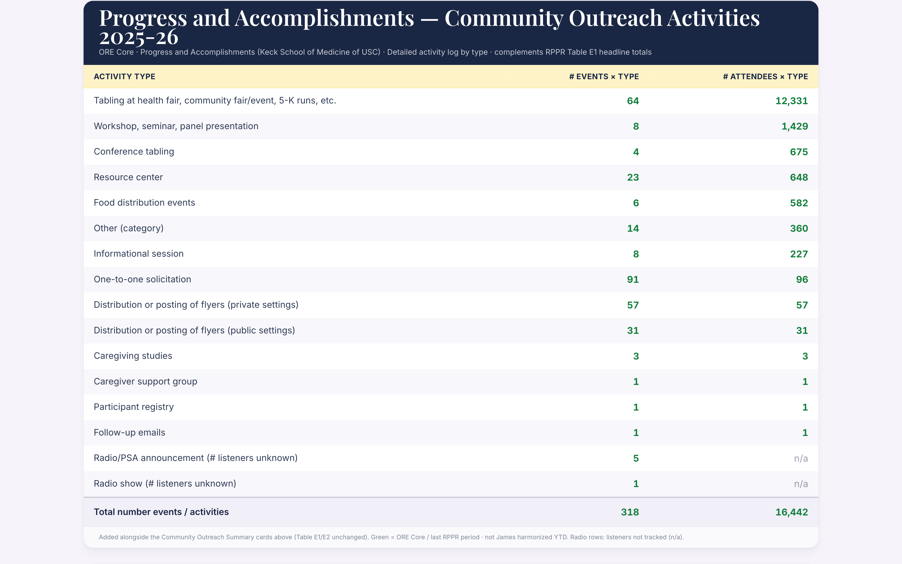
ORE · Outreach, recruitment & engagement (2 of 3)

Slide 17
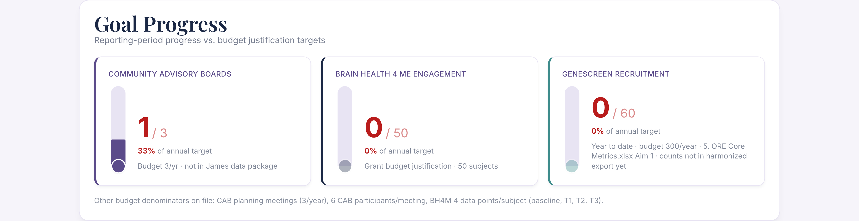
ORE · Outreach, recruitment & engagement (3 of 3)

Slide 18
Biomarkers
Collection, NCRAD, biofluid inquiries

Slide 19
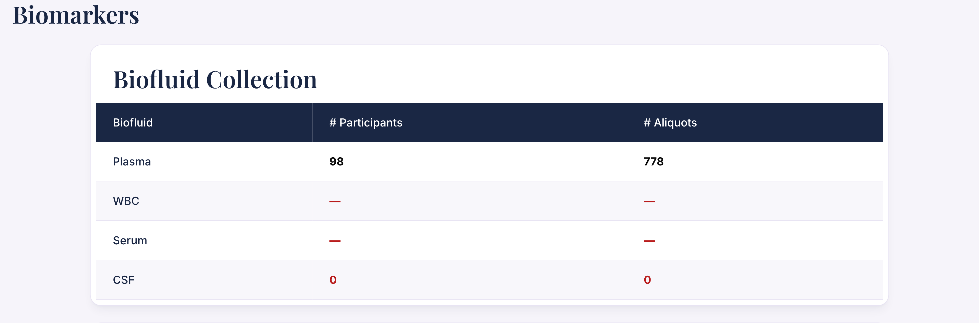
Biomarkers · Collection, NCRAD, biofluid inquiries (1 of 4)

Slide 20
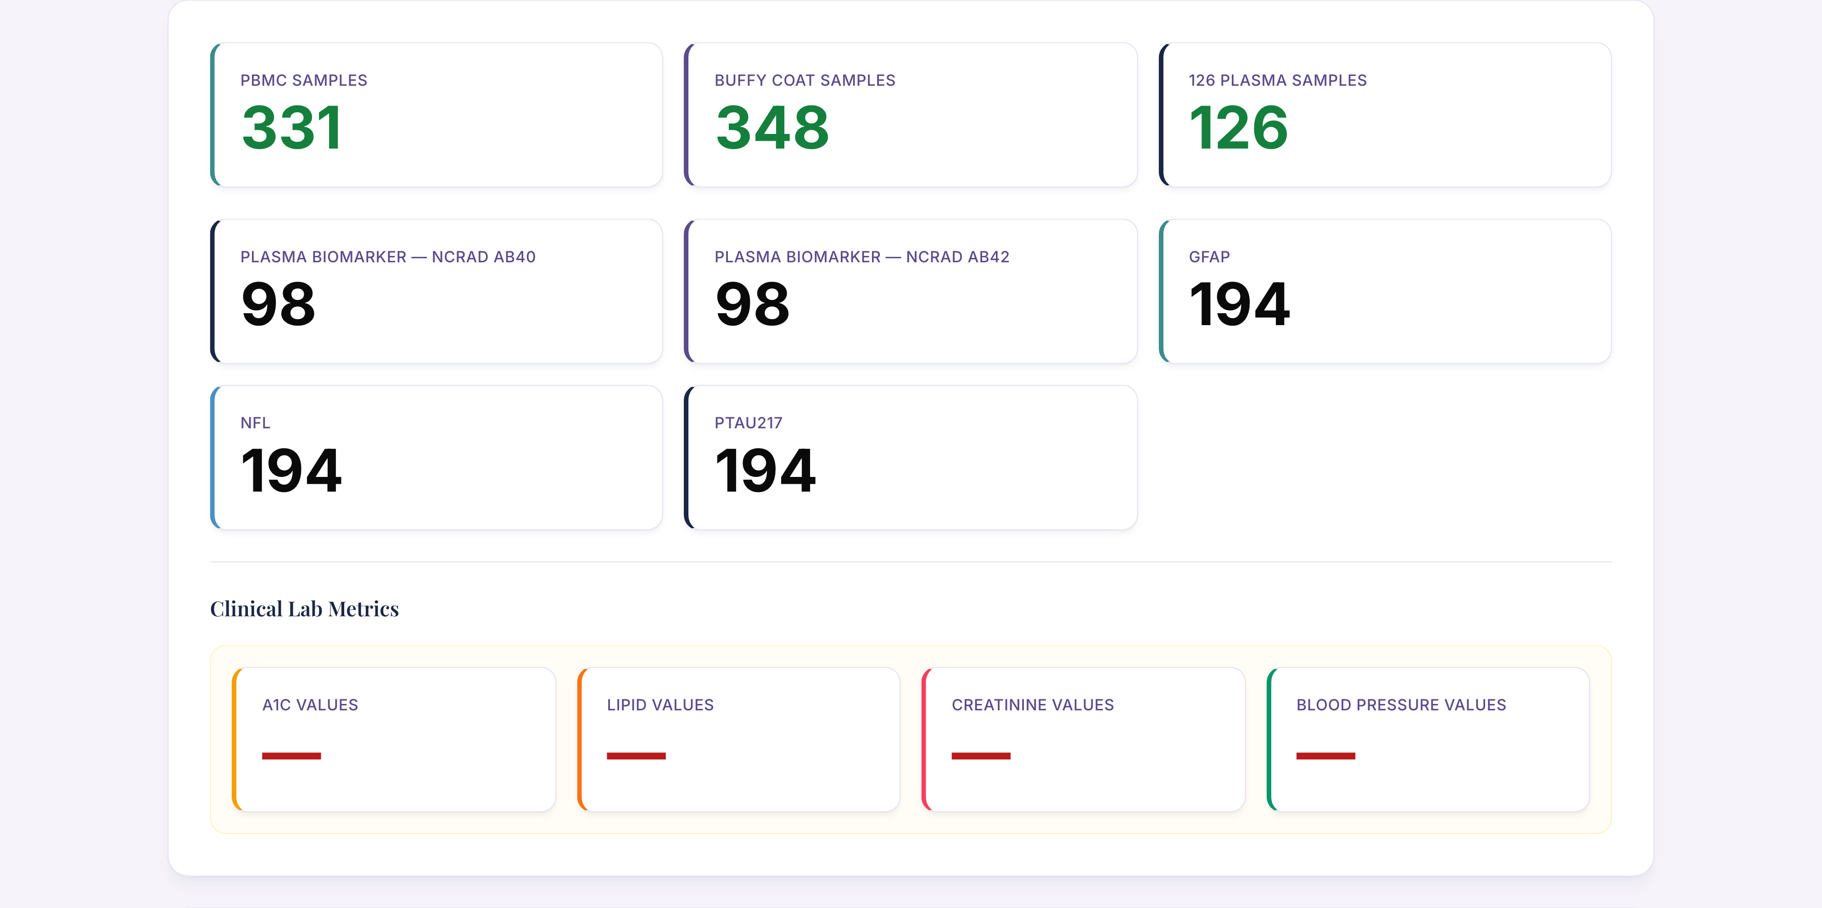
Biomarkers · Collection, NCRAD, biofluid inquiries (2 of 4)

Slide 21
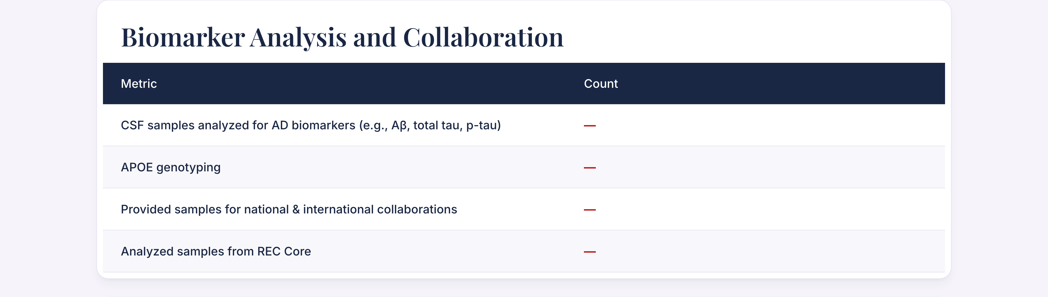
Biomarkers · Collection, NCRAD, biofluid inquiries (3 of 4)

Slide 22
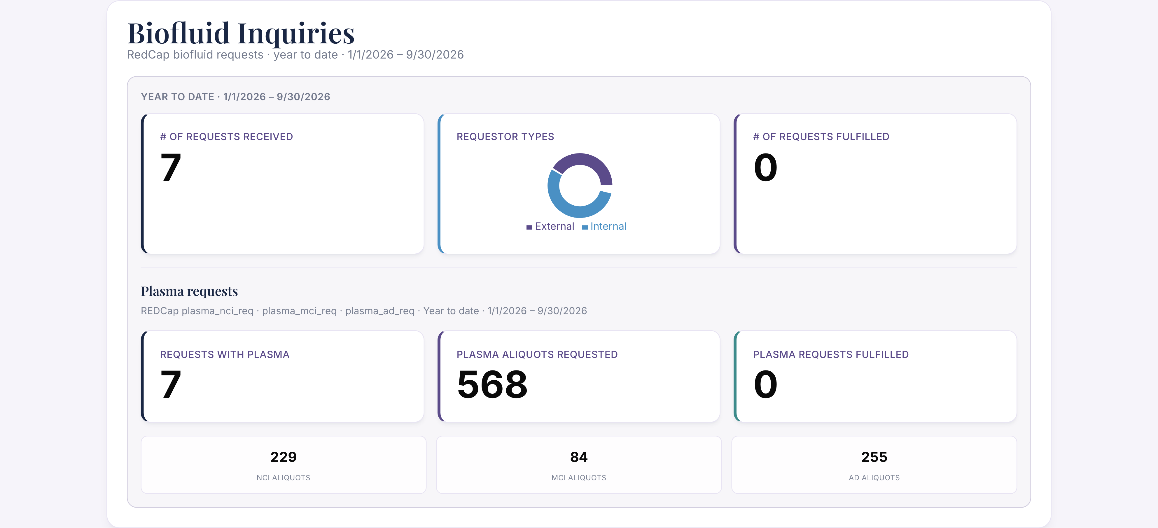
Biomarkers · Collection, NCRAD, biofluid inquiries (4 of 4)

Slide 23
REC
Research engagement coordinator

Slide 24
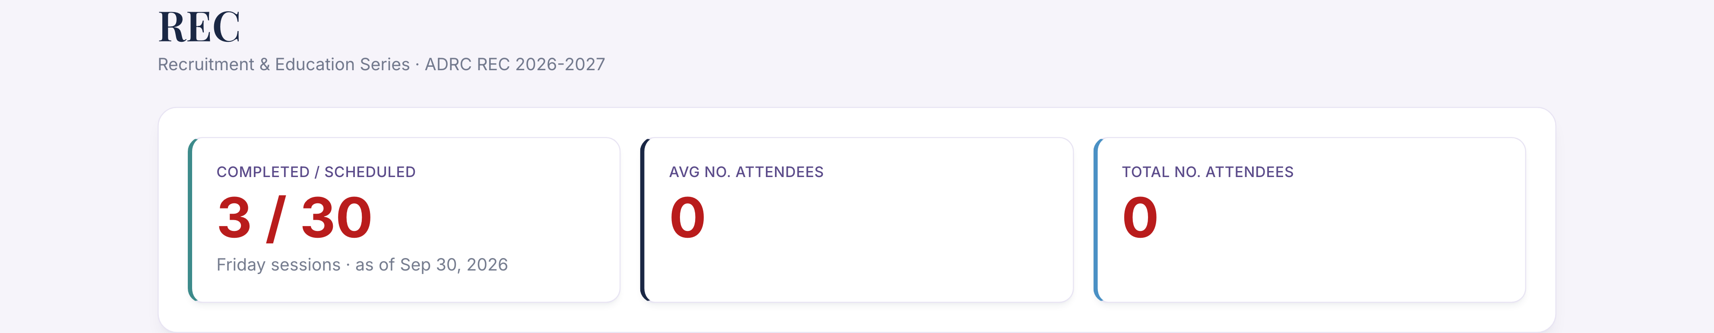
REC · Research engagement coordinator

Slide 25
Imaging
SCAN, CLARiTI & IDA

Slide 26
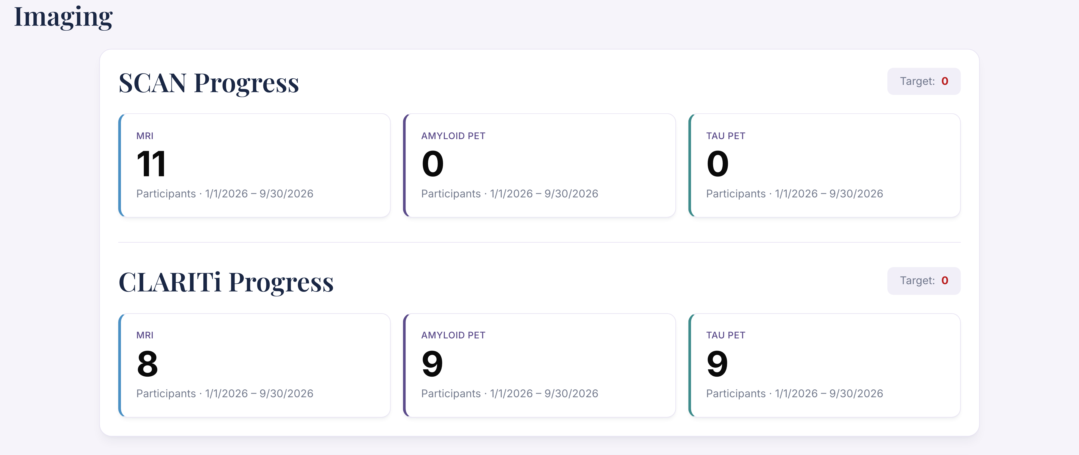
Imaging · SCAN, CLARiTI & IDA (1 of 3)

Slide 27
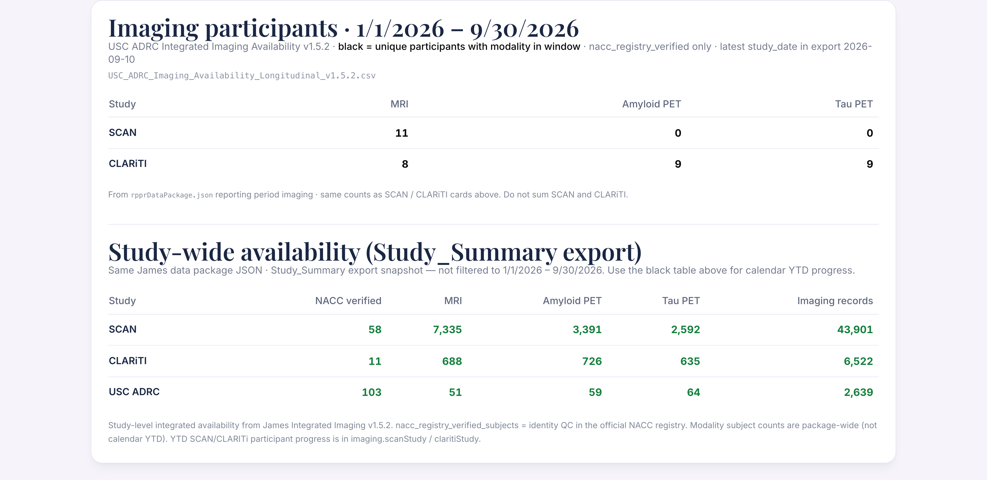
Imaging · SCAN, CLARiTI & IDA (2 of 3)

Slide 28
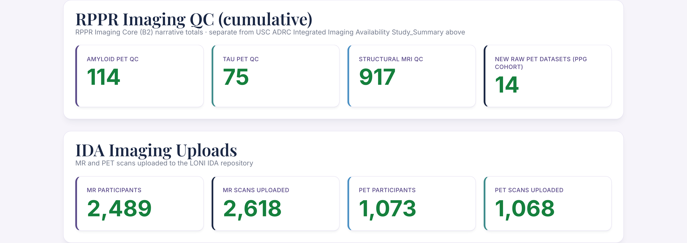
Imaging · SCAN, CLARiTI & IDA (3 of 3)

