Slide 1
USC ADRC Clinical Core · Metrics Dashboard
Reporting window 1/1/2026 – 9/30/2026 · 20 section captures · slide-center-v20 · 2026-10-08 20:21 UTC

Slide 2
Recruitment
GeneScreen, ADRC & BRS

Slide 3
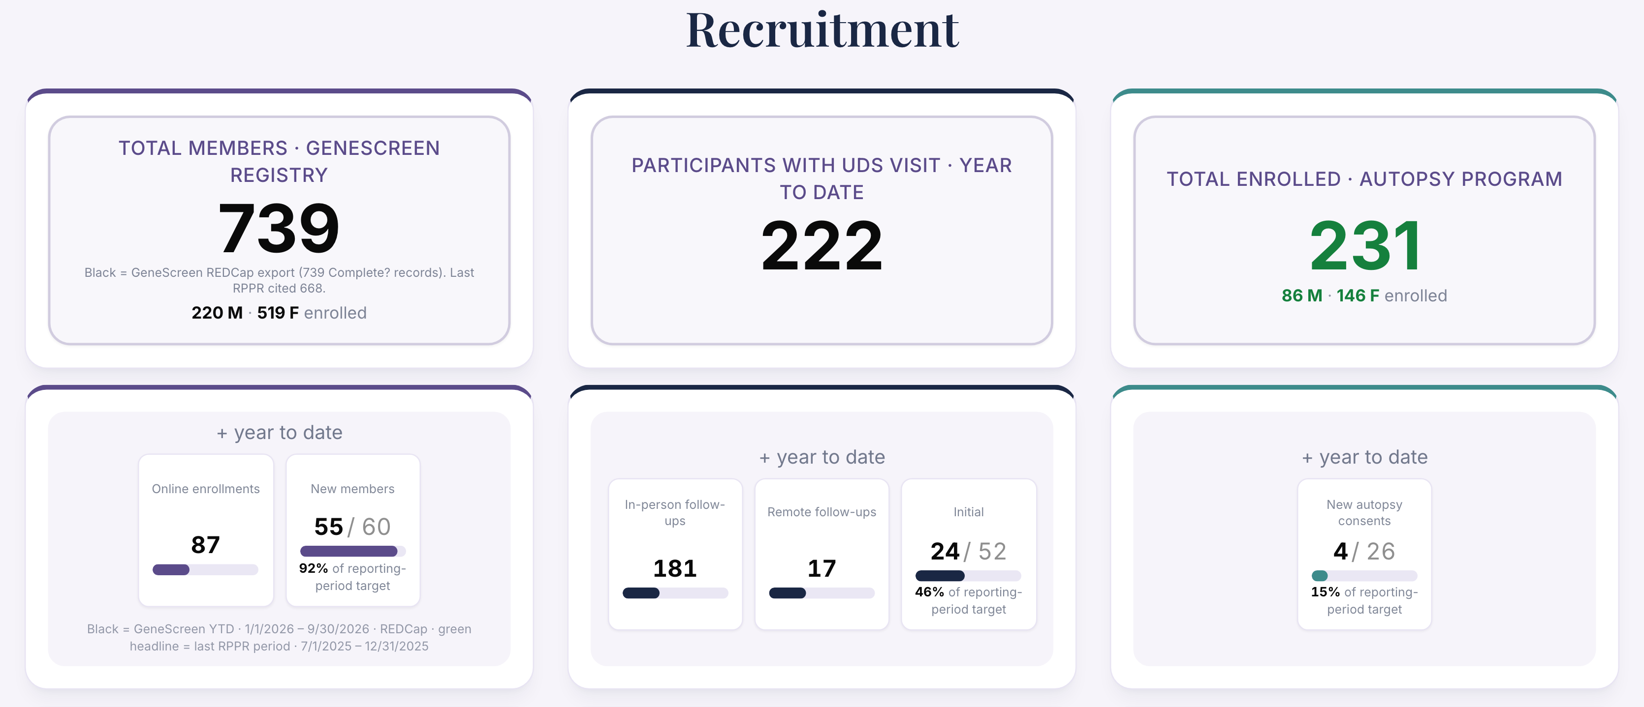
Recruitment · GeneScreen, ADRC & BRS (1 of 2)

Slide 4
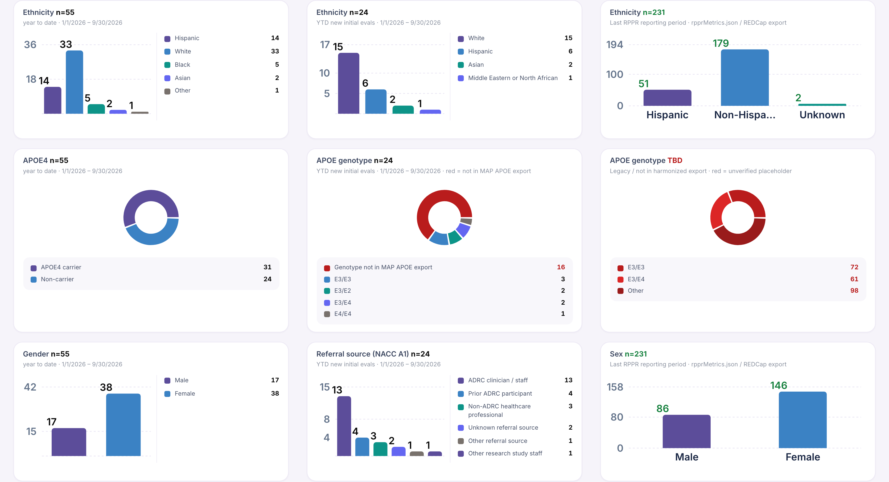
Recruitment · GeneScreen, ADRC & BRS (2 of 2)

Slide 5
Demographics
Table 1 · charts & cohort

Slide 6
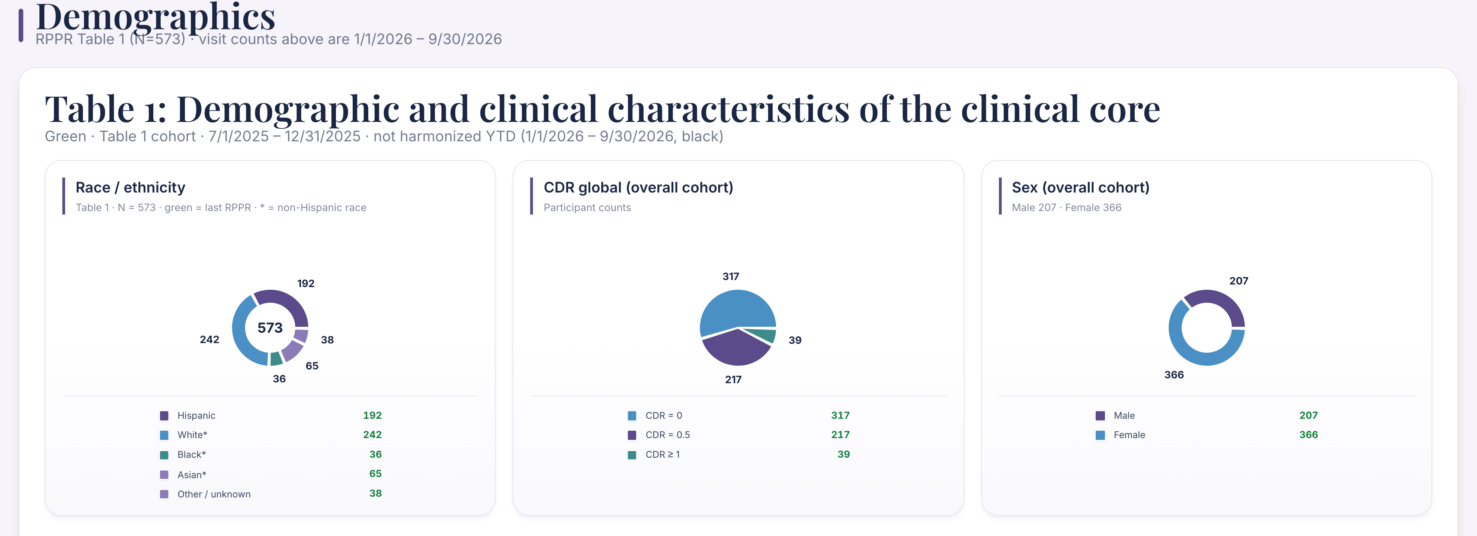
Demographics · Table 1 · charts & cohort (1 of 5)

Slide 7
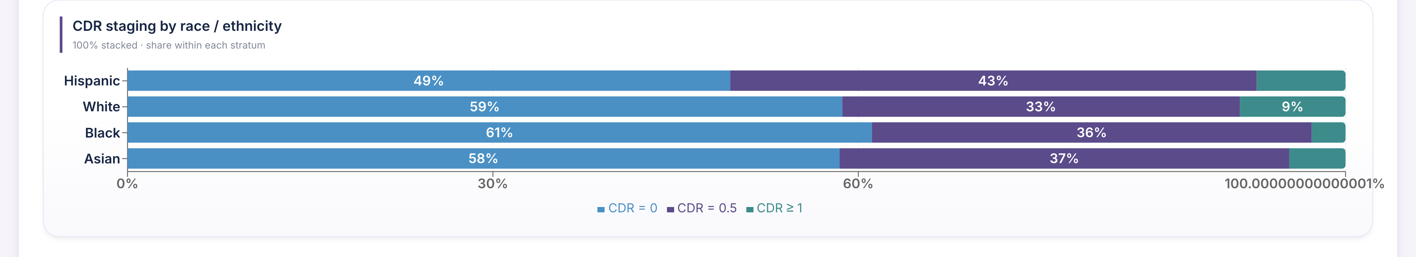
Demographics · Table 1 · charts & cohort (2 of 5)

Slide 8
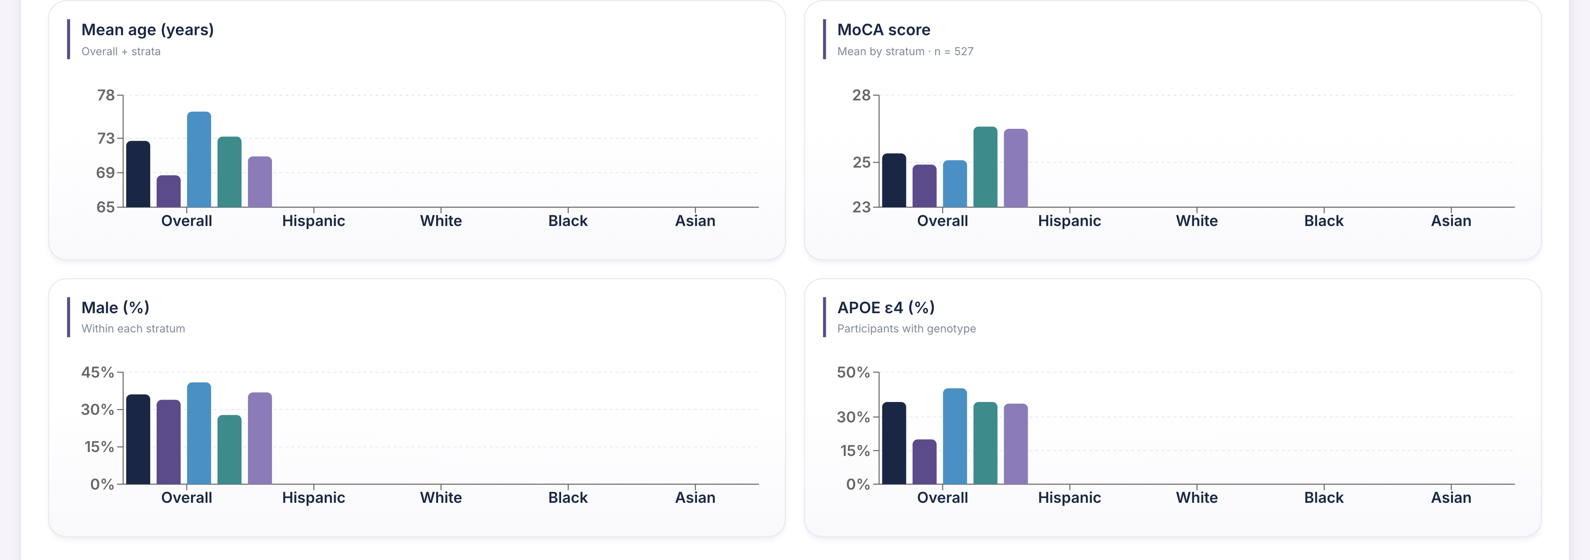
Demographics · Table 1 · charts & cohort (3 of 5)

Slide 9
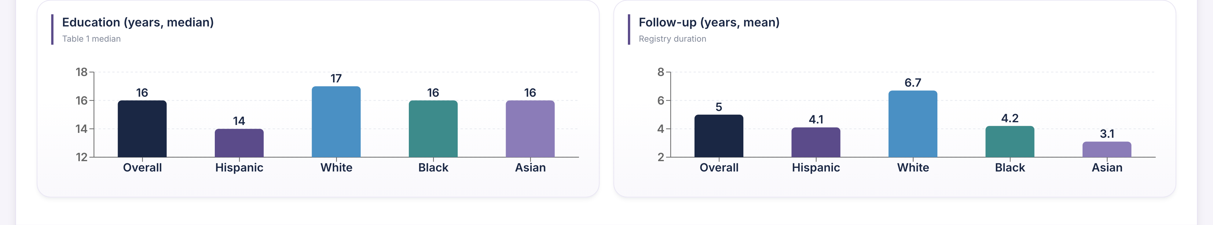
Demographics · Table 1 · charts & cohort (4 of 5)

Slide 10
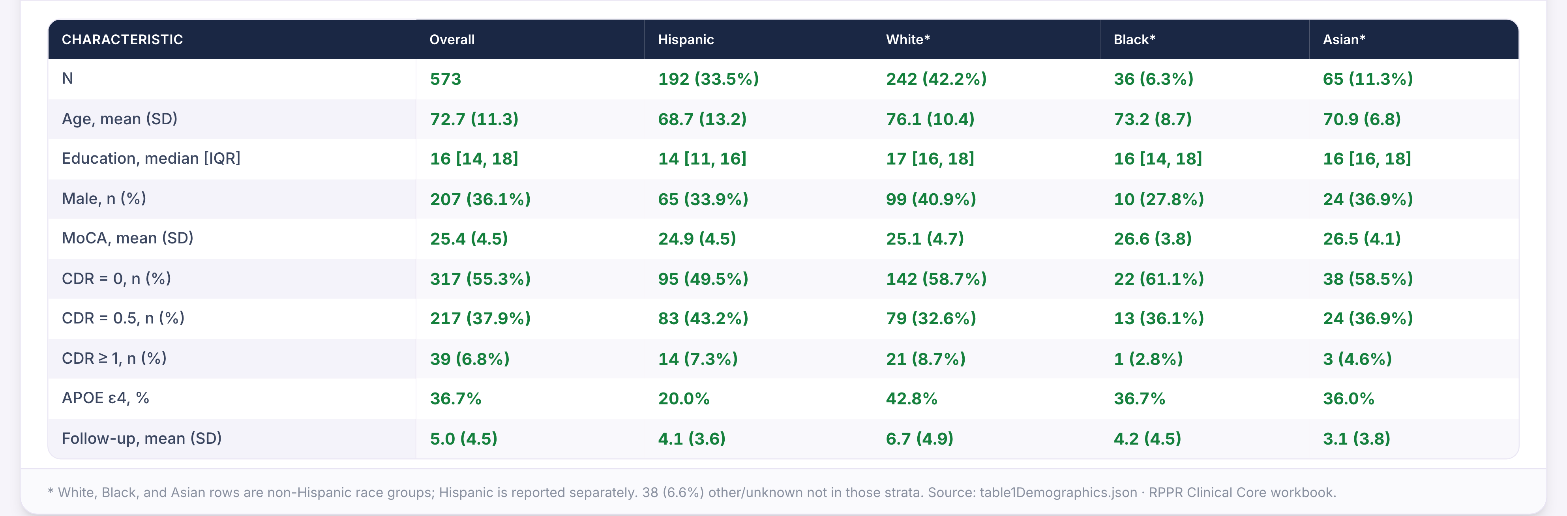
Demographics · Table 1 · charts & cohort (5 of 5)

Slide 11
Neuropathology
Autopsy metrics & tissue inquiries

Slide 12
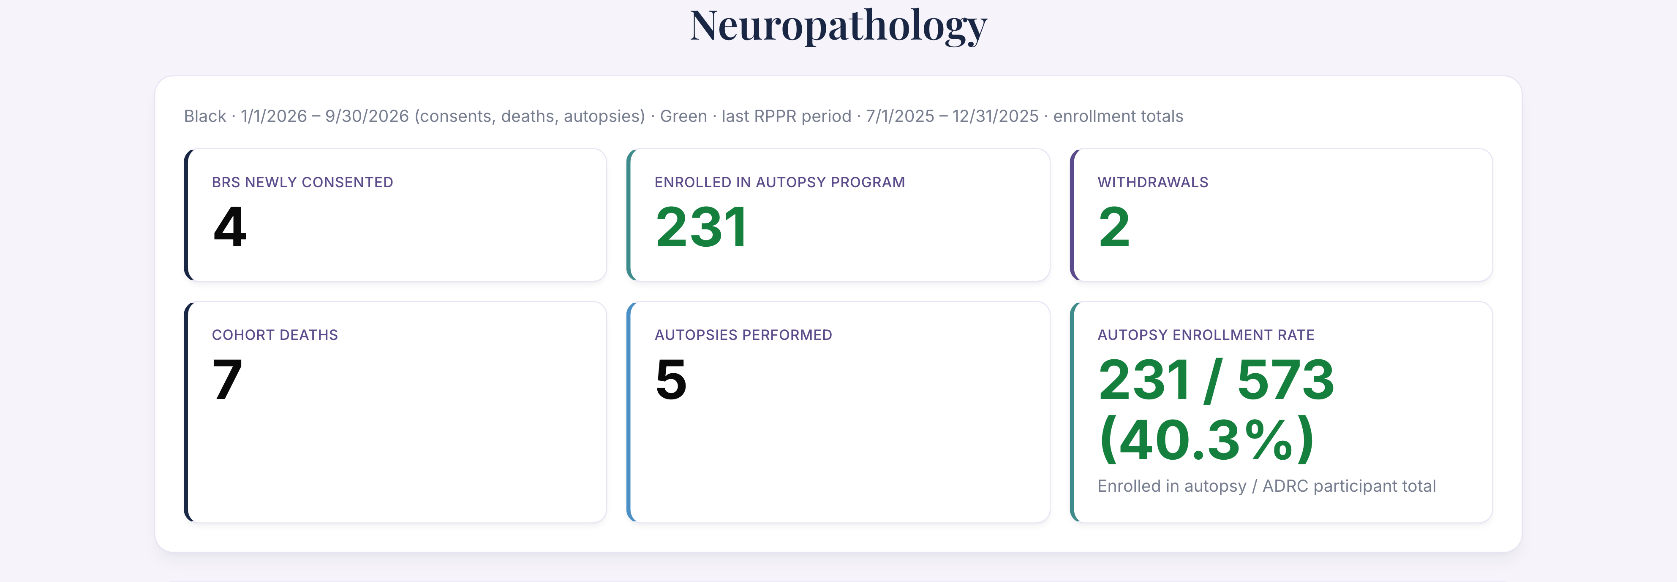
Neuropathology · Autopsy metrics & tissue inquiries (1 of 2)

Slide 13
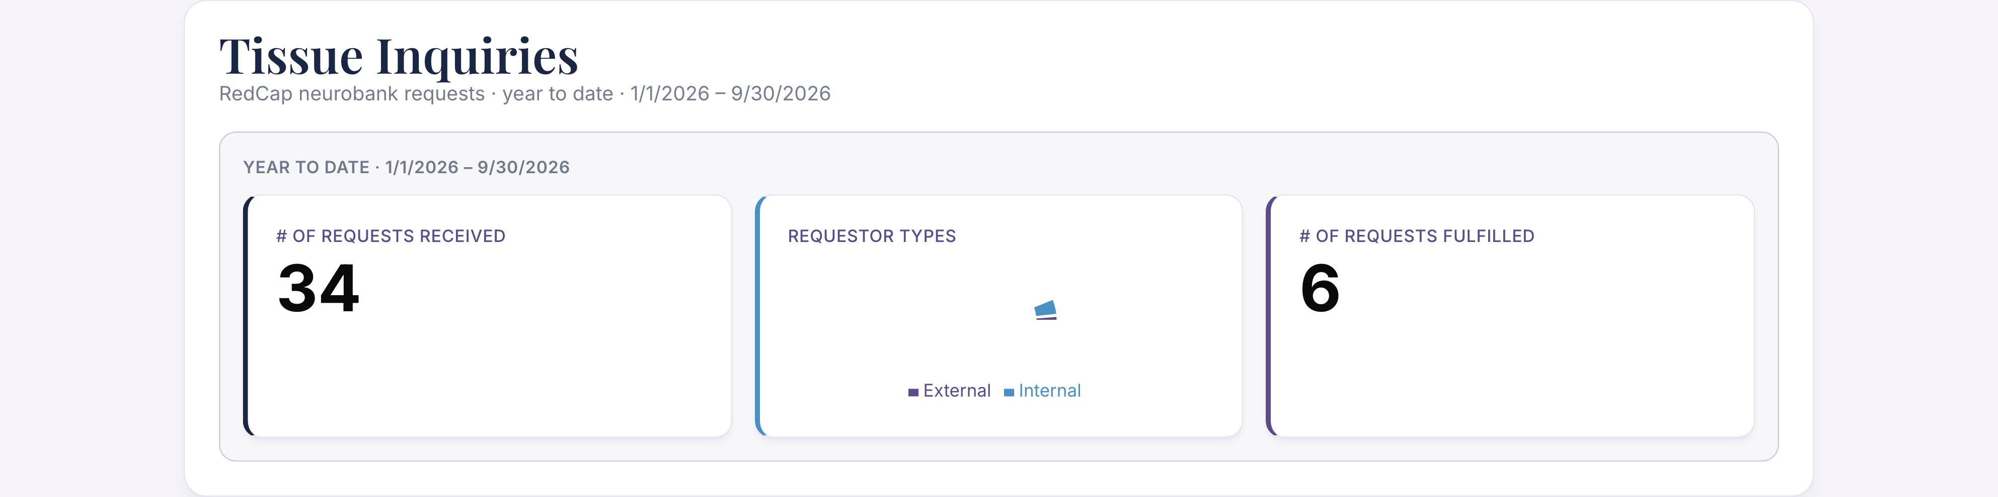
Neuropathology · Autopsy metrics & tissue inquiries (2 of 2)

Slide 14
ORE
Outreach, recruitment & engagement

Slide 15
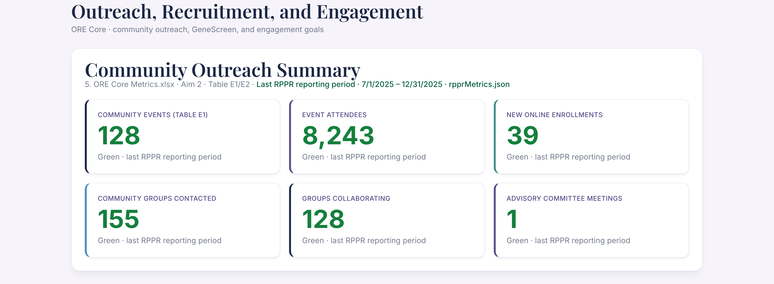
ORE · Outreach, recruitment & engagement (1 of 3)

Slide 16
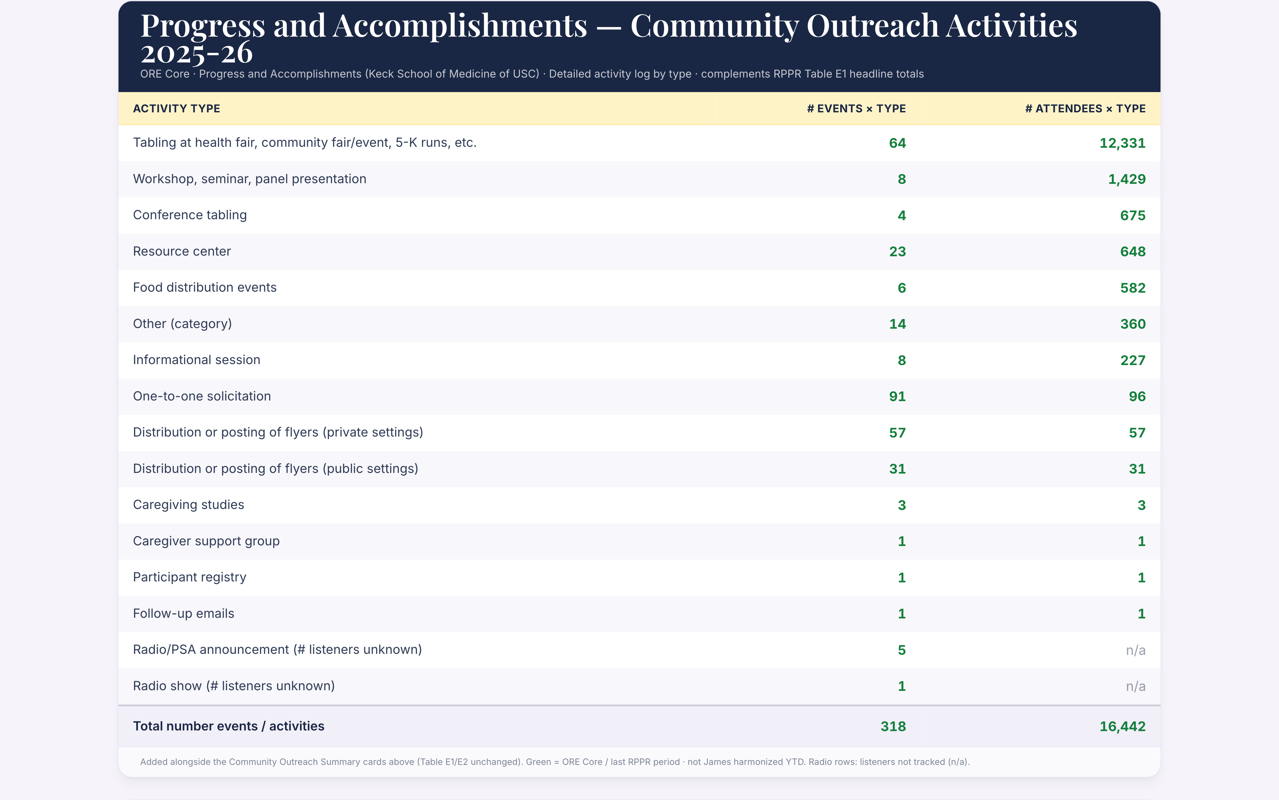
ORE · Outreach, recruitment & engagement (2 of 3)

Slide 17
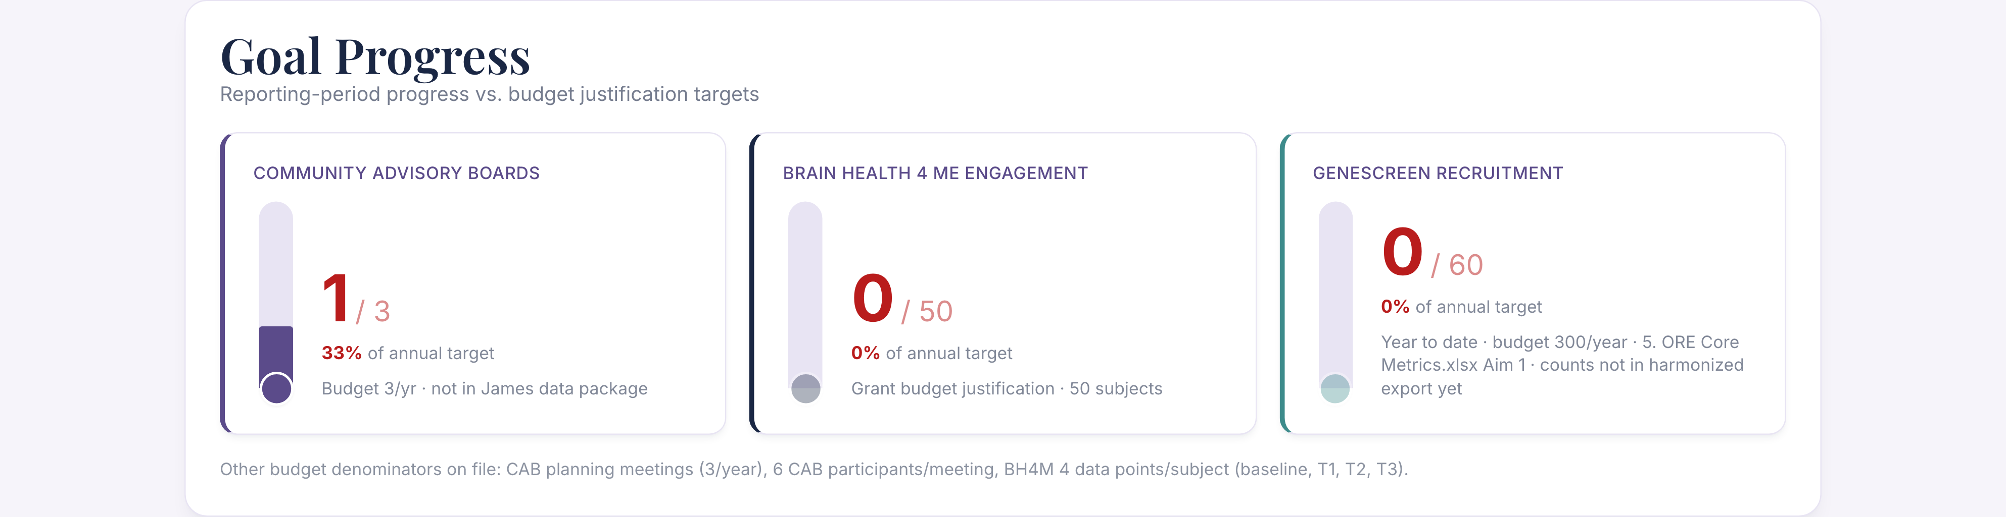
ORE · Outreach, recruitment & engagement (3 of 3)

Slide 18
Biomarkers
Collection, NCRAD, biofluid inquiries

Slide 19
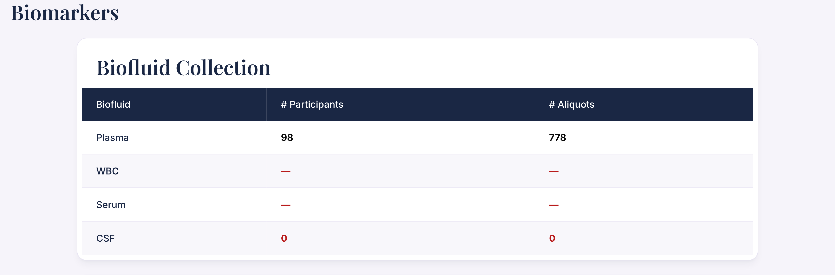
Biomarkers · Collection, NCRAD, biofluid inquiries (1 of 4)

Slide 20
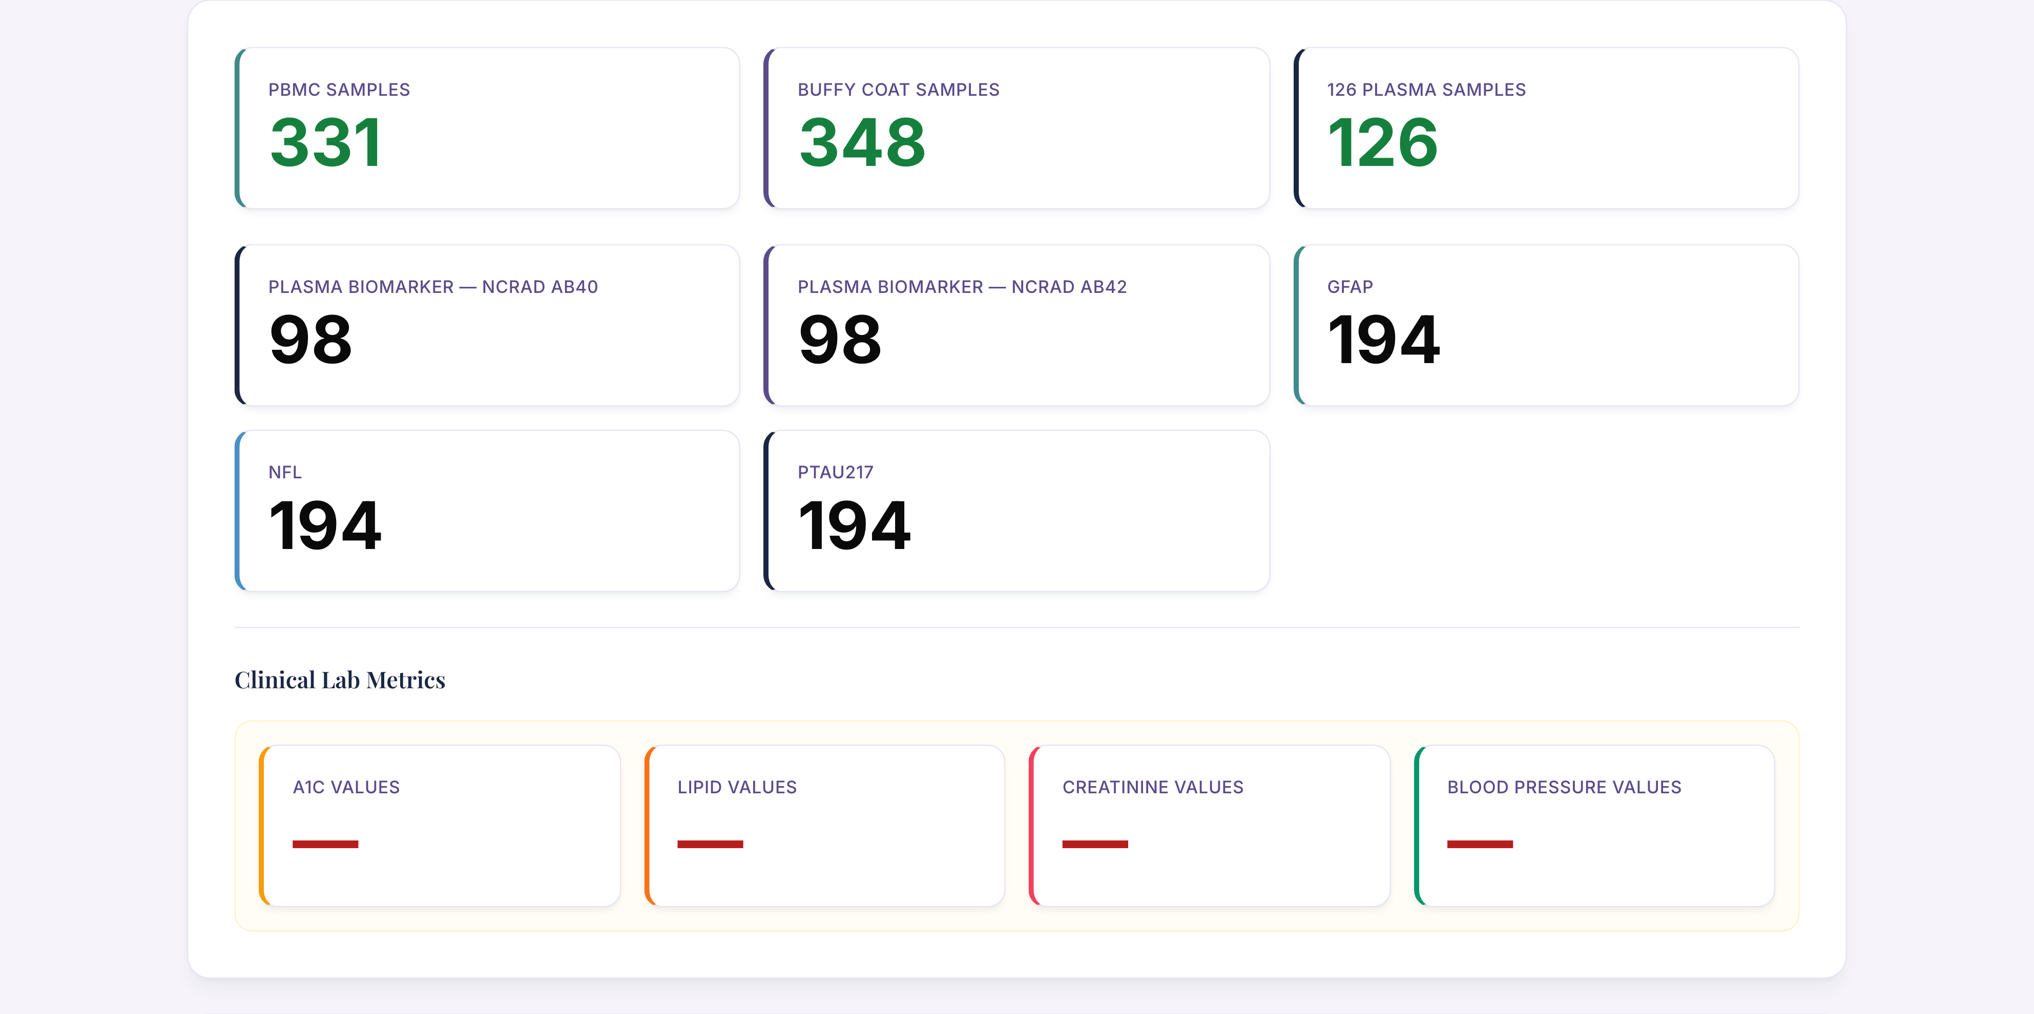
Biomarkers · Collection, NCRAD, biofluid inquiries (2 of 4)

Slide 21
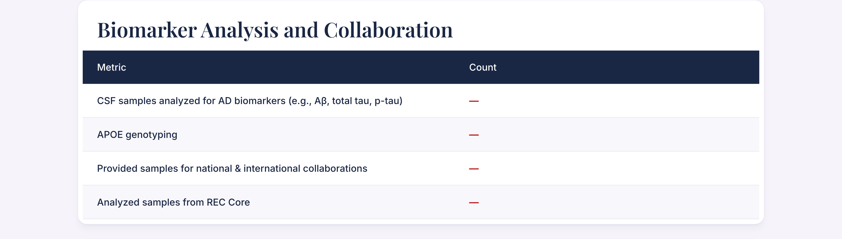
Biomarkers · Collection, NCRAD, biofluid inquiries (3 of 4)

Slide 22
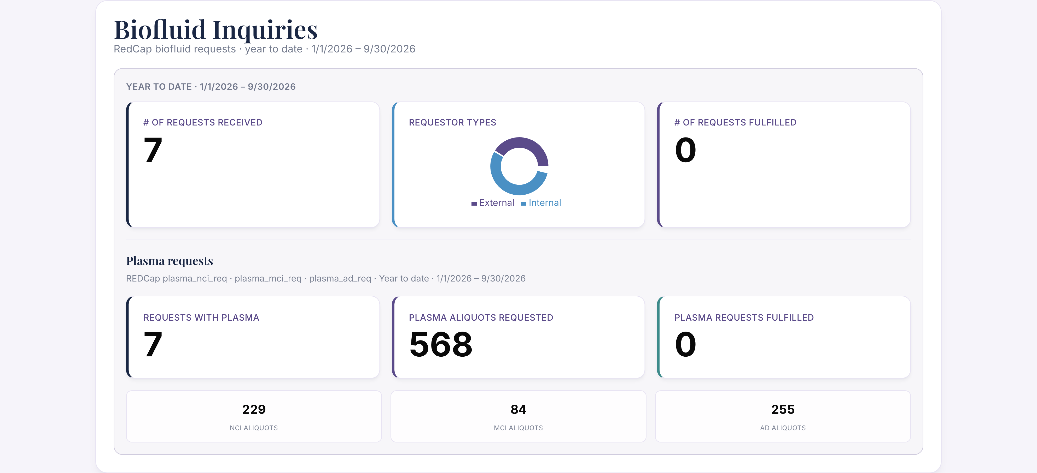
Biomarkers · Collection, NCRAD, biofluid inquiries (4 of 4)

Slide 23
REC
Research engagement coordinator

Slide 24

REC · Research engagement coordinator

Slide 25
Imaging
SCAN, CLARiTI & IDA

Slide 26
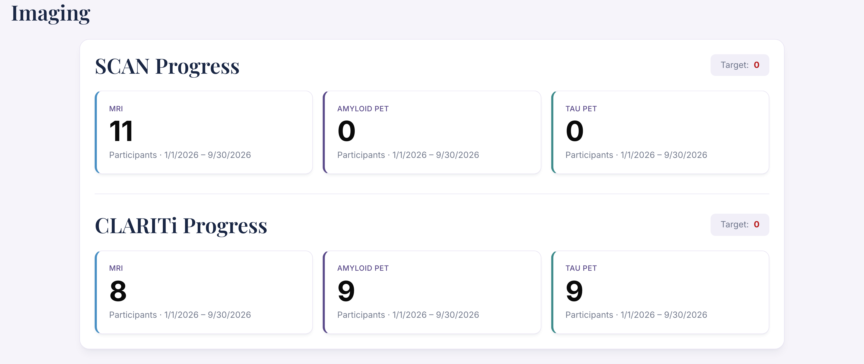
Imaging · SCAN, CLARiTI & IDA (1 of 3)

Slide 27
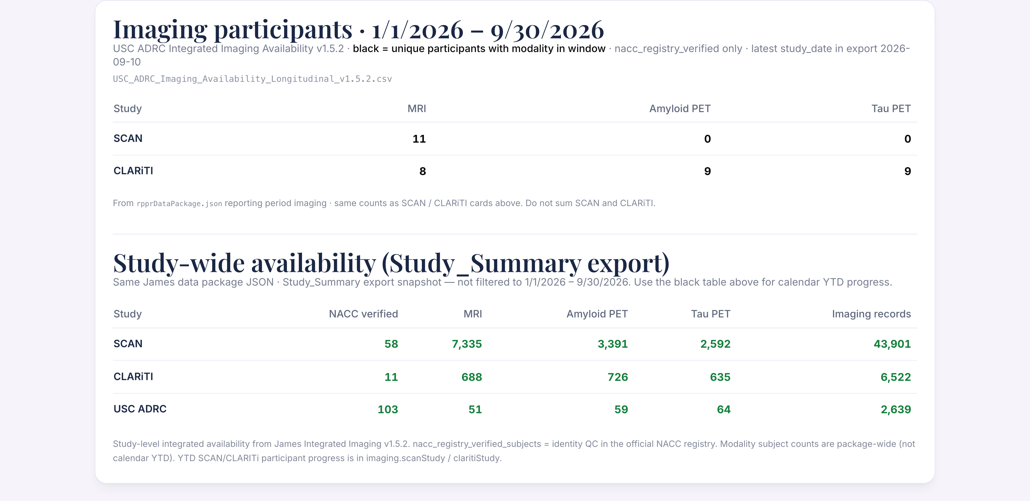
Imaging · SCAN, CLARiTI & IDA (2 of 3)

Slide 28
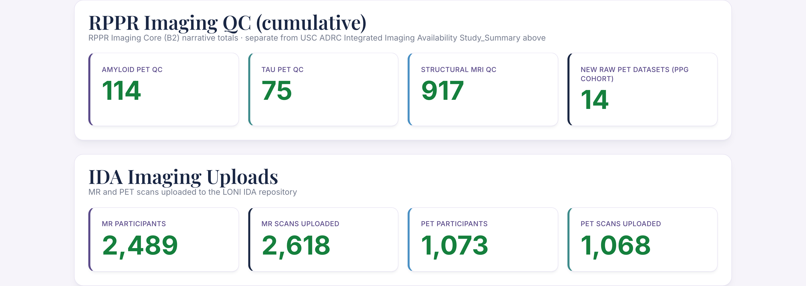
Imaging · SCAN, CLARiTI & IDA (3 of 3)

