Slide 1

Coding with AAUP
Free PowerPoint template
By: Hussein Younis
2023

Slide 2

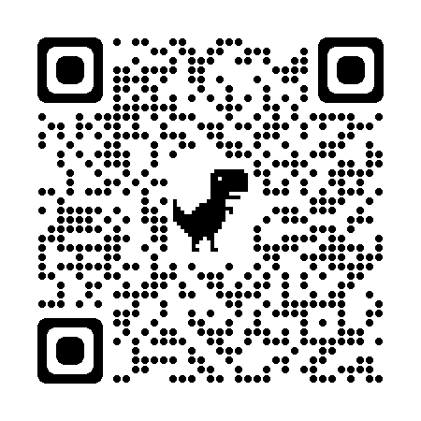
Download Git for windows
https://git-scm.com/download/win

Slide 3
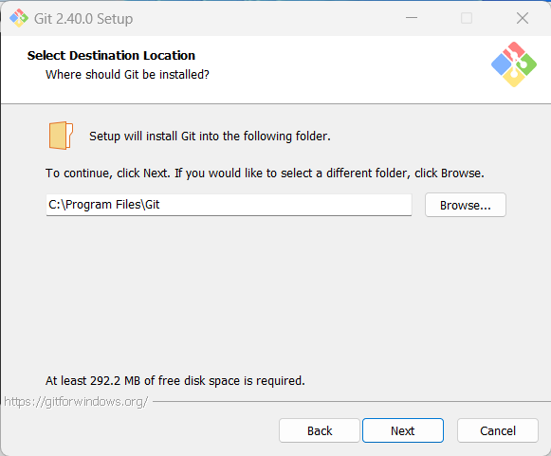
Git installation:
Click on next

Slide 4
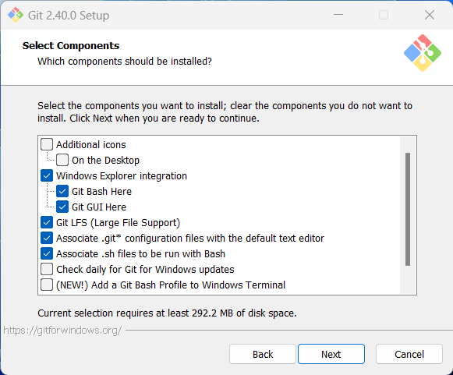
Git installation:
Click on next

Slide 5
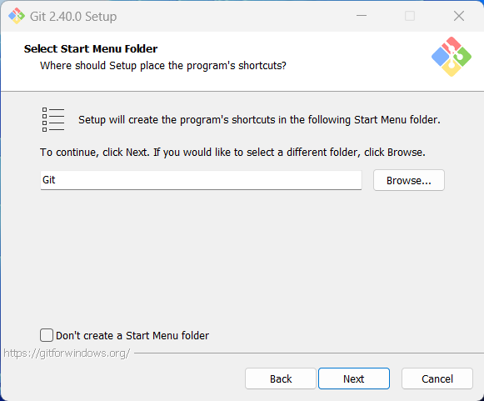
Git installation:
Click on next

Slide 6
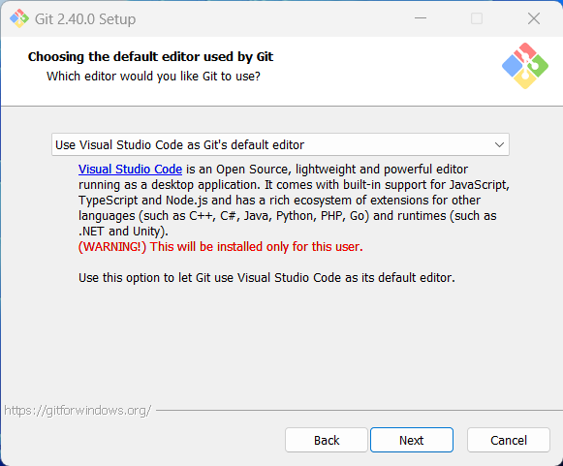
Git installation:
Select VSCode and then press next

Slide 7
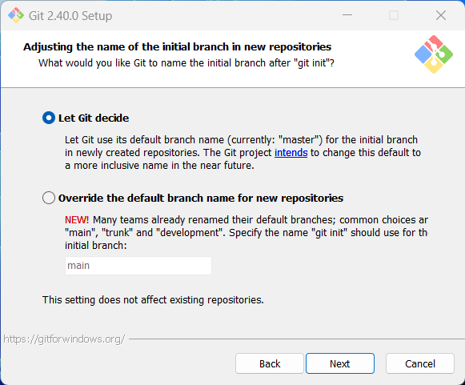
Git installation:
Click on next

Slide 8
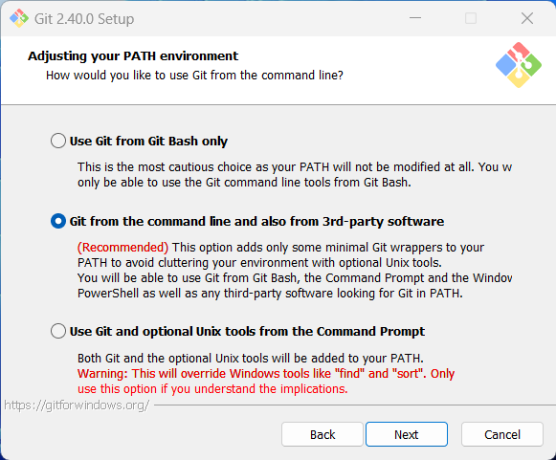
Git installation:
Click on next

Slide 9
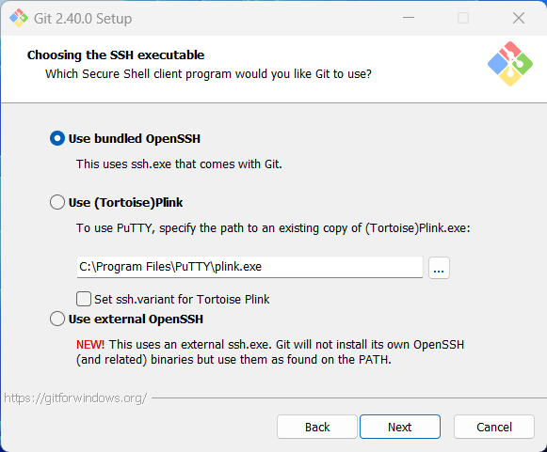
Git installation:
Click on next

Slide 10
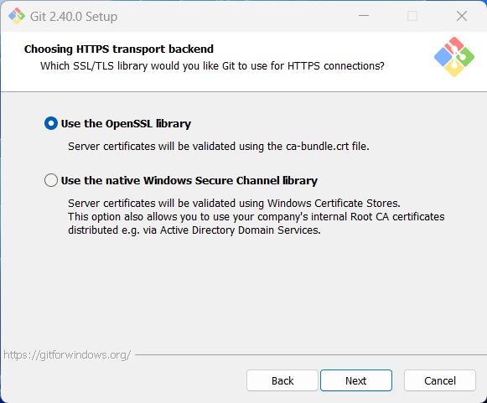
Git installation:
Click on next

Slide 11
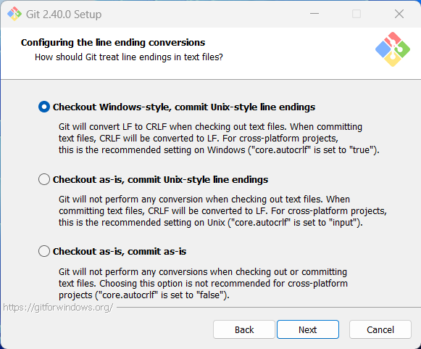
Git installation:
Click on next

Slide 12
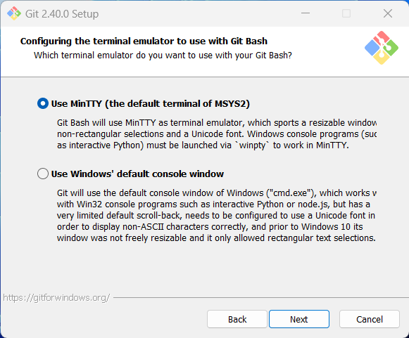
Git installation:
Click on next

Slide 13
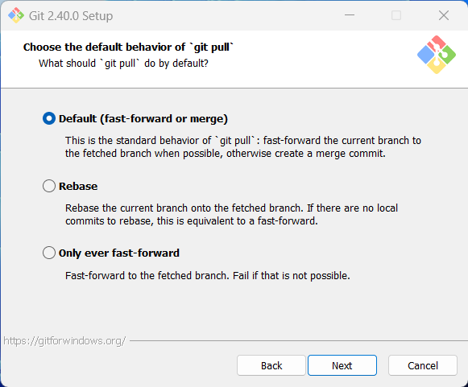
Git installation:
Click on next

Slide 14
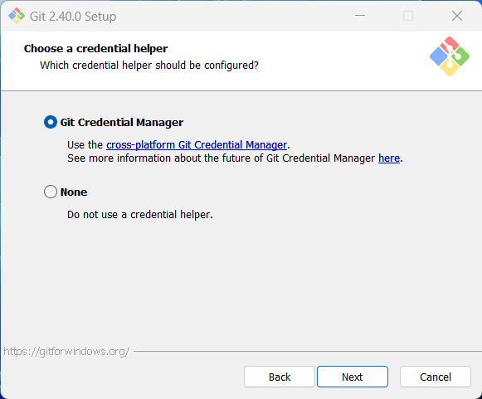
Git installation:
Click on next

Slide 15
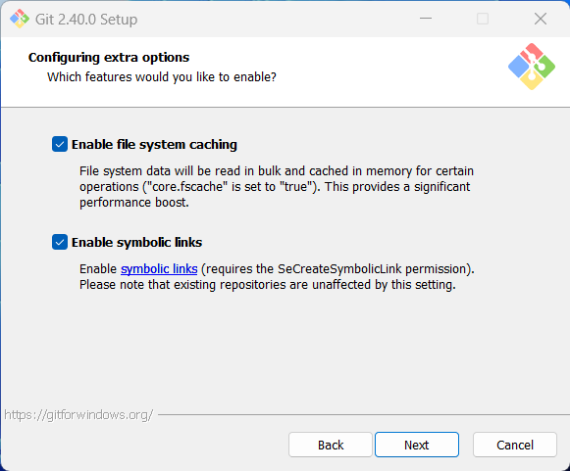
Git installation:
Click on next

Slide 16
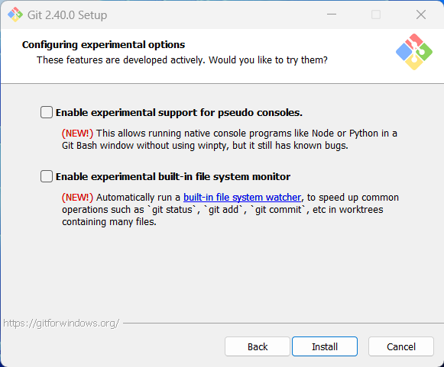
Git installation:
Click on install

Slide 17
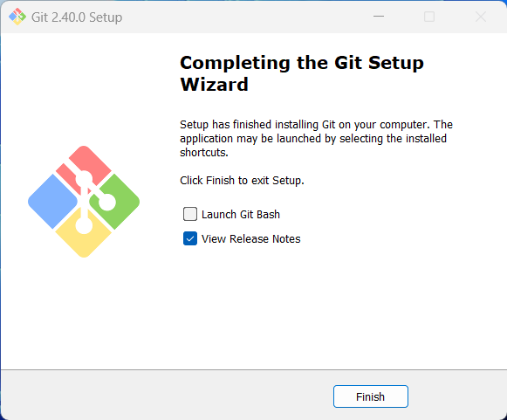
Git installation:
Click on finish

Slide 18
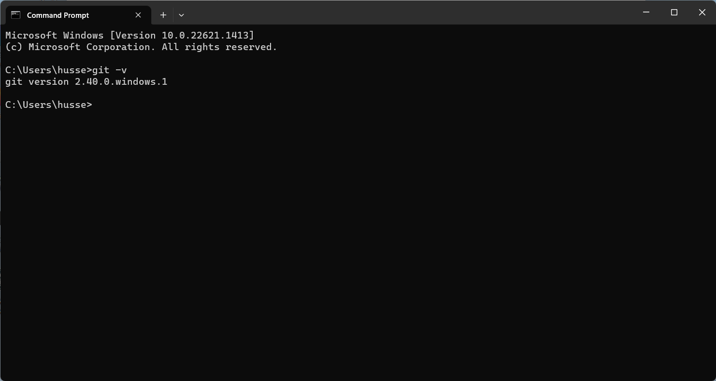
Git Version:

Slide 19
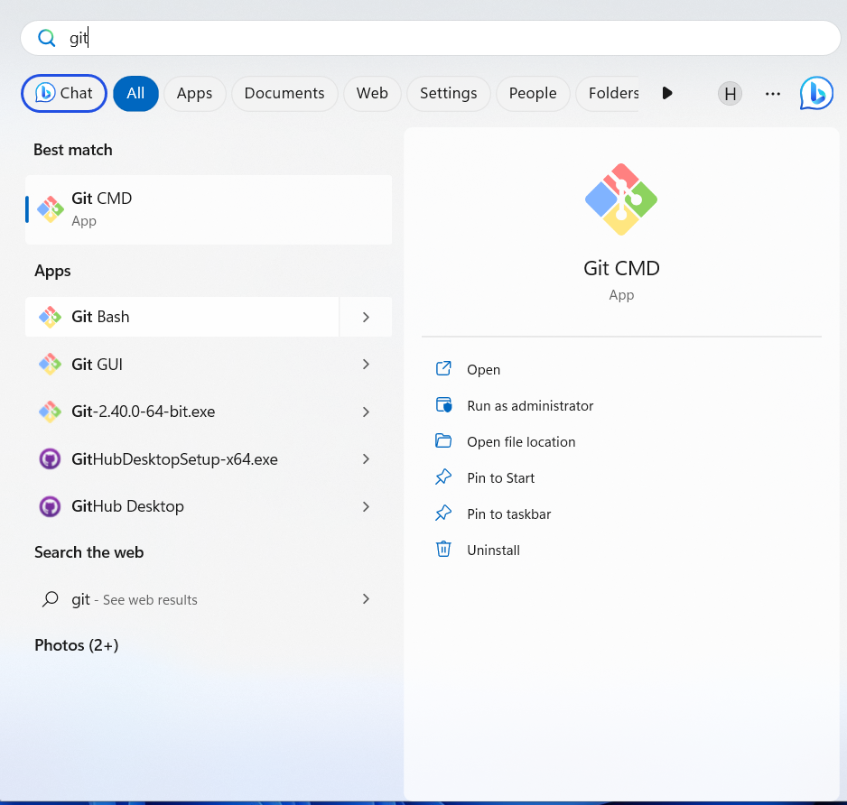
Git login:
Open Git Bash.

Slide 20
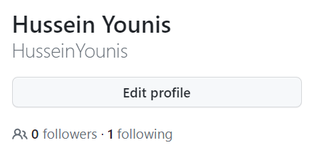
Git login:
Open Git Bash.
Get your full name from your profile on GitHub.

Slide 21
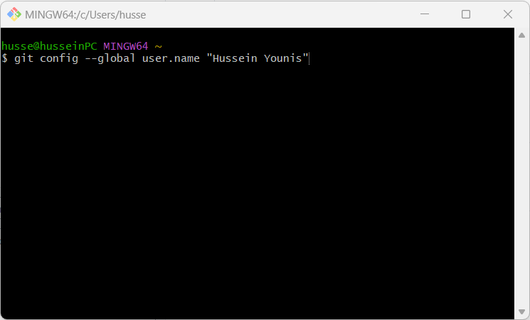
Git login:
Open Git Bash.
Get your full name from your profile on GitHub.
Set a Git username:

Slide 22
Caching your GitHub credentials in Git:
Open Git Bash.
Get your full name from your profile on GitHub.
Set a Git username:

