Slide 1
UDEMY Courses

Slide 2
Our Customer

Slide 3



National course providing cooperates like: AMIT, Noon academy and “نفهم”.

Slide 4
Problem Description

Slide 5
analyze the courses data.
improve the audience reachability and satisfaction.
Find ways to optimize price and other properties from duration and number of lectures etc.
Provide insights about the available course data.

Slide 6
What type of course that is most interesting for the audience.
What level should the course be.
What is the optimal number of lectures. And its duration.
What part of the year should the course be posted.

Slide 7
UDEMY Courses Data

Slide 8
course_id | The identifier of the course.
course_title | The title of the course.
url | The URL of the course.
Price | The price of the course.
num_subscribers | The number of subscribers.
num_reviews | The number of reviews.
num_lectures | The number of lectures.
Level | The level of the course.
Rating | The rating of the course.
content_duration | The content duration of the.
published_timestamp | The timestamp of the publication. 1/1/2011 → 1/6/2017
Subject | The subject of the course.

Slide 9
Hypothesis Tests used

Slide 10
One-Way ANOVA Test
(Numerical - Category)

Slide 11
Null Hypothesis (H₀): The means of all groups are equal.
Alternative Hypothesis (H₁): At least one group mean is different from the others.
H0: μA = μB = μC
Ha: At least one mean height is different.
Calculate the mean and variance for each group.
Get Mean of numerical col for A=μA , μB and μC
μ = (μA + μB + μC) / 3
F = (Between-group variability “SSB” ) / (Within-group variability “SSW” ).
SSB=n*Σ(μ -μi)**2 & SSW=Σgroups (Σpoints (ni-nj)**2)
Degrees of freedom between groups (DFB) = Number of groups - 1
Degrees of freedom within groups (DFW) = Total number of observations - Number of groups
F=(SSB/DFB)/(SSW/DFW)
F>.05 fail to reject null Hypothesis
F<.05 reject null Hypothesis

Slide 12
Spearman's rank
correlation coefficient test
(Numerical - Numerical)

Slide 13
Null Hypothesis (H₀): There is no monotonic relationship between the two variables.
Alternative Hypothesis (H₁): There is a monotonic relationship between the two variables.
Assign ranks to the values of each variable independently.
Compute the differences in ranks between the two variables = d.
The formula for Spearman's rank correlation coefficient is:
ρ = 1 - [(6 * Σd²) / (n * (n² - 1))]
df = n - 2,
t = (ρ * sqrt(n - 2)) / sqrt(1 - ρ^2)
And use t-distribution table or statistical software to determine the p-value corresponding to the calculated test statistic.
ρ approaches 1 then there is a positive monotonic relation
ρ approaches -1 then there is a negative monotonic relation
ρ approaches 0 then there is no monotonic relation
P-value < 0.05 then we are sure the result in the spearman correlation is valid

Slide 14
Subject and Level

Slide 15
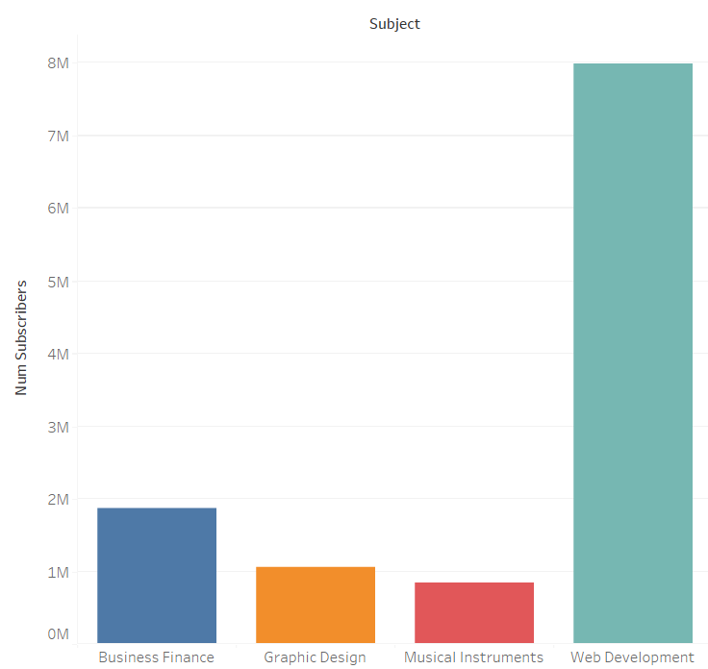
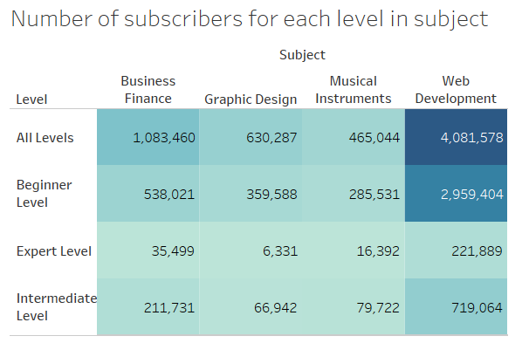

Slide 16
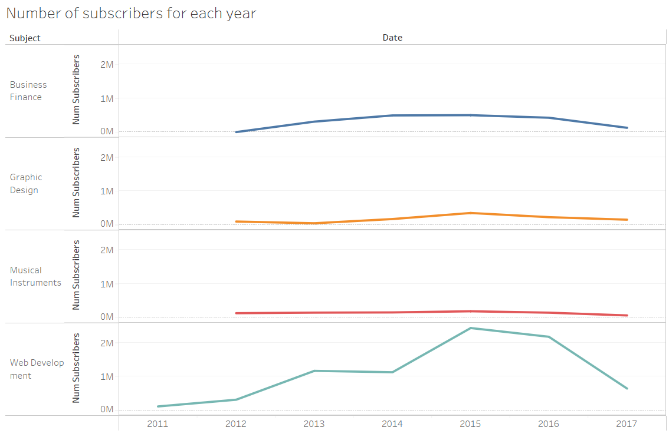

Slide 17
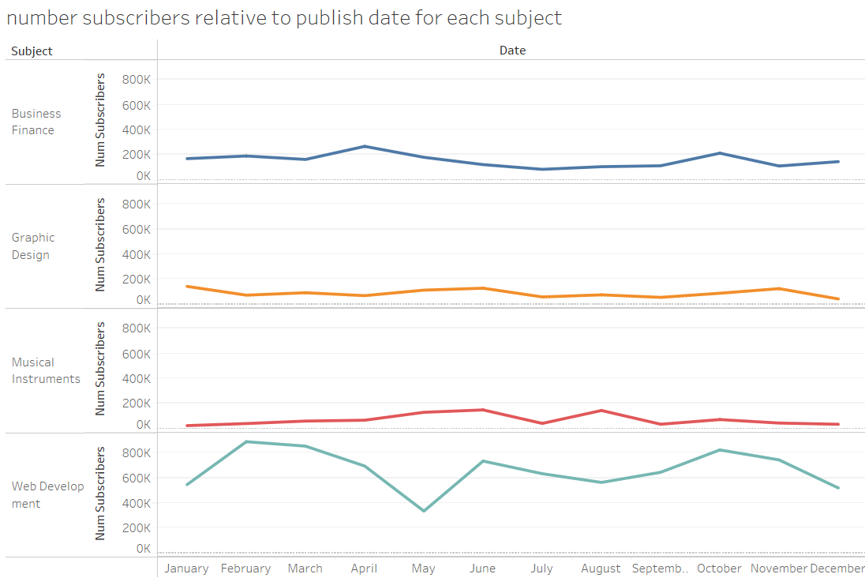

Slide 18
Duration

Slide 19
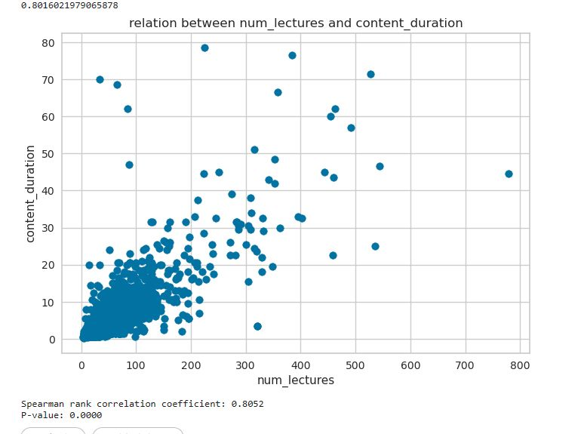

Slide 20
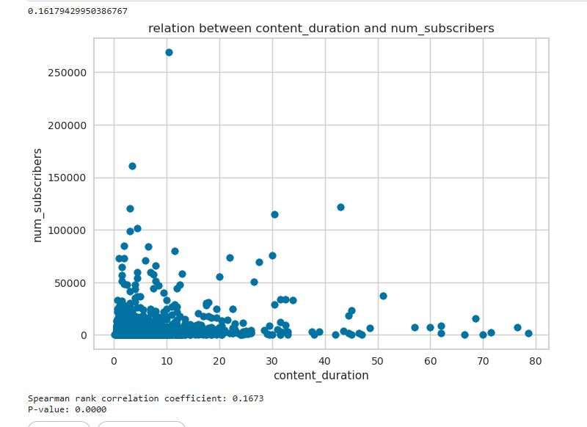

Slide 21
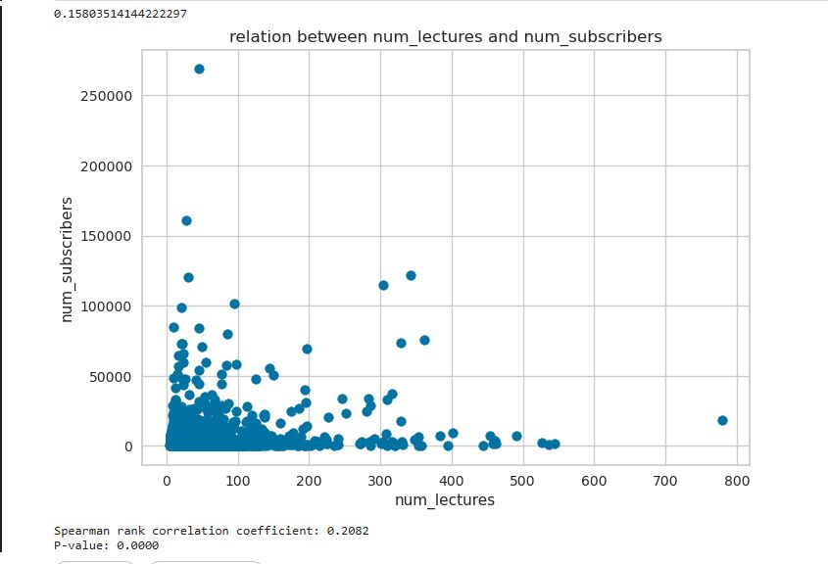

Slide 22
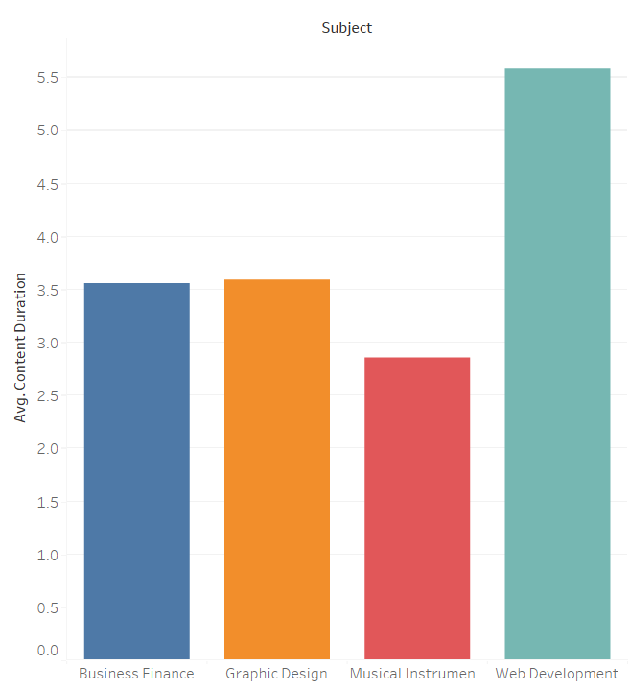
Anova test: p-value=0
There is a significant difference in the mean subject across different content_duration.

Slide 23
Price

Slide 24
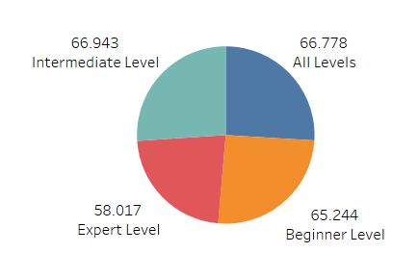
Using One-Way ANOVA test:
p-value=0.6634652659006761
Mean does not depend

Slide 25
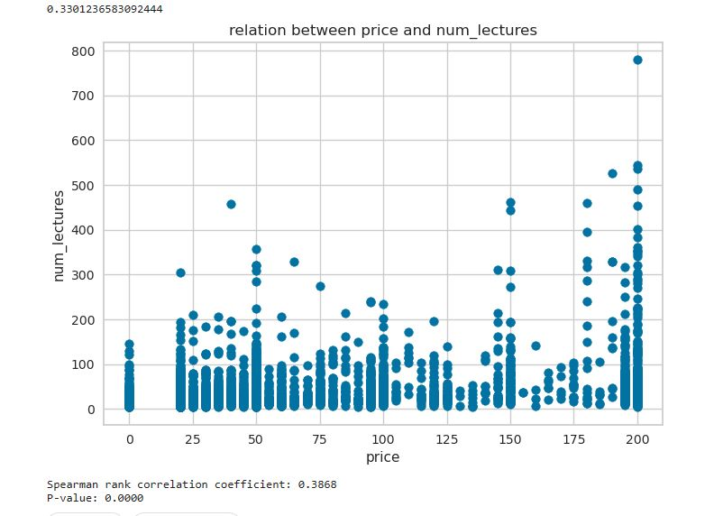
Using Spearman's rank correlation coefficient test: p-value=0
There is a weak relation.

Slide 26
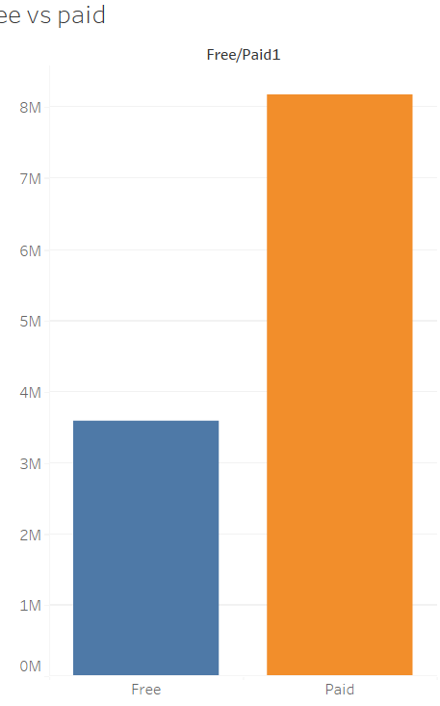

Slide 27
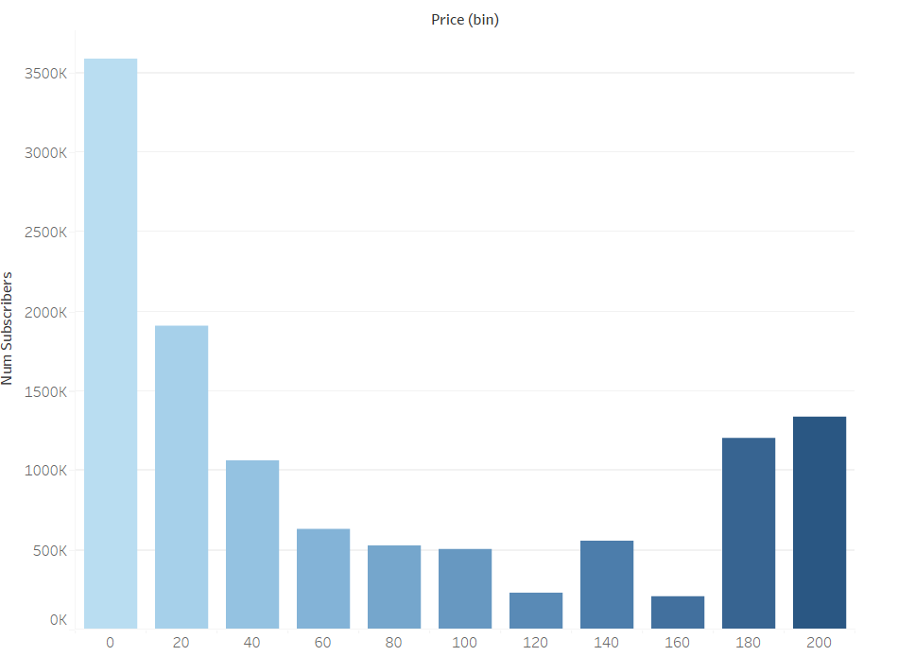
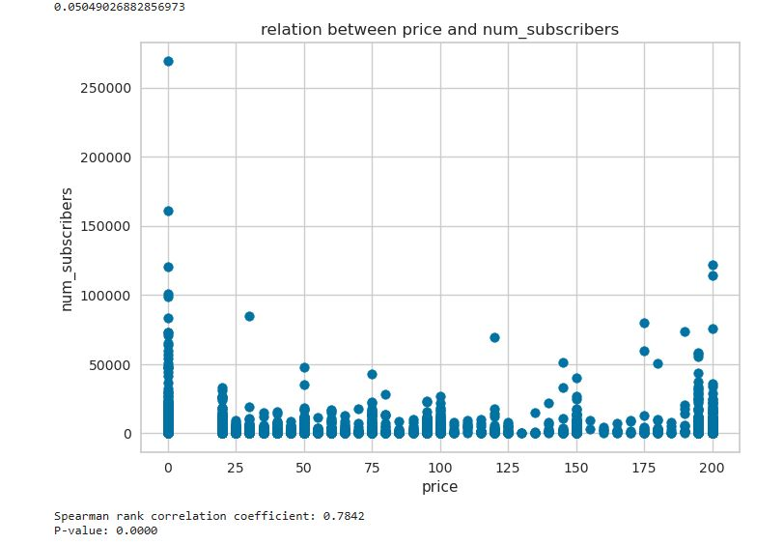

Slide 28
Rating

Slide 29
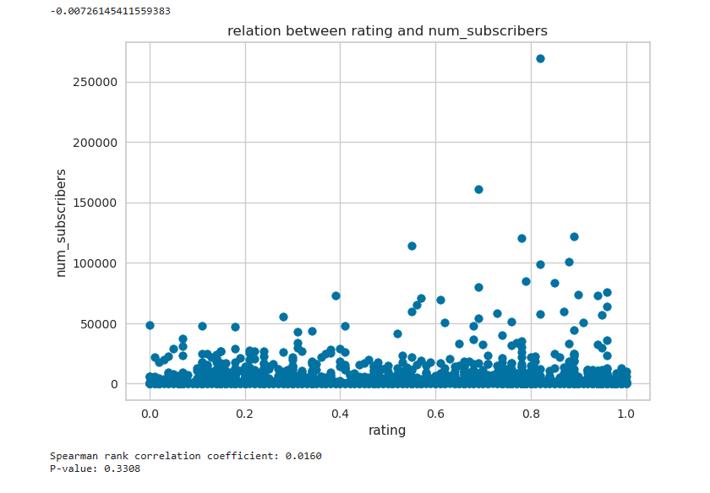

Slide 30
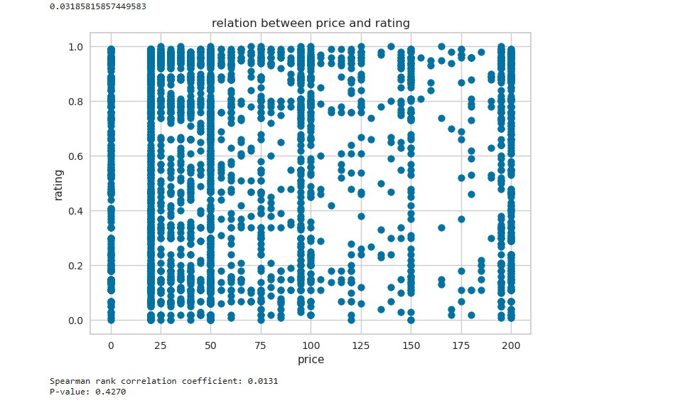

Slide 31
Conclusion

Slide 32
Subject: the web development showed to be the most popular subject in our data.
Level: the “all level” category reached the highest audience rate.
Course duration : the mean duration for the courses is 5 hours.
Data publish : the months that showed high trending numbers were February and October.
We also implemented models to predict the price and rating of the course.

Slide 33
Thank You!

