Slide 1
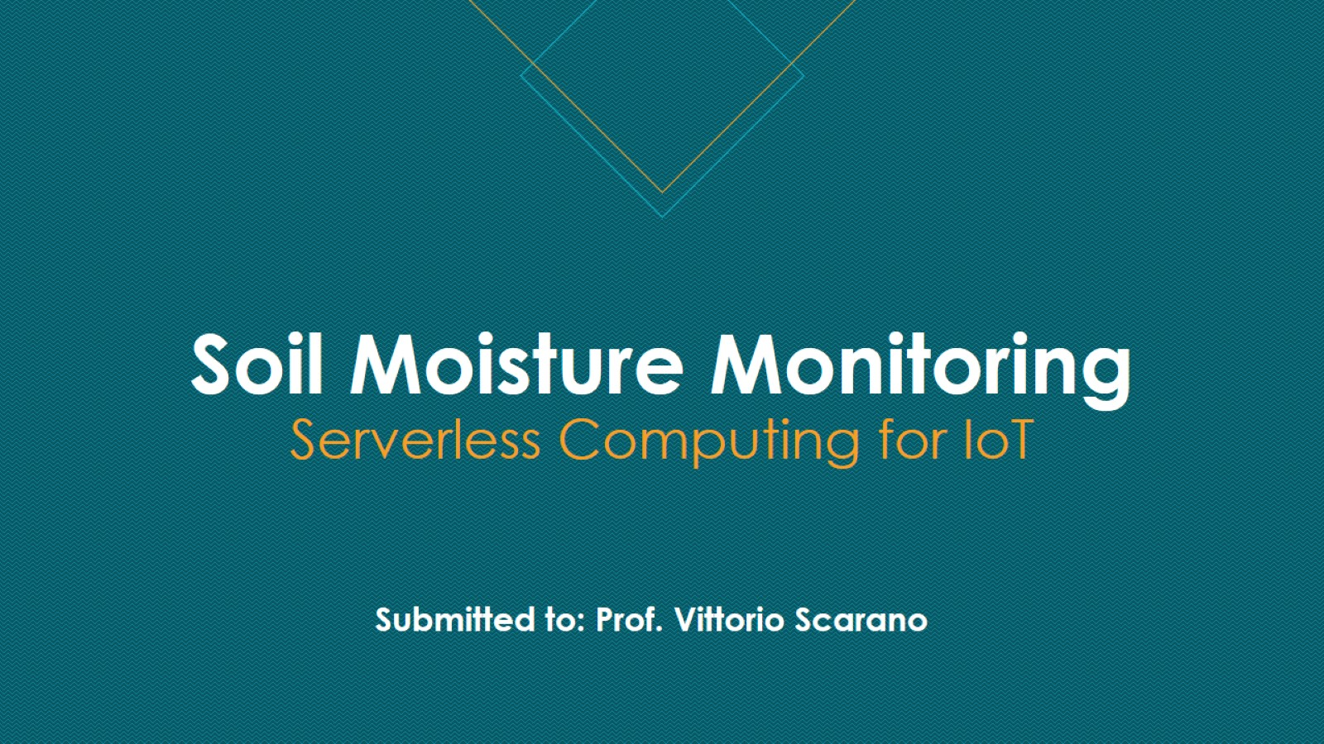
Soil Moisture Monitoring Serverless Computing for IoT

Slide 2
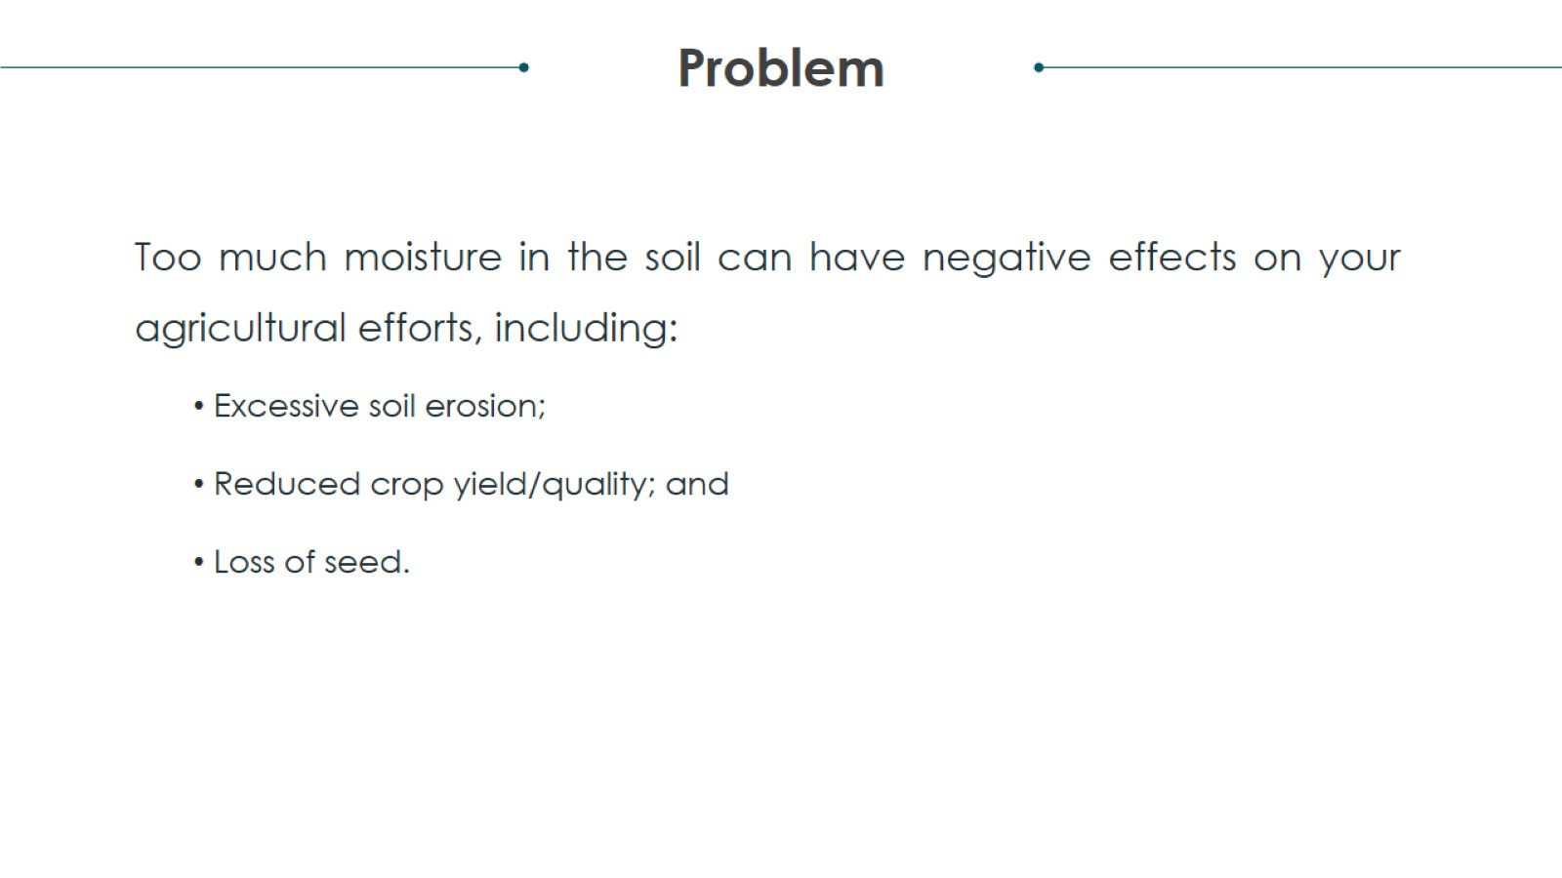
Project analysis slide 2

Slide 3
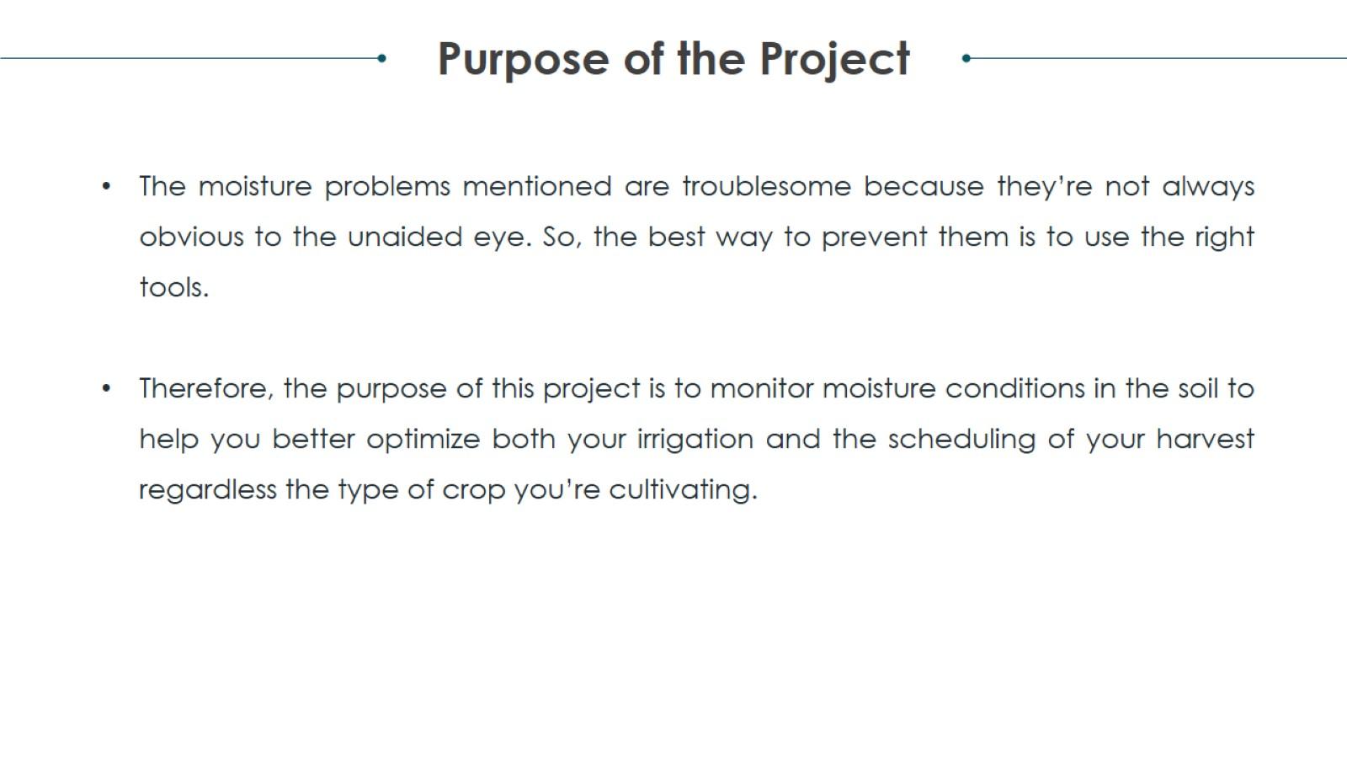
Project analysis slide 2

Slide 4
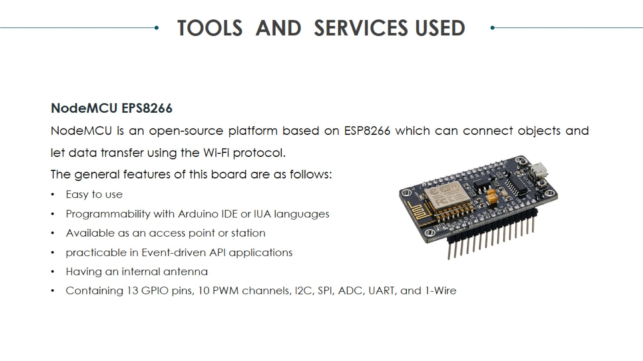
Project analysis slide 2

Slide 5
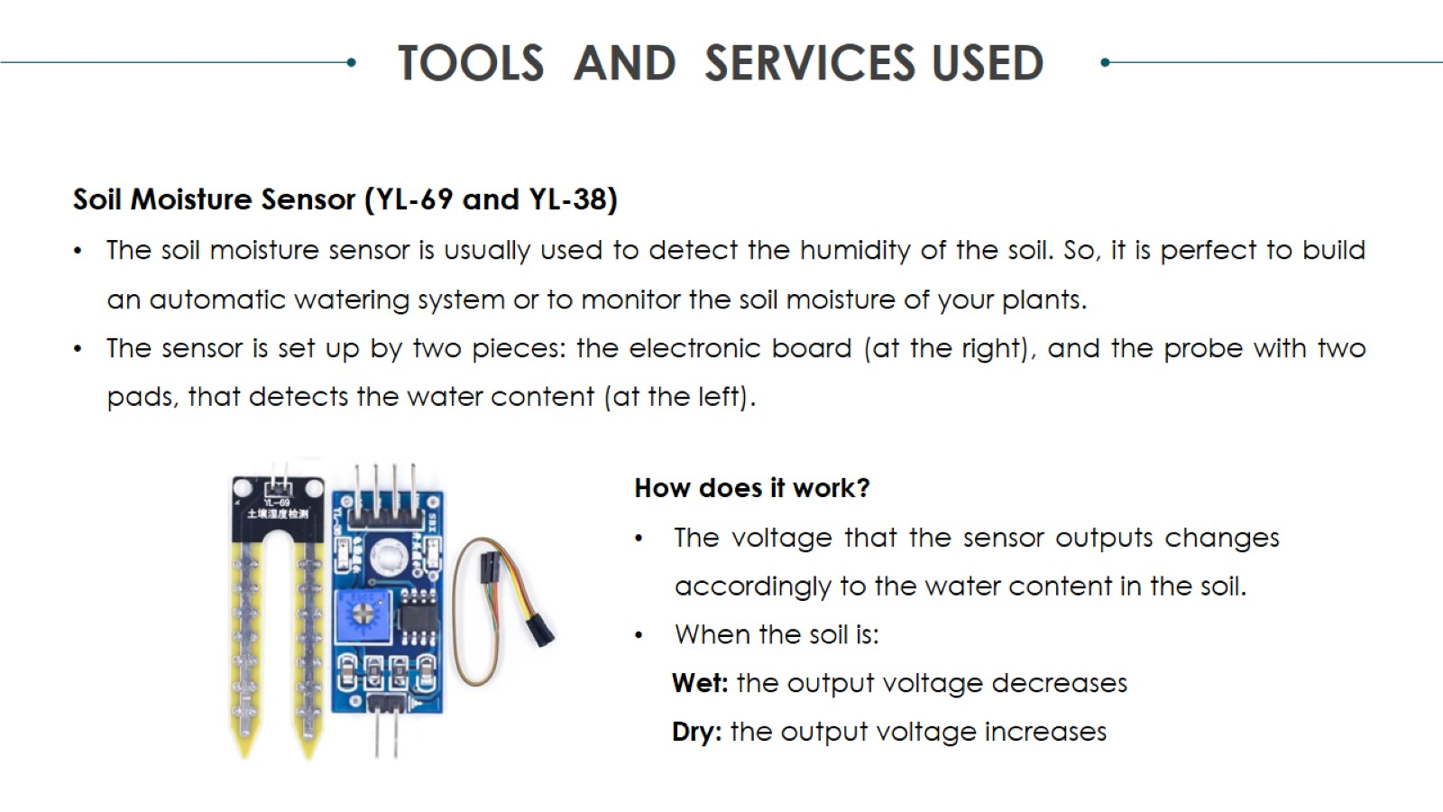
Project analysis slide 2

Slide 6
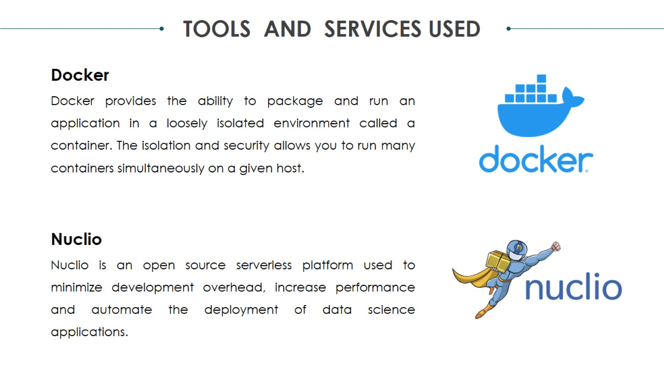
Project analysis slide 2

Slide 7
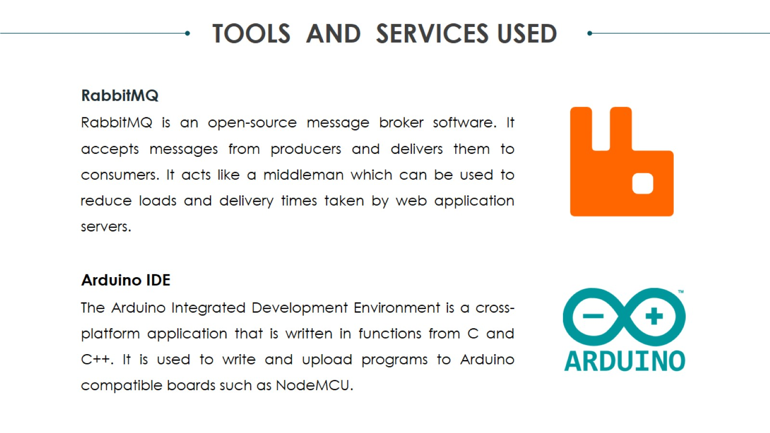
Project analysis slide 2

Slide 8
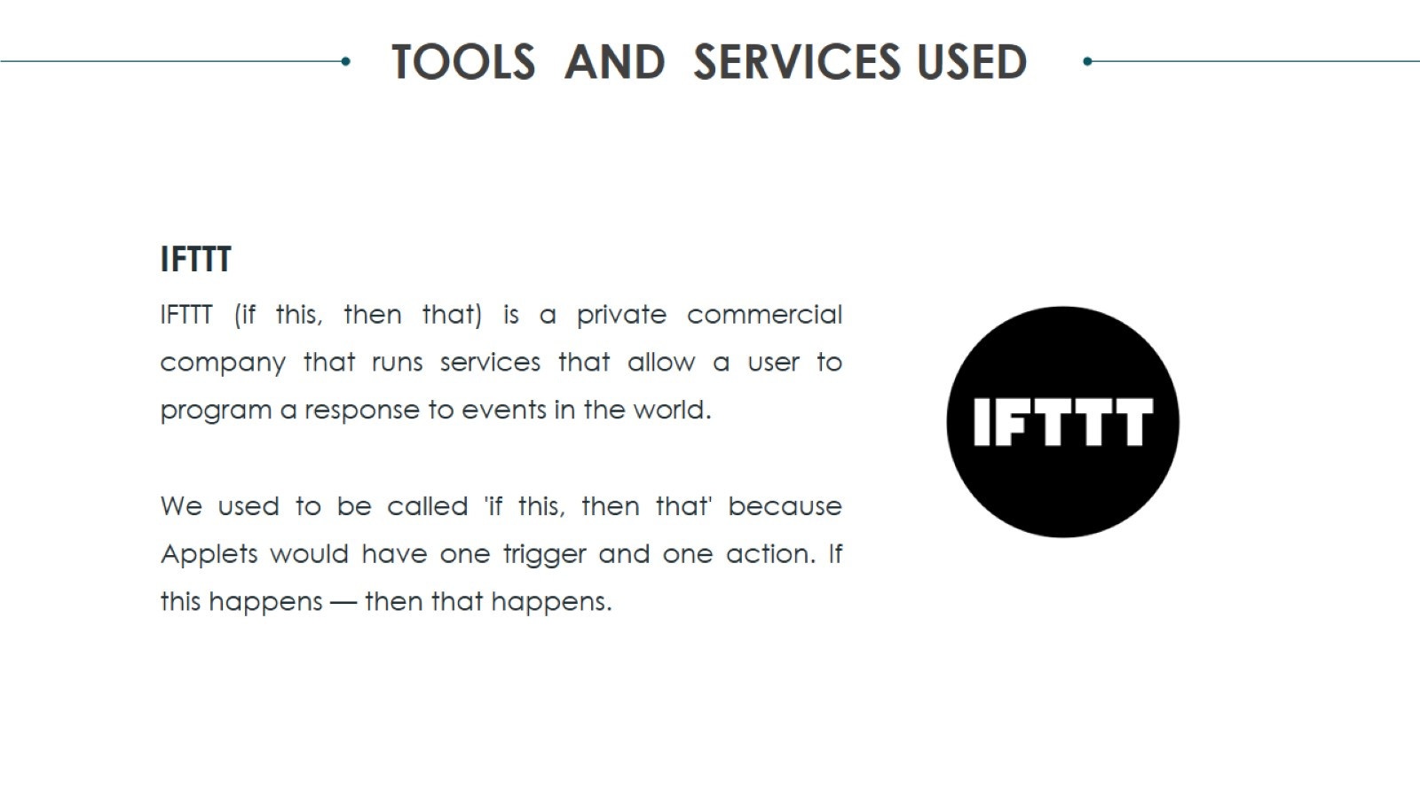
Project analysis slide 2

Slide 9
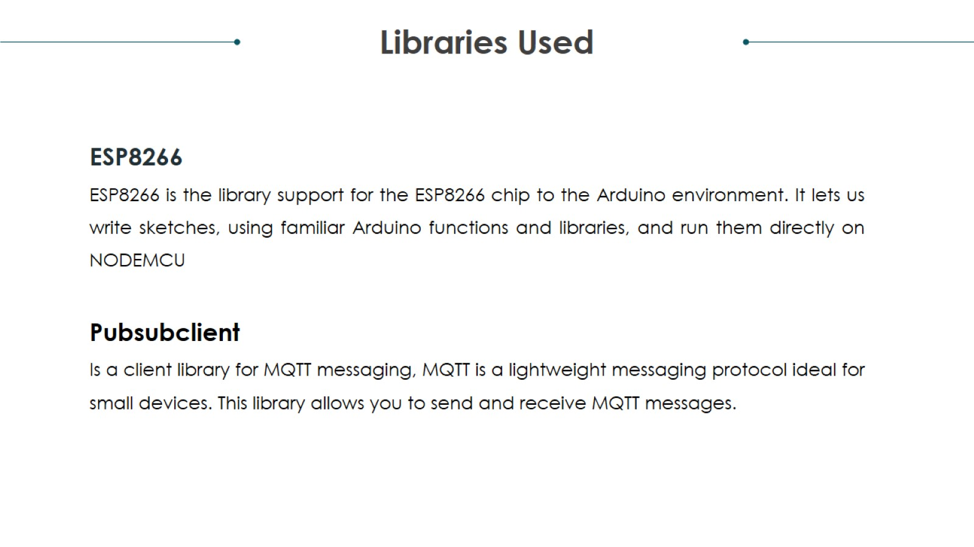
Project analysis slide 2

Slide 10
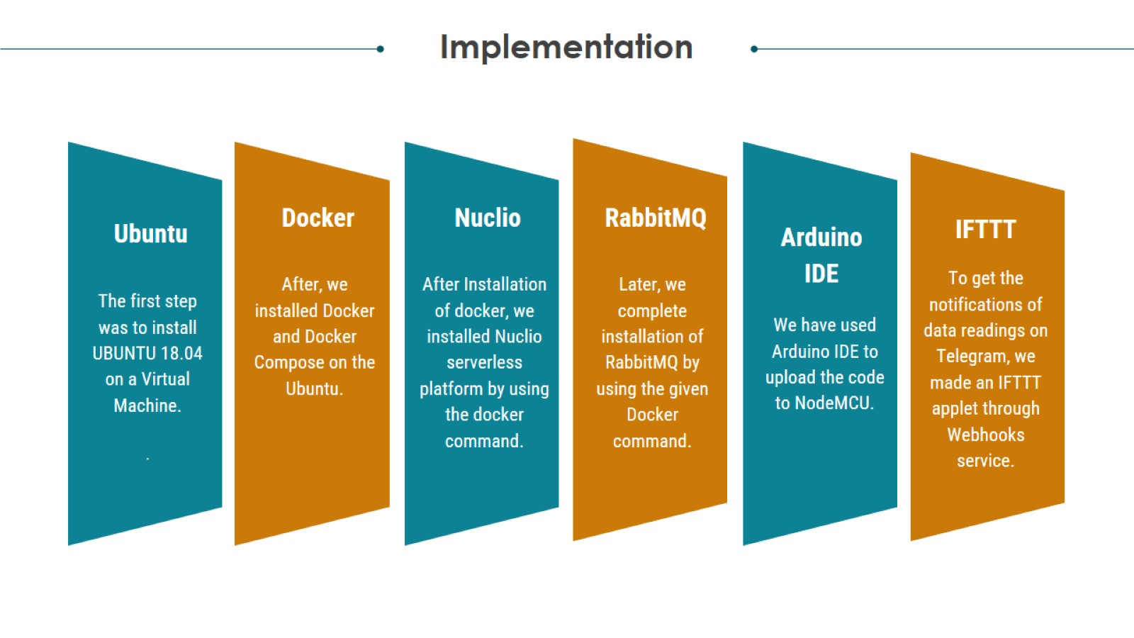
Project analysis slide 3

Slide 11
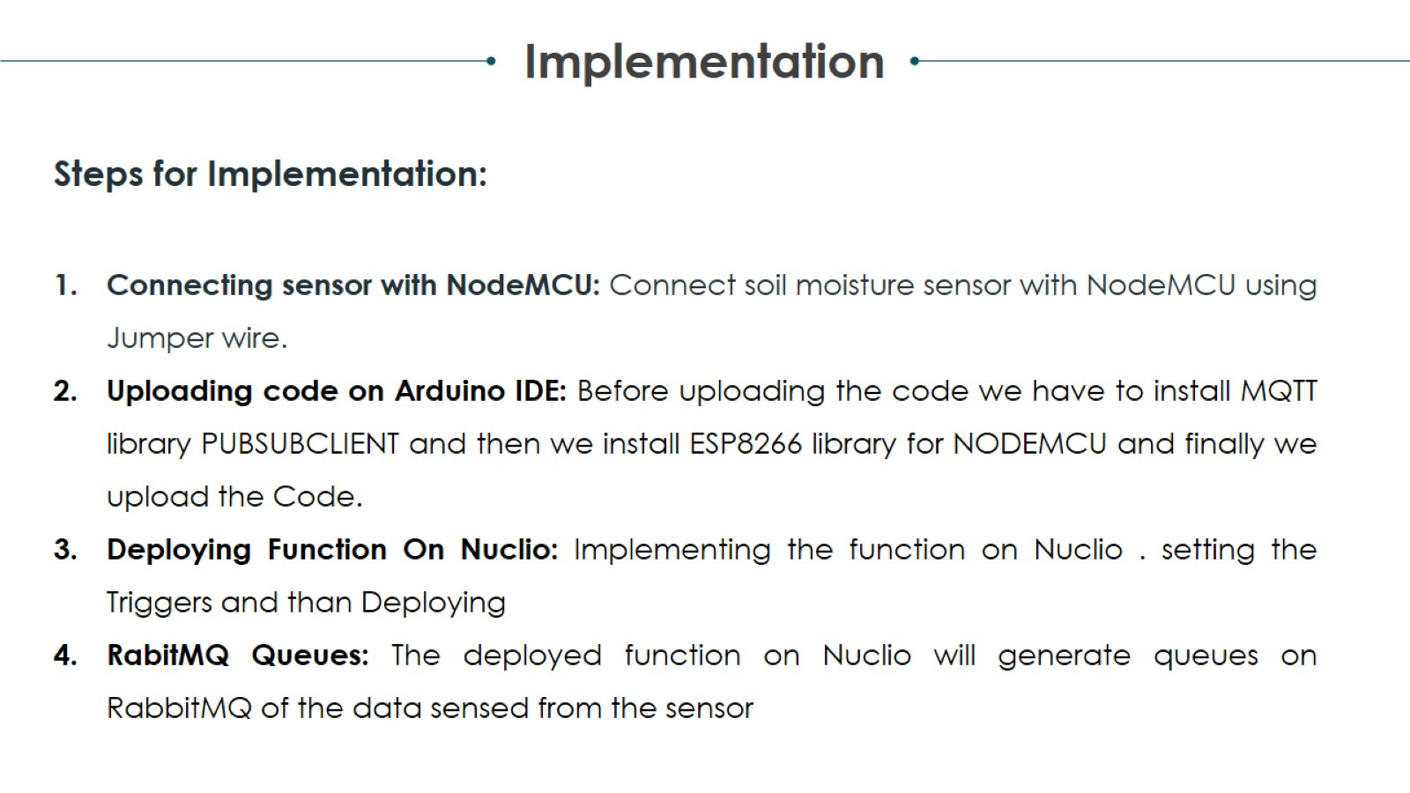
Project analysis slide 2

Slide 12
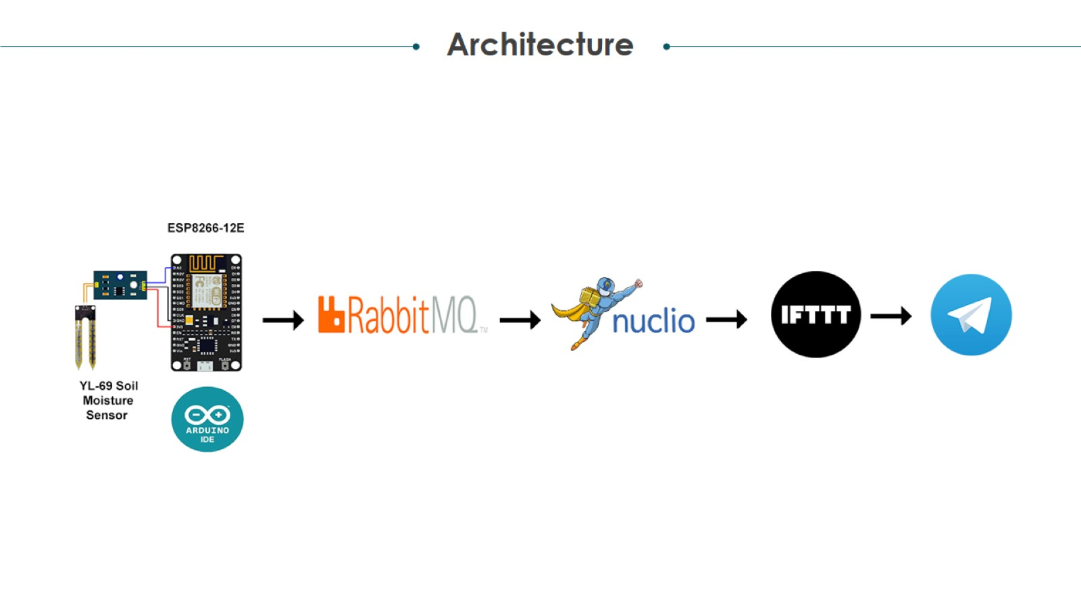
Project analysis slide 3

Slide 13
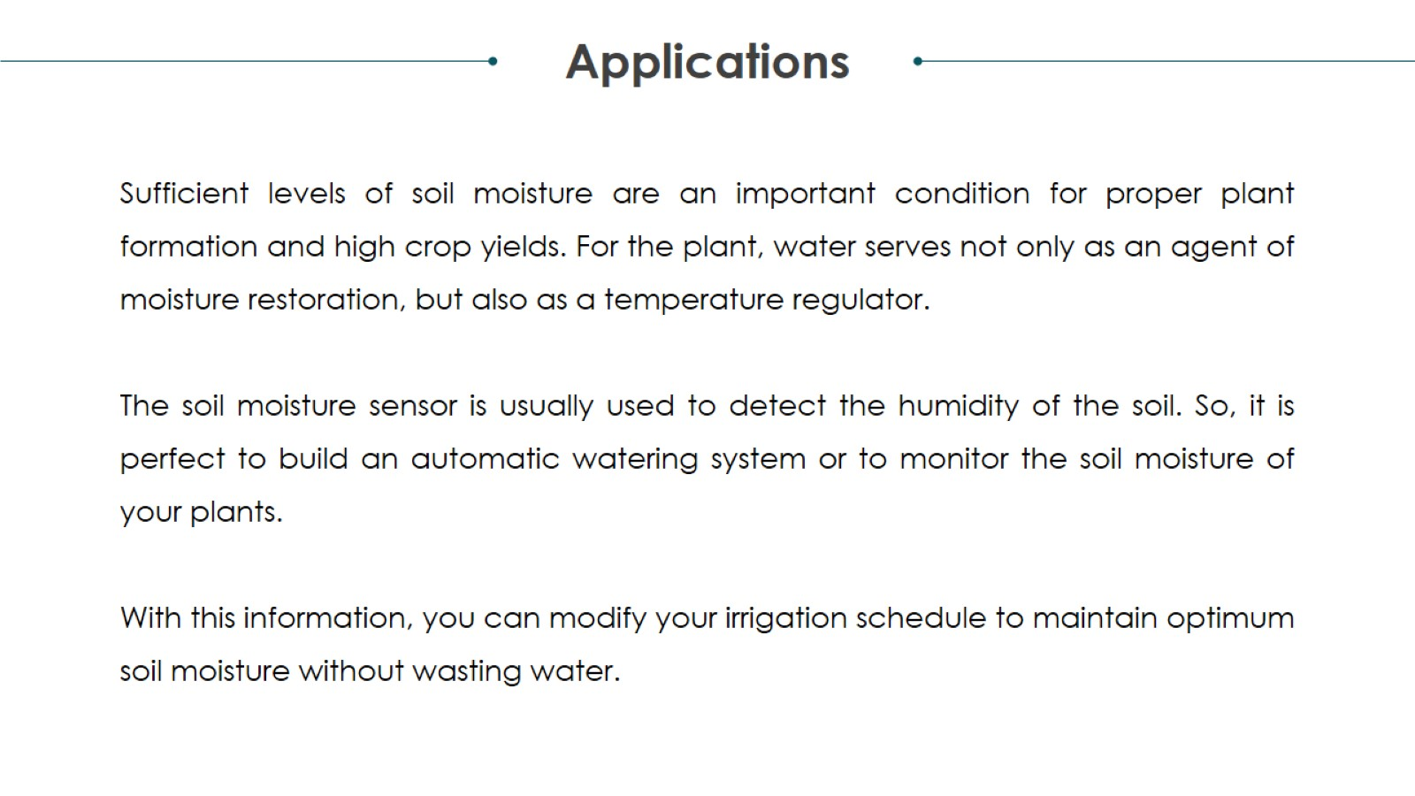
Project analysis slide 2

Slide 14

Thank You

