Slide 1
UVTOSIZE
Quantum Dot Size & Size Distribution Analysis from UV-Vis Absorption Spectra

Slide 2
01
Background & Motivation
Empirical Sizing Formulas
Quantum Dot Size from Optical Spectra
• Semiconductor QDs exhibit size-dependent band gaps
• First exciton peak (1Sₑ–1Sₕ) position → diameter via empirical sizing curves
• Peak width (HWHM) → size distribution σ via error propagation
Challenges Addressed
• Automated QD type detection from filename/spectrum
• Robust baseline subtraction for absorption edges (CdS/CdSe)
• Literature-constrained Gaussian fitting to prevent unphysical results
• Publication-quality figures with colorblind-friendly palettes
• Multi-format export (PNG/PDF/SVG) + Word report generation
PbS (Moreels, ACS Nano 2009)
E₀ = 0.41 + 1/(0.0252·d² + 0.283·d)
Valid: 730–2500 nm | 2.3–10 nm
PbSe (Moreels, Chem. Mater. 2007)
E₀ = 0.278 + 1/(0.016·d² + 0.209·d + 0.45)
Valid: 800–4000 nm | 2–20 nm
CdS (Yu, Chem. Mater. 2003)
D = −6.65×10⁻⁸·λ³ + 1.96×10⁻⁴·λ² − 9.24×10⁻²·λ + 13.29
Valid: 360–500 nm | 1–6 nm
CdSe (Yu, Chem. Mater. 2003)
D = 1.61×10⁻⁹·λ⁴ − 2.66×10⁻⁶·λ³ + 1.62×10⁻³·λ² − 0.428·λ + 41.57
Valid: 510–640 nm | 1.5–8 nm
UVTOSIZE · Quantum Dot Size Analysis Tool
2

Slide 3
02
QD Type Auto-Detection
Three-Tier Detection Strategy
Method 1 — User Prompt
Parse natural language: "PbS量子点", "CdSe analysis"
Method 2 — Filename Keywords
Regex match: pbs/pbse/cds/cdse (case-insensitive)
Examples: "500pbs 20mg ml.txt" → PbS
Method 3 — Spectral Inference
Find most prominent long-λ peak → compare position
against each material's calibrated range
Rank by confidence: high / medium / low
Auto-select if confidence = "high"
Spectral Inference Ranges
Peak Wavelength → Best Match
360–500 nm → CdS (high)
510–640 nm → CdSe (high)
800–2500 nm → PbS (high)
→ PbSe (high)
2500–4000 nm → PbSe (high)
<360 or >4000 nm → Ask user (low)
Confidence = f(peak position, margin from
range boundary, peak prominence)
API: POST /api/uvtosize/autodetect
UVTOSIZE · Quantum Dot Size Analysis Tool
3

Slide 4
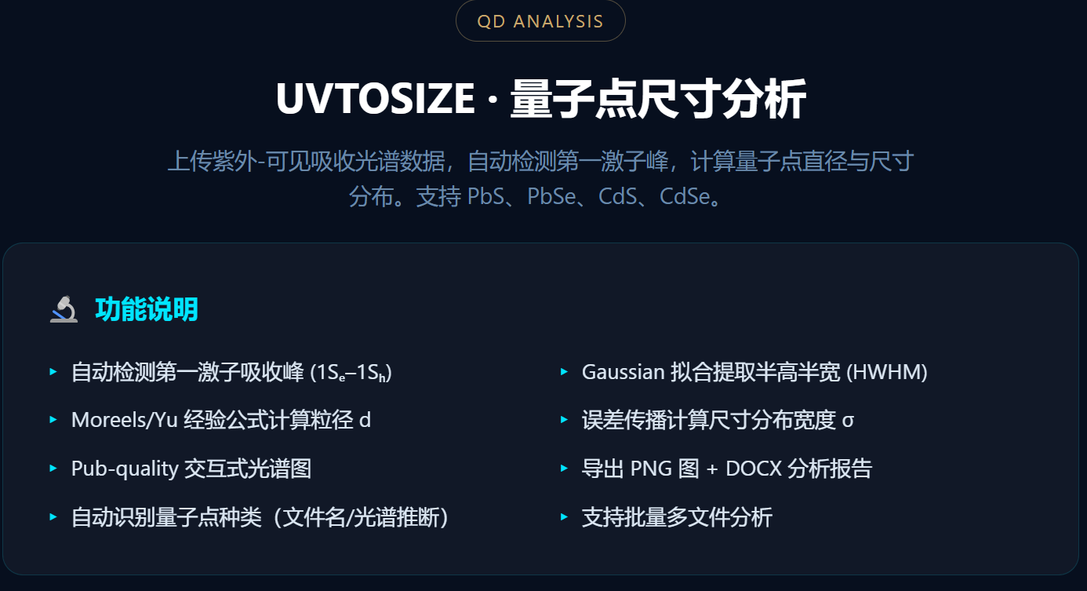
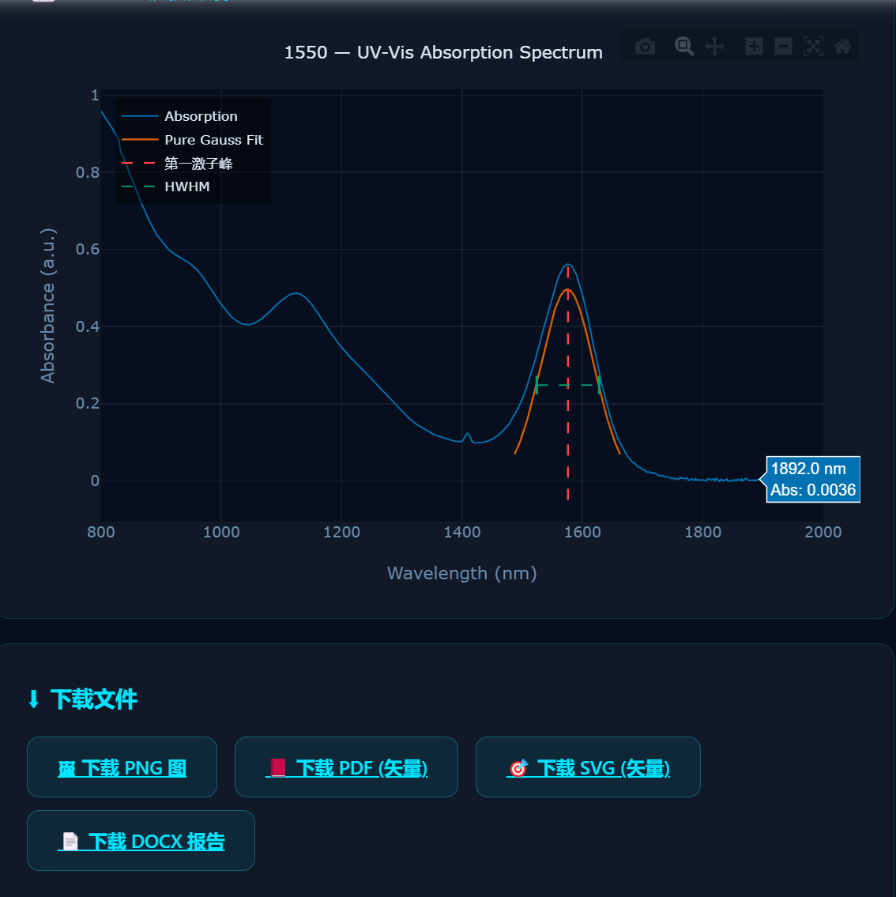
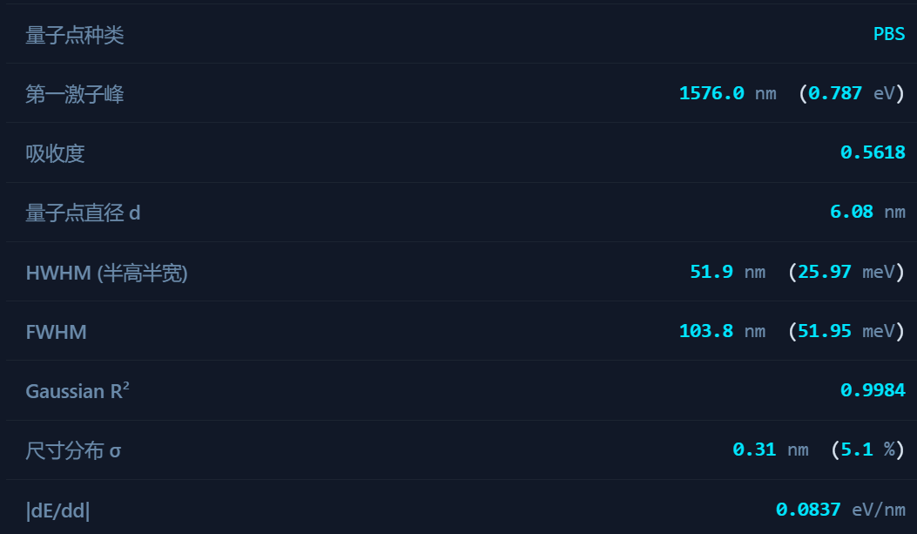
03
UVTOSIZE · Quantum Dot Size Analysis Tool
4

Slide 5
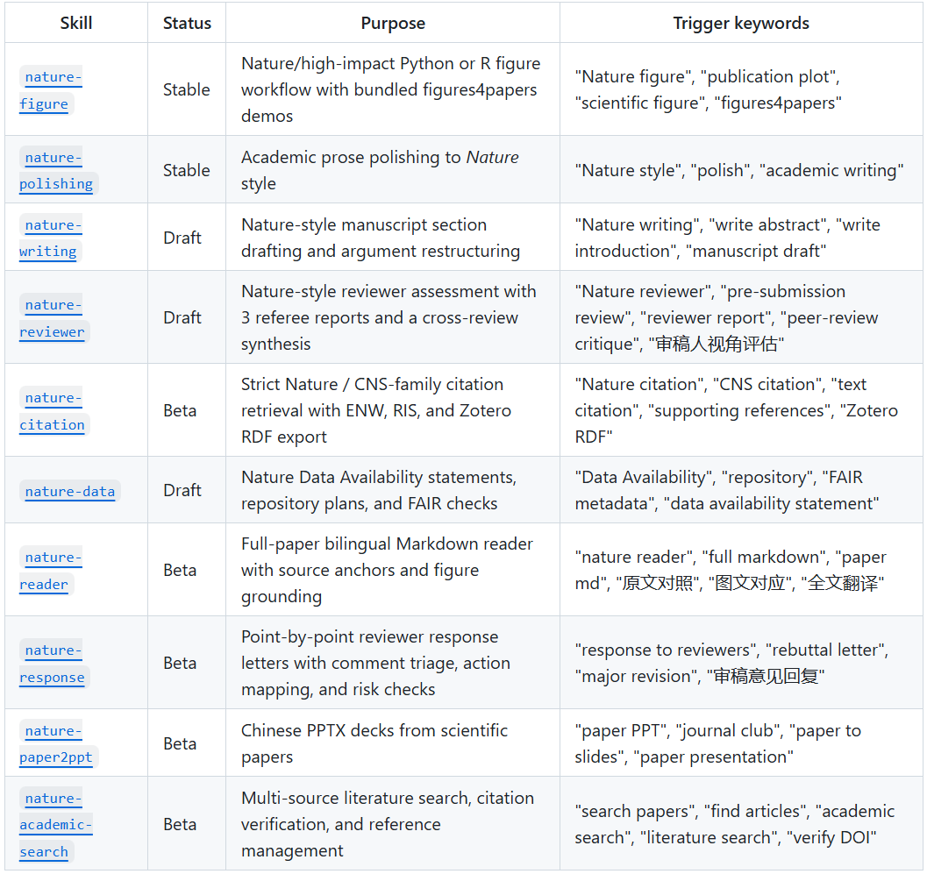
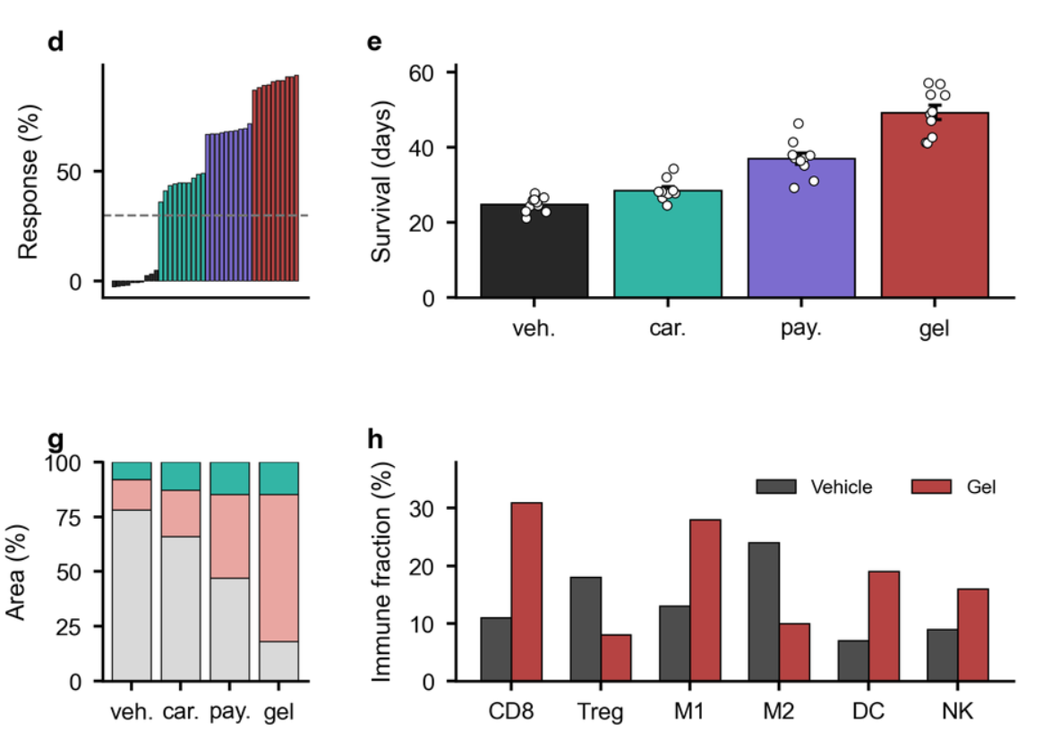
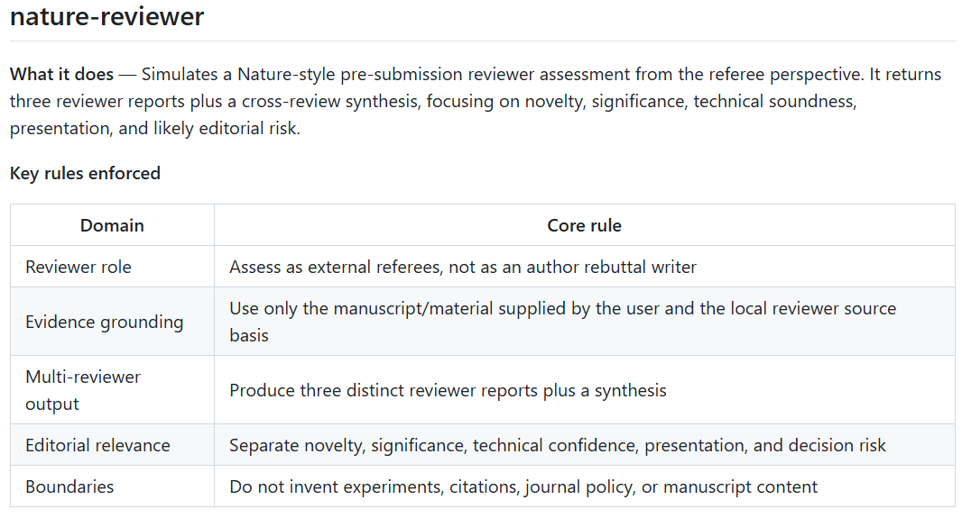
04
Nature-Skills
UVTOSIZE · Quantum Dot Size Analysis Tool
4

