Slide 1
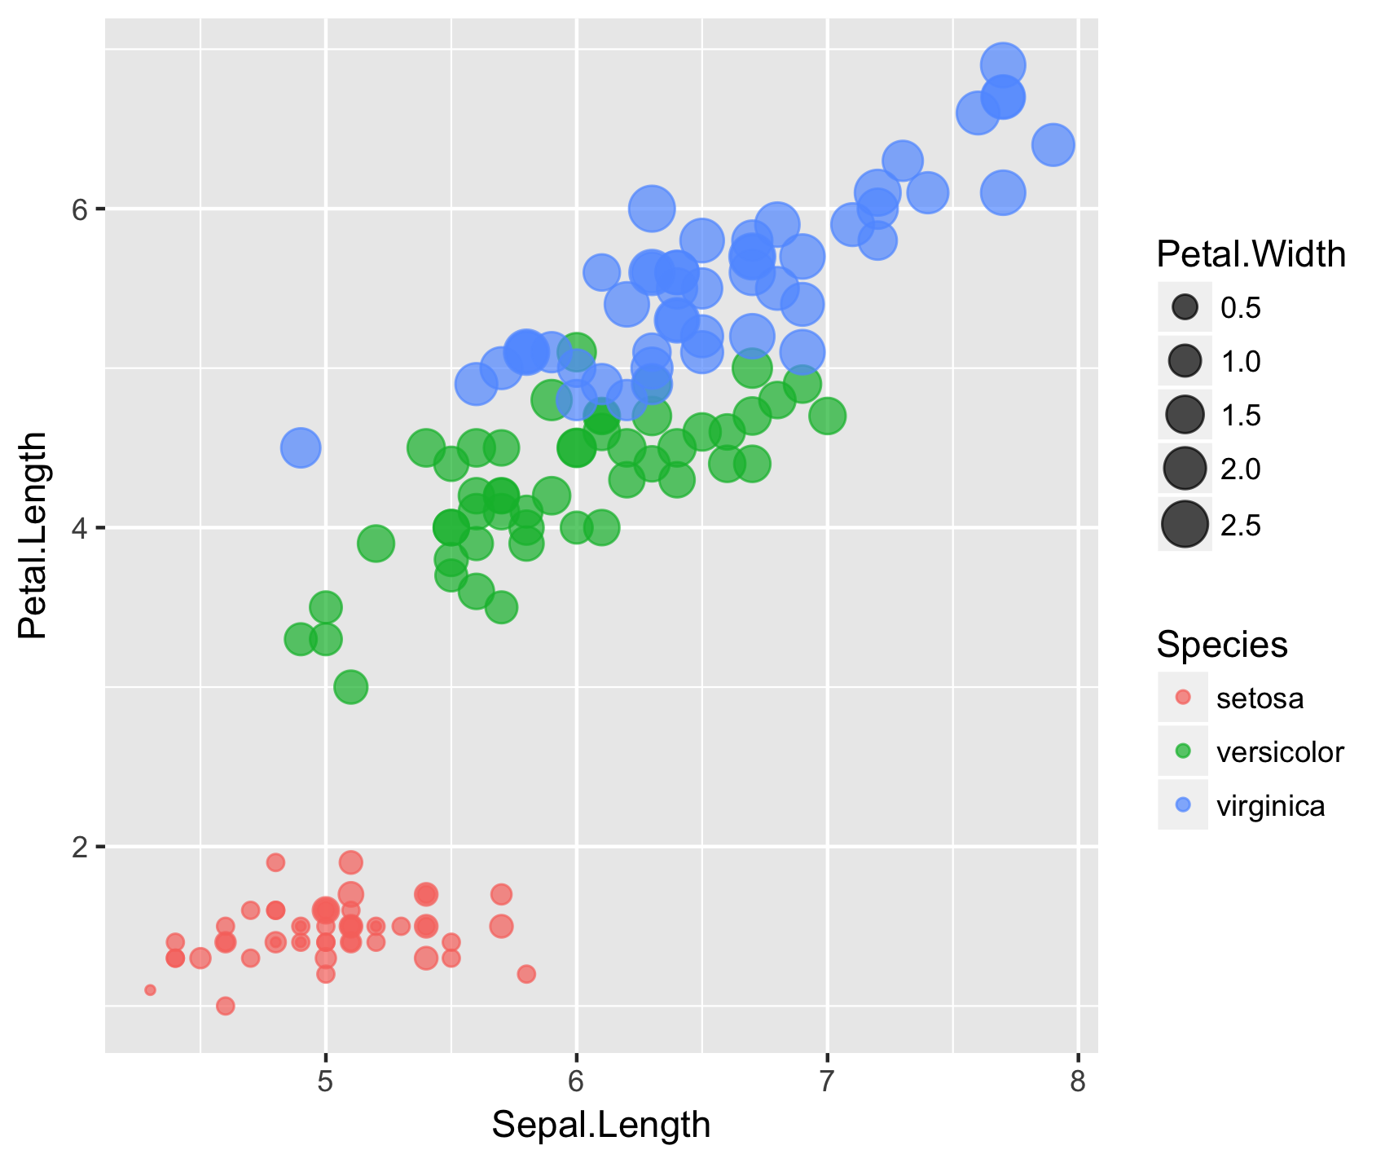
Vector graphics format versus raster format
6
Petal.Width
0.5
1.0
1.5
2.0
4
2.5
Petal.Length
Species
setosa
versicolor
virginica
2
5
6
7
8
Sepal.Length

