Slide 1
DCBA 3D Scanner
Low-Cost, High-Precision, User-Friendly

Slide 2
Vision
Our Vision:
All working in measurement, design, art, and manufacturing will soon take advantage of the accuracy and speed of 3D scanning.
Our Goal:
We will develop high-quality 3D scanners accessible to individuals and businesses on small budgets.

Slide 3
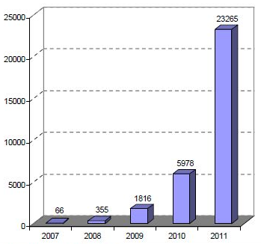
Market
Potential users
Research labs
Hobbyist builders
Artists
Product Designers
Small manufactures
Interest and growth in 3D printing is expanding wildly. 3D scanning is the other part of this revolution
Global personal 3D printer sales
Machines or kits priced between $500 and $4,000
Data from Wohlers Report 2012: Additive Manufacturing and 3D Printing State of the Industry

Slide 4
Relevant Hardware Advances
Optics and Digital Imaging – Notably emergence of high-quality, compact, and cheap cell phone cameras
Computing - High-power computers are practically ubiquitous
Available manufacturing methods – high-precision laser cutting and CNC machining is now easily attainable

Slide 5
Scanning Techniques
Existing methods include
Structured Light
Image Reconstruction
Laser Time of Flight
Laser Triangulation
Computed Tomography
Serial Sectioning
Contact Scanning
Recent interest in 3D scanning has spurred academic research advances, particularly in structured light and image reconstruction

Slide 6
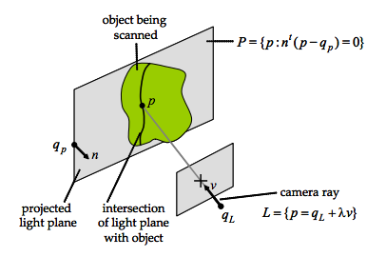
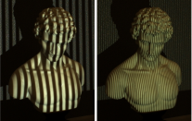
Structured Light Scanning
Known light pattern is projected onto scene
Scene is imaged using one or more cameras
Point cloud calculated by triangulation
Images from Douglas Lanman and Gabriel Taubin's SIGGRAPH 2009 Course Notes accessed on 3/4/2013 at
http://mesh.brown.edu/byo3d/notes.html

Slide 7
Product Goals
Accurate
0.025 mm accuracy
This level of precision comparable to or better than most manufacturing processes
Low-cost – less than $500
Usable
intuitive website and software UI
computer-controlled calibration
Modular
easily alter the workspace
Enables scanning a single face of large objects, all faces of a small object, or an entire room with one system
Allows easy upgrading, maintenance, and expansion
Compact – fits on top of a desk

Slide 8


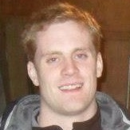

Our Team
Troy Astorino
Year: 2013
Major: Physics/AeroAstro
Job: Team Lead/Programming
Gus Downs
Year: 2013
Major: Physics
Job: Mechanical & Electrical Engineering
Craig Cheney
Year: 2014
Major: Mech. Eng.
Job: Mechanical Engineering
Turner Bohlen
Year: 2014
Major: Physics
Job: Programming

Slide 9
Our Current State
Ideas we want to explore:
Fixed and moving gratings over LEDs instead of projectors
Redundant arrays of cheap CMOS cameras
Merging multiple scanning techniques
[CAD model here]

Slide 10
Next Steps
Prototype Prototype Prototype!
Explore algorithmic methods for combining multiple scanning methods and reducing error
Forward-facing software development to allow for various input devices (allows rapid modification during prototyping and future additions)

