Slide 1
DCBA 3D Scanner
Low-Cost, High-Precision, User-Friendly

Slide 2
Problem
Physical measurement techniques are time consuming and provide incomplete information about the object of interest
Existing 3D scanners are inaccessible to ___

Slide 3
Vision
Our Goal:
We will develop an affordable, accurate, and easy-to-use 3D scanner for individuals and small businesses in measurement, design, art and manufacturing.
Our Vision:
To make 3D scanners as ubiquitous as power tools: a standard piece of equipment in every shop, studio, and lab

Slide 4
Applications

Slide 5
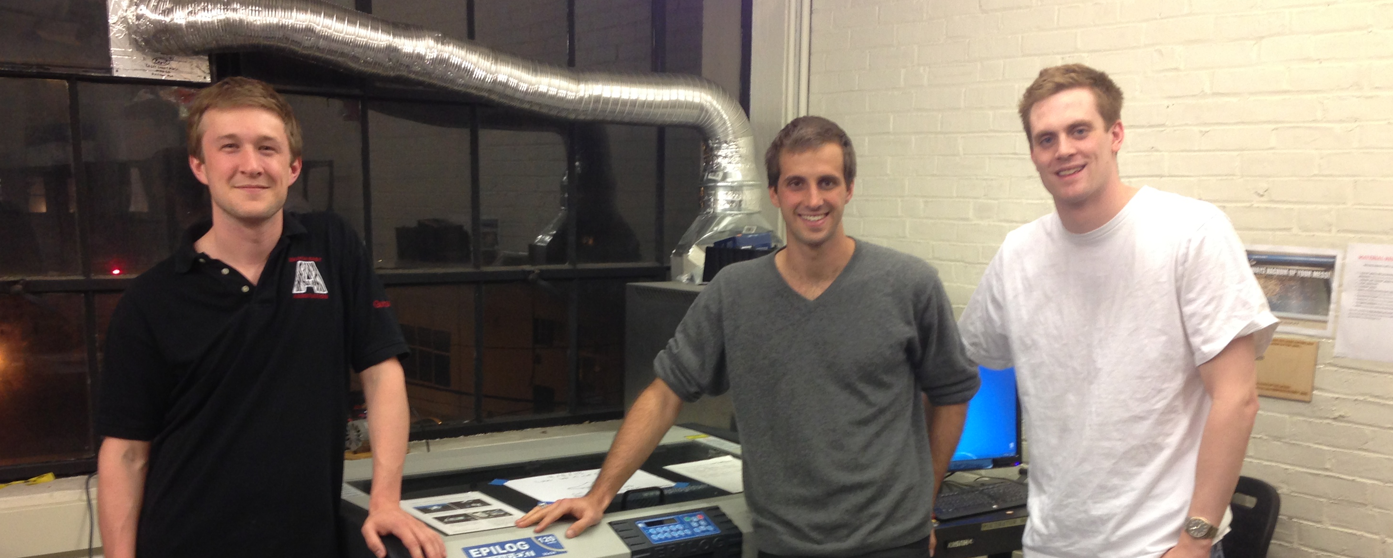
Team + Skill set
Troy Astorino: Programming and robotic systems
Craig Cheney: Mechanical engineering and embedded systems
Gus Downs: Optics and signal processing

Slide 6
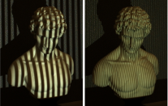
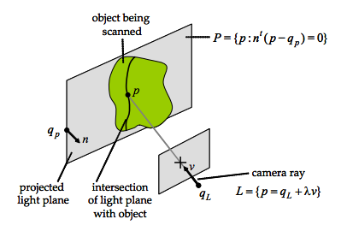
Technical approach
Structured light scanning
Inexpensive hardware
Plug-and-play software
Images from Douglas Lanman and Gabriel Taubin's SIGGRAPH 2009 Course Notes accessed on 3/4/2013 at http://mesh.brown.edu/byo3d/notes.html

Slide 7
Market
Existing $350 million 3D scanning market targets large businesses – similar accuracy and lower price exposes a much larger market
Potential users
Research labs
Hobbyist builders
Artists
Product Designers
Small manufactures
Interest in and use of 3D printing is growing wildly. 3D scanning is the second half of this revolution
Data from Wohlers Report 2012: Additive Manufacturing and 3D Printing State of the Industry

Slide 8
Structured Light Scanning
Known light pattern is projected onto scene
Scene is imaged using one or more cameras
Point cloud calculated by triangulation
Images from Douglas Lanman and Gabriel Taubin's SIGGRAPH 2009 Course Notes accessed on 3/4/2013 at
http://mesh.brown.edu/byo3d/notes.html

Slide 9
Product Goals
Accurate
0.025 mm accuracy
This level of precision comparable to or better than most manufacturing processes
Low-cost – less than $500
Usable
Intuitive website and software UI
Computer-controlled calibration
Compact – fits on top of a desk

Slide 10


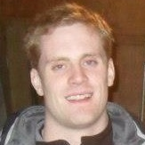
Our Team
Troy Astorino
Year: 2013
Major: Physics/AeroAstro
Job: Team Lead/Programming
Gus Downs
Year: 2013
Major: Physics, Math
Job: Projection System
Craig Cheney
Year: 2014
Major: Mech. Eng. & EECS
Job: Vision/Embedded System

Slide 11
Our Current State
Working towards completing a scan using a DLP Projector
Confident an array of cheap pinhole CMOS cameras can provide desired cost and accuracy
DLP Projector is cost driver – low-cost alternatives to DLP Projection include:
Fixed and moving gratings over collimated light
Optical interference fringes

Slide 12
Next Steps
Prototype Prototype Prototype!
Validate viability of low-cost projection alternatives
Explore algorithmic methods for combining multiple scanning methods and reducing error

