Slide 1
Introduction to
Artificial Intelligence
Lecture 6: Local Search

Slide 2
Outline
Optimization Problems
Hill-climbing Search
Simulated Annealing Search
Local Beam Search
Genetic Algorithm

Slide 3
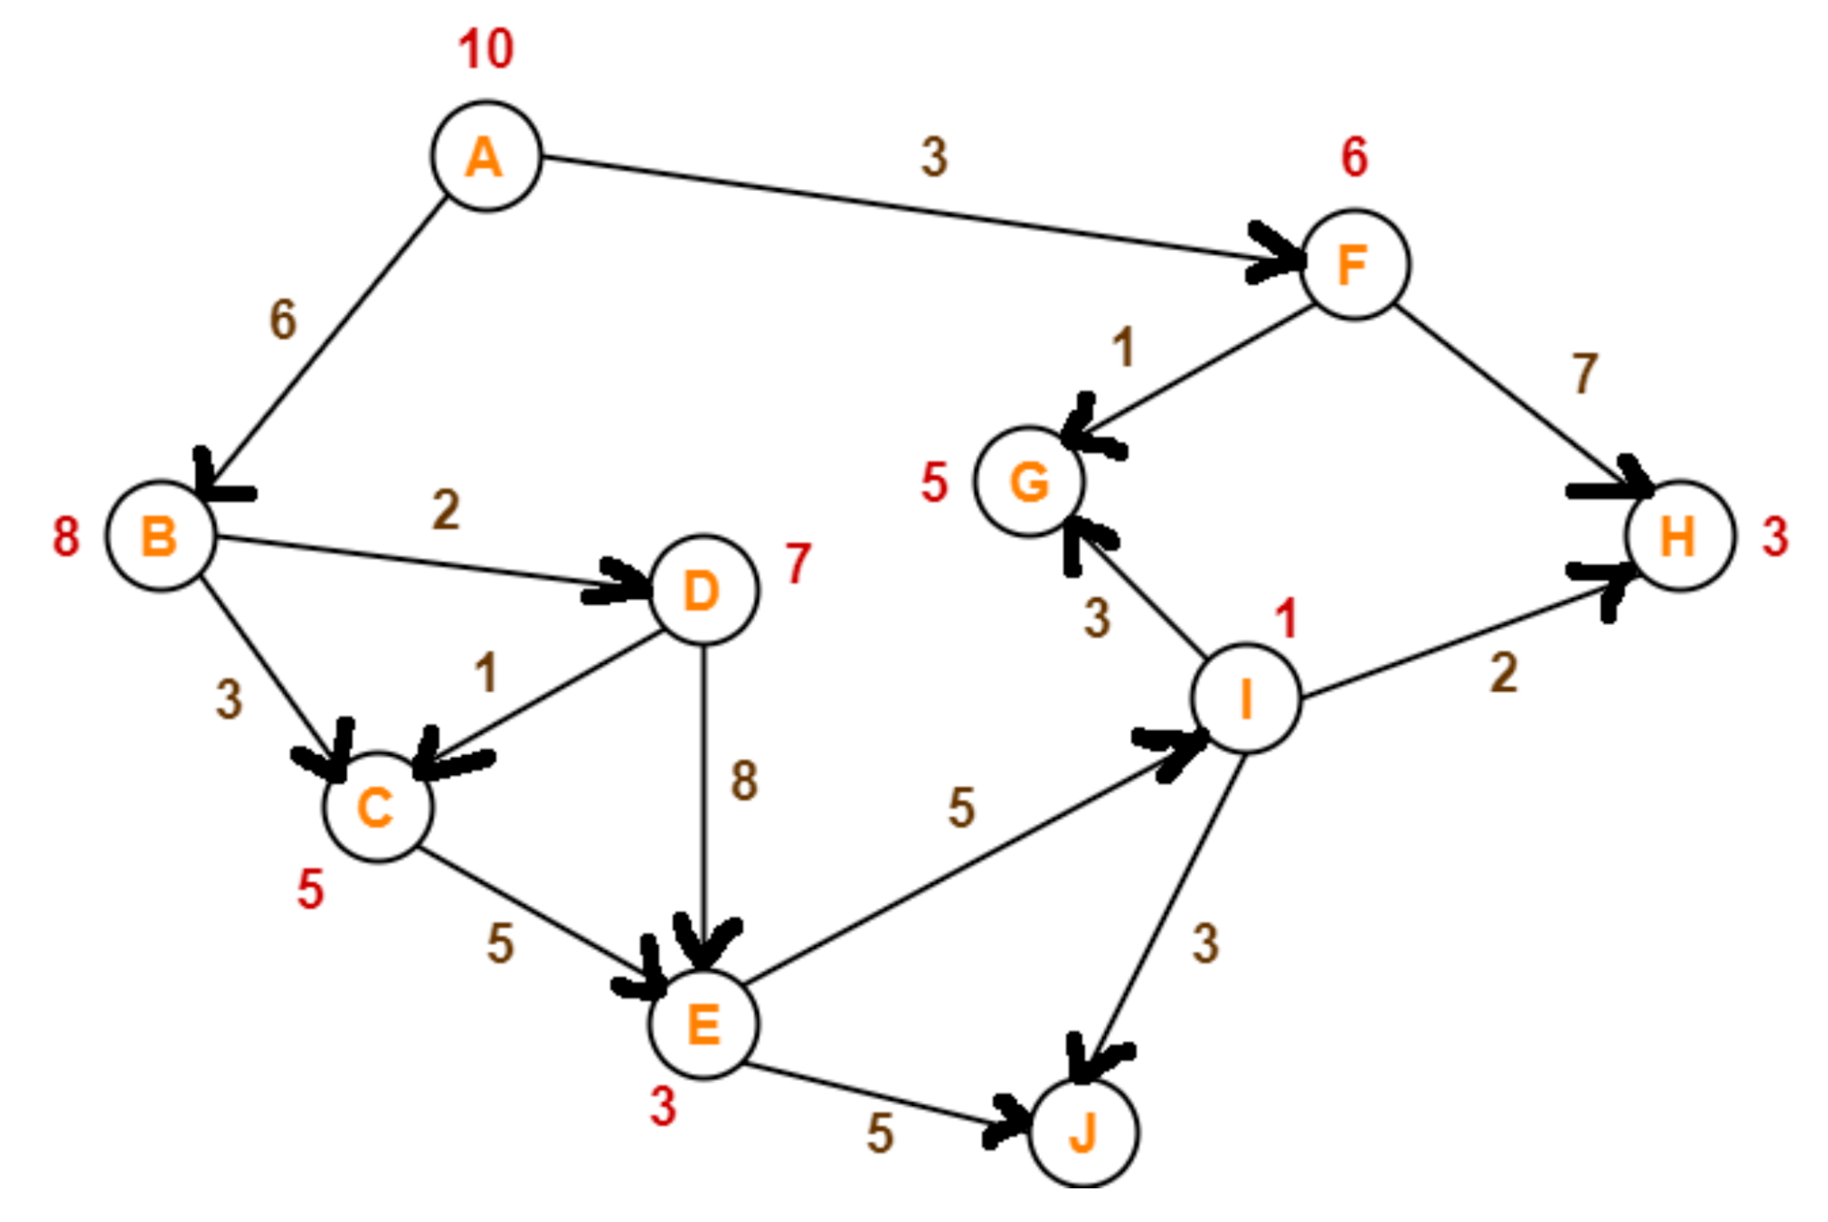
Example

Slide 4
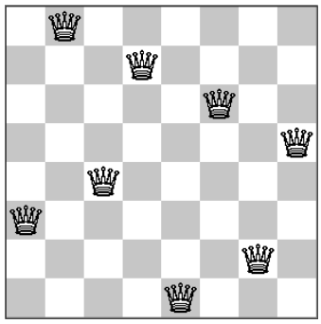
Global search algorithms
Global search: explore search spaces systematically
  Keep one or more paths in memory and record which alternatives have been explored at each point along the path
Many problems do not fit the “standard” search model
  The final configuration matters, not the order in which it is formed.
  No “goal test” and no “path cost”

Slide 5
Optimization problems
The optimization problems find the best state according to an objective function
  E.g., the Knight’s tour, TSP, scheduling, integrated-circuit design, factory-floor layout, automatic programming, vehicle routing, etc.

Slide 6
Local search algorithms
Operate using a single current node and generally move only to neighbors of that node
Not systematic: the paths followed by the search are typically not retained.
Use very little memory: usually a constant amount
Often able to find reasonable solutions in large or infinite (continuous) state spaces.

Slide 7
Local search and Optimization
“Pure optimization” problems
  All states have an objective function
  Goal is to find state with max (or min) objective value
Local search can do quite well on these problems.

Slide 8
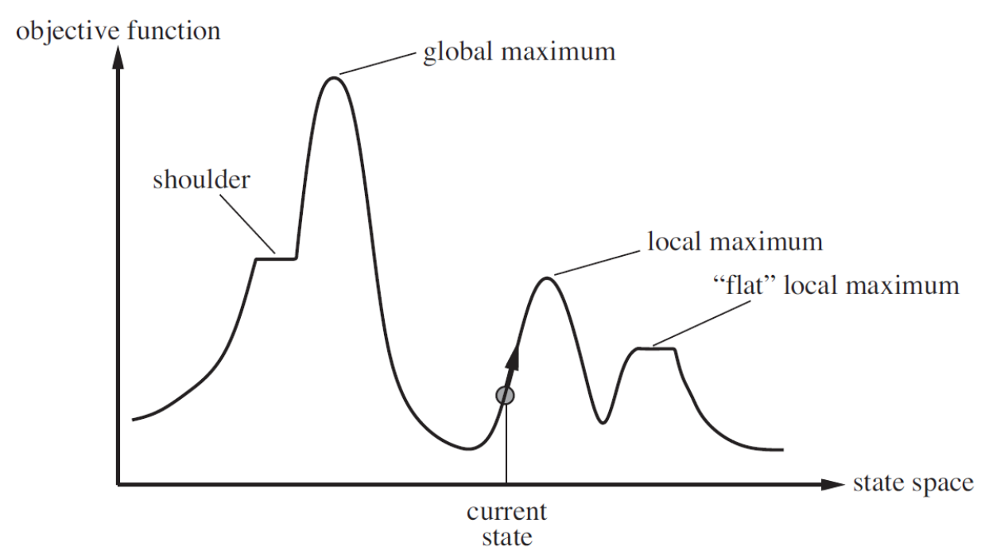
State-space landscape
A landscape has both “location” and “elevation”: location state, elevation heuristic cost or objective function
A complete local search algorithm finds a goal if one exists.
An optimal local search algorithm finds a global extremum

Slide 9
Hill-climbing Search
A loop that continually moves in the direction of increasing value and terminates when it reaches a “peak”.
Not look ahead beyond the immediate neighbors of the current state.
No search tree maintained, only the state and the objective function’s value for the current node recorded.
function HILL-CLIMBING(problem) returns a local maximum
current ← MAKE-NODE(problem.INITIAL-STATE)
loop do
neighbor ← a highest-valued successor of current
if neighbor.VALUE ≤ current.VALUE then return current.STATE current ← neighbor

Slide 10
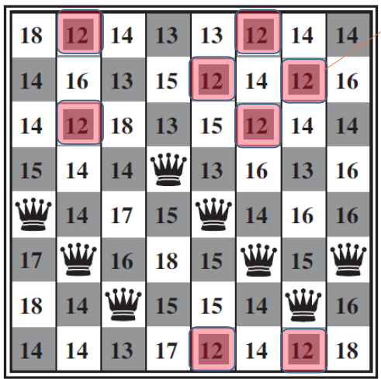
Hill-climbing: 8-queens problem
Complete-state formulation
  All 8 queens on the board, one per column
Successor function
  Move a single queen to another square in the same column
  8×7=56 successors
Heuristic cost function h(𝑛)
  The number of pairs of queens that are ATTACKING each other, either directly or indirectly
  Global minimum has h(𝑛) = 0

Slide 11
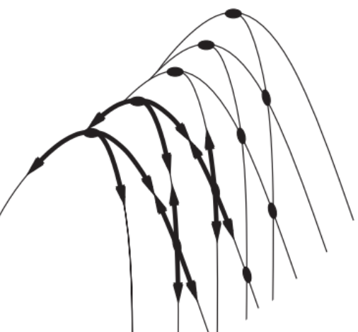
Hill-climbing Search
Hill climbing is often suboptimal, due to local maxima, ridges, and plateau

Slide 12
Hill-climbing Search Variants
Stochastic hill climbing:
  choose at random from among the uphill moves with a probability of selection varied with the moves’ steepness
First-choice hill climbing:
  generate successors randomly until one is generated that is better than the current state
Random-restart hill climbing:
  A series of hill-climbing searches from randomly generated initial states until a goal is found

Slide 13
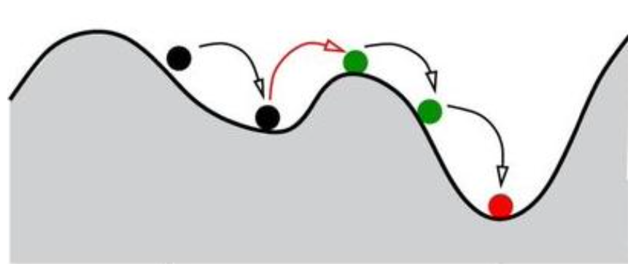
Simulated Annealing
Combine hill climbing with a random walk in some way that yields both efficiency and completeness
Shake hard (i.e., at a high temperature) and then gradually reduce the intensity of shaking (i.e., lower the temperature)

Slide 14
Simulated Annealing
function SIMULATED-ANNEALING(problem, schedule)
returns a solution state
inputs: problem, a problem
schedule, a mapping from time to “temperature”
current ← MAKE-NODE(problem.INITIAL-STATE)
for t = 1 to ∞ do
T ← schedule(t)
if T = 0 then return current
next ← a randomly selected successor of current
ΔE ← next.VALUE – current.VALUE
if ΔE > 0 then current ← next
else current ← next only with probability e^{ΔE/T}

Slide 15
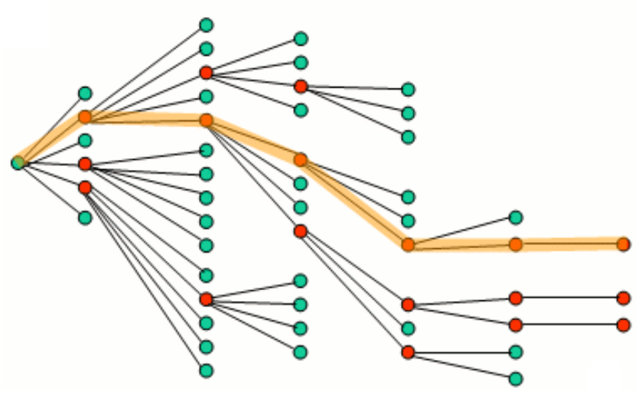
Local Beam Search
Keep track of 𝑘 states rather than just one
Begin with 𝑘 randomly generated states
At each step, all successors of all 𝑘 states are generated
If the goal is not found, select the 𝑘 best successors from the complete list and repeat

Slide 16
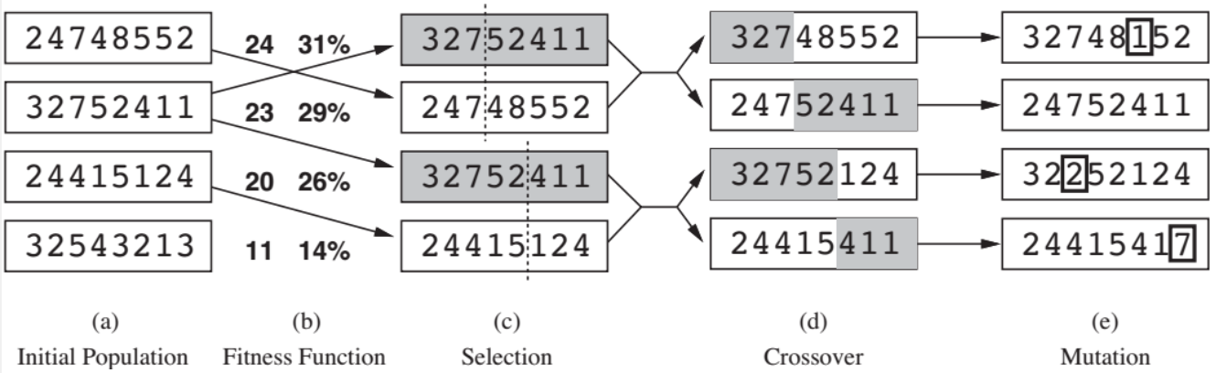
Genetic Algorithms
A variant of stochastic beam search
Successor states are generated by combining two parent states rather than by modifying a single state
The reproduction are sexual rather than asexual

Slide 17
Genetic Algorithms
Population: a set of 𝑘 randomly generated states that GA begins with
Fitness function: an objective function that rates each state
  Higher values for better state
  E.g., 8-queens: the number of non-attacking pairs of queens (min = 0, max = 8×7/2 = 28)
Produce the next generation by “simulated evolution”
  Random selection
  Crossover
  Random mutation
Each state, or individual, is represented as a string over a finite alphabet – most commonly, a string of 0s and 1s.

Slide 18
Genetic Algorithms
Pairs are selected at random for reproduction.
The probability of being chosen for reproducing is directly proportional to the fitness score.
One individual may be selected several times or not at all.

Slide 19
Genetic Algorithms
function GENETIC-ALGORITHM(population, FITNESS-FN)
returns an individual
inputs: population, a set of individuals
FITNESS-FN, a function that measures the fitness of an individual
repeat
new_population ← empty set
for i = 1 to SIZE(population) do
x ← RANDOM-SELECTION(population, FITNESS-FN)
y ← RANDOM-SELECTION(population, FITNESS-FN)
child ← REPRODUCE(x , y)
if (small random probability) then child ← MUTATE(child)
add child to new_population
population ← new_population
until some individual is fit enough, or enough time has elapsed
return the best individual in population, according to FITNESS-FN

Slide 20
Genetic Algorithms
function REPRODUCE(x , y)
returns an individual
inputs: x , y, parent individuals
n ← LENGTH(x)
c ← random number from 1 to n
return APPEND(SUBSTRING(x , 1, c), SUBSTRING(y, c + 1, n))

Slide 21
Homework
Conduct homework in the given notebook.

Slide 22
References
Stuart Russell and Peter Norvig. 2009. Artificial Intelligence: A Modern Approach (3rd ed.). Prentice Hall Press, Upper Saddle River, NJ, USA.
Lê Hoài Bắc, Tô Hoài Việt. 2014. Giáo trình Cơ sở Trí tuệ nhân tạo. Khoa Công nghệ Thông tin. Trường ĐH Khoa học Tự nhiên, ĐHQG-HCM.
Nguyễn Ngọc Thảo, Nguyễn Hải Minh. 2020. Bài giảng Cơ sở Trí tuệ Nhân tạo. Khoa Công nghệ Thông tin. Trường ĐH Khoa học Tự nhiên, ĐHQG-HCM.

