Slide 1
Introduction to
Artificial Intelligence
Lecture 12: Basic Machine Learning

Slide 2
Outline
Introduction to Machine Learning
ID3 Decision Tree Learning
Naïve Bayesian Learning

Slide 3
Machine Learning
Machine learning involves adaptive mechanisms that enable computers to learn from experience, learn by example, and learn by analogy.

Slide 4
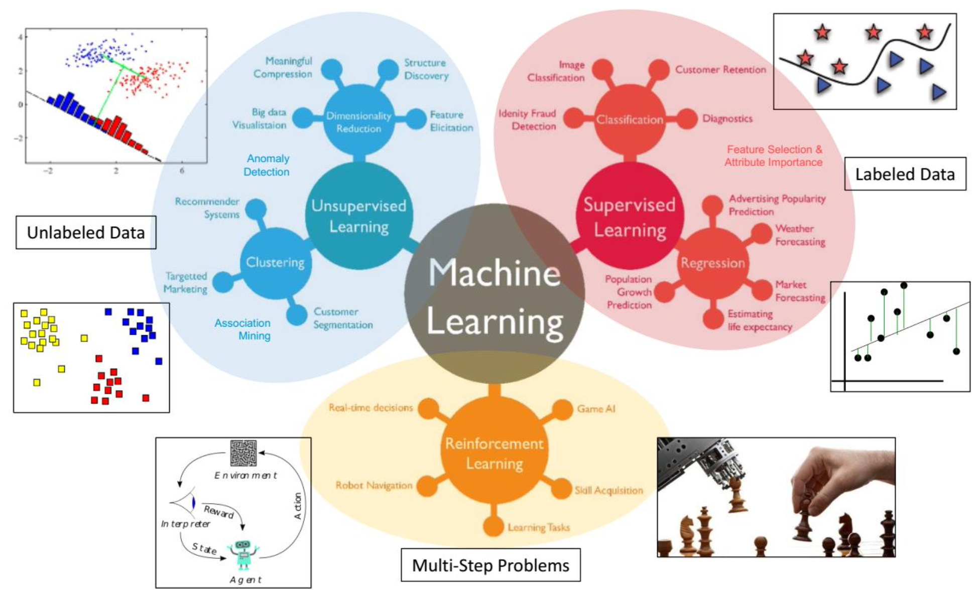
Machine Learning

Slide 5
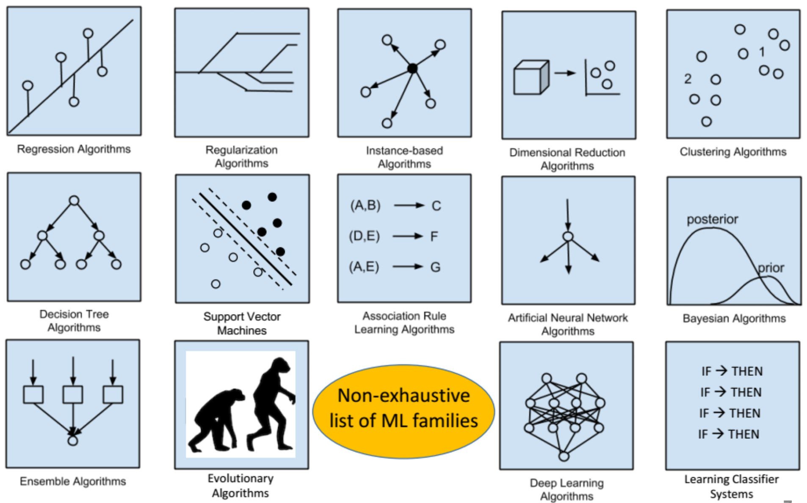
Machine Learning

Slide 6
Supervised learning
Learn a function that maps an input to an output based on example input-output pairs.
Example,
  Spam detection: Decide which emails are spam and which are important
  Object detection and recognition: Localize and identify instances of semantic objects of a certain class (e.g., humans, buildings, or cars) in digital images and videos.

Slide 7
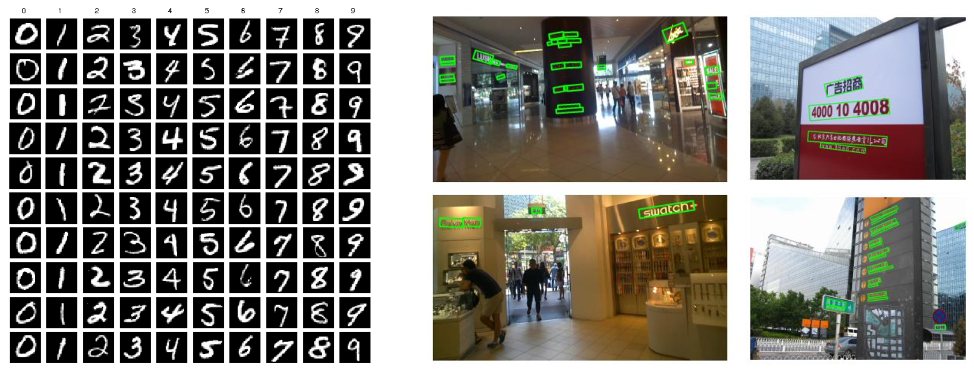
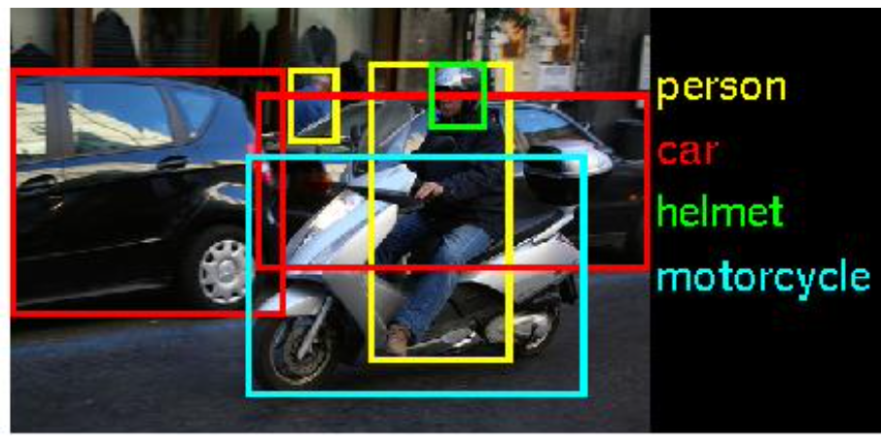
Supervised learning

Slide 8
Classification vs. Regression
Classification
  Train a model to predict a categorical dependent variable
  Case studies: predicting disease, classifying images, predicting customer churn, buy or won’t buy, etc.
  Binary classification vs. Multiclass classification vs. Multilabel classification
Regression
  Train a model to predict a continuous dependent variable
  Case studies: predicting height of children, predicting sales, forecasting stock prices, etc.

Slide 9
Unsupervised learning
Infer a function to describe hidden structure from "unlabeled" data.
Example,
  Social network analysis: cluster users of social networks by interest (community detection)

Slide 10
Semi-supervised learning
The model is initially trained with a small amount of labeled data and a large amount of unlabeled data.

Slide 11
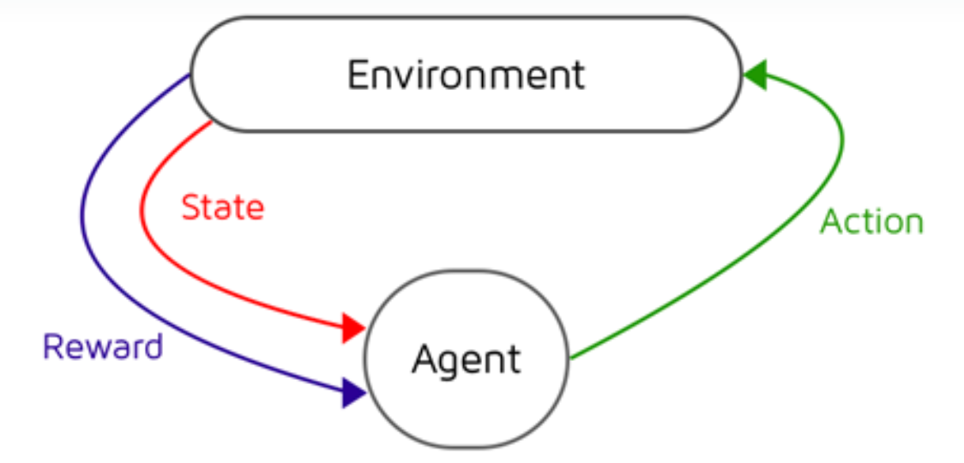
Reinforcement learning
The agent learns from the environment by interacting with it and receives rewards for performing actions.

Slide 12
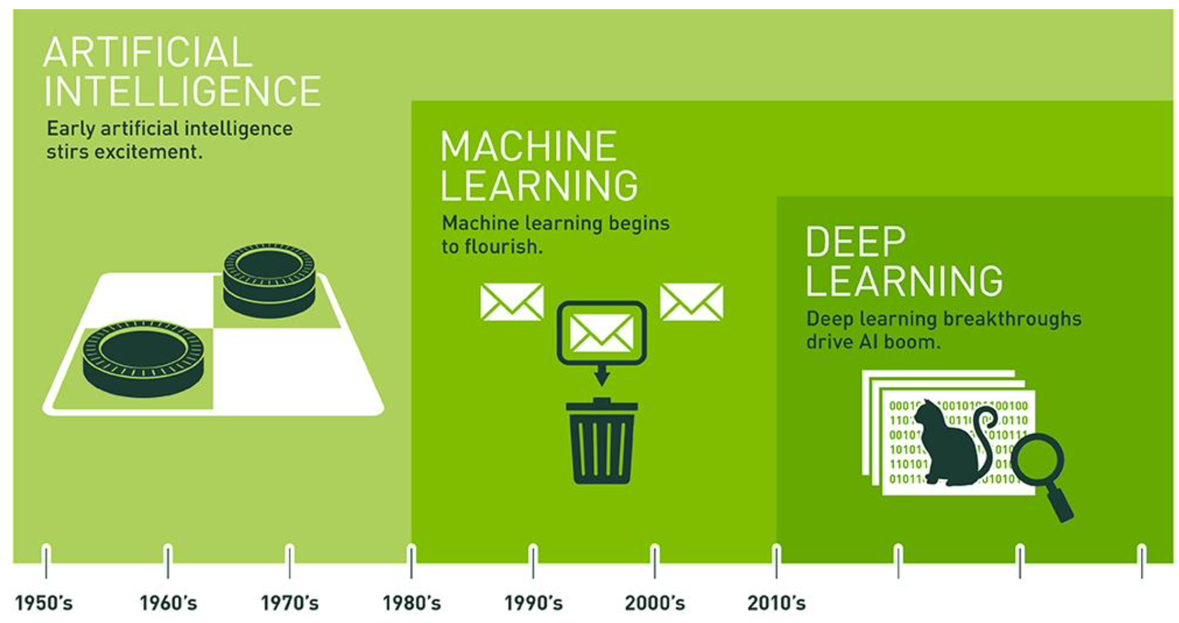
Machine Learning

Slide 13
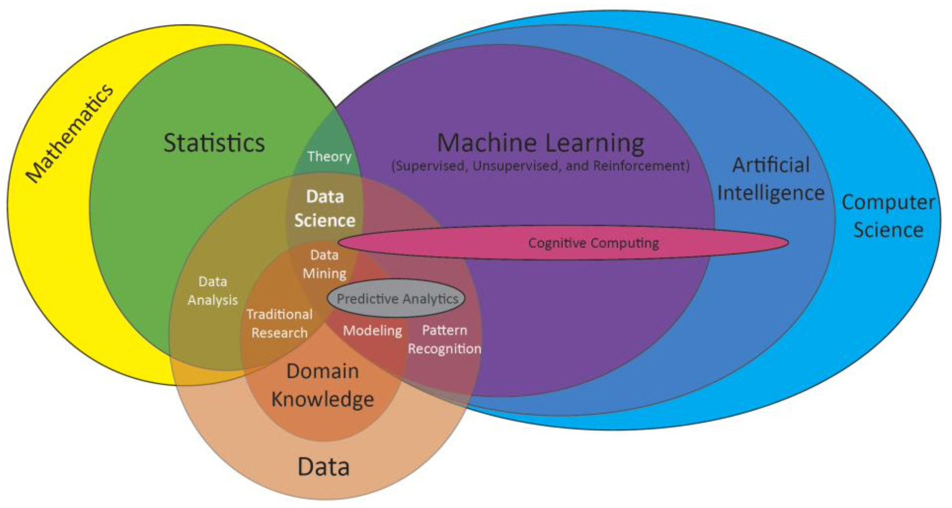
Machine Learning

Slide 14
ID3 Decision Tree Learning
The decision is based on the following attributes
Alternate: is there an alternative restaurant nearby?
Bar: is there a comfortable bar area to wait in?
Fri/Sat: is today Friday or Saturday?
Hungry: are we hungry?
Patrons: number of people in the restaurant (None, Some, Full)
Price: price range ($, $$, $$$)
Raining: is it raining outside?
Reservation: have we made a reservation?
Type: kind of restaurant (French, Italian, Thai, Burger)
WaitEstimate: estimated waiting time (0-10, 10-30, 30-60, >60)

Slide 15
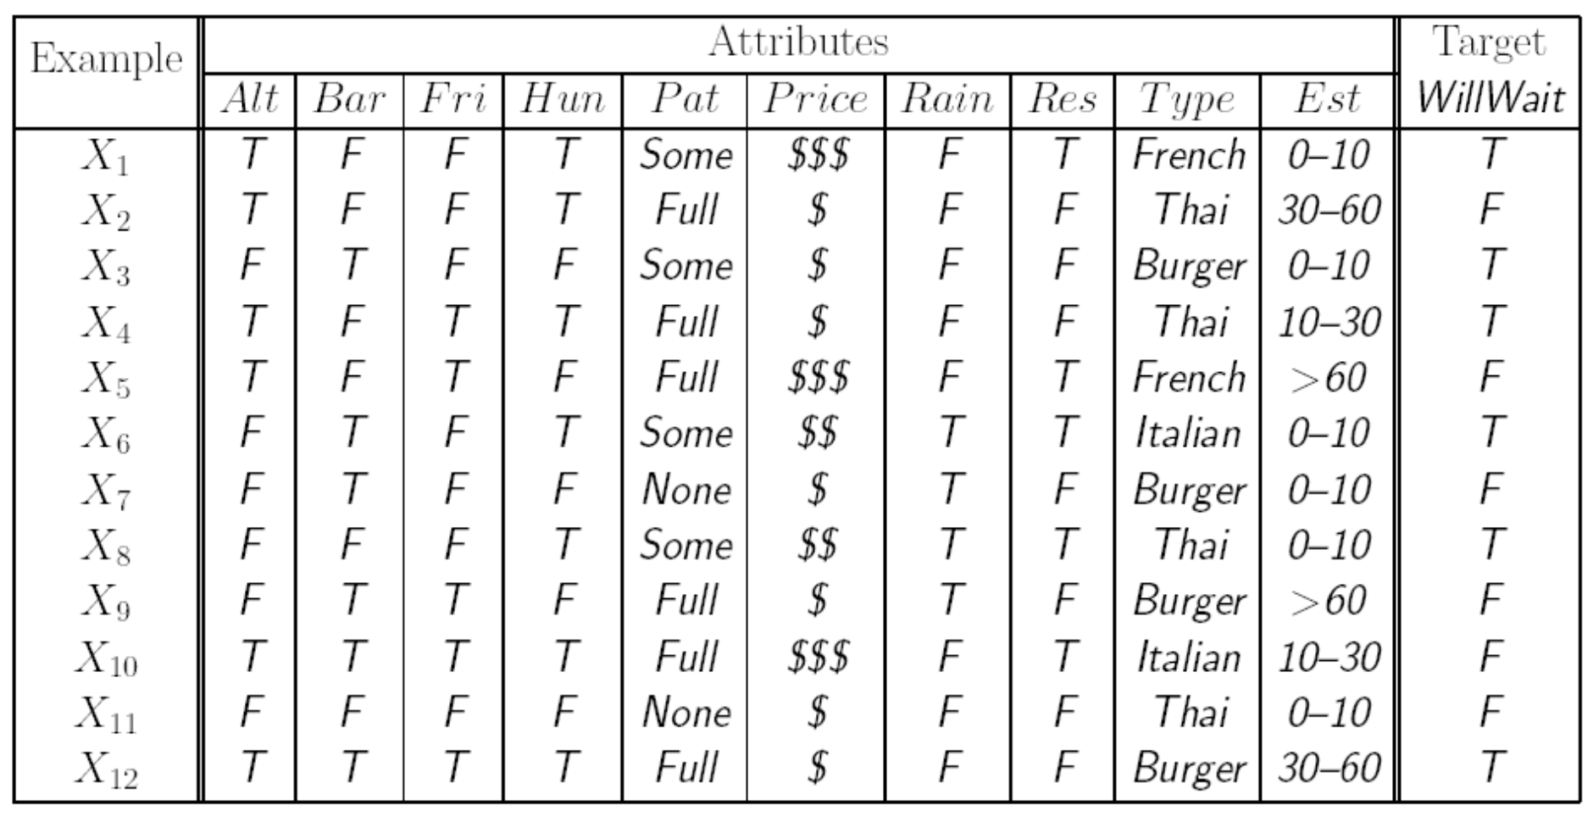
ID3 Decision Tree Learning

Slide 16
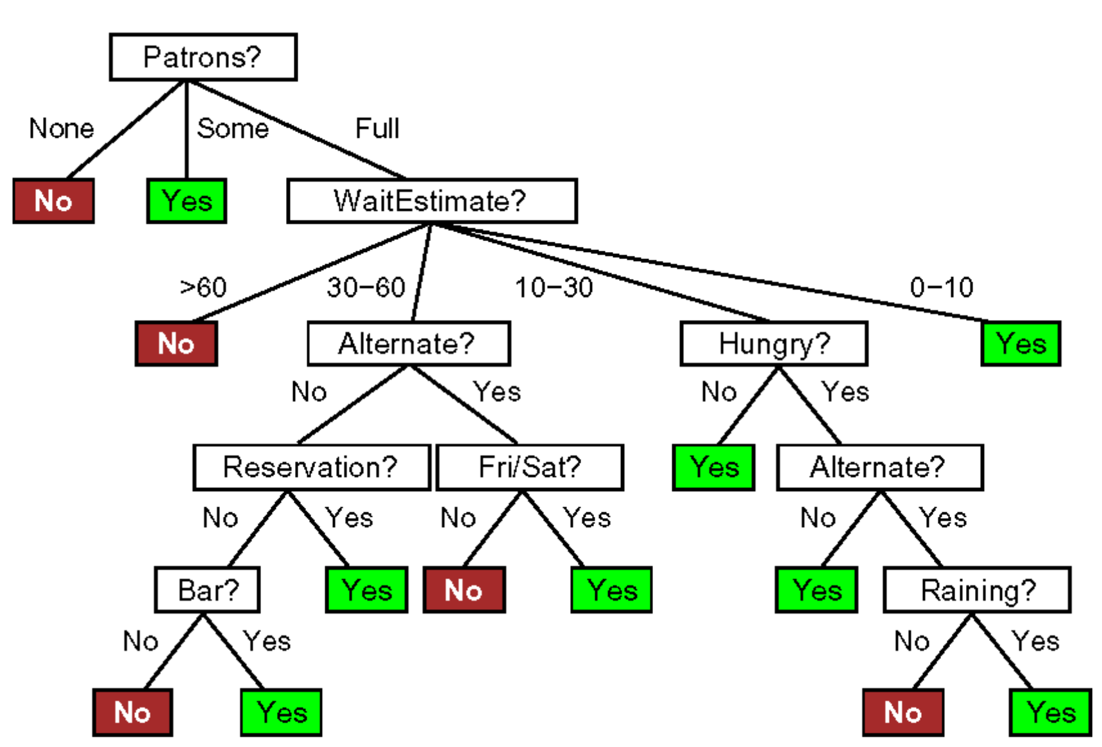
ID3 Decision Tree Learning

Slide 17
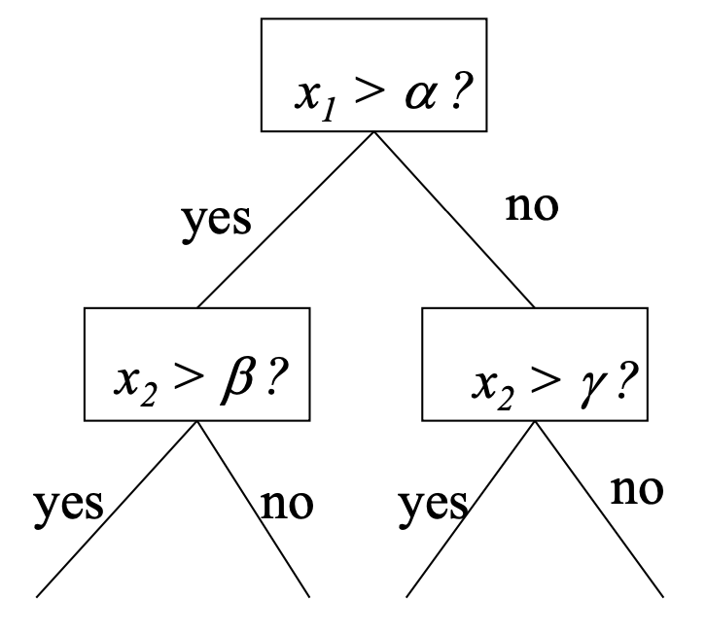
ID3 Decision Tree
Divide and conquer: Split data into smaller and smaller subsets
Splits usually on a single variable

Slide 18
ID3 Decision Tree
The remaining examples are all positive (or all negative)
→ DONE, it is possible to answer Yes or No
There are some positive and some negative examples
→ choose the “best” attribute to split them
No examples left at a branch
→ return a default value
No attributes left but both positive and negative examples
→ return the plurality classification of remaining ones.

Slide 19
ID3 Decision Tree
function DECISION-TREE-LEARNING (𝑒𝑥𝑎𝑚𝑝𝑙𝑒𝑠, 𝑎𝑡𝑡𝑟𝑖𝑏𝑢𝑡𝑒𝑠, 𝑝𝑎𝑟𝑒𝑛𝑡 𝑒𝑥𝑎𝑚𝑝𝑙𝑒𝑠) returns a tree
if 𝑒𝑥𝑎𝑚𝑝𝑙𝑒𝑠 is empty
then return PLURALITY-VALUE(𝑝𝑎𝑟𝑒𝑛𝑡 𝑒𝑥𝑎𝑚𝑝𝑙𝑒𝑠)
else if all 𝑒𝑥𝑎𝑚𝑝𝑙𝑒𝑠 have the same classification
then return the classification
else if 𝑎𝑡𝑡𝑟𝑖𝑏𝑢𝑡𝑒𝑠 is empty
then return PLURALITY-VALUE(𝑒𝑥𝑎𝑚𝑝𝑙𝑒𝑠)
else
𝐴 ← 𝑎𝑟𝑔𝑚𝑎𝑥_{𝑎 ∈ 𝑎𝑡𝑡𝑟𝑖𝑏𝑢𝑡𝑒𝑠}IMPORTANCE(𝑎, 𝑒𝑥𝑎𝑚𝑝𝑙𝑒𝑠)
𝑡𝑟𝑒𝑒 ← a new decision tree with root test A
for each value 𝑣_{𝑘} of A do
𝑒𝑥𝑠 ← {𝑒∶ 𝑒 ∈ 𝑒𝑥𝑎𝑚𝑝𝑙𝑒𝑠 and 𝑒.𝐴 = 𝑣_{𝑘}}
𝑠𝑢𝑏𝑡𝑟𝑒𝑒 ← DECISION-TREE-LEARNING(𝑒𝑥𝑠, 𝑎𝑡𝑡𝑟𝑖𝑏𝑢𝑡𝑒𝑠−𝐴, 𝑒𝑥𝑎𝑚𝑝𝑙𝑒𝑠)
add a branch to 𝑡𝑟𝑒𝑒 with label (𝐴 = 𝑣_{𝑘}) and subtree 𝑠𝑢𝑏𝑡𝑟𝑒𝑒
return 𝑡𝑟𝑒𝑒

Slide 20
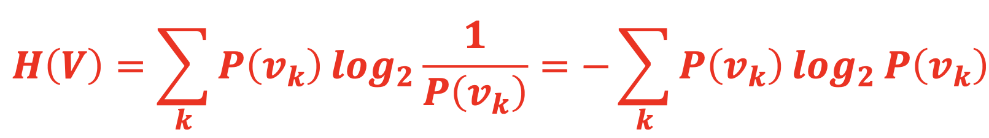
A purity measure with entropy
Entropy is a measure of the uncertainty of a random variable 𝑉 with values 𝑣_{𝑘}.
𝑣_{𝑘} is a class in 𝑉 (e.g., yes/no in binary classification)
𝑃(𝑣_{𝑘}) is the proportion of the number of elements in class 𝑣_{𝑘} to the number of elements in 𝑉.

Slide 21
A purity measure with entropy
Entropy is maximal when all possibilities are equally likely.
Entropy is zero in a pure “yes” (or pure “no”) node.
Decision tree aims to decrease the entropy in each node.

Slide 22
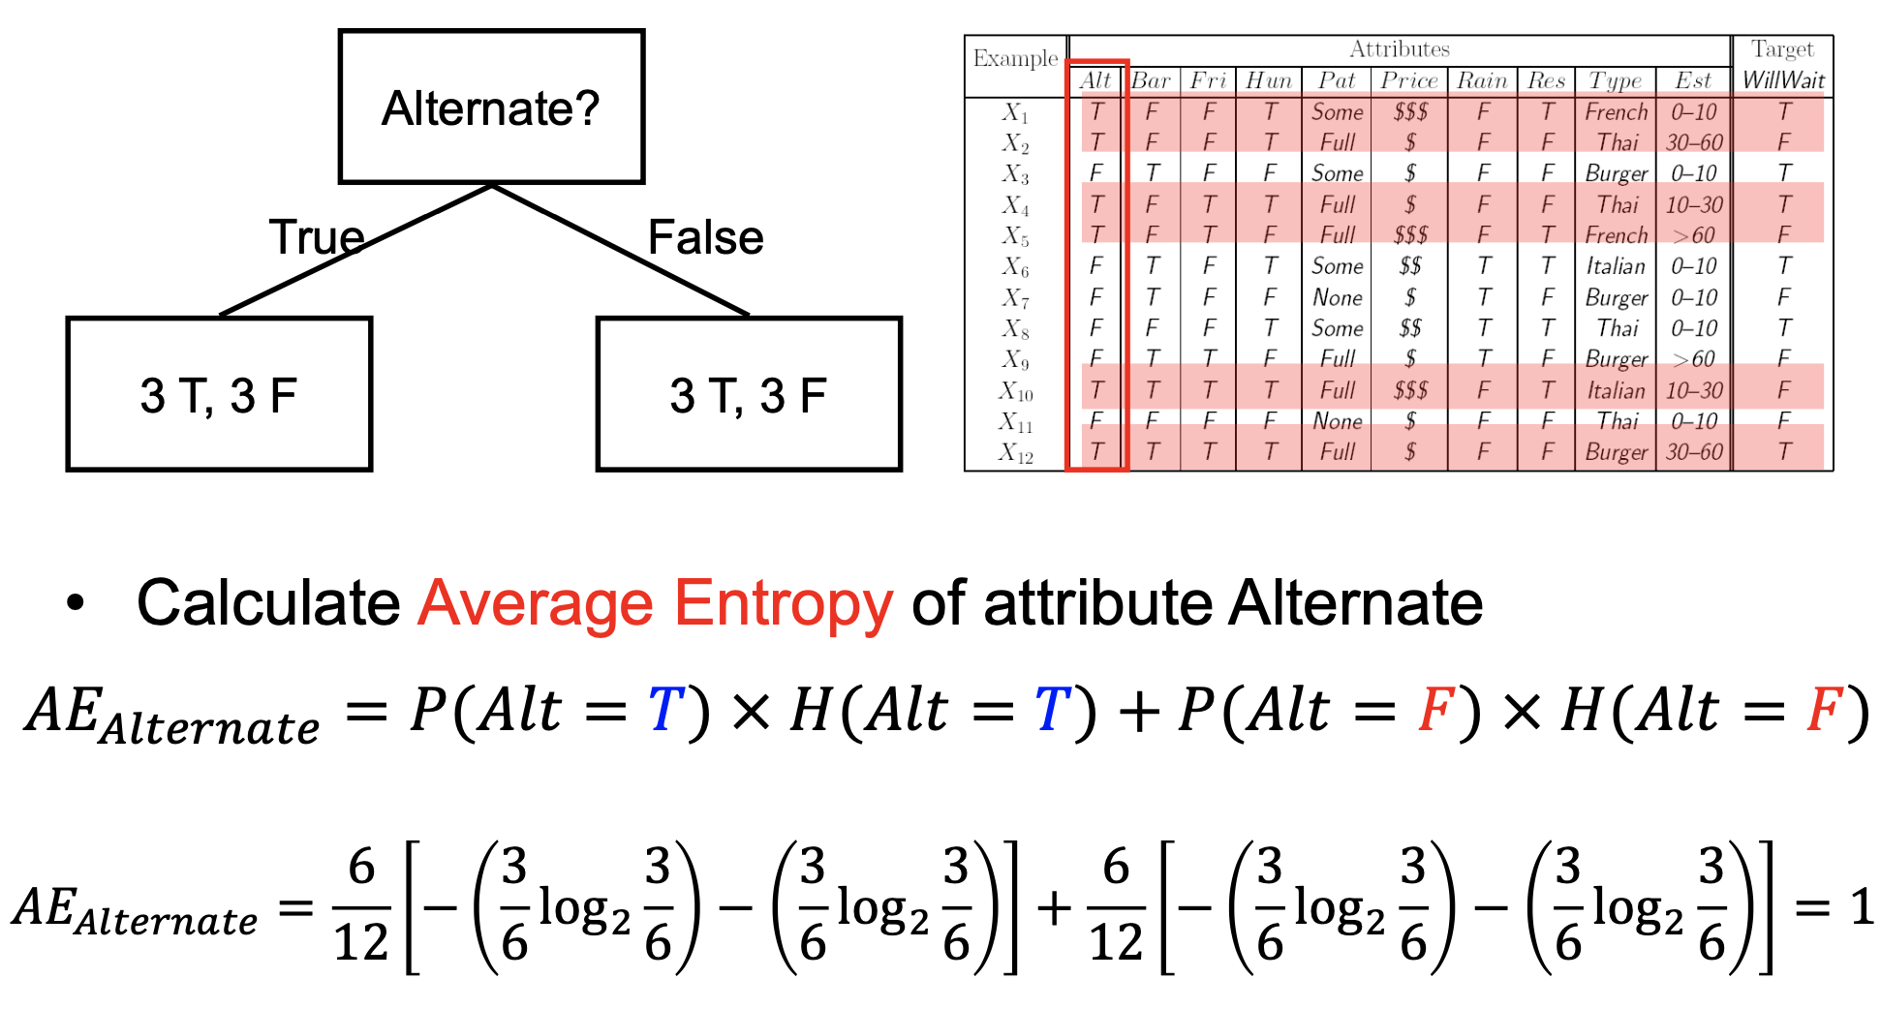
Average Entropy

Slide 23
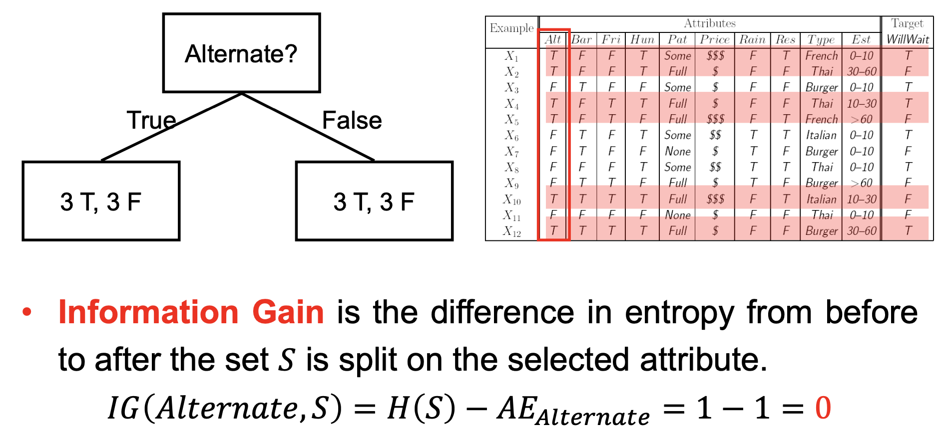
Information Gain

Slide 24
Information Gain
IG(Alternate, S) = 0
IG(Bar, S) = 0
IG(Sat/Fri?, S) = 0.021
IG(Hungry, S) = 0.196
IG(Raining, S) = 0
IG(Reservation, S) = 0.021
IG(Patron, S) = 0.541
IG(Price, S) = 0.23
IG(Type, S) = 0
IG(Est. waiting time, S) = 0.208

Slide 25
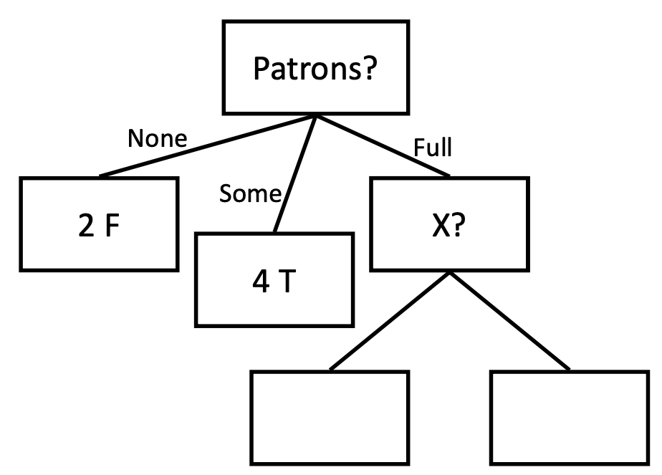
Decision Tree Learning
Largest Information Gain (0.541) / Smallest Entropy (0.459) achieved by splitting on Patrons.

Slide 26
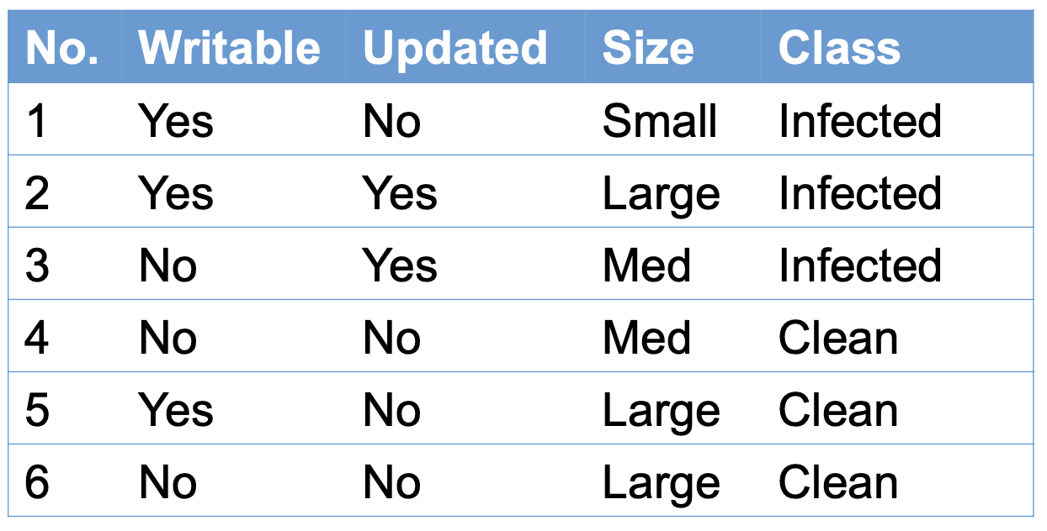
Homework

Slide 27
Homework
from sklearn.tree import DecisionTreeClassifier, plot_tree
import pandas as pd
df = pd.DataFrame(
[{'W':1, 'U':0, 'S':0, 'L':0},
{'W':1, 'U':1, 'S':2, 'L':0},
{'W':0, 'U':1, 'S':1, 'L':0},
{'W':0, 'U':0, 'S':1, 'L':1},
{'W':1, 'U':0, 'S':2, 'L':1},
{'W':0, 'U':0, 'S':2, 'L':1},
]
)
clf = DecisionTreeClassifier()
clf.fit(df[['W', 'U', 'S']], df['L'])
plot_tree(clf)

Slide 28
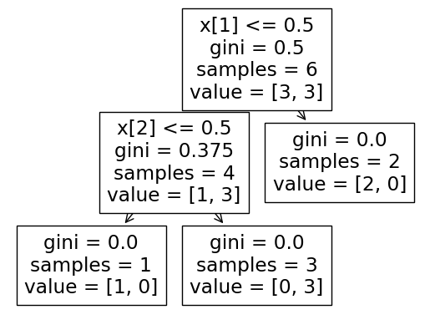
Homework

Slide 29
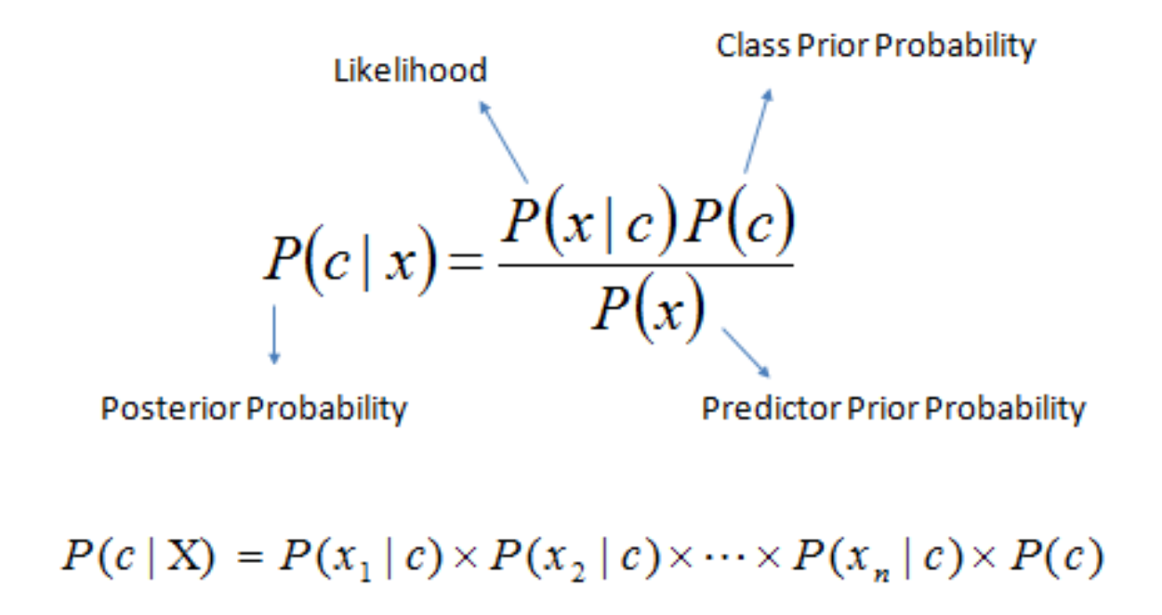
Bayesian classification
A statistical classifier performs probabilistic prediction, i.e., predicts class membership probabilities
  Foundation: Based on Bayes’ Theorem

Slide 30
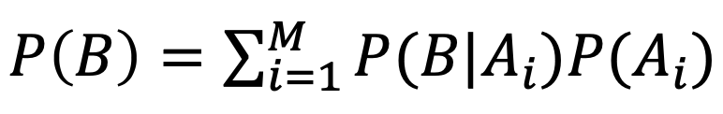
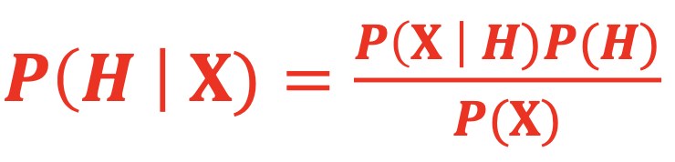
The Bayes’ Theorem
Total Probability Theorem:
Let 𝐗 be a data sample (“evidence”) with unknown class label and 𝐻 be a hypothesis that 𝐗 belongs to class 𝐶.
Bayes’ Theorem:
Classification is to determine 𝑃(𝐻 | 𝐗), i.e. the probability that the hypothesis 𝐻 holds given the observed data sample 𝐗.

Slide 31
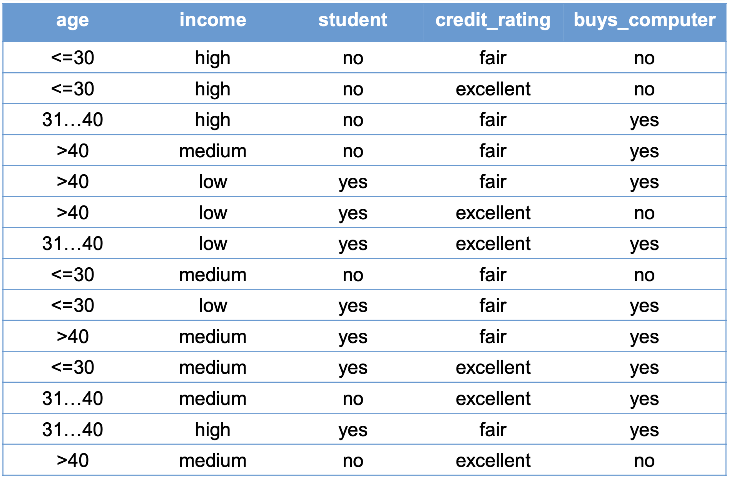
Example data set

Slide 32
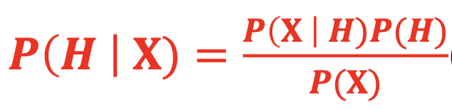
The Bayes’ Theorem
𝑷(𝑯) (prior probability): the initial probability
  E.g., 𝐗 will buy computer, regardless of age, income, ...
𝑃(𝐗) : the probability that sample data is observed
  E.g., 𝐗 is 31..40 and has a medium income, regardless of the buying
𝑃(𝐗 | 𝐻) (likelihood): the probability of observing the sample 𝐗, given that the hypothesis holds
  E.g., Given that 𝐗 will buy computer, the probability that 𝐗 is 31..40 and has a medium income
E.g., given that 𝐗 is 31..40 and has a medium income, the probability that 𝐗 will buy computer

Slide 33
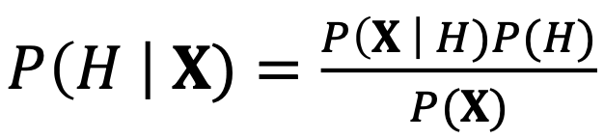
The Bayes’ Theorem
Informally,
𝑝𝑜𝑠𝑡𝑒𝑟𝑖𝑜𝑟𝑖 = 𝑙𝑖𝑘𝑒𝑙𝑖h𝑜𝑜𝑑 ∗ 𝑝𝑟𝑖𝑜𝑟 / 𝑒𝑣𝑖𝑑𝑒𝑛𝑐𝑒
𝐗 belongs to 𝐶_{i} iff the probability 𝑃(𝐶_{i} | 𝐗) is the highest among all the 𝑃(𝐶_{𝑘} | 𝐗) for all the 𝑘 classes.

Slide 34
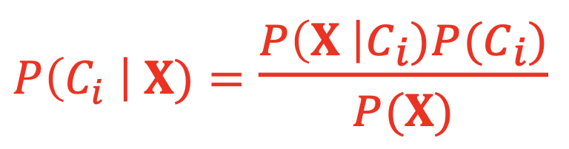
Classification with Bayes’ Theorem
Let 𝐷 be a training set of tuples and associated class labels
Each tuple is represented by a 𝑛-attribute 𝐗 = (𝑥₁, 𝑥₂, ... , 𝑥_{𝑛})
Suppose there are 𝑚 classes 𝐶₁, 𝐶₂,..., 𝐶_{m}
Classification is to derive the maximum posteriori 𝑃(𝐶_{i} | 𝐗) from Bayes’ theorem
𝑃(𝑋) is constant for all classes, only 𝑃(𝐗|𝐶_{i})𝑃(𝐶_{i}) needs to be maximized.

Slide 35
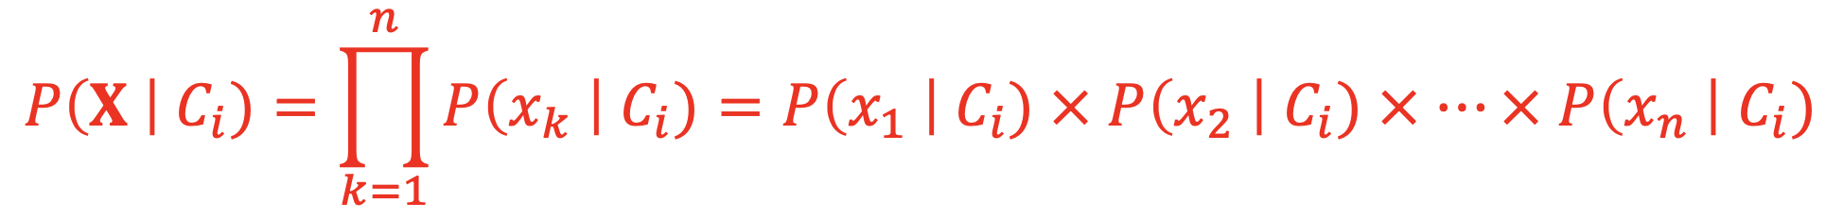
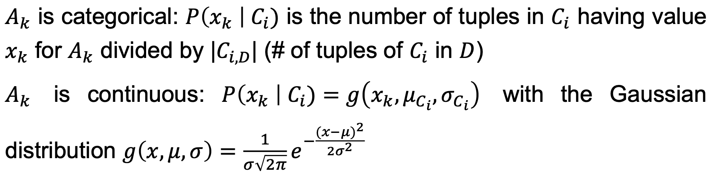
Naïve Bayesian classifier
Class-conditional independence: There are no dependence relationships among the attributes.
The naïve Bayesian classification formula is written as

Slide 36
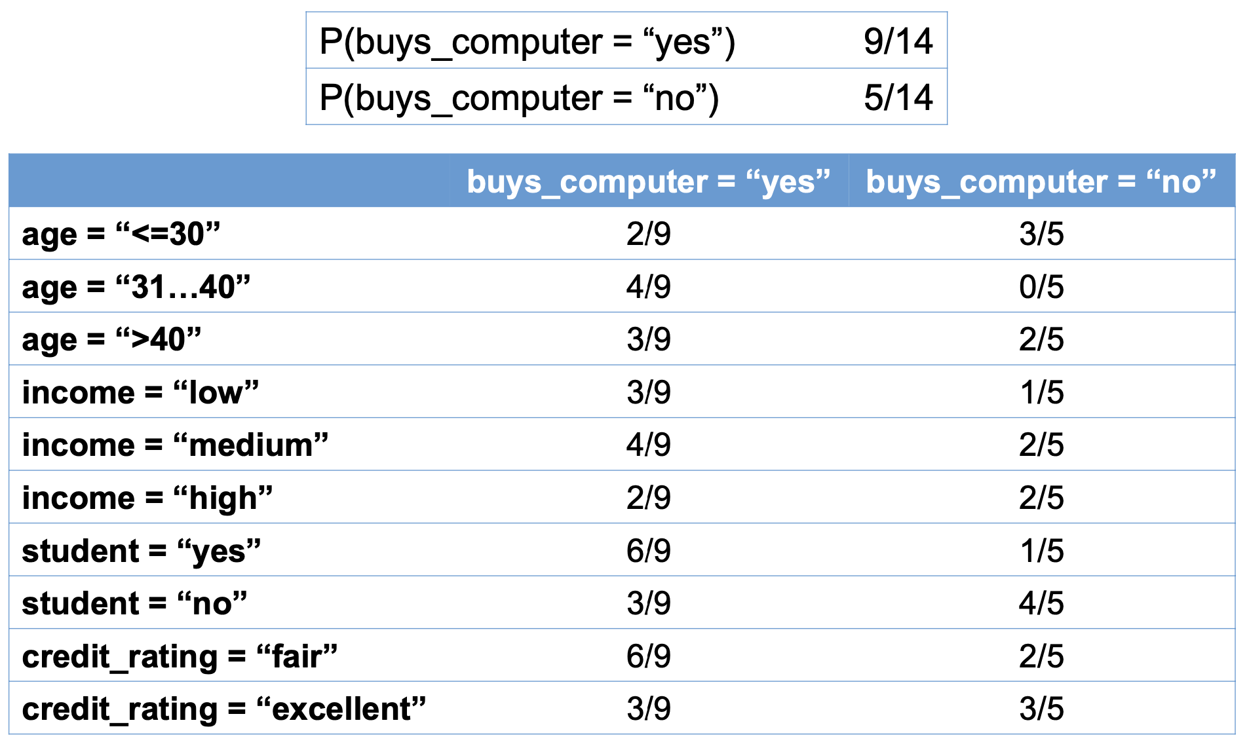
Naive Bayesian for the example dataset

Slide 37
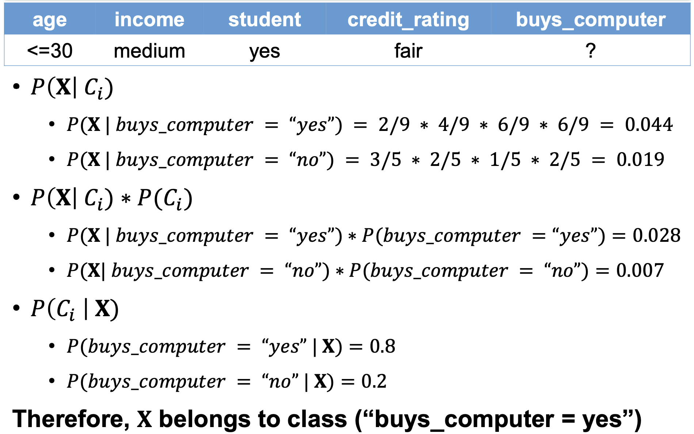
Naive Bayesian for the example dataset

Slide 38
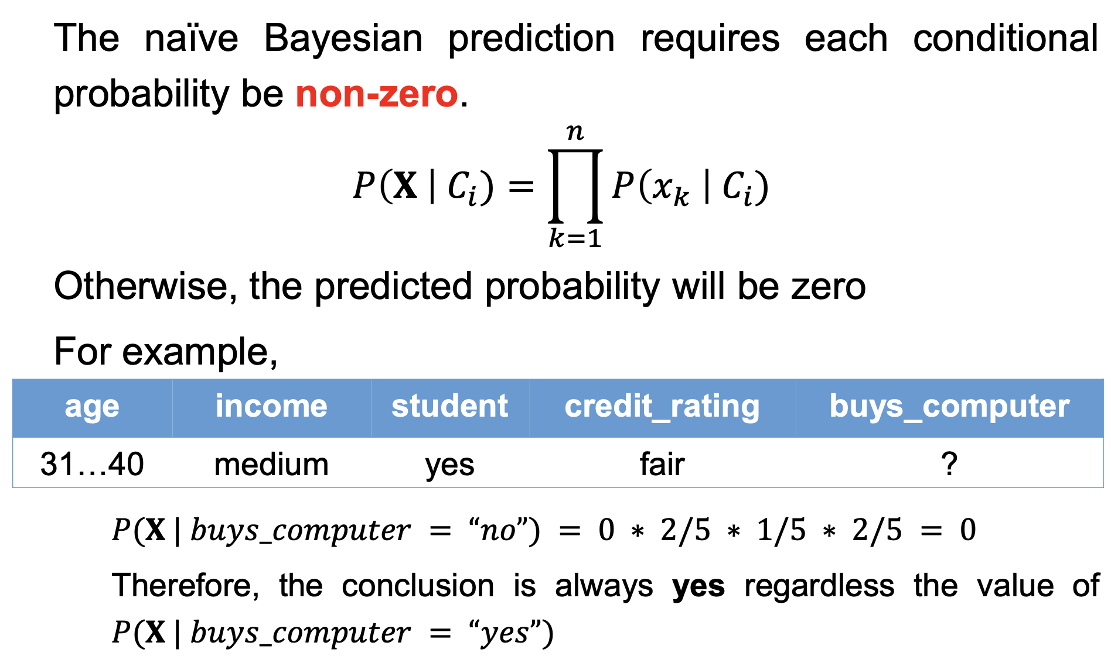
Avoiding the zero-probability problem

Slide 39
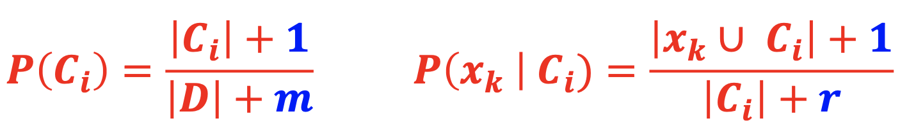
Avoiding the zero-probability problem
Laplacian correction (or Laplacian estimator)
  where 𝑚 is the number of classes, |𝑥_{k} ∪ 𝐶_{i}| denotes the number of tuples contains both 𝐴_{k} = 𝑥_{k} and 𝐶_{i}, and 𝑟 is the number of values of attribute 𝐴_{𝑘}
The “corrected” probability estimates are close to their “uncorrected” counterparts.

Slide 40
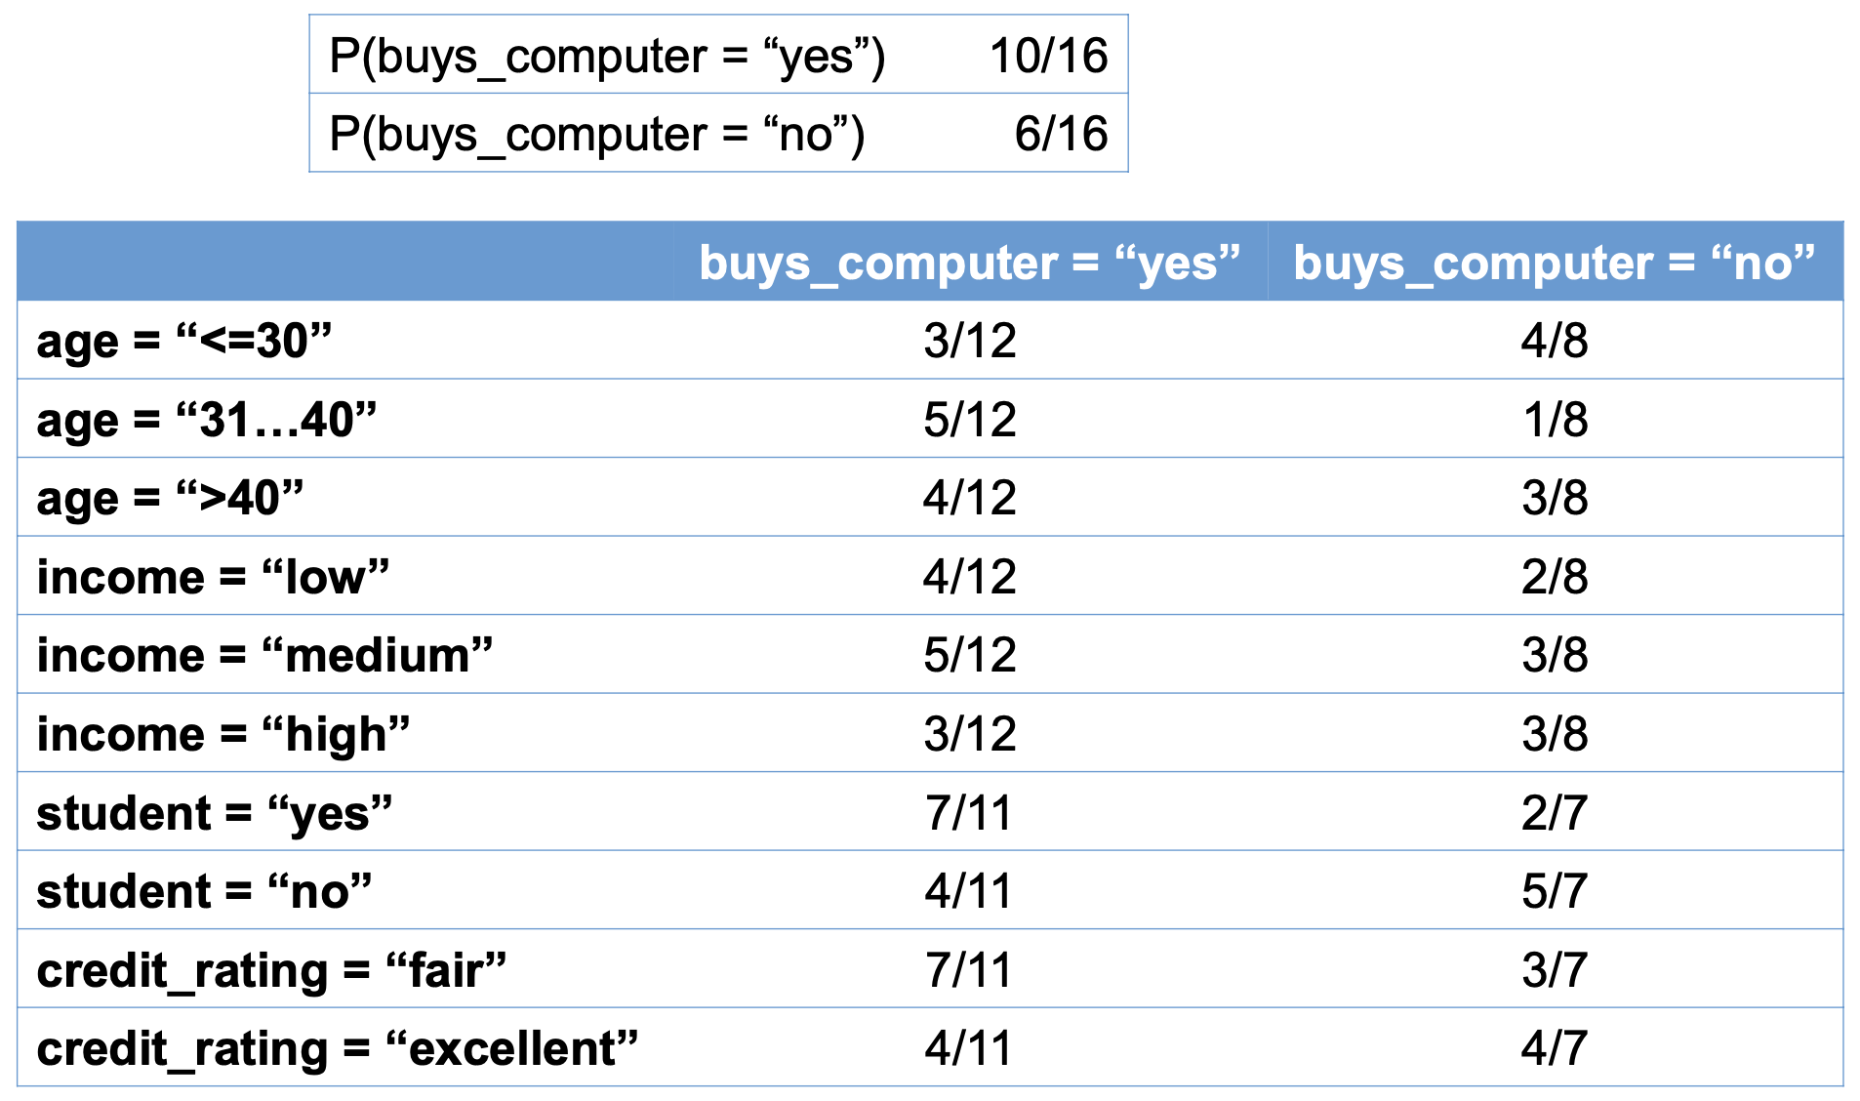
Naive Bayesian for the example dataset

Slide 41
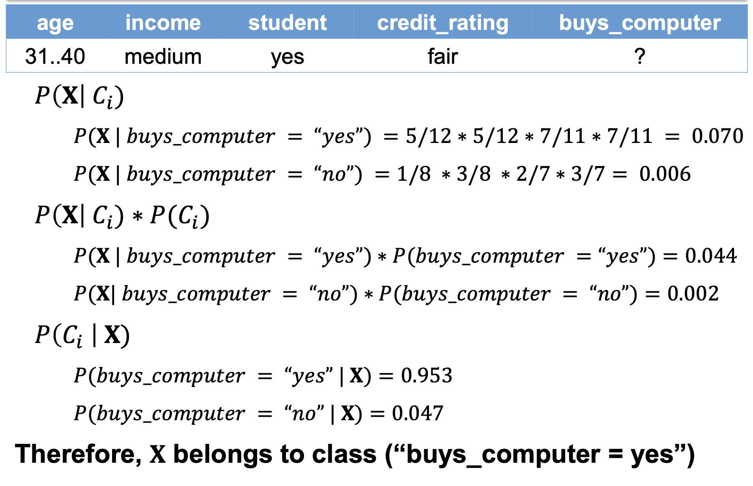
Naive Bayesian for the example dataset

Slide 42
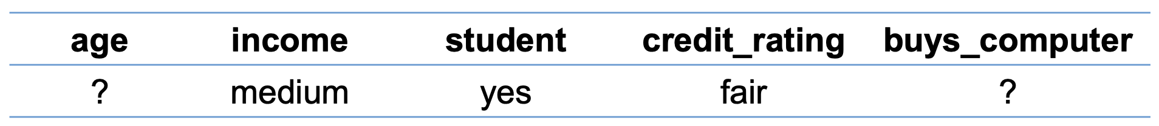
Handling missing values
If the values of some attributes are missing, these attributes are omitted from the product of probabilities
As a result, the estimation is less accurate
For example,

Slide 43
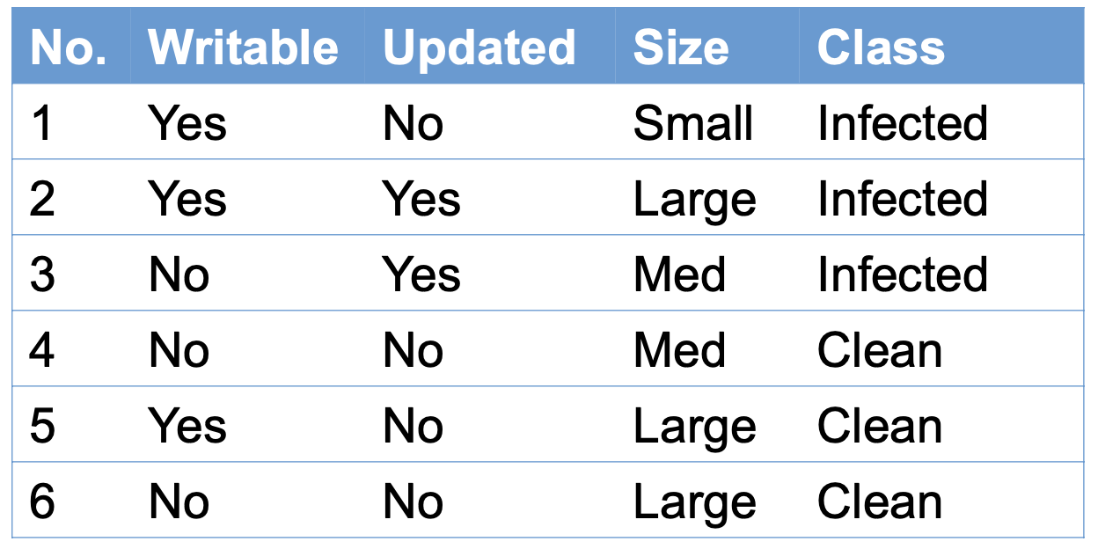
Homework

Slide 44
Homework
Conduct homework in the given notebook

Slide 45
References
Stuart Russell and Peter Norvig. 2009. Artificial Intelligence: A Modern Approach (3rd ed.). Prentice Hall Press, Upper Saddle River, NJ, USA.
Lê Hoài Bắc, Tô Hoài Việt. 2014. Giáo trình Cơ sở Trí tuệ nhân tạo. Khoa Công nghệ Thông tin. Trường ĐH Khoa học Tự nhiên, ĐHQG-HCM.
Nguyễn Ngọc Thảo, Nguyễn Hải Minh. 2020. Bài giảng Cơ sở Trí tuệ Nhân tạo. Khoa Công nghệ Thông tin. Trường ĐH Khoa học Tự nhiên, ĐHQG-HCM.

