Slide 1
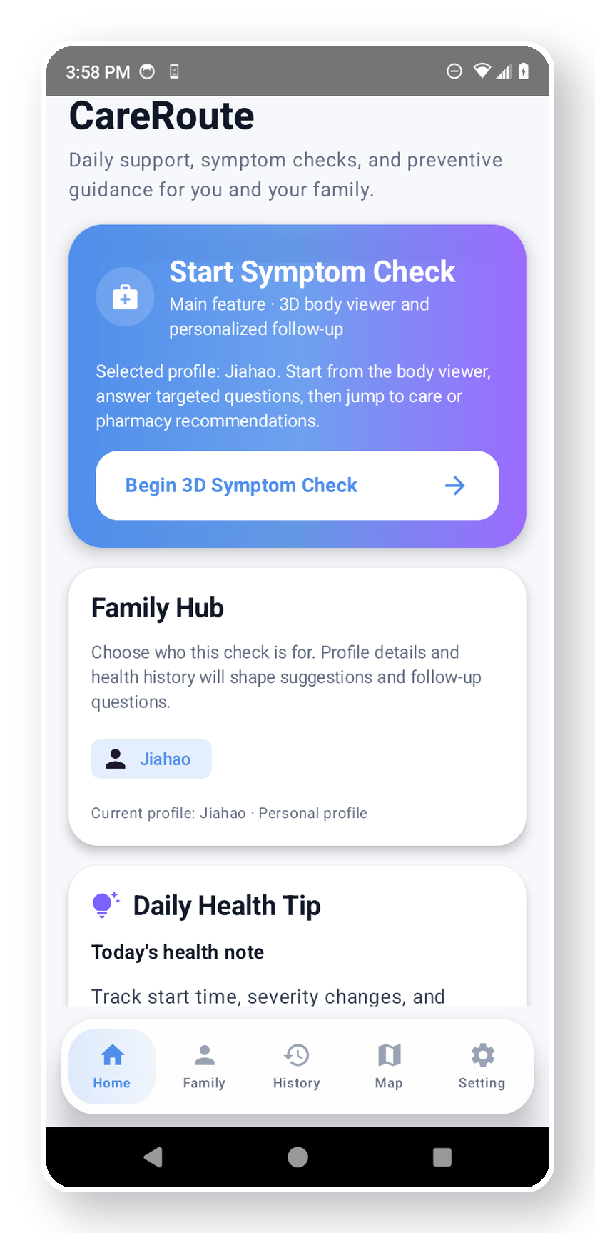
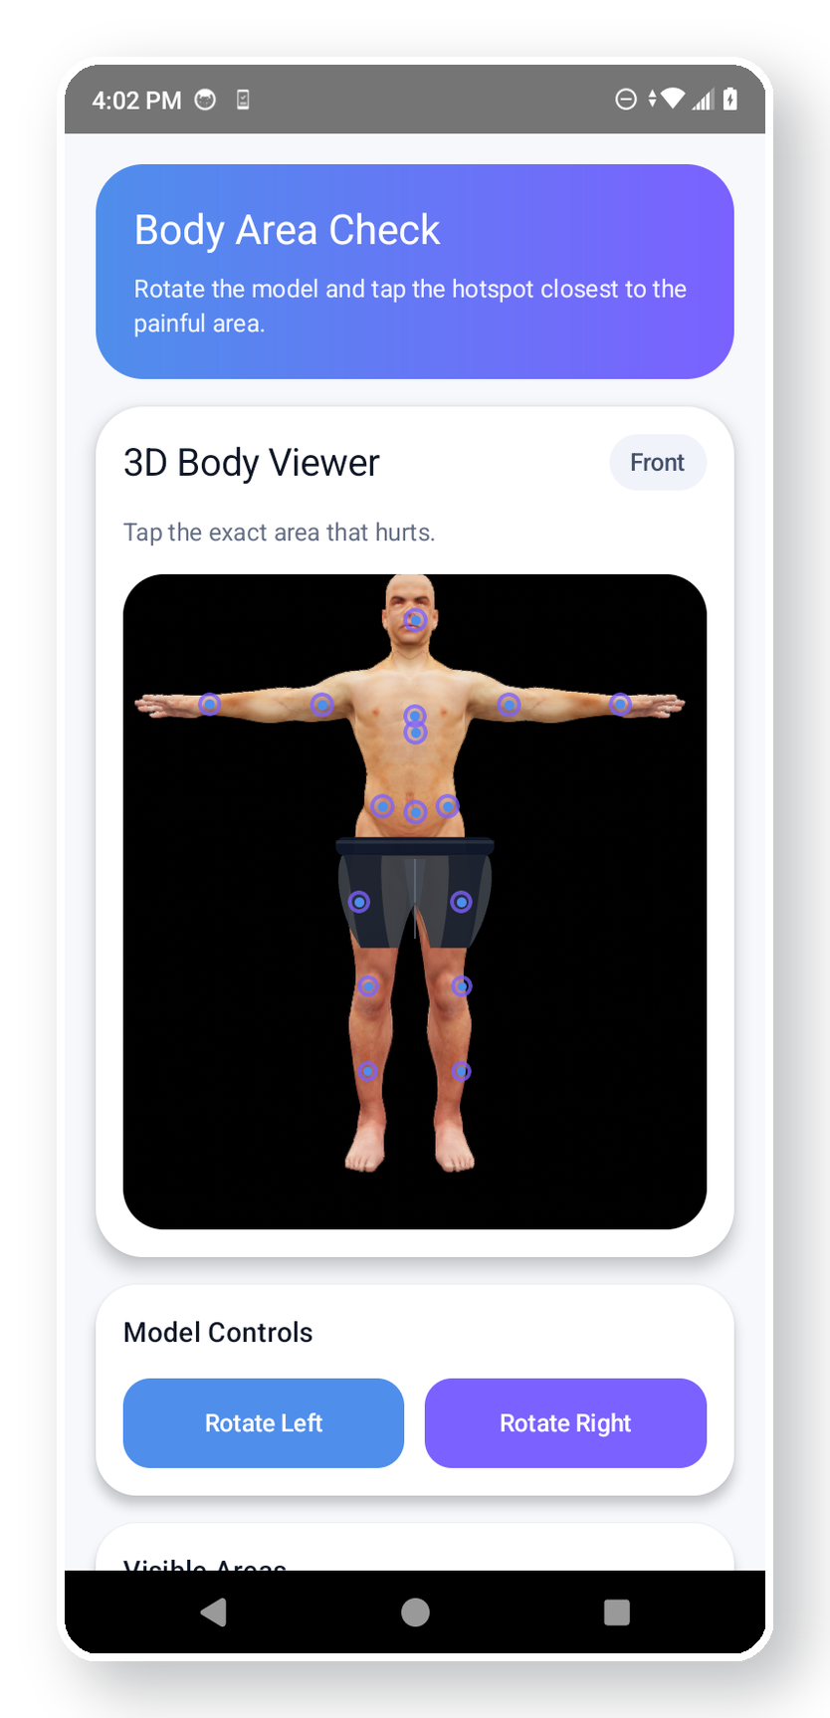
CareRoute
When a health problem happens, most people don’t know what to do next.
CareRoute turns panic into action by guiding users from symptoms to a clear next step — fast.
The Problem
Our Solution
Symptoms are confusing and stressful.
People often can’t tell ER vs urgent care vs primary care vs home care.
Finding the right help takes too long.
Managing care for family members is even harder.
Select the body area and describe symptoms.
AI asks focused follow-up questions.
Users get a clear urgency recommendation.
The app shows nearby care options and family support.
In under one minute, CareRoute can:
Value Proposition: Faster decisions • Less anxiety • More confident care navigation
collect symptoms, ask follow-up questions, recommend the right care level, and direct users to nearby resources.

Slide 2
Live Demo Flow
Complete demo story
1
Login / Emergency Mode
2
Select body part + enter symptom
3
AI follow-up questions
4
Structured care recommendation
5
Nearby care map
6
History + Family Hub
CareRoute is not trying to replace doctors — it helps people make smarter first decisions when every minute feels uncertain.

