Slide 1
A Crash Course in Topic Modelling with BERTopic
Huw Day JGI Data Scientist

Slide 2
Who are the JGI?
The Jean Golding Institute is the research institute for data science at the University of Bristol.
We have a pool of data scientists who can be costed out to support projects at fractional FTE (usually ~40% for a period of 6 months or more), kind of like a pool of post docs. For more details you can contact me: huw.day@bristol.ac.uk (or Ask-JGI)
All UoB researchers are entitled to up to a day of free support from our Ask-JGI data science helpdesk run by paid PhD students. Just email your query to: ask-jgi@bristol.ac.uk
We also do yearly Seedcorn funding every September, free coding courses and other data science related events.
I’ve been supporting this project for 3 months at 40% FTE as part of a mini competition the JGI ran over the summer.
https://www.bristol.ac.uk/golding/

Slide 3
The Project
Dr Eunice Lo, Dr Jo Godwin and team are doing a project on lived experience of people’s physical and mental health, wellbeing and behaviour during extreme weather events.
They sent out a survey to Bristol residents to get information about their physical and mental health during heatwaves, cold snaps and storms.
Some of the survey questions had an option for free text, where respondents could articulate how they had adjusted to extreme weather. For example: “I would do exercise earlier in the morning when it was cooler” (during a heatwave)
We want to see what sort of themes or topics were mentioned and how frequently. This task is referred to as “topic modelling” in NLP (Natural Language Processing) which is the data science of working with text data.

Slide 4
How might you topic model by hand?
“I closed curtains and drank more water”
“I stayed hydrated. Took the dog out earlier”
“Routine changed, went for walks before it got hot”
“Quite enjoyed it! Used more suncream tho”
“See previous answer”
“Cooked less warm food, ate more ice cream”
Notes:
Start reading documents and noting down characteristics.
When you read enough, you’ll start seeing patterns pop out – this might lead you to double back on yourself when you notice a pattern later on.
You might also want start to discount themes as “topics” if they appear *too* frequently or to start collecting info about how important certain terms are (i.e. their weighting).
You could make a list beforehand of potential topics and try and match your documents to this list, but this might lead you to miss other topics.
The longer the list of your documents, the longer it takes and the more diverse topics, the harder it is to do well (this is true when we use automatic methods too!)

Slide 5
How can you do topic modelling?
Previously Latent Dirichlet Allocation (LDA) was used.
Currently the standard is BERTopic Modelling. This is the method we used for this work.
All the code for this has been done in Python: https://github.com/JGIBristol/ClimateTopicModelling
A nice YouTube playlist on using LDA for Topic Modelling: https://www.youtube.com/watch?v=N0crN8YnF8Y&list=PL2VXyKi-KpYttggRATQVmgFcQst3z6OlX
Notes:
The main method for a while was Latent Dirichlet Allocation (LDA) which uses Bayesian methods to do topic modelling. You basically try and get a system to generate a synthetic document of certain topics and see how well it matches your originals. Currently the standard is BERTopic Modelling which relies on some LLM embedding of text into vectors and then you can just do standard ML on these vectors.

Slide 6
When can you do topic modelling automatically?
More data (bigger documents) is (usually) better.
Diversity of topics is a limiting factor, so the more topics you expect, the more documents you should have.
Shorter “sentences” are easier to interpret.
The less standard the sentences are (e.g. slang or variety of languages) the more documents you should have.
A JGI Seedcorn Project that used both LDA and BERTopic Topic Modelling on a collection of 424,629 Tweets from Medical Influencers talking about COVID-19: https://jeangoldinginstitute.blogs.bristol.ac.uk/2024/10/02/exploring-the-impact-of-medical-influencers-on-health-discourse-through-socio-semantic-network-analysis/
Notes:
A longer writeup of their work in a publication: https://arxiv.org/pdf/2407.05198

Slide 7
How does BERTopic work?
Embed documents
Dimensionality reduction
Cluster documents
Bag-of-words
Topic representation
(Optional) Fine-tune Topic representation
https://maartengr.github.io/BERTopic/algorithm/algorithm.html

Slide 8
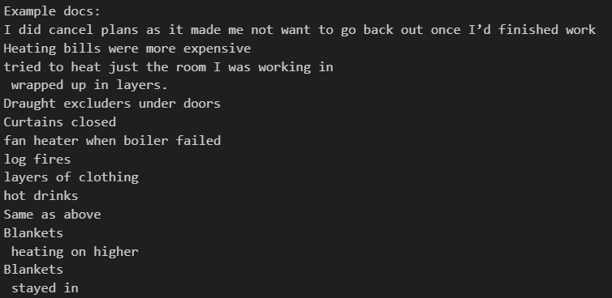
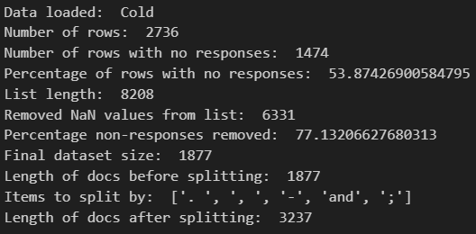
0. Pre-processing
Remove empty entries and flatten into a list.
Split longer documents according to various “splitters”
E.g. full stops, other punctuation, conjunction words like “and”
Notes:
Before we do any topic modelling, we need to pre-process our data from an excel spreadsheet with missing values into a list.
We also want to remove any documents (i.e. survey responses) that we don’t want to contribute to our analysis.
There are methods of removing topics retrospectively, but I’ve found it’s easier to run the model, spot what sort of documents you want to remove and then remove these from your documents (either manually or with some other NLP tools) before training the model again.
In this case, the main types of responses we wanted to remove were those where people had said things like “see previous question” and “no comment”.
This will be very contextual based on what you’re looking for in your analysis.

Slide 9


1. Embed documents
We start by converting our documents to numerical representations.
There are lots of methods for doing this, but the default for BERTopic is sentence-transformers.
Highly recommend 3Blue1Brown’s series on neural networks and specifically Chapter 5’s visual intro to transformers: https://youtu.be/wjZofJX0v4M?si=iae0rolfQDhvI-1l&t=747
In practice we embed sentences, not just words, because we want each individual document to be represented as a whole.
Directions in the embedding vector space have associations with certain meanings extracted from training data*
*which means some encoded biases might be present

Slide 10
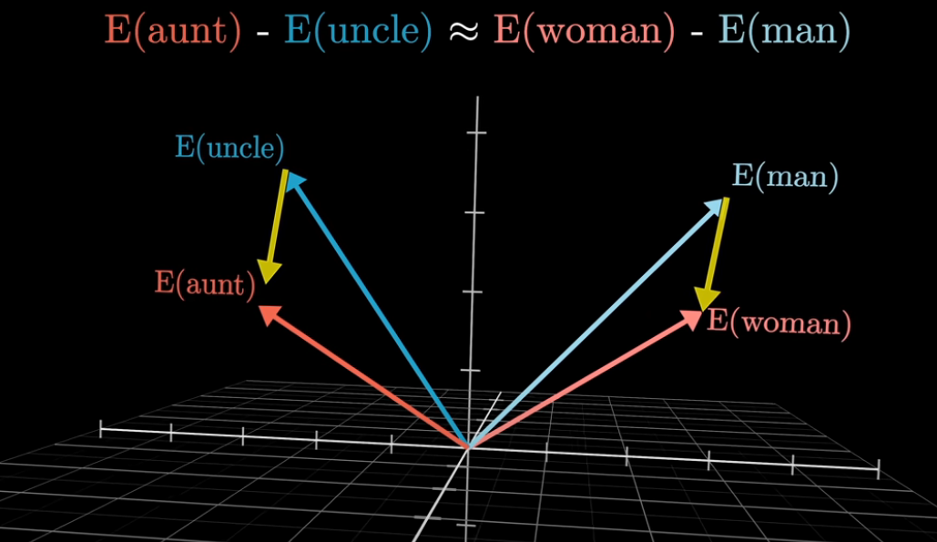
https://youtu.be/wjZofJX0v4M?si=iae0rolfQDhvI-1l

Slide 11
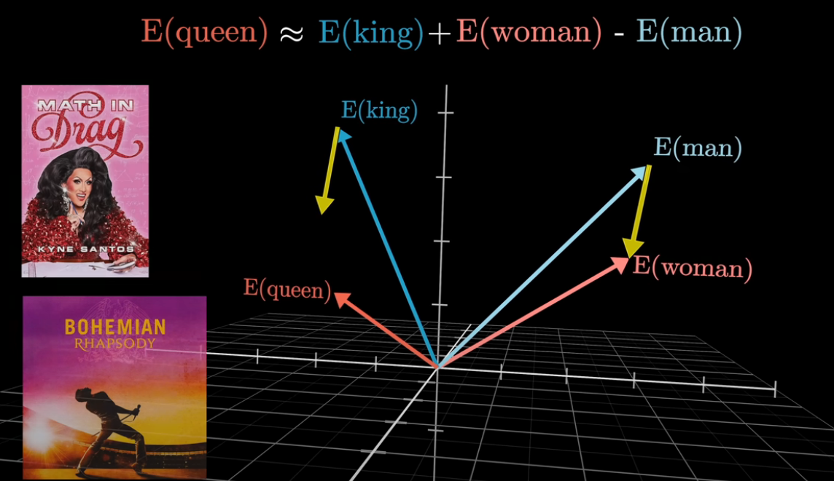
https://youtu.be/wjZofJX0v4M?si=iae0rolfQDhvI-1l

Slide 12
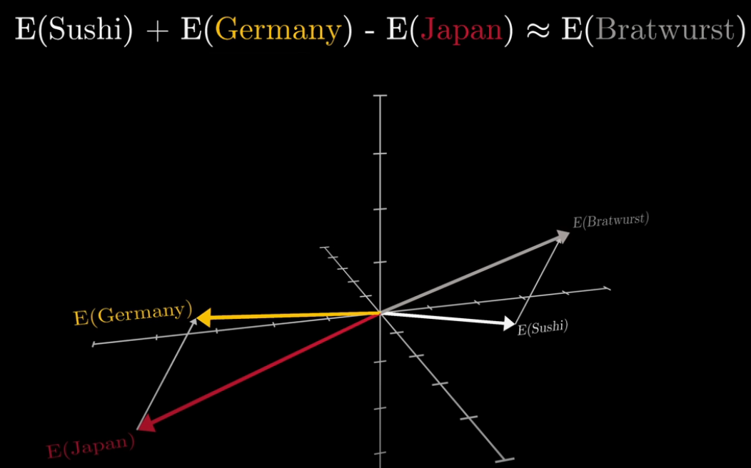
https://youtu.be/wjZofJX0v4M?si=iae0rolfQDhvI-1l

Slide 13
2. Dimensionality reduction
We aspire to take our vectorized documents and cluster them, but we’re currently in quite a high dimension space; GPT3’s embedding space is 12,288 dimensions but our default embedder is only 384 dimensions!
BERTopic can use lots of different methods for this but the default is UMAP which is a technique that can keep some of a dataset’s local and global structure when reducing dimensionality.
You can actually skip the clustering step entirely, but this is not recommended! It’s all to do with the “curse of dimensionality”.
High dimensional vector spaces behave quite counterintuitively and we need to be careful how we apply machine learning tools to datasets in these spaces.
Counterintuitive Properties of High Dimensional Space: https://people.eecs.berkeley.edu/~jrs/highd/

Slide 14
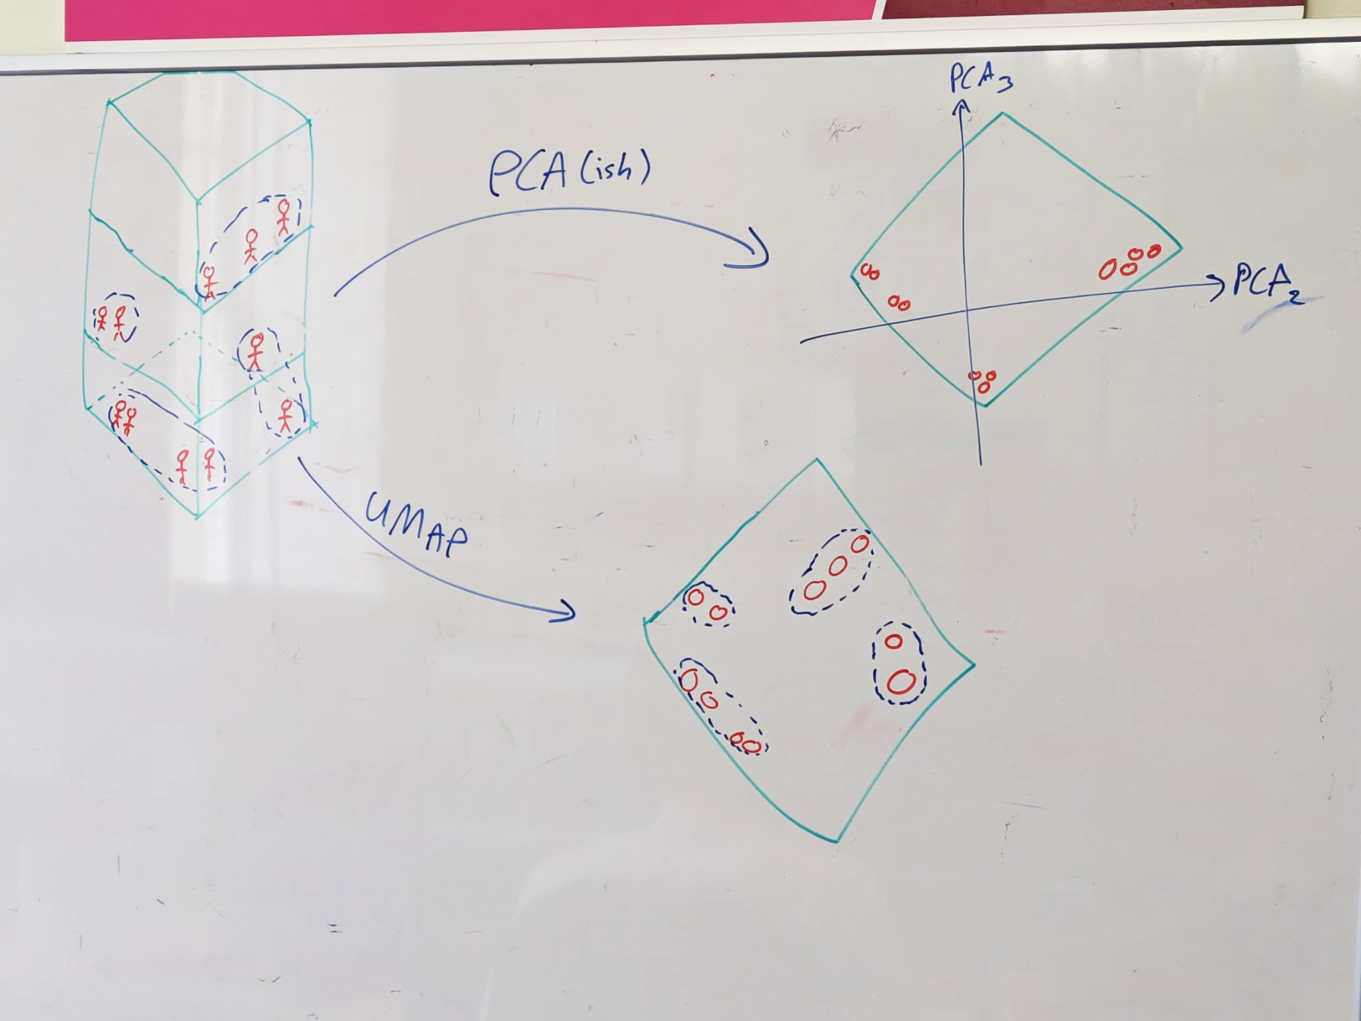
Notes:
Imagine a situation where you have a bunch of people in a 3 storey office building (on the left). Directions in the 3 dimensional building have meanings: More senior employees have offices on higher floors. The sun comes in from the right handside of the image, and data scientists don’t like the sun so if someone is on the left of the building they’re more likely to be a data scientist and if they’re on the right then they’re more likely to be admin/management.
We want to compress our view of this building into a way where directions have some meaning.
If we just naively looked from the top of the building (top right) and looked at where people were, we do capture the sense of if they’re close to the sun (so we get the data science/admin split) but we completely lose any information about seniority. When we do dimensionality reduction using a tool like UMAP (bottom right), we deduce clusters in the data first and then we project to a lower dimension, we try and preserve the clusters and the distances between the clusters. The bottom right shows a situation where we’ve compressed to 2 dimensions but higher up on the plot corresponds to seniority and left and right still shows the data science/admin split. I did it by hand, so it’s obviously not perfect, but hopefully that makes some intuitive sense!

Slide 15
Uniform Manifold Approximation and Projection (UMAP)
Using dimension reduction to boost the performance of density based clustering is a bit subtle, recommend reading more here: https://umap-learn.readthedocs.io/en/latest/clustering.html#umap-enhanced-clustering
StatQuest has some great videos explaining UMAP: https://www.youtube.com/watch?v=eN0wFzBA4Sc
UMAP works by looking both at local and global structure and trying to replicate this on a smaller scale.
When we use UMAP to enhance dimensionality reduction, we dictate how big we expect the clusters to be with the parameter “n_neighbors”. We want our output from this to be quite dense, we set this number to be large so we end up with more points packed together.
Notes:
You don’t have use UMAP. BERT is very modular so you can pick your favourite clustering method and use it here instead. UMAP is the default and the recommended, but you could use Principal Component Analysis or whatever you like. The parameter in the BERT Topic model is called “umap_model” though which can be a bit confusing, so worth commenting well!

Slide 16
3. Cluster documents
Now we want to group our documents together with clustering. BERTopic works with lots of different clustering methods, but by default it uses HDBSCAN (Hierarchical Density-Based Spatial Clustering of Applications with Noise).
StatQuest has a great video for an intuition as to how DBSCAN (the related predecessor) works: https://www.youtube.com/watch?v=RDZUdRSDOok&t=0s
We can use the parameter “min_cluster_size” to indirectly influence how many clusters you have. Note this parameter needs to be tuned for different datasets for optimal performance!
Notes:
Again, since BERT is modular, you can sub in your preferred clustering method here. HDBSCAN is the default because it uses density based clustering, which is handy in higher dimensions. HDBSCAN can find clusters of different shapes and has the nice feature of identifying outliers where possible. This is handy because some documents might be unrelated to the rest.
HDBSCAN has the features that 1) you can’t tell it directly how many clusters you expect and 2) it will not force all points to be in a cluster and will output a list of outlier points. If you don’t want this, you might consider using something like K-Means clustering which has the downside of being more centroid based in how it works (stats quest has a great video on this one too!) but you can tell if how many clusters you expect directly and it will force points to be in clusters.
BERT also has methods where you can use hdbscan but tell it to reduce to a set number of clusters as well as ask it to reduce outliers. These methods are a bit more implicit and can be a bit harder to interpret and justify.

Slide 17
4. Bag-of-words (Tokenizing Topics)
We take all the documents in each cluster and combine them into a single document and then count how many each times each word appears in each cluster. This generates something called a “bag-of-words” representation for each cluster.
“min_df” tells you how frequent a word must be before being added to our representation. You can imagine that if we have a million documents and a certain word only appears a single time across all of them, then it would be highly unlikely to be representative of a topic.
This step also allows for processing the documents however you want without affecting the first step where we embedded the documents.
The two steps I found most useful were removing stop words and accounting for n-grams.

Slide 18
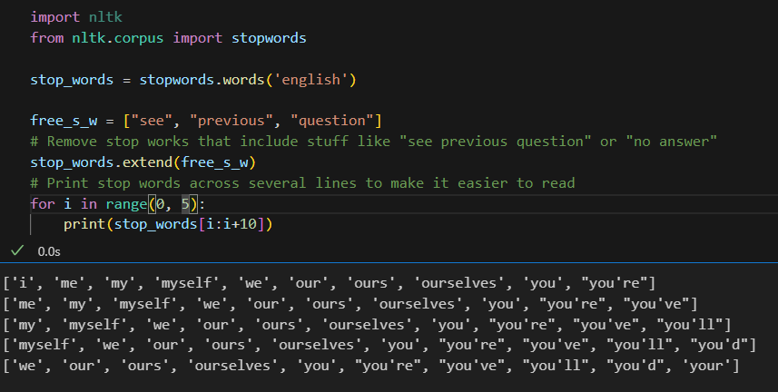
Stopwords
Notes:
Stopwords are a great tool in NLP but there’s a subtlety in how they’re used in BERTopic. If we remove certain stop words from our bag-of-words representation, we do not remove the documents from our topic model. What you can end up with is a cluster of documents that follow a certain topic (e.g. “see previous question” type responses) where you’ve removed all viable representations – but you have not removed these documents!
If you see a topic of documents you don’t want, you need to remove these documents as part of your pre-processing. Removing stop words for your tokenizing of topics is only useful if you have documents that you *do* want represented but you want to control how they’re represented. E.g. you might have a topic where lots of people talked about “keeping themselves cool” and the representation you want is “keeping cool” and not anything like “themselves”

Slide 19
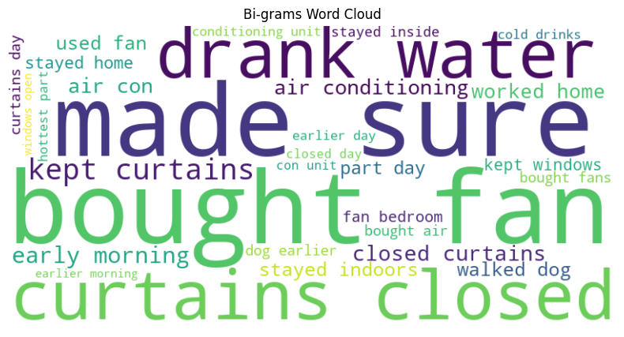
N-grams (N=1, 2 and 3…usually)
Notes:
N-grams are basically common sequences of “N” words. It can be quite useful to include these amongst your representations and other sorts of processing. You can dictate what sort of n-grams you want, 1-grams are just words, 2-grams are common pairs, 3-grams are common triplets etc. but the standard is usually including grams of length 1, 2 and 3. This might be different depending on your training data.

Slide 20
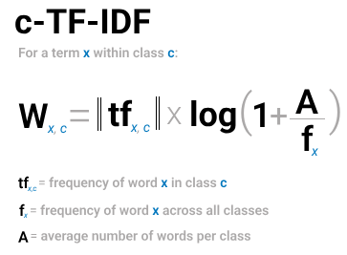

5. Topic representation
Term Frequency – Inverse Document Frequency (TF-IDF) is a method you can apply on a set of documents where you compare the importance of words between documents.
If a word appears across lots of different clusters, it might be semantically less insightful than if it only appears in one cluster lots of time. E.g. a word like “run” that has many different meanings depending on contexts.
If we treat all documents in a cluster as a single document and then apply TF-IDF then we would get importance scores for words within a cluster.
This is called class based TD-IDF or c-TF-IDF.
The most important words per cluster are essentially descriptions of the topics!

Slide 21
6. (Optional) Fine-tune Topic representation
c-TF-IDF is a method that we can use to quickly generate accurate topic representations.
We can consider the c-TF-IDF generated topics to be candidate topics. They each contain a set of keywords and representative documents that we can use to further fine-tune the topic representations.
Notes:
This step is optional because often the representations generated by step 5 are sufficient! Having a set of representative documents for each topic is huge advantage as it allows for fine-tuning on a reduced number of documents. This reduces computation for large models as they only need to operate on that small set of representative documents for each topic.

Slide 22

Maximal Marginal Relevance (MMR)
It is important that our topic representations are suitably diverse: “using fans”, “used fan”, “use fans” are semantically identical but give us the same insight on a topic.
To decrease this redundancy and improve the diversity of keywords, we can use a representation model called Maximal Marginal Relevance (MMR).
MMR considers the similarity of keywords/keyphrases with the document, along with the similarity of already selected keywords and keyphrases. This results in a selection of keywords that maximize diversity with respect to the document.
You can tune how diverse these representations are with the diversity parameter; 0 being not diverse, 1 being most diverse.
Notes:
There are lots of other representative models available and you can also chain models together, calling on things like MMR and also exploiting APIs with LLMs like ChatGPT and get to describe your topic for you!

Slide 23
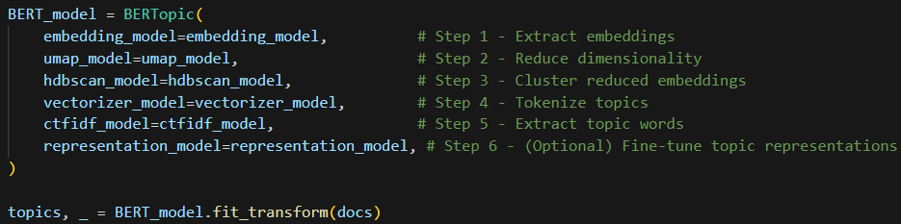
Putting it all together!
Notes:
You can literally load the model with model = BERTopic() and call it a day, but the way I’ve written this code makes it easier to change the parameters under the hood! Most of the visualizations are useful for model diagnostics but less so (in my opinion) for sharing results so in the next few slides I’ll show some example outputs.

Slide 24

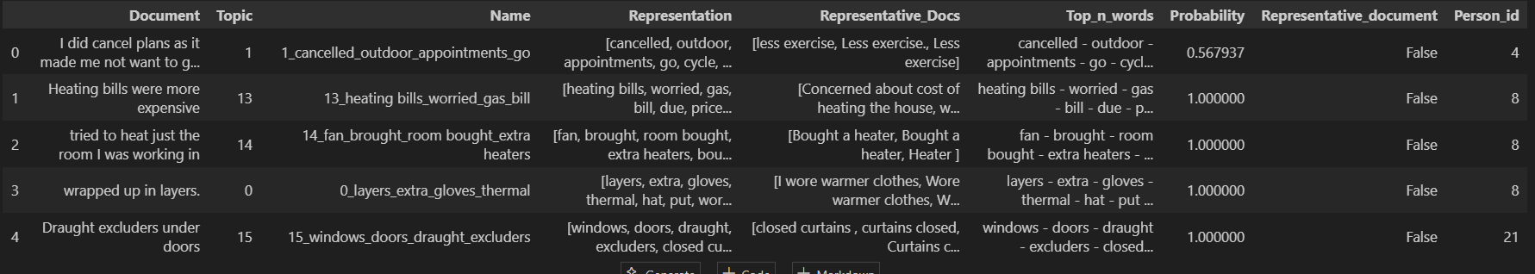
Document Info
Notes:
For every document we loaded in, it is assigned to a topic. Each topic has a number, name, representation etc. associated with it. The final column “Person_id” is some code that helps keep track of how much stuff was said by each individual (this will make more sense in a few slides!

Slide 25
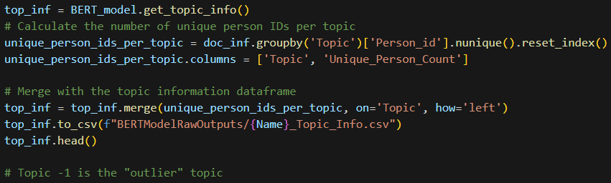
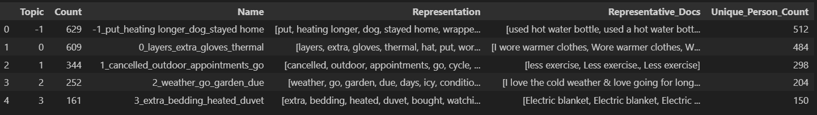
Topic Info
Notes:
Similarly, for each topic, we can get a summary of it. Note the distinction between “Count” and “Unique_Person_Count”. This is a function of how we pre-processed and “split” our documents. If you didn’t split any of your documents, these numbers would be the same.

Slide 26
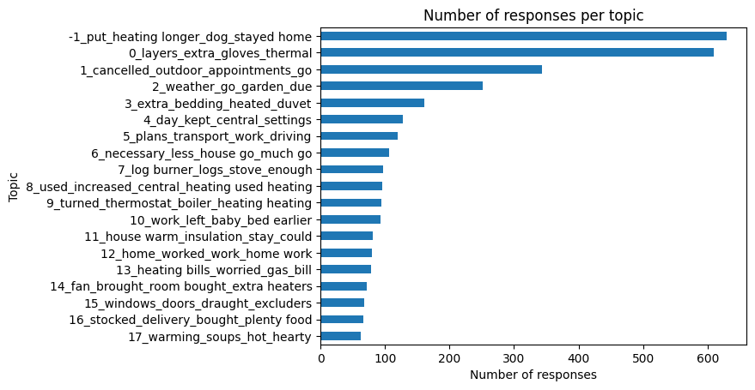
Number of responses per topic

Slide 27
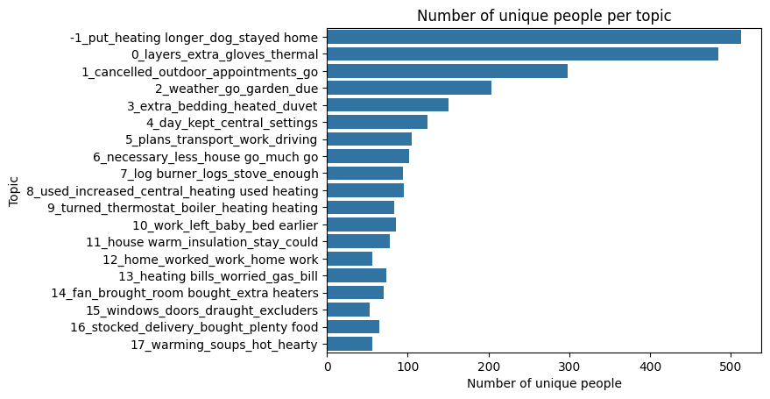
Number of unique people per topic

Slide 28

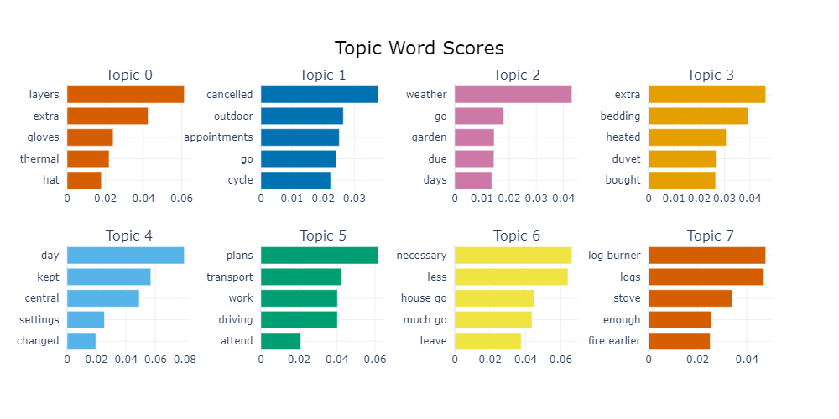

Slide 29

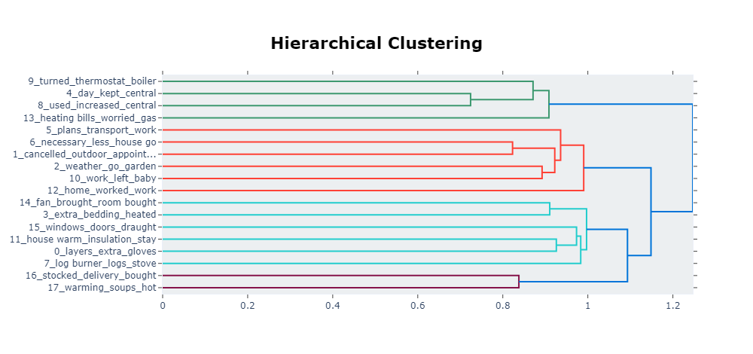
Notes:
I’ve found that diagnostically, the most useful plots are the hierarchical clustering and the get topic words from the previous slide. They give you a sense of how close topics are to one another and what topics are about.

Slide 30
Fine-tuning
As with all ML models, we have to do some fine tuning to improve our model.
You run your model, visualize the outputs and then tweak parameters and run again.
BERTopic does allow you to reduce the number of clusters or number of outliers after the model is trained, but this makes things a little bit less reproducible.

Slide 31
Other cool things you can do with BERTopic (not a comprehensive list)
Dynamic Topic Modelling: if your documents have a temporal element (e.g. publication date of paper titles or tweets) then you can map how topic representations change over time.
Zero-shot Topic Modelling: if you have some idea of what topics might appear in your data you can it a suggestion list and fine tune how much you want your topic model to pay attention to this.
BERTopic is quite a new tool and so is constantly being updated, zero-shot was released early September 2024!
The downside is that the “best practices” are still sort of developing in this area.
Thanks for listening ☺
Notes:
Note with Dynamic Topic Modelling, the clusters themselves won’t change over time, but their representation might. So what happens is you do topic modelling on all your documents regardless of time component and then you explore, given on the produces topics, how the representation varies over time.
Zero-shot ML problems are those where no labelled examples are given. An example might be if you trained a model to recognize images of horses with labelled data and then gave it enough info to deduce that zebras look like horses with black and white stripes. We considered using zeroshot for our analysis (and so there is some commented out code that can be directly integrated with the topic model) but decided that it felt like putting our assumptions on peoples’ lived experiences and so it would be more appropriate to just let the topic model run unsupervised and see what pops up.

Slide 32
The slide with the useful links:
Public GitHub Repo with my Python code and this PowerPoint (but no data): https://github.com/JGIBristol/ClimateTopicModelling
JGI Website: https://www.bristol.ac.uk/golding/
Data Science and Research Software Engineering Training: https://bristol-training.github.io/
My email: huw.day@bristol.ac.uk
Ask-JGI helpdesk email: ask-jgi@bristol.ac.uk

