Slide 1
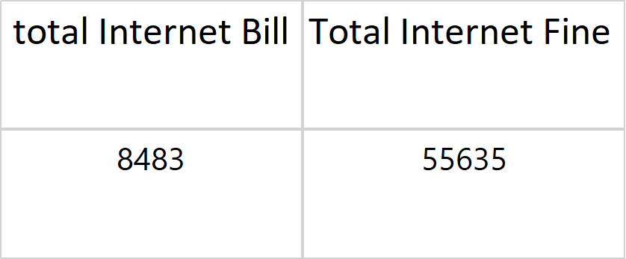
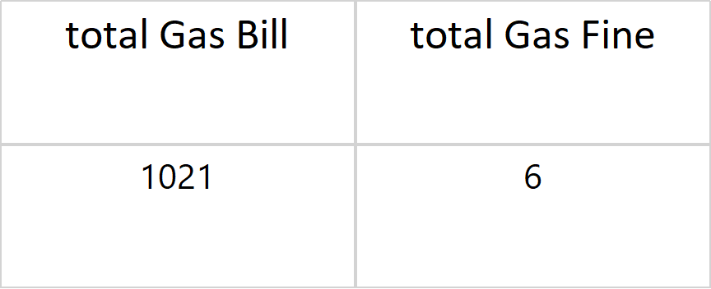
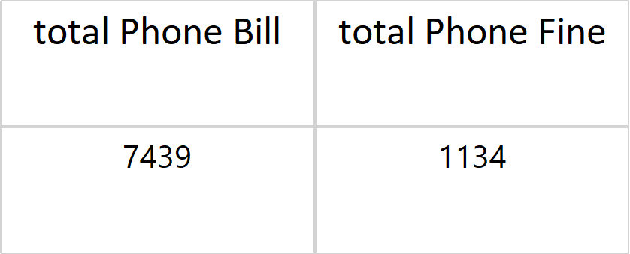
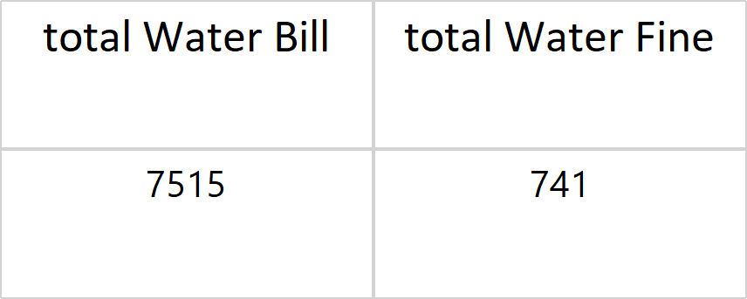
Utilities Information
Average of Internet Bill:
Average of Gas Bill:
942.555555555556
340.333333333333
Number of Internet Bills:
Number of Gas Bills:
9
3
Average of Phone Bill:
Average of Water Bill:
1239.83333333333
1503
Number of Phone Bills:
Number of Water Bills:
6
5

Slide 2
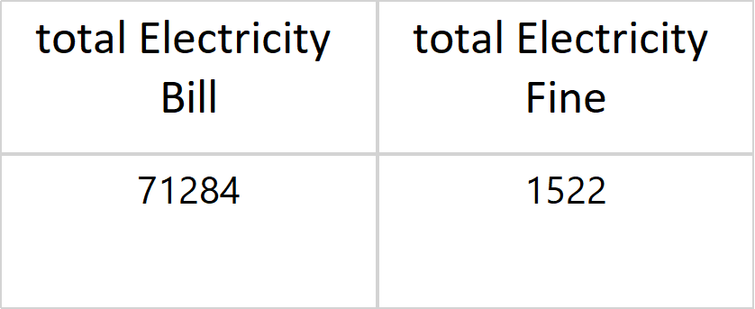
Average of Electricity Bill:
11880.6666666667
Number of Electricity Bills:
6
Bill Amounts on Same dates
total Internet Bill
total Gas Bill
total Water Bill
total Electricity Bill
1600
888
6666
11198
total Phone Bill
888

Slide 3
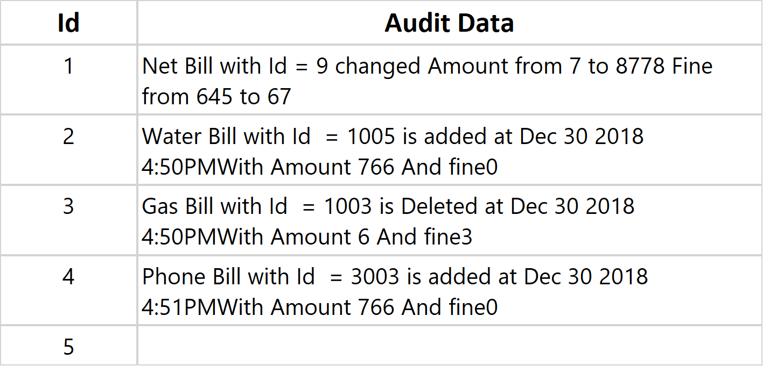
Bill Fines on Same dates
Total Internet Fine
total Gas Fine
total Water Fine
total Electricity Fine
6
8
666
561
total Phone Fine
8
Audits on All bills

Slide 4
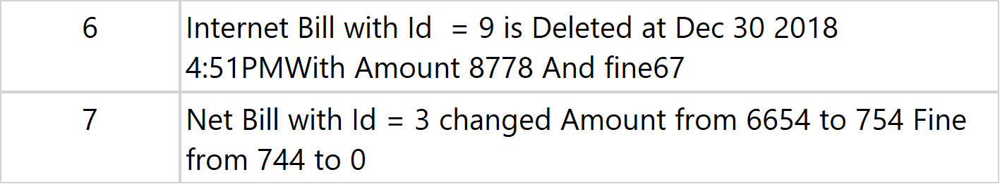
All rights reserved Neoteric group

