Slide 1

An Update on the $κ_{2}^{T}$ Universal Relation
5/29/19

Slide 2
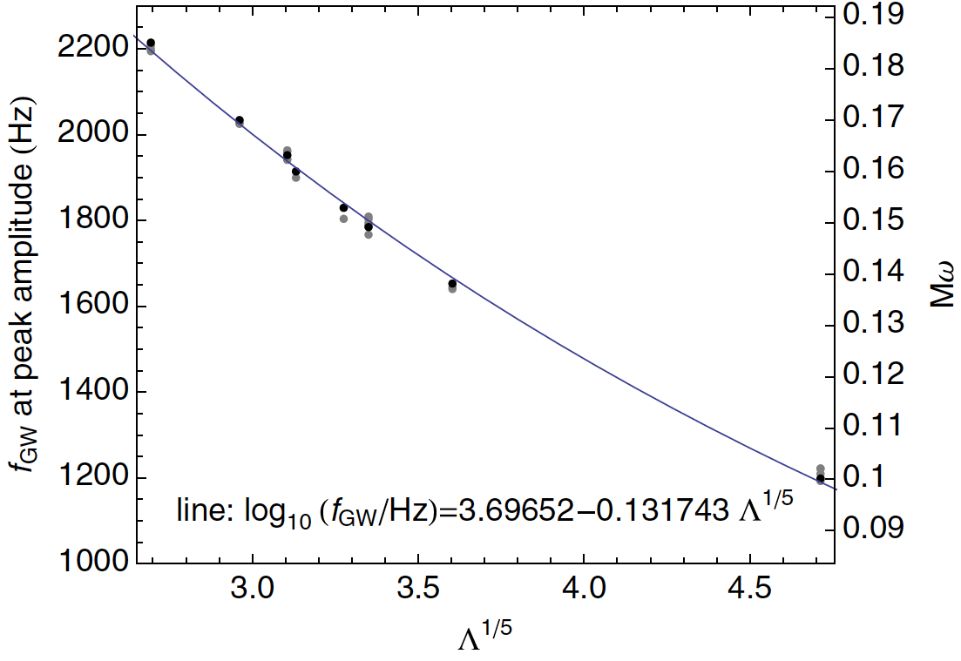
Read et. al. 2013
Relation between frequency at peak amplitude and tidal deformability of equal mass, non-spinning NS mergers

Slide 3
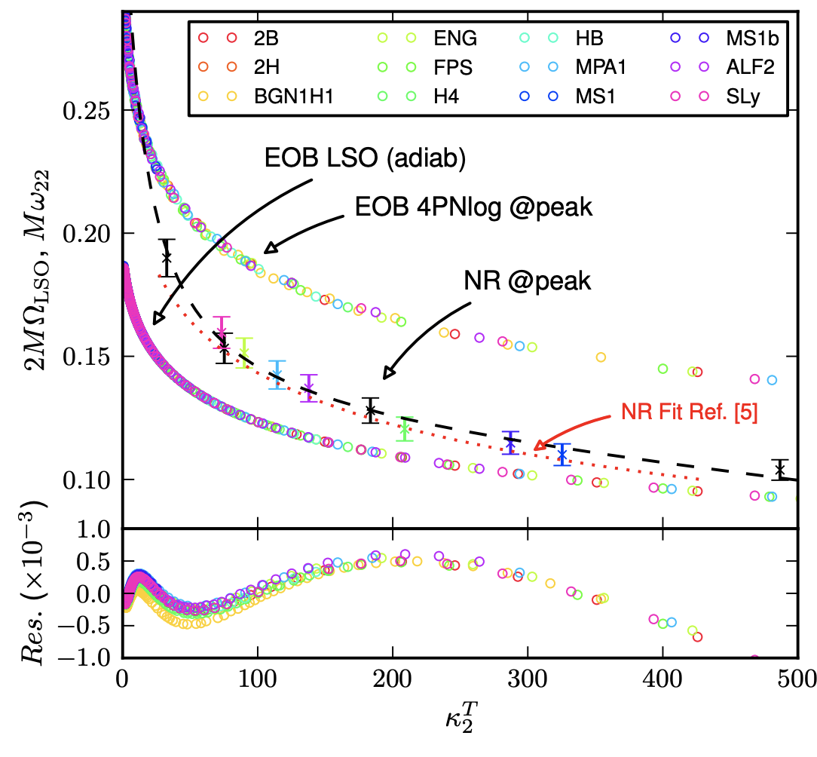
Bernuzzi et. al 2014
Relation between frequency at peak amplitude and mass by tidal coupling constant of equal mass, non-spinning NS mergers

Slide 4
Our Update
Used BAM files from the CoRe Numerical Relativity Database
Only used lowest resolution, highest extraction radius files
Used these files to recreate Read and Bernuzzi plots

Slide 5
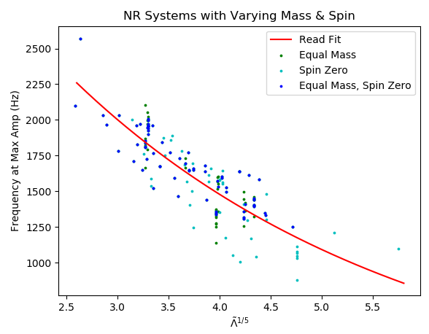
Our Update
Note the scatter compared to Read’s original fit

Slide 6
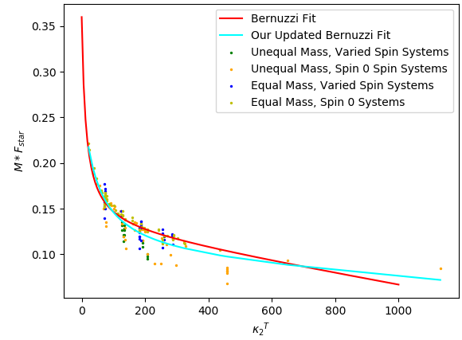
Our Update
Note the scatter not present in the Bernuzzi paper
Note also the the increased deviation from fit due to increased spin ratio

Slide 7
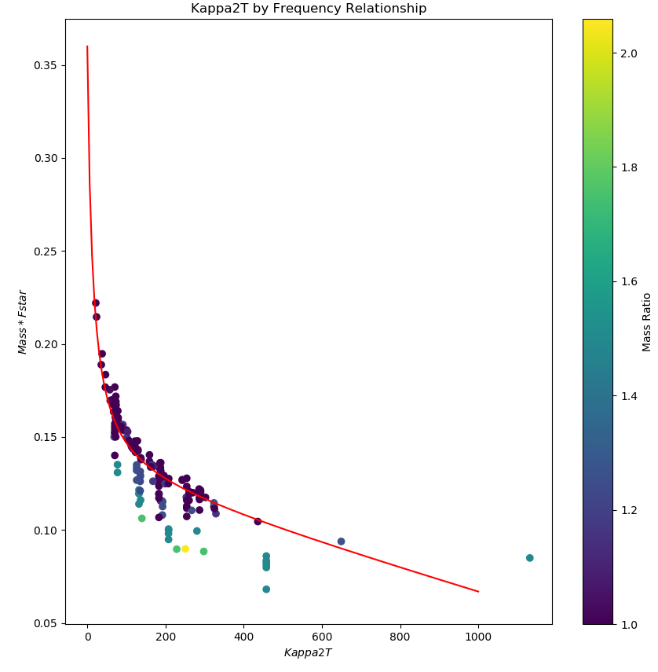
Our Update
Plot by Mass Ratio
Note the increasing ratio with increasing shift from fit

Slide 8
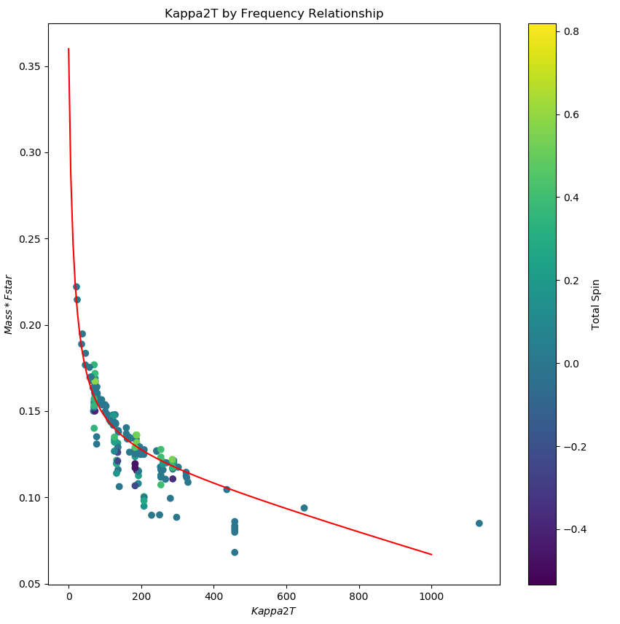
Our Update
Plot by Total Spin

Slide 9
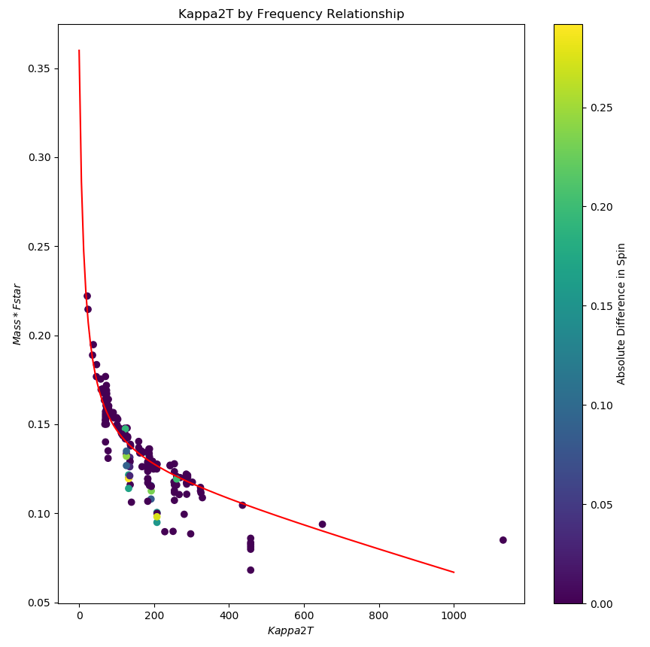
Our Update
Plot by Absolute Difference in Spin

