Slide 1

Live Weather Data Aggregation System
Group 15
Đỗ Doãn Hoàng Du – 20220060
Lê Gia Huy – 20225498
Nguyễn Tiến Thành – 20225459
Tăng Tiệu Long - 20225507

Slide 2
Project Overview
The project focuses on creating an end-to-end data pipeline to ingest, process, store, and visualize real-time weather data.
The system adopts a modular, fully containerized architecture for consistent deployment and easy scaling across all components.
The system is capable of:
  Continuously ingesting data from multiple sources (APIs, sensors).
  Processing and enriching data via streaming.
  Providing a powerful SQL query interface and visualization tools for data exploration.
  Dual-path outputs: OLAP (analytics data lake) and OLTP (serving DB for low-latency queries).
The entire platform is orchestrated through a multi-service Docker Compose environment. Each component—NiFi, Kafka, Spark, MinIO, Hive Metastore, MongoDB, Trino, and Superset—runs as a dedicated container, simplifying operations and enabling effortless scaling. This approach ensures reproducibility, fast setup, and clean service isolation.

Slide 3
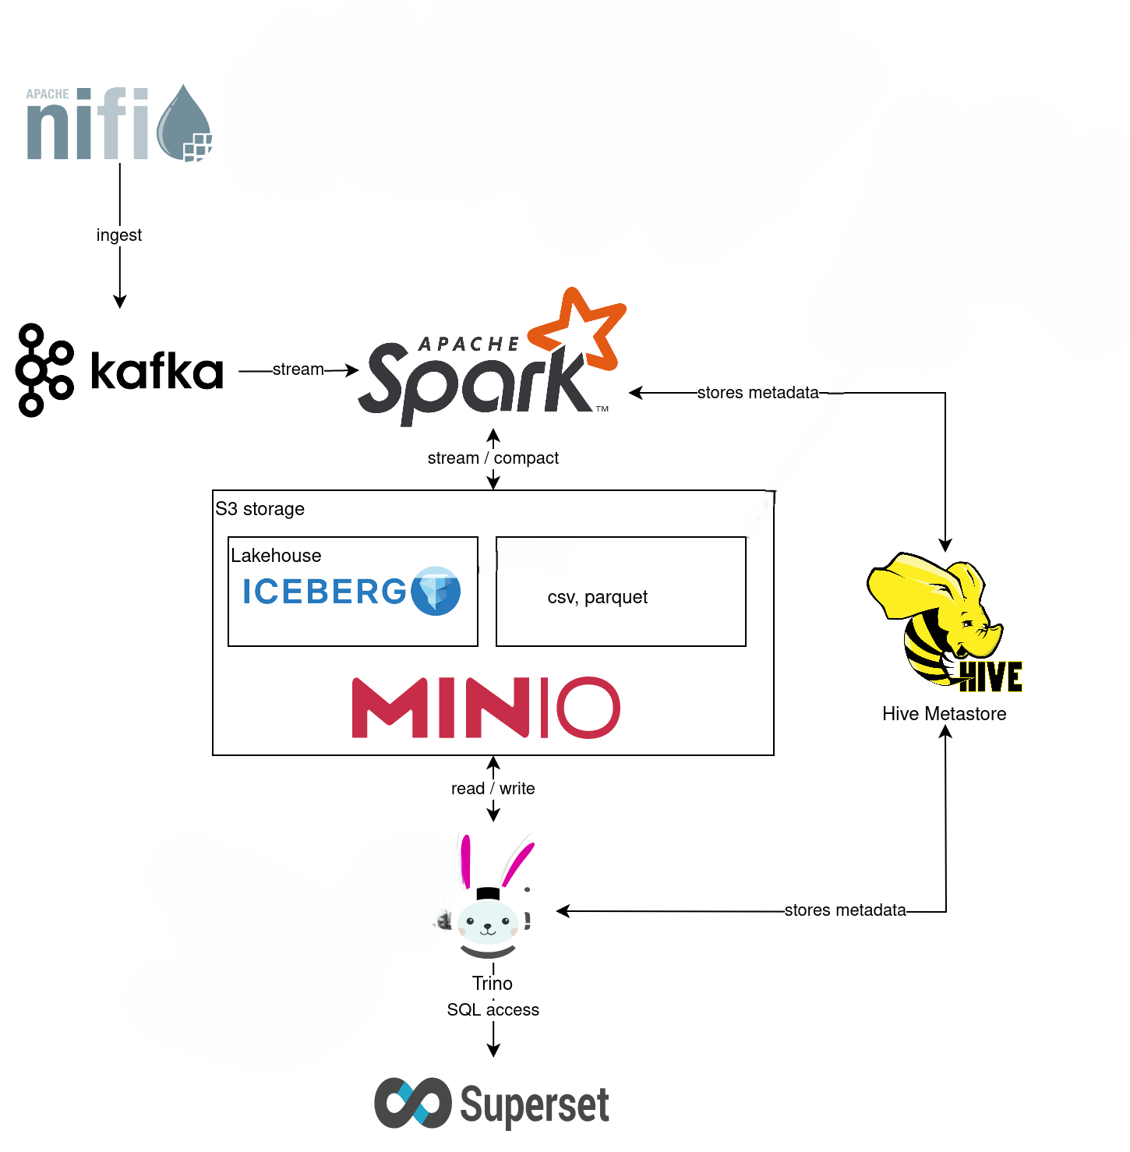
General architecture

Slide 4

Data Source
The system establishes a continuous data ingestion pipeline from a globally trusted meteorological provider to ensure high accuracy:
  Primary Source: Leveraged OpenWeatherMap API (Current Weather Data endpoint).
  Data Format: Semi-structured JSON containing nested weather metrics.
  Coverage: Real-time monitoring for provinces and cities in Vietnam.
  Key Metrics Extracted: Temperature (Celcius), Humidity (%), Wind Speed/Direction, and Pressure.

Slide 5
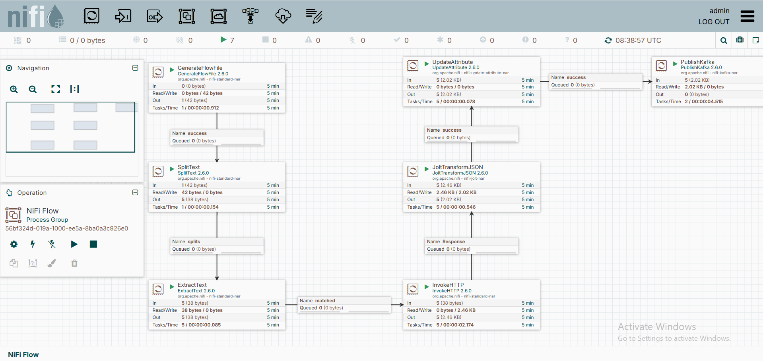
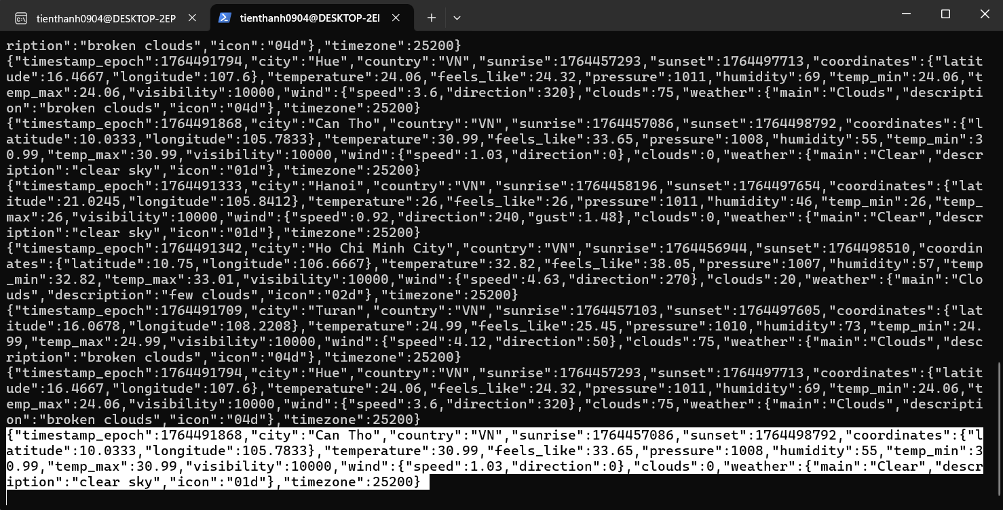
Data ingestion layer: Apache NiFi and Kafka
NiFi Flow: Automates multi-city weather data collection, transforms raw API responses, and publishes structured JSON messages to a Kafka topic.
Kafka Consumer: Reads and verifies the live messages streamed from the pipeline, ensuring that data is produced correctly and consistently in real time.
NiFi Flow
Kafka Consumer (terminal)

Slide 6
Streaming Flow with NiFi
NiFi Flow:
  Scheduler: Triggers the entire flow on a fixed schedule (e.g., every 15 minutes)
  Create List: Generates a FlowFile containing a list of target cities (Hanoi, Da Nang, etc.).
  Split: Splits the list into individual FlowFiles, one for each city.
  Extract: Reads the city name from the content and saves it as an attribute (e.g., city = "Hanoi").
  Fetch: Uses the city attribute to call the OpenWeatherMap API and get the raw JSON data.
  Transform: Cleans the raw JSON and adds a new timestamp field.
  Publish: Sends the final, clean JSON to the weather-data Kafka topic, using the city as the message key.

Slide 7
Data Processing with Apache Spark
Apache Spark: processes streaming weather data from Kafka and writes to Iceberg and MongoDB.
Key Workflow:
  Ingest: Consumes raw JSON events from Kafka topic “weather-data”.
  Parse & Clean: Validates data schema and handles missing values.
  Aggregate: Computes hourly weather statistics.
  Route: Distributes data to Iceberg (for analytics) and MongoDB (for real-time serving).

Slide 8
Apache Spark: Data Transformation and Aggregation Logic
Schema Enforcement: Raw JSON strings are parsed into DataFrames using a predefined schema (StructType). This ensures invalid data is rejected early in the pipeline.
Event-Time Processing: The system uses the actual event time rather than ingestion time. It also implemented a strategy to handle null timestamps by falling back to Kafka ingestion timestamp if API Timestamp is null.
Tumbling Windows: Data is grouped into 1-hour non-overlapping windows (e.g., 08:00-09:00, 09:00-10:00). The system also apply Watermarking Mechanism with 10 minutes threshold to handles late-arriving data and determines when a window is closed to flush results to storage.
Calculated Metrics: AVG/MAX/MIN(Temperature), AVG(Humidity), AVG(Pressure), AVG(Wind Speed). The system also implements custom User Defined Function (UDF) to classify weather conditions (e.g., "Scorching", "Comfortable") based on Temperature and Humidity.

Slide 9
Storage Layer - Apache Iceberg and MongoDB
The system splits processed data into two distinct storage layers optimized for different latency requirements:
  Analytics Path: We utilize MinIO, a high-performance, S3-compatible object storage system. On top of MinIO, we implement Apache Iceberg which brings database-like features to object storage. Spark will append data to Iceberg tables in batches after the aggregation window closes, ensuring efficient file sizing and read performance.
  Serving Path: We use MongoDB, a NoSQL document database with flexible schema, which perfectly matches the JSON structure of weather data. Spark will use an Upsert (Update or Insert) logic to continuously updates the document for each city with the latest weather information. This ensures that dashboards always display the most current state without needing complex aggregation queries at read time.

Slide 10
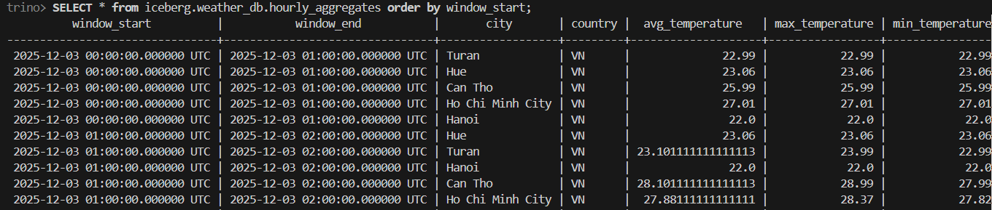
Query and Visualization Layer- Trino and Apache Superset
Trino: serves as the powerful distributed query engine designed to execute SQL queries on data stored in Iceberg. It connects to the Hive Metastore to retrieve table schema information, then reads Parquet files directly from MinIO to produce query results. This capability enables Apache Superset to visualize charts and analyze historical data with real-time responsiveness, high performance, and smooth interactive exploration, supporting deeper insights and more effective data-driven decision-making.

Slide 11
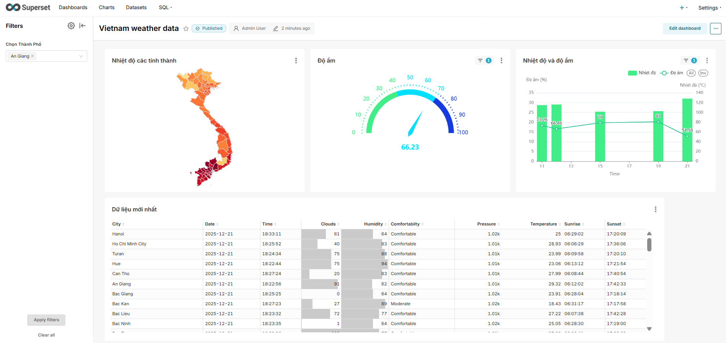
Query and Visualization Layer- Trino and Apache Superset
Apache Superset: serves as the user-facing layer, transforming raw data lake signals into meaningful visual stories.
  Implemented Geospatial Visualization (Deck.gl) to map data across Vietnamese provinces.
  Designed Gauge Charts with conditional formatting for immediate humidity alerts.
  Visualized temperature trends using Time-series Analysis and mixed-chart types.
  A dynamic table fetching data from the MongoDB "Hot Path", showing the latest weather metrics and comfort indices for each city.

Slide 12
THANK YOU !

