Slide 1
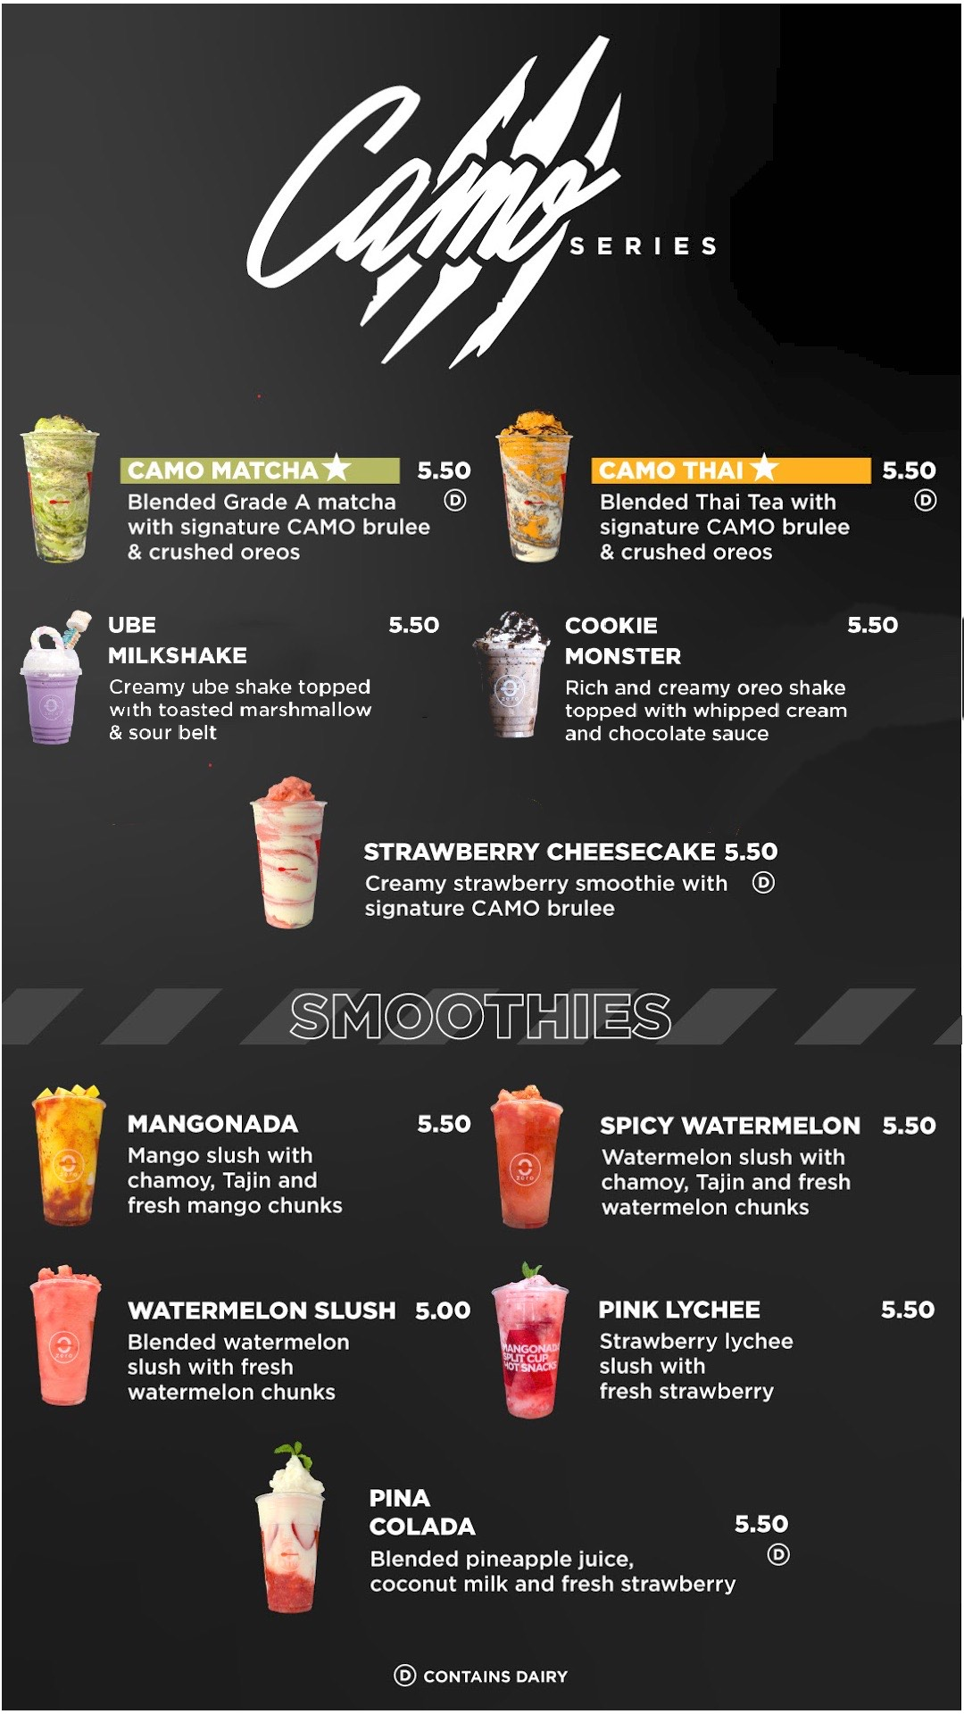
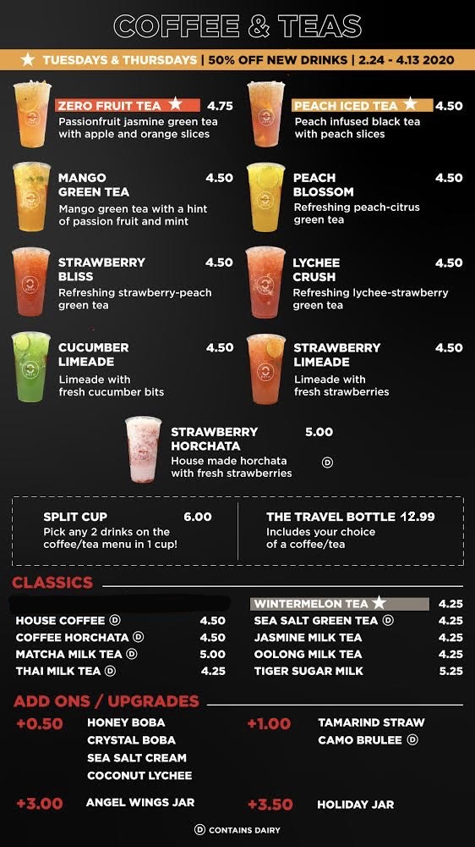
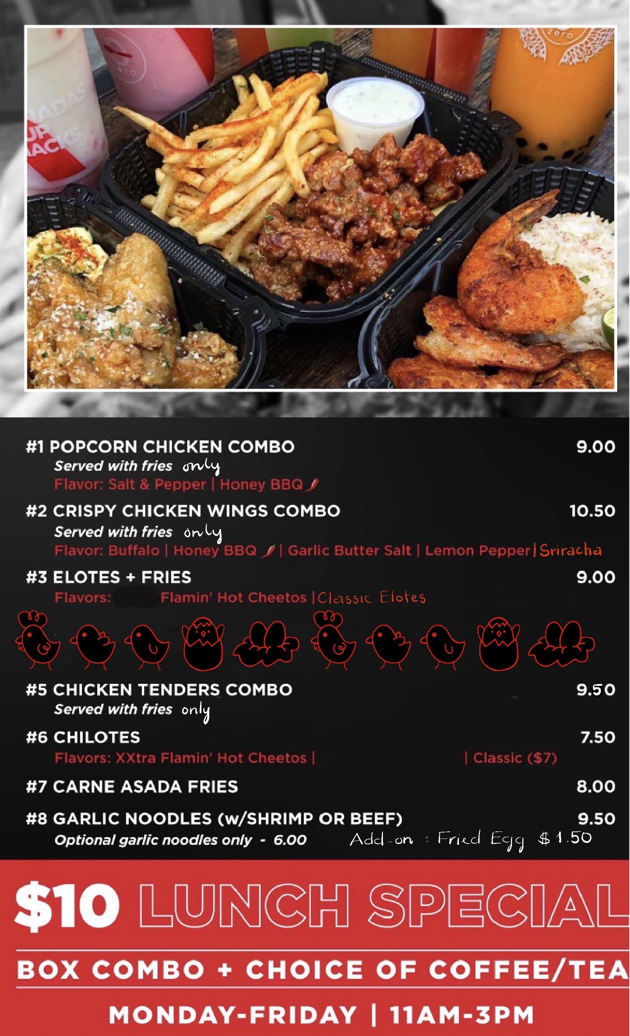
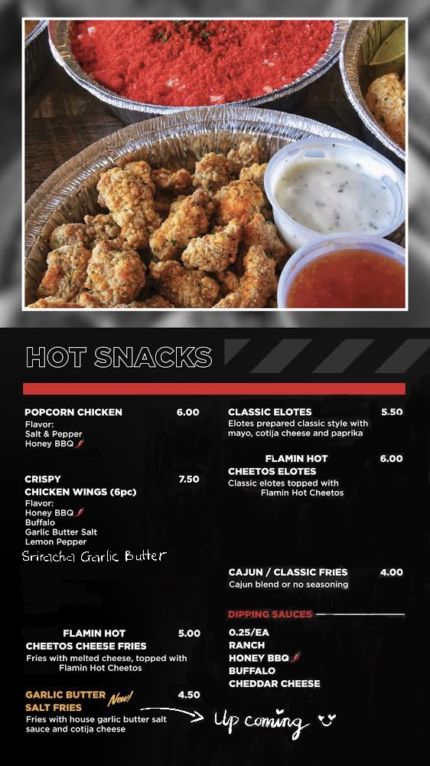
Zero Degrees Barker Cypress
11510 Barker Cypress Rd, Cypress, TX 77433 ( 11 A.M to 10 P.M everyday)
Call to order: (832) 653-3817
Due to Covid-19 outbreak, we are temporarily close at 8 P.M until further notice

