Slide 1
AWS CloudOps Agent
Built with AWS Strands Agents SDK

Slide 2
Contents
Challenges
Cloud AI Agent
Strands Agents
Architecture
Cost Estimation
Implementation Plan

Slide 3
Challenges
In Cloud-Computing

Slide 4

7 Most Common Cloud Computing Challenges
Data Security and Privacy
Cost Management
Multi-Cloud Environments
Performance Challenges
Interoperability and Flexibility
High Dependence on Network
Lack of Knowledge and Expertise

Slide 5
Cloud AI Agent
The Evolution of Cloud Operations

Slide 6
Cloud AI Agent Objectives
Ask and understand
Ask plain-language questions about cloud resources, incidents, and health.
Automate incidents
Diagnose, mitigate, and resolve incidents across monitoring dashboard or integrated tools.
The agent works autonomously or with approvals.
Stay proactive
Agent sends daily summaries of environment health, flags spikes in CPU/memory usage, and identifies resources that don't follow security best practices.

Slide 7
Strands Agents
An Open-Source AI Agent SDK

Slide 8
Strands Agents core concepts
The simplest definition of an agent is a combination of three things
Model
Tools
Prompt
The agent uses these three components to complete a task, often autonomously
Model
Prompt
Agent
Tools

Slide 9
Strands Agents main components
1 Model
Strands offers flexible model support.
You can additionally define your own custom model provider with Strands. (Ollama, Open AI, Anthropic, etc.)
2 Tools
You can choose from thousands of published Model Context Protocol (MCP) servers to use as tools for your agent.
3 Prompt
You provide a natural language prompt that defines the task for your agent, such as answering a question from an end user.

Slide 10
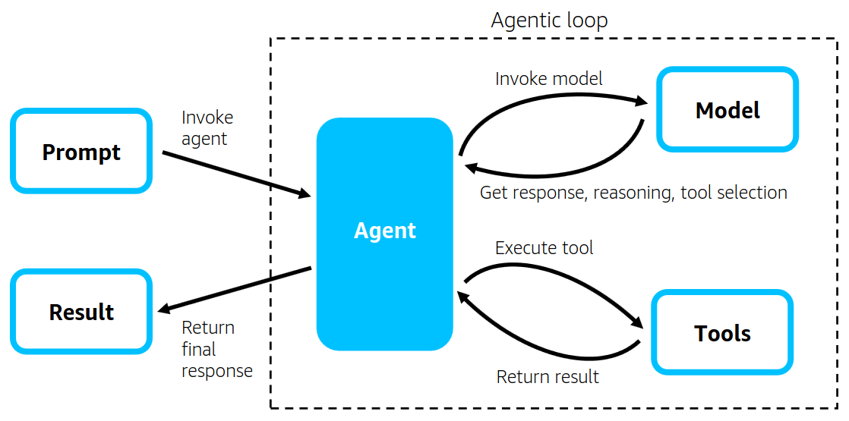
Strands Agents main components
Introducing Strands Agents, an Open Source AI Agents SDK | AWS Open Source Blog

Slide 11
Architecture
An initial overview of the design system

Slide 12
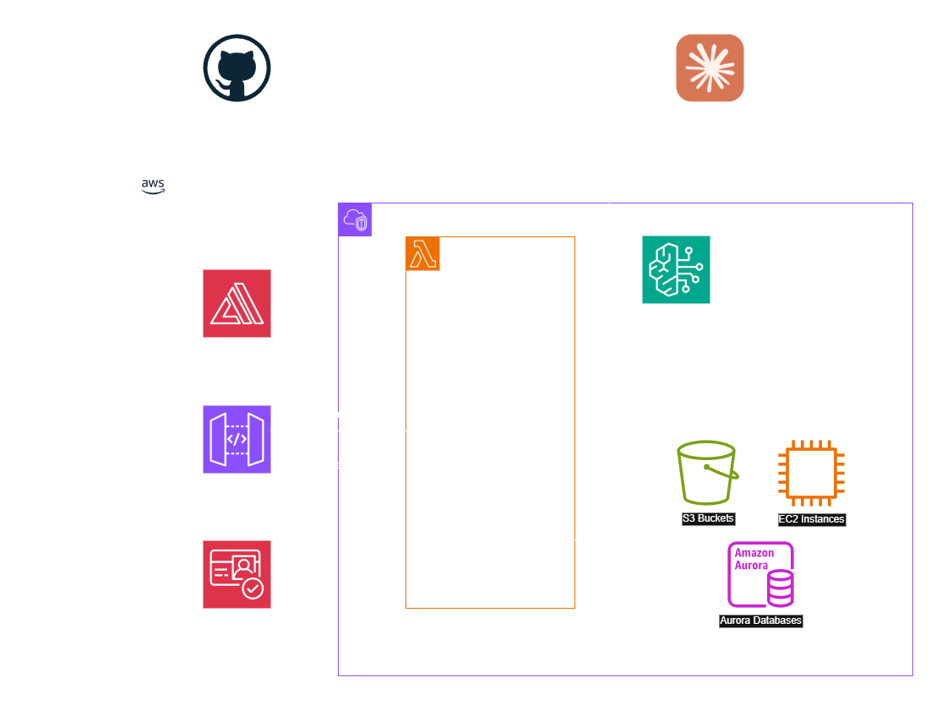
Architecture

Slide 13
Cost Estimation
Summary of ASW expenses

Slide 14
Cost Estimation
Service | AWS Cost | BD Cost
Amazon Amplify (Front-end) | Hosting: ~$1-15/month (depends on traffic) Build minutes: $0.01 per build minute Data transfer: $0.15/GB after 15GB free tier | N/A
Amazon Cognito (Authentication) | User pools: Free for first 50,000 MAUs, then $0.0055 per MAU Identity pools: Free for first 50,000 identities, then $0.15 per 10,000 | N/A
Amazon API Gateway (API) | REST API: $3.50 per million requests WebSocket: $1.00 per million messages Free tier: 1 million requests/month for 12 months | N/A
AWS Lambda (Agent Runtime) | $0.20 per 1M requests $0.0000166667 per GB-second of compute Free tier: 1M requests + 400,000 GB-seconds/month | N/A
Amazon Bedrock (LLM Provider) | Varies by model (Claude, Titan, etc.) Input tokens: ~$0.003-0.015 per 1K tokens Output tokens: ~$0.015-0.075 per 1K tokens | N/A
Typical Small-Medium App Estimate: $50-500/month

Slide 15
Implementation Plan
Timeline with objectives

Slide 16
Implementation Plan
Phase | Timeline in days | Objectives
0 | - | Prepare AWS resources
1 | 10 | Development Agent Core Function
 | 1 | Rollout prototype V1.0 – Running in terminal
 | 2 | Deploy Agent to AWS Cloud
 | 1 | Rollout prototype V1.1 – Running on AWS Cloud
2 | 10 | Front-end Development
 | 1 | Rollout Cloud Agent V2.0
3 | 10 | Monitor – Feedback – Document

