Slide 1
Variants
Nate Foster
Spring 2020
Today’s music: Union by The Black Eyed Peas (feat. Sting)
Notes:
Music: 2 copies, start at 9:59:58
Variants are "tagged unions"

Slide 2
Clicker Question 1

Slide 3

WICC
Women in Computing at Cornell

Slide 4
Pattern Matching on Lists
Demo
Notes:
(* pattern matching on lists *)
let empty lst =
match lst with
| [] -> true
| h :: t -> false
let empty' lst =
match lst with
| [] -> true
| _ :: _ -> false
let empty'' lst =
match lst with
| [] -> true
| _ -> false
let rec sum lst =
match lst with
| [] -> 0
| h :: t -> h + sum t
let rec sum' = function
| [] -> 0
| h :: t -> h + sum t

Slide 5
Pattern matching
Syntax:
match e with
| p1 -> e1
| p2 -> e2
| …
| pn -> en
p1..pn: pattern expressions

Slide 6
Semantics of pattern matching
[] matches [] and nothing else
h :: t
matches 2::[], binding h to 2 and t to []
matches 1::3::[], binding h to 1 and t to 3::[]
_ matches everything underscore character, called wildcard (it’s like a blank space)
Full details in textbook

Slide 7
Question 4
match ["taylor"; "swift"] with
| [] -> "1989"
| h :: t -> h
To what value does the above expression evaluate?
“taylor”
“swift”
“1989”
[]
h
Notes:
Correct answer: A.

Slide 8
Pattern Matching is INCREDIBLE
Three ways pattern matching detects programmer error
Cf. textbook 3.1.1.4
Demo
Notes:
let bad_empty lst =
match lst with
| [] -> true
(* The code above causes the compiler to produce the following warning: *)
(*
Warning 8: this pattern-matching is not exhaustive.
Here is an example of a case that is not matched:
_::_
*)
let rec bad_sum lst =
match lst with
| h :: t -> h + sum t
| [x] -> x
| [] -> 0
(* The code above causes the compiler to produce the following warning: *)
(*
Warning 11: this match case is unused.
*)
let rec bad_sum' lst =
List.hd lst + bad_sum' (List.tl lst)
(* The code above raises an exception when applied to the empty list *)

Slide 9
Review
Previously in 3110:
Lists, records, tuples
Pattern matching
Today:
Variants

Slide 10
Variants
Demo
Notes:
(* simplest variant: constant constructors *)
type primary_color = Red | Blue | Green
let c = Red
(* more complicated variant with non-constant constructors *)
type point = float * float
type shape =
| Circle of {center : point; radius : float}
| Rectangle of {lower_left : point; upper_right : point}
(* | Point of point *) (* we'll add this later: when we do note warning *)
let s = Circle {center=(0.,0.); radius=1.}
let mid a b =
(b -. a) /. 2.
let center = function
| Circle {center} -> center
| Rectangle {lower_left=(x_ll, y_ll); upper_right=(x_ur, y_ur)} ->
(mid x_ll x_ur, mid y_ll y_ur)
(* | Point p -> p *) (* we'll add this later *)
(* the code for [center] above is equivalent to this more verbose version
that doesn't take advantage of various pieces of syntactic sugar
and pattern syntax *)
let center_verbose s =
match s with
| Circle {center=c} -> c
| Rectangle {lower_left=ll; upper_right=ur} ->
let x_ll, y_ll = ll in
let x_ur, y_ur = ur in
(mid x_ll x_ur, mid y_ll y_ur)

Slide 11
Variant types
Type definition syntax:
type t =
| C1 of t1
| ...
| Cn of tn
Optional data carried by constructor
Constructors aka tags

Slide 12
Clicker Question 2

Slide 13
Variant: union
type string_or_int =
| String of string
| Int of int
strings
ints
∪

Slide 14
Variant: tagged union
type blue_or_pink_int =
| Blue of int
| Pink of int
ints
ints
⨄

Slide 15
Recursive variants
Demo
Notes:
type intlist =
| Nil
| Cons of int * intlist
let rec length = function
| Nil -> 0
| Cons (_,t) -> 1 + length t

Slide 16
Parameterized variants
Demo
Notes:
type stringlist =
| Nil
| Cons of string * stringlist
let rec length = function
| Nil -> 0
| Cons (_,t) -> 1 + length t
(* poor engineering to copy code! *)
(* parameterized variants *)
type 'a mylist =
| Nil
| Cons of 'a * 'a mylist
let rec length = function
| Nil -> 0
| Cons (_,t) -> 1 + length t

Slide 17
List implementation
OCaml just codes up lists as variants:
type 'a list = [] | (::) of 'a * 'a list
list is a type constructor parameterized on type variable 'a
[] and :: are constructors
Notes:
(* lists are just parameterized recursive variants *)
type 'a mylist =
| []
| (::) of 'a * 'a mylist
let rec length = function
| [] -> 0
| _ :: t -> 1 + length t

Slide 18
Options
Notes:
Options solve a very real problem that you know from Java: null pointer exceptions
(But options are more general than that.)

Slide 19

Option: A built-in variant
type 'a option = None | Some of 'a
Demo
Notes:
"Maybe" something in the box, maybe not
Options are parameterized but not recursive variants.
Stdlib.max;;
let rec list_max = function
| [] -> None
| h :: t ->
match list_max t with
| None -> Some h
| Some m -> Some (max h m)

Slide 20

Tony Hoare
Turing Award 1980
For his “fundamental contributions to the definition and design of programming languages.”
Inventor of quicksort
b. 1934
“I call [null] my billion-dollar mistake…I was designing the…type system for…an object-oriented language. I couldn’t resist the temptation to put in a null reference…This has led to innumerable errors, vulnerabilities, and system crashes, which have probably caused a billion dollars of pain and damage in the last forty years."
Notes:
Part of the problem is that programmers forget to check whether something is null or not.

Slide 21
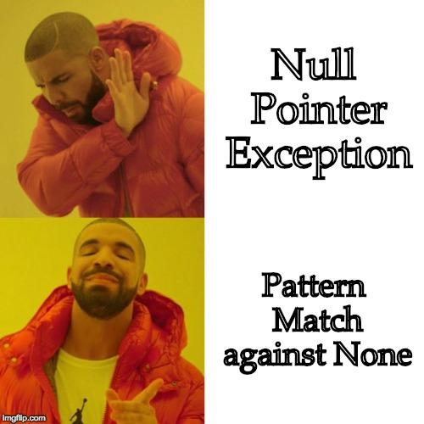

Slide 22
Exceptions

Slide 23
Exceptions are extensible variants
type exn
exception MyNewException of string
Type exn is an extensible variant that may have new constructors added after its original definition
Raise exceptions with raise e, where e is a value of type exn
Handle exceptions with pattern matching, just like you would process any variant

Slide 24
Upcoming events
[Tonight, 6-7pm] WICC Partner Finding
[Wed] A1 due
[Thu] A2 out
[Mon] R2 due
This is powerful.
THIS IS 3110

