Slide 1
Proofs about Programs, part II
Nate Foster
Spring 2020
Today’s scene: One Ring Donuts

Slide 2
Review
Previously in 3110:
Proofs about programs
Equational reasoning
Today:
Induction on natural numbers, lists, trees
Proofs about recursive functions on those types
Algebraic specifications of data structures

Slide 3
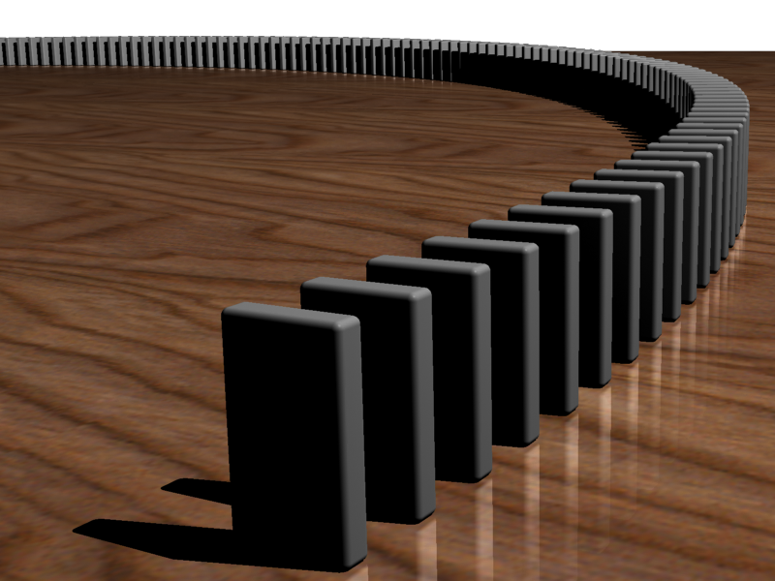
Induction principle on naturals
forall properties P,
if P(0)
and (forall k, P(k) implies P(k+1))
then (forall n, P(n))

Slide 4
Induction principle on lists
forall properties P,
if P([])
and (forall h t, P t implies P (h :: t))
then (forall lst, P lst)

Slide 5
Induction on lists
Theorem: forall lst, P(lst).
Proof: by induction on lst
Base case: lst = []
Show: P([])
Inductive case: lst = h :: t
IH: P(t)
Show: P(h :: t)
QED

Slide 6
Example: map
Theorem: forall f g,
(map f) << (map g) = map (f << g)
let rec map f = function
| [] -> []
| h :: t -> f h :: map f t
let compose f g x = f (g x)
let (<<) = compose
Notes:
Proof.
By extensionality, we need to show:
forall lst, ((map f) << (map g)) lst = map (f << g) lst
((map f) << (map g)) lst
= { eval << }
(map f) ((map g) lst)
= { remove parens }
map f (map g lst)
So we need to show:
forall lst, map f (map g lst) = map (f << g) lst
We do so by induction on lst.
P(lst) = map f (map g lst) = map (f << g) lst
Base case: lst = []
Show: map f (map g []) = map (f << g) []
map f (map g [])
= { eval }
map f []
= { eval }
[]
map (f << g) []
= { eval }
[]
Inductive case: lst = h :: t
IH: map f (map g t) = map (f << g) t
Show: Show: map f (map g (h :: t)) = map (f << g) (h :: t)
map f (map g (h :: t))
= { eval inner map }
map f (g h :: map g t)
= { eval outer map }
f (g h) :: map f (map g t)
= { IH }
f (g h) :: map (f << g) t
map (f << g) (h :: t)
= { eval map }
(f << g) h :: map (f << g) t
= { eval first << }
f (g h) :: map (f << g) t
QED

Slide 7
Binary trees
type 'a tree =
| Leaf
| Node of 'a tree * 'a * 'a tree

Slide 8
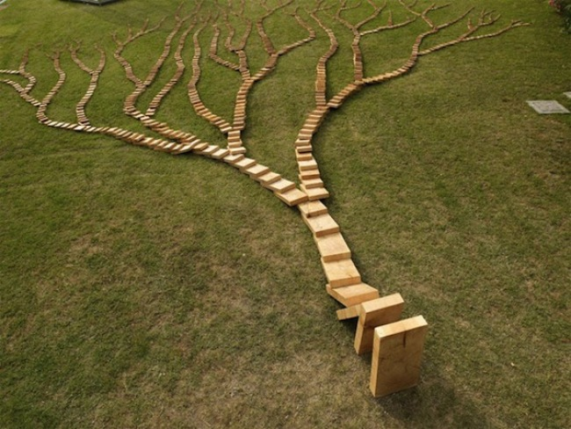
Induction principle on trees
forall properties P,
if P(Leaf)
and (forall v l r,
(P(l) and P(r)) implies P(Node (l, v, r)))
then forall t, P(t)

Slide 9
Induction on trees
Theorem: forall t, P(t).
Proof: by induction on t
Case: n = Leaf
Show: P(Leaf)
Case: n = Node (l, v, r)
IH1: P(l)
IH2: P(r)
Show: P(Node (l, v, r))
QED

Slide 10
Example: leaves and nodes
let rec nodes = function
| Leaf -> 0
| Node (l, _, r) ->
1 + nodes l + nodes r
let rec leaves = function
| Leaf -> 1
| Node (l, _, r) ->
leaves l + leaves r
Theorem: forall t, leaves t = 1 + nodes t
Notes:
Proof: by induction on t
P(t) = leaves t = 1 + nodes t
Base case: t = Leaf
Show: leaves Leaf = 1 + nodes Leaf
leaves Leaf
= { eval }
1
1 + nodes Leaf
= { eval }
1 + 0
= { algebra }
1
Inductive case: t = Node (l, v, r)
IH1: leaves l = 1 + nodes l
IH2: leaves r = 1 + nodes r
Show: leaves (Node (l, v, r)) = 1 + nodes (Node (l, v, r))
leaves (Node (l, v, r))
= { eval }
leaves l + leaves r
= { IH1 }
1 + nodes l + leaves r
= { IH 2}
1 + nodes l + 1 + nodes r
= { algebra }
2 + nodes l + nodes r
1 + nodes (Node (l, v, r))
= { eval }
1 + 1 + nodes l + nodes r
= { algebra }
2 + nodes l + nodes r
QED

Slide 11
Induction vs. Recursion
What induction principles tell us about

Slide 12
Induction vs. recursion
Inductive proofs are like recursive programs
 | Proofs | Programs
Per constructor… | One proof case | One pattern-matching branch
On smaller value… | Use IH | Make recursive call

Slide 13
Part II: Algebraic Specifications

Slide 14
Stack
module type Stack = sig
type 'a t
val empty : 'a t
val is_empty : 'a t -> bool
val peek : 'a t -> 'a
val push : 'a -> 'a t -> 'a t
val pop : 'a t -> 'a t
end
Notes:
Note lack of [option]s. So [peek] (and probably [pop]) must involve some exceptions.
Colors will become meaningful later in lecture

Slide 15
Specification comment
(** [push x s] is the stack [s]
with [x] pushed on the top *)
val push : 'a -> 'a stack -> 'a stack
Not suitable for verification: no equational proof suggested by spec

Slide 16
Equational specification
aka algebraic specification
is_empty empty = true
is_empty (push x s) = false
peek (push x s) = x
pop (push x s) = s
Every equation shows how to simplify an expression

Slide 17
Simplification
peek (pop (push 1 (push 2 empty)))
= { simplify pop/push with eq 4 }
peek (push 2 empty)
= { simplify peek/push with eq 3 }
2

Slide 18
Algebraic specification
(a + b) + c = a + (b + c)
a + b = b + a
a + 0 = a
a + (-a) = 0
(a * b) * c = a * (b * c)
a * b = b * a
a * 1 = a
a * 0 = 0
a * (b + c) = a * b + a * c
Notes:
By analogy: in algebra we have similar specifications based on equalities between operations

Slide 19
Stack implementation, as list
module Stack = struct
type 'a t = 'a list
let empty = []
let is_empty s = (s = [])
let peek = List.hd
let push = List.cons
let pop = List.tl
end
All of our equations hold simply “by evaluation” for this impl.

Slide 20
Example proof: eq 4
pop (push x s)
= { eval push and pop }
tl (x :: s)
= { eval tl }
s

Slide 21
Designing Equations

Slide 22
Canonical form
canonical: conforming to some rule
Only build up structure
Not canonical: pop (push 1 (push 2 empty))
Canonical: push 2 empty
Every value of data structure can be created solely with operations that create canonical forms

Slide 23
Categories of operations
Generator: create canonical form
Manipulator: create non-canonical form
Query: create value of different type

Slide 24
Stack
module type Stack = sig
type 'a t
val empty : 'a t
val is_empty : 'a t -> bool
val peek : 'a t -> 'a
val push : 'a -> 'a t -> 'a t
val pop : 'a t -> 'a t
end
generator
query
generator
manipulator

Slide 25
Designing equations
query
x
generator
manipulator
is_empty empty = true
is_empty (push x s) = false
peek (push x s) = x
pop (push x s) = s
Note what’s missing: peek empty, pop empty
Notes:
Might not have equation for every possible interaction, because some might not be meaningful.
For example, [peek empty] and [pop empty] not included here, because they are errors.

Slide 26
Sets

Slide 27
Sets
module type Set = sig
type 'a t
val empty : 'a t
val is_empty : 'a t -> bool
val add : 'a -> 'a t -> 'a t
val mem : 'a -> 'a t -> bool
val remove : 'a -> 'a t -> 'a t
end

Slide 28
Sets
module type Set = sig
type 'a t
val empty : 'a t
val is_empty : 'a t -> bool
val add : 'a -> 'a t -> 'a t
val mem : 'a -> 'a t -> bool
val remove : 'a -> 'a t -> 'a t
end

Slide 29
Designing equations
is_empty
x
empty
mem
add
remove

Slide 30
Equational specification
is_empty empty = true
is_empty (add x s) = false
mem x empty = false
mem y (add x s) = true if x = y
mem y (add x s) = mem y s if x <> y
remove x empty = empty
remove y (add x s) = remove y s if x = y
remove y (add x s) = add x (remove y s) if x <> y
RHS of eqn applies non-generator to smaller input than LHS
Notes:
We can’t completely get rid of [remove] in those last two equations, but we can ensure it’s applied to a smaller input.
Recursively, eventually that means it could get down to [empty].

Slide 31
Upcoming events
[Friday]: Project MS2 due on CMS
[Monday/Tuesday]: Project MS2 demos
This is verified.
THIS IS 3110

