Slide 1
Modular Programming
Nate Foster
Spring 2020
Today’s music: "Giorgio By Moroder" by Daft Punk
Notes:
Start at 10:03:20 at 2:00 into music; it ends at about 8:40 and has a little talking in the middle
.
I chose this music because it mentions the Moog modular synthesizer in a monologue by Giorgio, who pioneered electronic dance music.

Slide 2
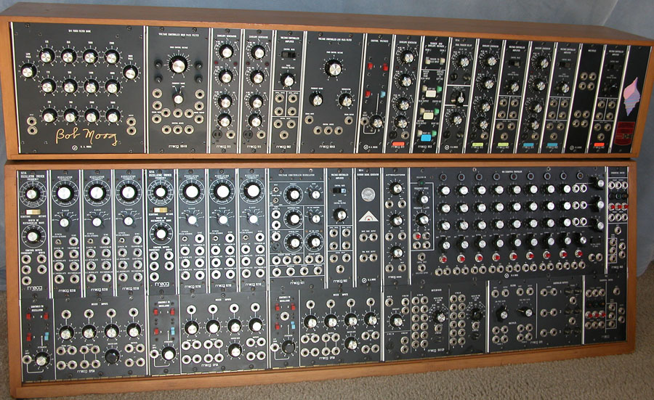
Moog modular synthesizer
Based in Trumansburg, NY, 1953-1971
Game changing! picked up by the Beatles, the Rolling Stones…
Notes:
Lots of individual modules you could plug in, patch through, and change the sound.

Slide 3
Clicker Question 1

Slide 4
Review
Previously in 3110:
how to build small programs
Today:
language features for building large programs: structures, signatures, modules

Slide 5
Clicker Question 2

Slide 6
Scale
Staff solution to A1: 100 LoC
OCaml: 200,000 LoC
Unreal engine 3: 2,000,000 LoC
Windows Vista: 50,000,000 LoC
http://www.informationisbeautiful.net/visualizations/million-lines-of-code/
...can’t be done by one person
...no individual programmer can understand all the details
...too complex to build with OCaml we’ve seen so far
Notes:
Unreal 3: Arkham Asylum, Bioshock Infinite, Dishonored

Slide 7
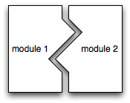
Modularity
Modular programming: code comprises independent modules
developed separately
understand behavior of module in isolation
reason locally, not globally

Slide 8
Java features for modularity
classes, packages: organize identifiers (classes, methods, fields, etc.) into namespaces
interfaces: describe related classes
public, protected, private: control what is visible outside a namespace
subtyping, inheritance: enables code reuse

Slide 9
OCaml features for modularity
structures: organize identifiers (functions, values, etc.) into namespaces
signatures: describe related modules
abstract types: control what is visible outside a namespace
functors, includes: enable code reuse
...the OCaml module system

Slide 10
Structures
Demo
Notes:
module MyStack = struct
type 'a stack =
| Empty
| Entry of 'a * 'a stack
let empty = Empty
let is_empty s = s = Empty
let push x s = Entry (x, s)
let peek = function
| Empty -> failwith "Empty"
| Entry(x,_) -> x
let pop = function
| Empty -> failwith "Empty"
| Entry(_,s) -> s
end
------> Design choice: raise exceptions in peek/pop? Or return option?
module ListStack = struct
type 'a stack = 'a list
let empty = []
let is_empty s = s = []
let push x s = x :: s
let peek = function
| [] -> failwith "Empty"
| x::_ -> x
let pop = function
| [] -> failwith "Empty"
| _::xs -> xs
end

Slide 11
Structures
Collections of definitions
Evaluated in order
Structure can be bound to module name
Structures are second class

Slide 12
Signatures
Demo
Notes:
module type MyStackSig = sig
type 'a stack =
| Empty
| Entry of 'a * 'a stack
val empty : 'a stack
val is_empty : 'a stack -> bool
val push : 'a -> 'a stack -> 'a stack
val peek : 'a stack -> ’a
val pop : 'a stack -> 'a stack
end
module type ListStackSig = sig
type 'a stack = ‘a list
val empty : 'a stack
val is_empty : 'a stack -> bool
val push : 'a -> 'a stack -> 'a stack
val peek : 'a stack -> ’a
val pop : 'a stack -> 'a stack
end
-----> MyStack : MyStackSig, ListStack : ListStackSig; don’t talk about abstract types yet

Slide 13
Signatures
Collections of declarations (and some definitions)
Not evaluated; just type checked
Signature can be bound to module type name
Signatures are second class

Slide 14
Type checking
If you give a module a type...
module Mod : Sig = struct ... end
Then type checker ensures...
Signature matching: everything declared in Sig must be defined in Mod (OK to add new definitions to Mod that aren't declared in Sig)
Encapsulation: nothing other than what’s declared in Sig can be accessed from outside Mod
Demo
Notes:
Demo:
Play with what happens when stacks are given signatures
What does utop show?
What can you add/subtract from signature?
What can you access from outside?

Slide 15
Clicker Question 3

Slide 16
Abstract types
Demo
Notes:
module type Stack = sig
type 'a stack
…
end
Demo:
Encapsulate the rep type of MyStack or ListStack
What can you see from the outside? What becomes abstract?

Slide 17
Exposure is bad
Client code shouldn't need to know what the representation type is
Rule of thumb: clients will exploit knowledge of representation if you let them
Client code shouldn't get to know what the representation type is

Slide 18
Queues
Study two implementations in today’s demo code and in textbook

Slide 19
OCaml features for modularity
structures: organize identifiers (functions, values, etc.) into namespaces
signatures: describe related modules
abstract types: control what is visible outside a namespace
functors, includes: enable code reuse [next lec]

Slide 20
Upcoming events
[Tomorrow] A1 due
[Thursday] A2 out
[Thurday] Level Up: Command-Line!
This is game changing.
THIS IS 3110

