Slide 1
Final Exam Review

Slide 2
Outline
How to study
Review--suggested topics:
Efficiency
Balanced Trees
Interpreters
Substitution, Environment Models
Hash Tables
Streams, Laziness
Type Checking
Promises, Monads
Proofs about Programs
Ask questions anytime! Also Q&A at end.
Notes:
Spencer:
Balanced Trees
Interpreters
Promises, Monads
Type Checking
Proofs about Programs
John:
Substitution, Env Models
Hash Tables
Streams, Laziness
Efficiency

Slide 3
How To Study
Study material that you don’t understand
Do textbook exercises
Do practice exams
Ask questions on Slack / Canvas

Slide 4
EFFICIENCY

Slide 5
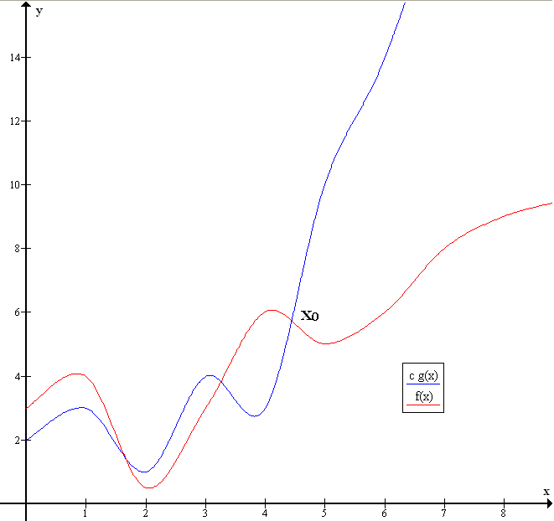
Efficiency: Review
O(g) = { f | ∃c > 0, n₀ > 0. ∀n ≥ n₀. f(n) ≤ c g(n) }
f(n) ∈ O(g(n)) as there exists c > 0 (e.g., c = 1) and n₀ (e.g., n₀ = 5) such that f(n) ≤ cg(n) whenever n ≥ n₀.

Slide 6
Efficiency: Review
Properties of Big Oh:
Reflexive: f = O(f)
Transitive: if f = O(g) and g = O(h) then f = O(h)
Ignores constants:
c * O(f) = O(f)
O(c * f) = O(f)
Distributes over + and *:
O(f) + O(g) = O(f + g)
O(f) * O(g) = O(f * g) where f op g means (fun n -> f(n) op g(n))
Useful to memorize these equalities
Also useful to be able to prove them if asked

Slide 7
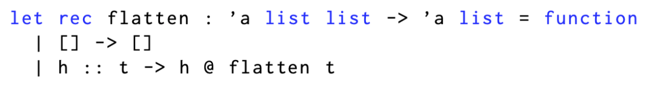
Efficiency: Exercises
Show that 2n + 1 is O(n)
If n is the number of elements in the output list, what is the running time of this function?

Slide 8
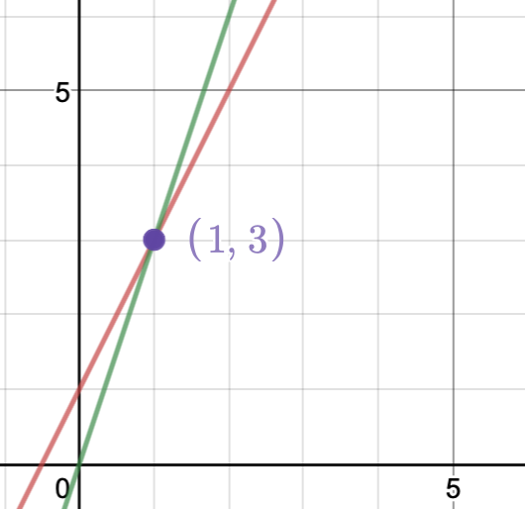
Exercise: Show that 2n + 1 is O(n)
Let c = 3, n = 1.
We want to show that
2n + 1 ≤ 3n whenever n ≥ 1.
2(1) + 1 = 3
3(1) = 3
3 ≤ 3

Slide 9
Exercise: flatten runtime
Usually we state runtime in terms of input size. But since we’re operating on an ‘a list list, the runtime depends not only on the size of the list of lists, but the size of the sub-lists (since @ is linear in the size of the sub-lists).
The number of elements in the output list is the sum of the number of elements in each sublist. We call flatten once for every sub-list, and each call to @ is linear in the size of that sublist, so runtime is linear in the size of the output: O(n).

Slide 10
BALANCED TREES

Slide 11
Balanced Trees material
Binary Search Tree invariant
Asymptotic complexity
Red-Black Trees
Red-Black invariant, insertion algorithm

Slide 14
INTERPRETERS

Slide 15
Lexing, Parsing, Evaluation
-Lexer converts input string to tokens
-Parser converts tokens to AST
-”Evaluator” converts AST to value

Slide 16
BNF Grammars
-Describe syntax with derivation rules
-Basically the same as (potentially (mutually) recursive) variant types
-Definitions for terms are inductive: we have base cases and recursive cases
-Example: regular expressions
r ::= 𝝐 | a | r1 + r2 | r1 * r2 | r*

Slide 17
SUBSTITUTION MODEL

Slide 18
Substitution model: Review
single-step relation: e → e' (exactly 1 step)
multi-step relation: e →* e' (0+ steps)
e1 + e2 → e1' + e2 if e1 → e1'
v1 + e2 → v1 + e2' if e2 → e2'
v1 + v2 → i
if i is the result of primitive operation v1 + v2

Slide 19
Substitution model: Review
let x = e1 in e2 → let x = e1' in e2
if e1 → e1'
let x = v1 in e2 → e2{v1/x}
x{v1/x} → v1

Slide 20
Substitution model: Review
For shadowing to work, let expressions must do substitution differently based on the bound name of a variable:
(let x = e1 in e2){e/x} → let x = e1{e/x} in e2
(let y = e1 in e2){e/x} → let y = e1{e/x} in e2{e/x}

Slide 21
Substitution model: Review
Capture-avoiding substitution
(fun x -> e'){e/x} → fun x -> e'
(fun y -> e'){e/x} → fun y -> e'{e/x} [if y is not bound in expression e]
If we ignore the bracketed statement, we could violate the Principle of Name Irrelevance:
(fun z -> x){z/x} → (fun z -> z)
(fun a -> x){z/x} → (fun a -> z)
Our choice in variable names affected what the functions do: one is the identity function, while the other is not!

Slide 22
Substitution model: Exercises
let x = 1 in (let x = x + x in x + x) (4 steps)
let f = fun x -> x + x in let x = 1 in
let g = fun y -> x + f y in g 3 (7 steps)

Slide 23
Substitution model: Solutions
let x = 1 in (let x = x + x in x + x) →
let x = 1 + 1 in x + x →
let x = 2 in x + x →
2 + 2 →
4

Slide 24
Substitution model: Solutions
2. let f = fun x -> x + x in let x = 1 in
let g = fun y -> x + f y in g 3 →
let x = 1 in let g = fun y -> x + (fun x -> x + x) y in g 3 →
let g = fun y -> 1 + (fun x -> x + x) y in g 3 →
(fun y -> 1 + (fun x -> x + x) y) 3 →
1 + (fun x -> x + x) 3 →
1 + 3 + 3 →
4 + 3 →
7

Slide 25
ENVIRONMENT MODEL

Slide 26
Environment Model: Review
The substitution model involves small-step evaluation, whereas the environment model involves big-step evaluation
Instead of describing evaluation in terms of the expression being converted to successively simpler expressions until we reach a terminal value, we compute the terminal value directly from the original expression

Slide 27
Environment Model: Closures
For the environment, model, we need a different way of avoiding name overlap
If a function uses a variable and that variable’s name is used later, the variable’s older value should still be used in applications of the function afterward (lexical scope)

Slide 28
Closures (cont.)
(|e, env|)
-A closure is an expression with an environment attached to it
-You can’t write this syntax directly in OCaml
-When we evaluate e, we use the environment stored in its closure

Slide 29
HASH TABLES

Slide 30
Hash Tables: Review
Hash function: map an infinite set of things to a finite set of things
if x = y then hash(x) = hash(y)
if x != y it's still possible that hash(x) = hash(y), but we want collision resistant hash functions that have a low chance of this happening
Hash table: Maps of key -> value backed by array; use hash(key) to compute which index of the array to put the value. The fastest and most common way to implement a map (better than association lists).
On collision:
chaining: store multiple values in same index (array of linked lists)
probing: store in a different index
When the array starts to fill up (load factor): allocate a bigger array and move/rehash everything into that array (resizing)

Slide 31
Hash Tables: Exercises
1)
Suppose we have a hash table on integer keys, backed by an array that is size 10. The hash function is simply let hash k = k mod 10.
Draw the hash table that results from inserting the keys 1, 2, 3, 10, 12 if the hash table used...
chaining
probing
(Don't worry about resizing)
2)
How would you implement a set using a hash table?

Slide 32
Amortized Analysis
-Expected insertion and lookup time is O(1)
-This relies on a number of assumptions:
-Does not cover rebalancing cases
-Relatively even hash distribution
-Rebalancing: expected linear time

Slide 33
STREAMS/LAZINESS

Slide 34
Laziness: Review
Represent deferred computation
A deferred computation is called a thunk
Examples:
let x = failwith "eager"
let y = fun () -> failwith "lazy" in y ()
let z = lazy (failwith "lazy") in Lazy.force z
The Lazy module is special, i.e. you can’t implement the lazy keyword yourself
Notes:
OCaml performs eager evaluation (compare to e.g. Haskell which has lazy evaluation)

Slide 35
Streams: Review
Deferred computation on progress through lists; useful for infinite lists (or trees, etc.)
type 'a stream =
| Cons of 'a * (unit -> 'a stream)
We only compute one value at a time and each computation yields the next thunk
let rec from n =
Cons (n, fun () -> from (n + 1))
let nats = from 0

Slide 36
Streams/Laziness: Exercises
Define a value pow2 : int stream whose elements are the powers of two: <1; 2; 4; 8; 16, ...>.
Define a function filter : ('a -> bool) -> 'a stream -> 'a stream, such that filter p s is the sub-stream of s whose elements satisfy the predicate p. For example, filter (fun n -> n mod 2 = 0) nats would be the stream <0; 2; 4; 6; 8; 10; ...>. If there is no element of s that satisfies p, then filter p s does not terminate.
Recall that type 'a stream = Cons of 'a * (unit -> 'a stream)

Slide 37
Streams/Laziness: Solutions
let pow =
let rec pow_gen n =
Cons (n, fun () -> pow_gen (n * 2))
in pow_gen 1
let filter p (Cons(x,s)) =
let tl = s () in
if p x then Cons(x, () => filter p tl)
else filter p tl

Slide 38
TYPE CHECKING

Slide 39
Type Checking

Slide 40
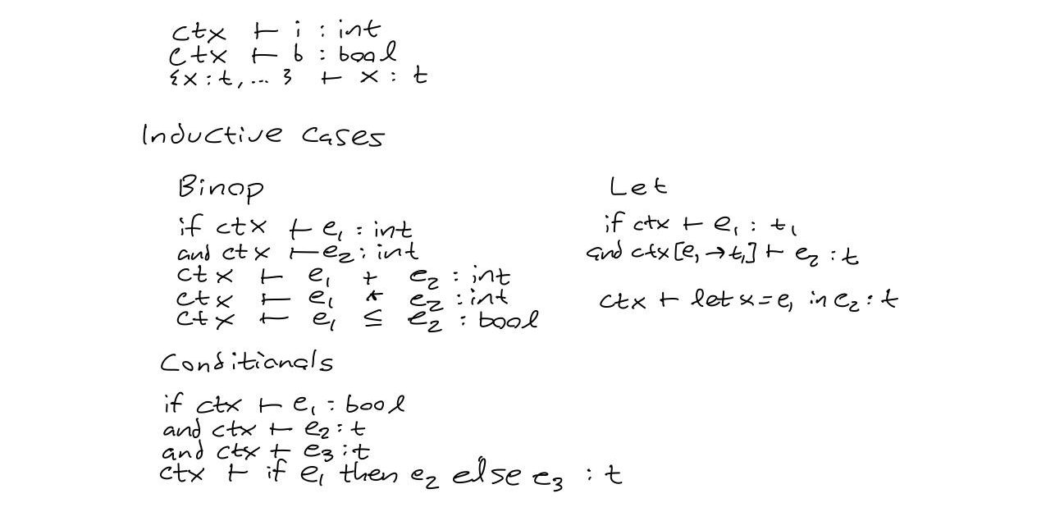

Slide 41
Type Safety
Progress: every well-typed expression is either a terminal value or can take a step
Preservation: if a well-typed expression can step to another expression, that other expression is well-typed and of the same type

Slide 42
PROMISES

Slide 43
Promises: Review (Old slides)
Promises allow us to implement deferred computations.
Before the computation is finished, the promise is empty.
After the computation, the promise is filled with the result.
There are 3 states: pending, resolved, and rejected.
They are called write-once references because they can only transition from pending -> resolved or pending -> rejected (can't go back to pending).
Notes:
The client should be able to access (query whether a promise is resolved or pending, make use of resolved values), but not mutate promises.
The implementers of the promise must be able to mutate the promise. So each promise has an associated resolver; a data structure that is used internally by the library, but not revealed to clients.

Slide 44
Promises: Callbacks (Old slides)
Callback = a function that is called when a promise is resolved; the resolved value is passed as input to that function
Callbacks can be bound to promises; at the time of binding if the promise is...
already resolved, then the callback is called immediately
unresolved, then the callback will be called when/if the promise is resolved
already rejected, then the callback will never be called

Slide 45
Promises: binding callbacks (Old slides)
bind :‘a promise -> (‘a -> ‘b promise) -> ‘b promise
bind p c (also written p >>= c)
If p is resolved, run c
If p is rejected, do not run c; just return a rejected promise with the same exception as p
If p is pending, return a new pending promise that will become resolved when/if c finishes running.

Slide 46
Promises: Exercises
Write functions with these types, using (>>=), return and previous parts
(i) map : (‘a -> ‘b) -> ‘a promise -> ‘b promise
(ii) apply: (‘a -> ‘b) promise -> ‘a promise -> ‘b promise
(iii) map2 : (‘a -> ‘b -> ‘c) -> ‘a promise -> ‘b promise -> ‘c promise
(iv) join : ‘a promise list -> ‘a list promise which executes each promise from left to right then returns the resulting list. Use only the previous parts and List.fold_left.

Slide 47
Promises: Solutions
let map f x = x >>= fun x -> return (f x)
let apply f x = f >>= fun f -> map f x
let map2 f x y = apply (map f x) y
let join = List.fold_left
(map2 (fun xs x -> x::xs))
(Lwt.return [])

Slide 48
MONADS

Slide 49
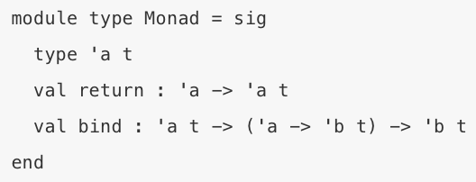
Monads: Review
satisfies “monad laws”
Promises are an example of monads
(and so are lists, options… )

Slide 50
Monads: Review
The Three Monad Laws:
1. return x >>= f behaves the same as f x.
2. m >>= return behaves the same as m.
3. (m >>= f) >>= g behaves the same as m >>= (fun x -> f x >>= g)

Slide 51
Monads: Exercises
All of the exercises in the Promises section
work for any monad.
Exercise: What do each of the functions do for the List monad or the Option monad?

Slide 52
PROOFS

Slide 53
Proofs About Programs: Review
Use the proof format that we learned in-class to prove equivalence of two statements
use Axiom of Extensionality to show that two functions are equivalent
use structural induction to show that inductively-defined data structures (like lists and trees) are equivalent
use induction on natural numbers to show that recursive functions on naturals are equivalent

Slide 54
Induction format
Theorem: forall n, P(n).
Proof: by induction on n
Base case: n = {BASE STRUCTURE: 0, [], Node …}
Show: P(BASE STRUCTURE)
Inductive case: n = {INDUCTIVE STRUCTURE: k+1, h :: t, Leaf (left, v , right)
IH: {P(k), P(t), P(left) AND P(right) ...}
Show: P(INDUCTIVE STRUCTURE)
QED

Slide 55
Natural numbers
base case: P(0)
inductive step: assume P(n), prove P(n+1)
Lists
base case: P([])
inductive step: assume P(t), prove P(h::t)
Trees (assume 2 things, prove 1)
base case: P(leaf)
inductive step: assume P(l) and P(r), prove P(Node(l,v,r))
Variants (potentially have to prove more than 1 case)
ex: type ablist = Empty | A of a * ablist | B of b * ablist
base case: P(Empty)
inductive step: assume P(t), prove P(A(a,t)) and P(B(b,t))

Slide 56
Extensionality format
Theorem: f = g
Proof: By extensionality, we want to show that f x = g x for an arbitrary x.
[proof details go here]
QED

Slide 57
Proofs About Programs: Exercises
See lecture notes for exercises:
https://github.coecis.cornell.edu/cs3110/lectures-2019fa/blob/master/20-proofs/notes.md
https://github.coecis.cornell.edu/cs3110/lectures-2019fa/blob/master/21-proofs2/notes.md
https://github.coecis.cornell.edu/cs3110/lectures-2019fa/blob/master/21-proofs2/notes.md

Slide 58
Proofs About Programs: Exercises
Prove that reverse is an involution, i.e., that forall lst, rev (rev lst) = lst. Proceed by induction on lst. You will the previous exercise as a lemma.
Previous lemma:
forall lst1 lst2, rev (lst1 @ lst2) = rev lst2 @ rev lst

Slide 59
Proofs About Programs: Solutions
Claim: forall lst, rev (rev lst) = lst
Proof: by induction on lst
P(lst) = rev (rev lst) = lst
Base case: lst = []
Show: rev (rev []) = []
rev (rev [])
= { eval rev, twice }
[]
Inductive case: lst = h :: t
Show: rev (rev (h :: t)) = h :: t
IH: rev (rev t) = t
rev (rev (h :: t))
= { eval rev }
rev (rev t @ [h])
= { exercise 3 }
rev [h] @ rev (rev t)
= { IH }
rev [h] @ t
= { eval rev }
[h] @ t
= { eval @ }
h :: t
QED

Slide 60
Proofs About Programs: Solutions
Claim: forall lst, rev (rev lst) = lst
Proof: by induction on lst
P(lst) = rev (rev lst) = lst
Base case: lst = []
Show: rev (rev []) = []
rev (rev [])
= { eval rev, twice }
[]
Inductive case: lst = h :: t
Show: rev (rev (h :: t)) = h :: t
IH: rev (rev t) = t
rev (rev (h :: t))
= { eval rev }
rev (rev t @ [h])
= { exercise 3 }
rev [h] @ rev (rev t)
= { IH }
rev [h] @ t
= { eval rev }
[h] @ t
= { eval @ }
h :: t
QED

Slide 61
Q&A TIME

