Slide 1
Assignment 2
Ngoc Truong Huy Nguyen
99266640

Slide 2
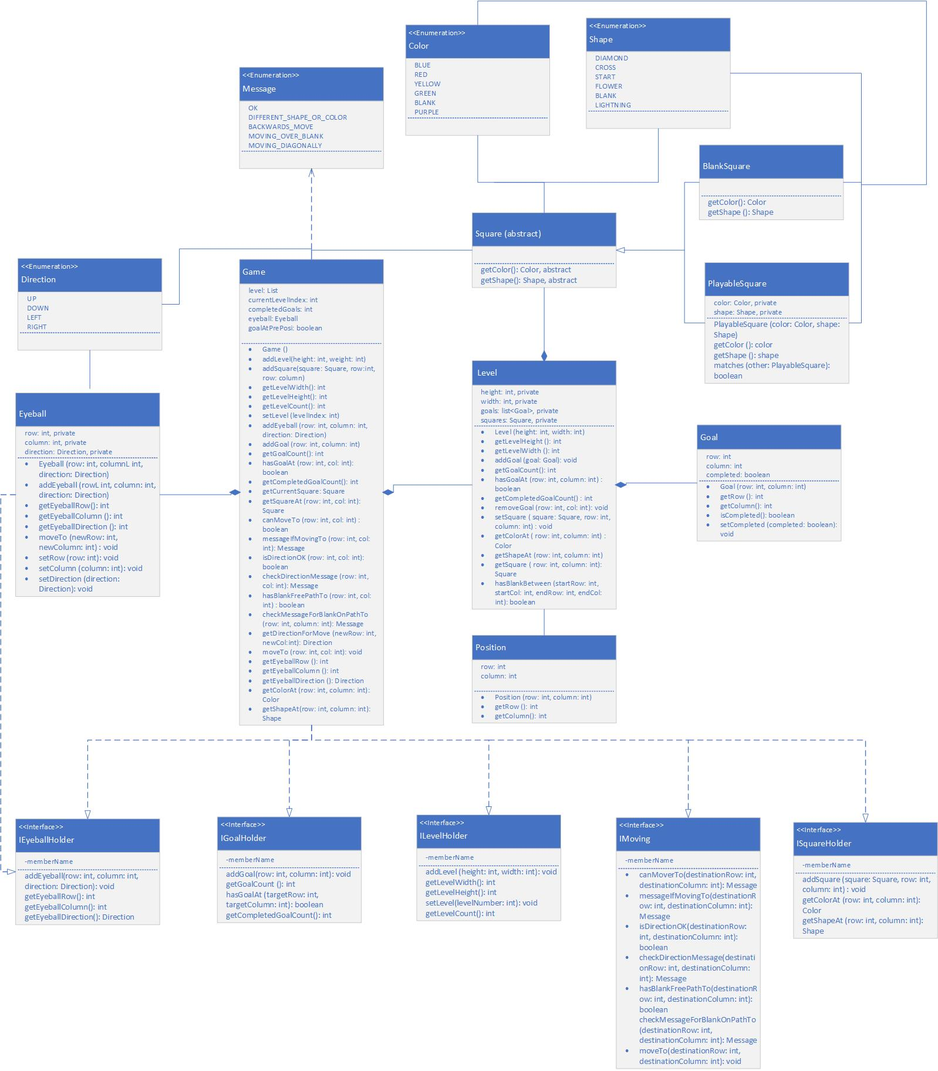
Uml Class diagram

Slide 3
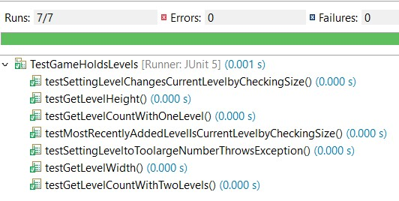
Test game holds levels

Slide 4
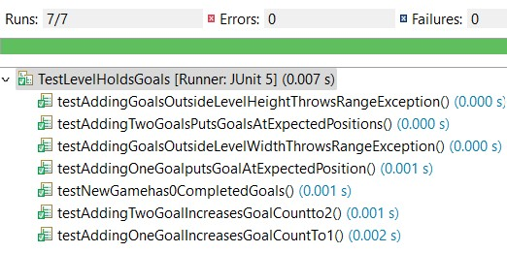
Test Levels holds Goals

Slide 5
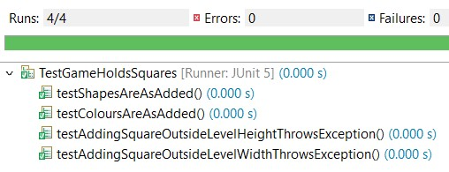
Test game holds Squares

Slide 6
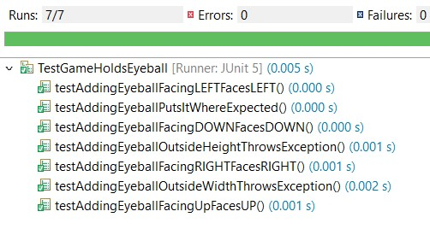
Test game holds eyeball

Slide 7
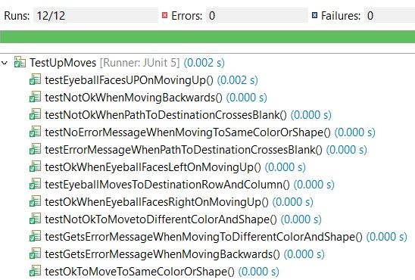
Test up moves

Slide 8
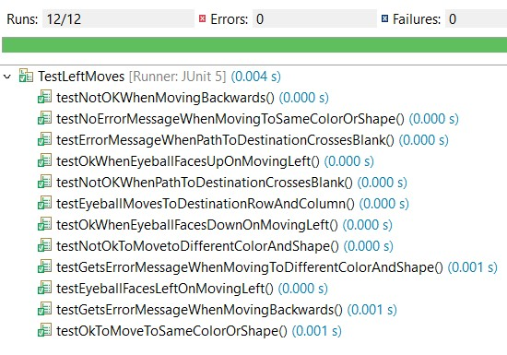
Test left moves

Slide 9
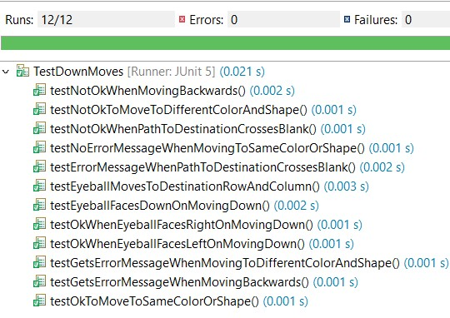
Test down moves

Slide 10
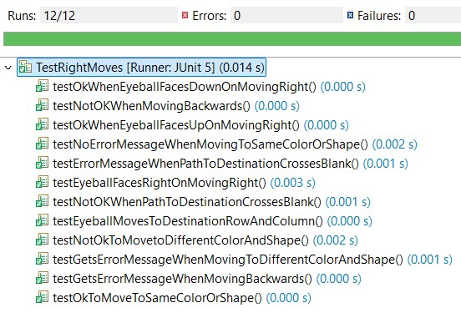
Test right moves

Slide 11
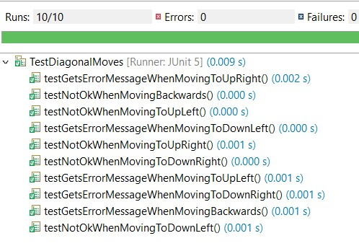
Test Diagonal moves

Slide 12
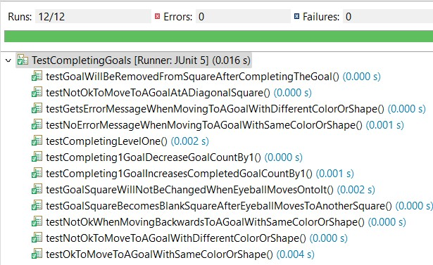
Test completing goals

Slide 13
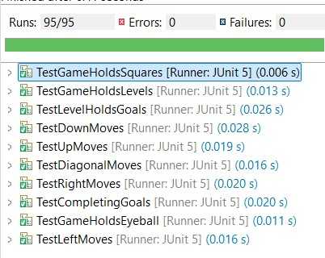
Total tests

Slide 14
Expected marks

Slide 15

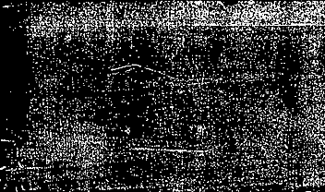

Thank you for watching and give me feedbacks!

