Slide 1








Exemplar-Set ε^{t-1}
Node Model t-1
Dataset D^{t-1}
Classifier C^{t-1}
forward
Feature Extractor F^{t-1}
forward
backward
backward
Task t-1
Exemplar-Set ε^{t}
Node Model t
Dataset D^{t-1}
Classifier C^{t}
forward
Feature Extractor F^{t}
forward
backward
backward
Task t

Slide 2

Exemplar-Set ε^{t-1}
Hearding
Dataset D^{t-1}
Feature Extractor F^{t-1}
Feature Maps
forward
forward
Task t-1
Hearding
Exemplar-Set ε^{t}
Dataset D^{t-1}
Feature Maps
forward
Feature Extractor F^{t}
forward
Task t

Slide 3
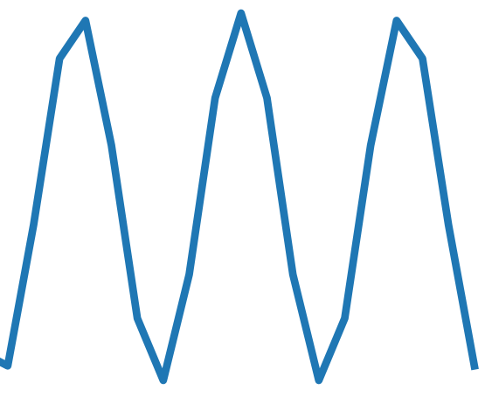


Classifer Kolmogorov-Arnold Network
Exemplar-Set ε^{t-1}
∑
training
∑
Exemplar-Set ε^{t}
∑

Slide 4
Test dataset t-1
Node Model t-1
Classifier KAN
testing
Test dataset t
Node Model t

