Slide 1



SHARING SESSION
CUSTOM FORM (CFO)

Slide 2

About Custom Form
Custom Forms are intended for customizations that go beyond the out-of-the-box usage. They extend the app's functionality, are highly flexible as they can be reused in various modules and are not affected by version upgrades. It also gives an option to Pricefx partners to build connected applications.
For example, you may want to calculate the CO2 emissions when creating Quotes. You can create an embedded custom object that can do that inside the Quoting module.

Slide 3
Custom Forms Features
Custom Form can be defined as a standalone object or can be embedded in a parent object (Quote, Rebate Agreement, Deal Plan, Compensation Plan, a standalone Custom Object).
Each Custom Form can be considered a micro-app and typically has:
Configurable inputs and outputs.
Visualizations
of outputs
(charts, etc.).
The inputs and calculation results are persisted.
Approval workflow (standalone Custom Forms).

Slide 4
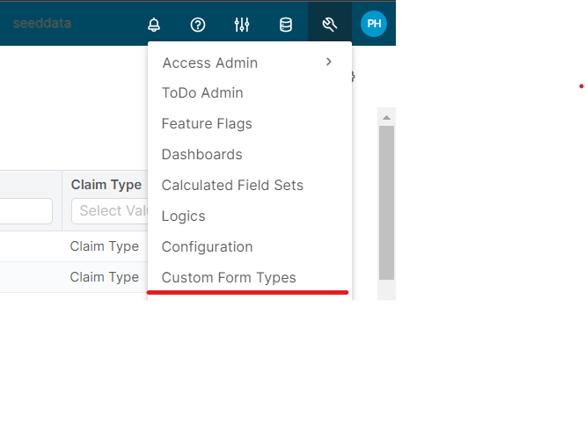
Custom Form Types
Custom Form Type is used by solution developers to predefine possible types of Custom Forms, which can be then used by end users from within the Pricefx UI.
Custom Form types are managed on the page Administration › Custom Form Types.

Slide 5
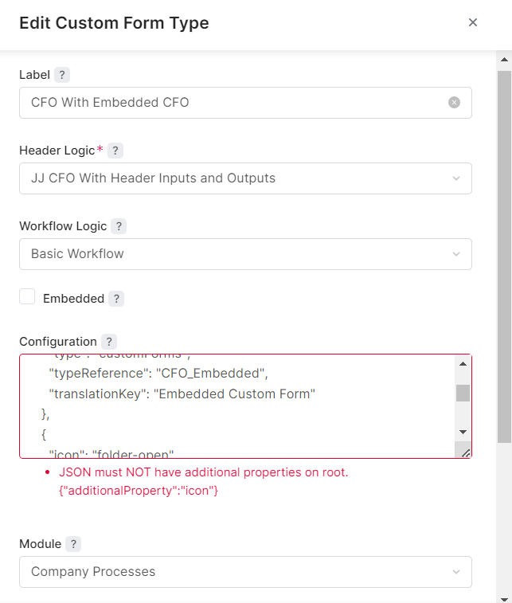
Edit Custom Form Type

Slide 6
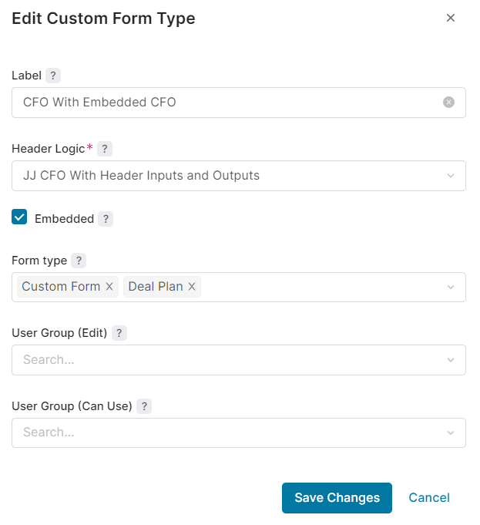
Edit Custom Form Type (Embedded)

Slide 7

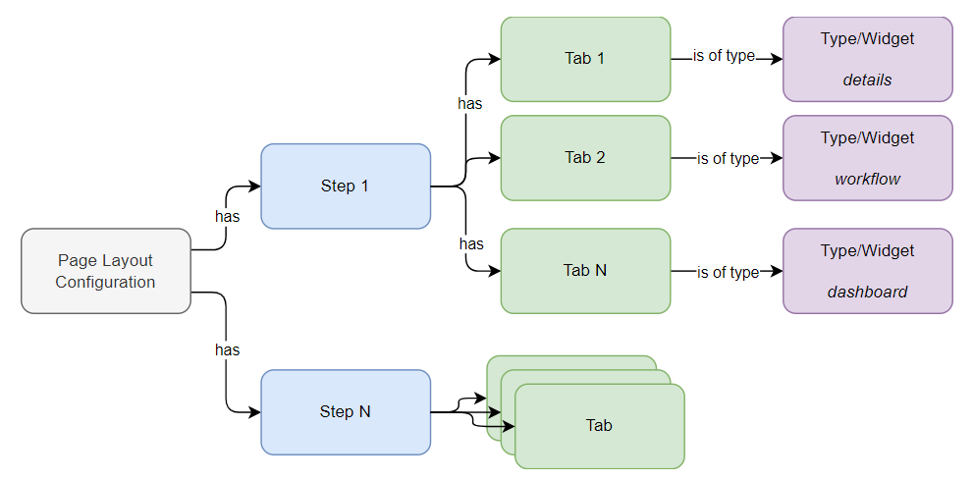
Detail Page Layout and Dynamic Tabs
For certain types of documents, you can change the look and behavior of their detail page.
Many document types have an out-of-the-box layout, so their detail page works fine without any layout configuration.
This default layout can be changed and you can re-configure it based on your needs - for example, add a tab with a dashboard with visualization of historical data for the specified customer.

Slide 8
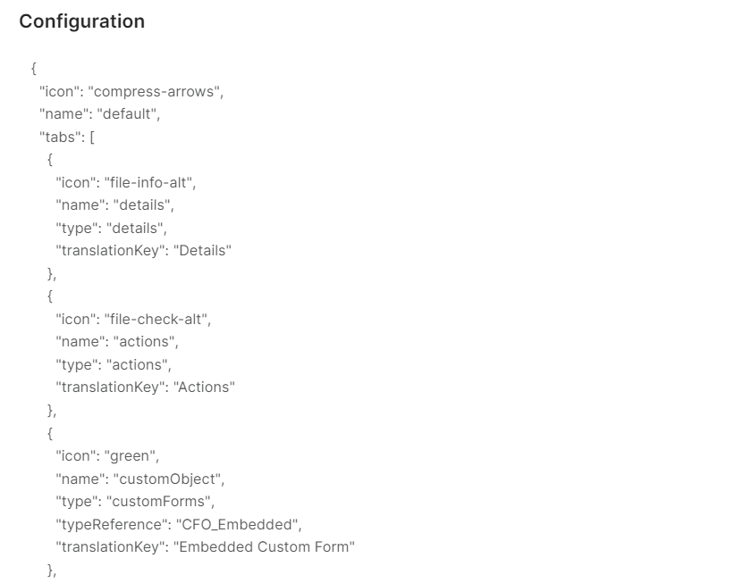
Detail Page Layout and Dynamic Tabs Configurations

Slide 9
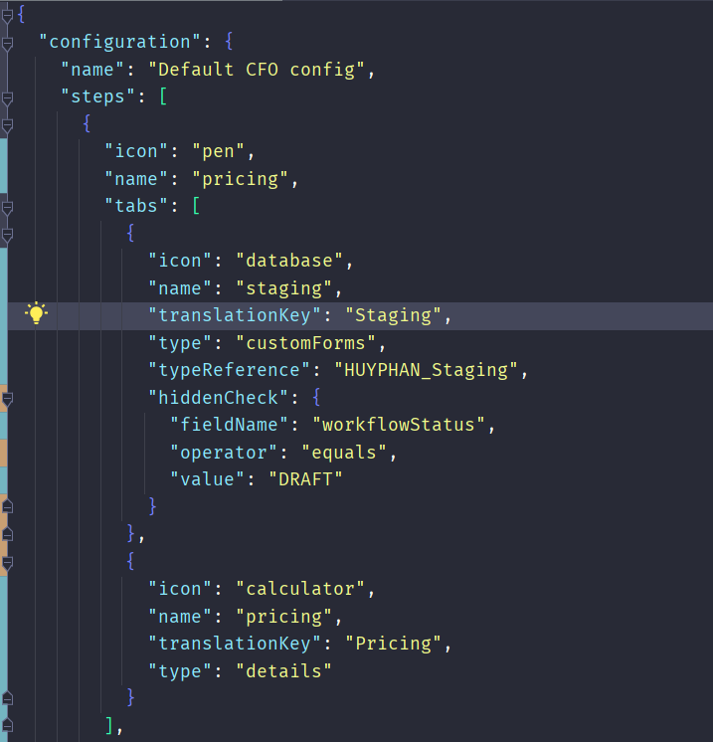
Disable/Hidden tabs

Slide 10
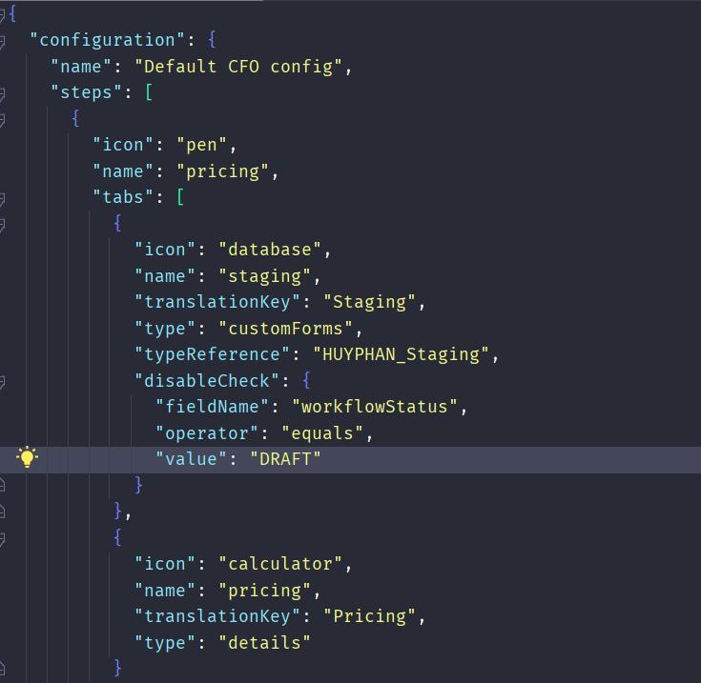
Disable/Hidden steps

Slide 11
Custom Form Logic
Logic Nature: customFormHeader
Logic Type: Calculation/Pricing
Execution Types:
pre-phase - This execution is used to create input fields on header, and hide out-of-the-box buttons.
post-phase - The other execution is called post-phase - to calculate results and store and present them on calculation results of the header or on the Custom Header.
Information provided to the logic:
input: [Map] - Contains the values provided by the user to the input fields.
customFormProcessor: [CustomFormCollectionBuilder], provides information about the phase and also can add the inputs and outputs to the Custom Form object.
api.currentItem(): [Map] - The content of the Custom Form itself, provided as a Map.

Slide 12
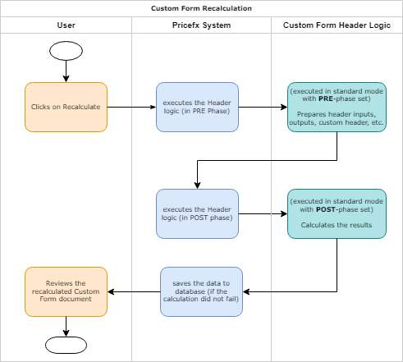

Slide 13
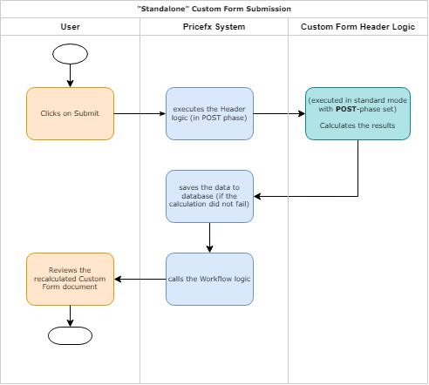

Slide 14

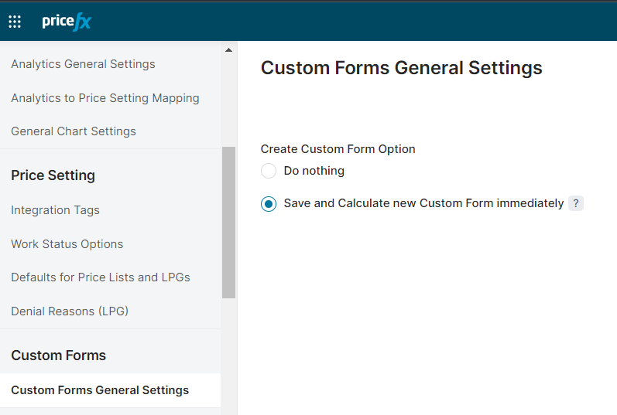
LARANA COMPANY
Change Custom Form Creation Settings (Optional)

Slide 15
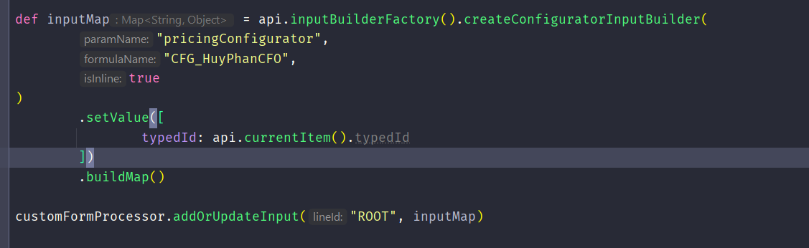
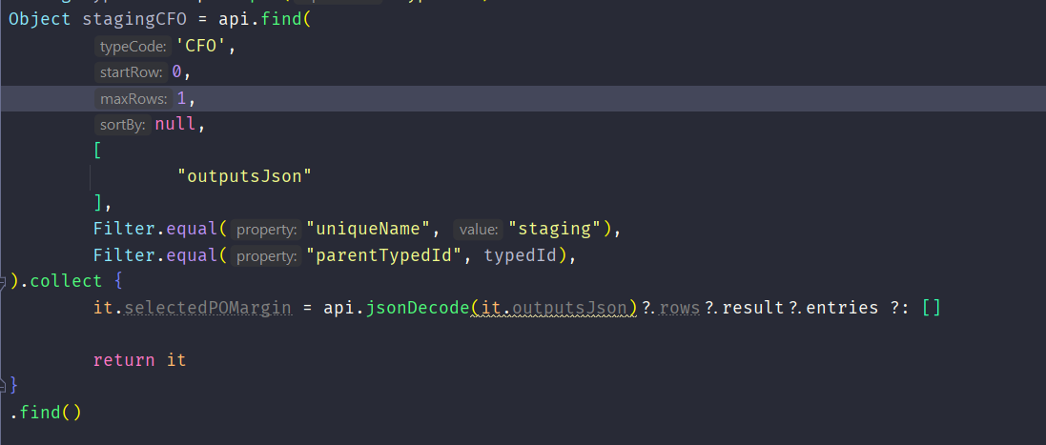
Retrieve Data
From Tab Inside
Configurator

Slide 16
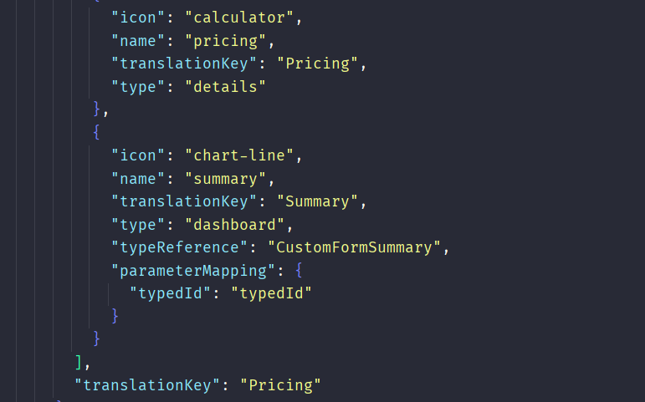
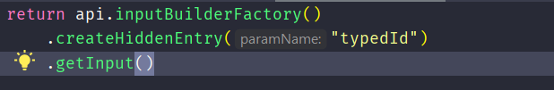
Embedded Dashboard in CFO

Slide 17
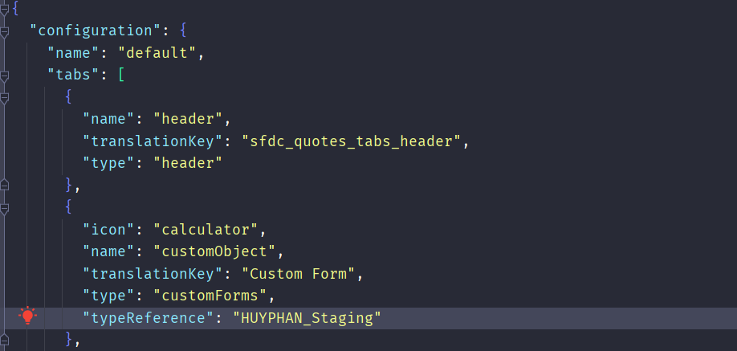
Embedded Dashboard in CFO

Slide 18
Reference
Confluence Custom Form Reference
Partition URL: e2e-aws-staging.pricefx.com, partition: seeddata
Github: https://github.com/HuyPhan-RND4U/Custom-Form-Demo
Dynamic tab schema

Slide 19
THANK
YOU

