Slide 1
Mini project 1 report
Phat - Phatpt8 Linh - linhnt87
Huy - huydq43

Slide 2
PROBLEMs
Monitor Sensor
Simulate
GTFS Analysis

Slide 3
DATA SOURCES
Tokyo GTFS csv file
Humboldt GTFS txt file
Ireland/Dublin GTFS txt file, API json
Sensor real time data

Slide 4
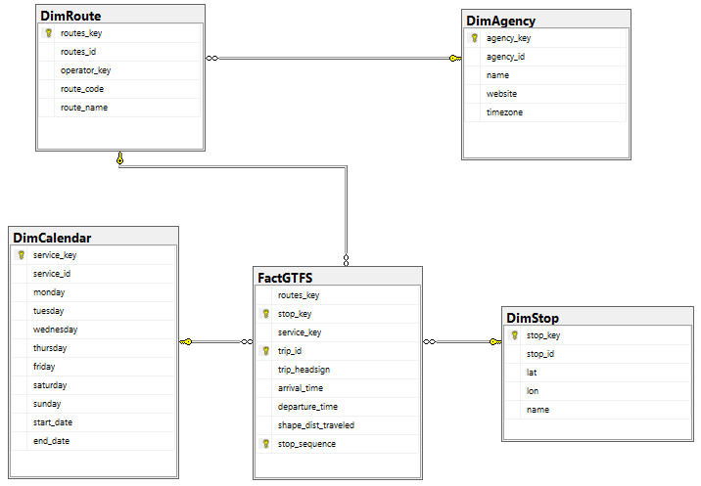
Schema modeling

Slide 5
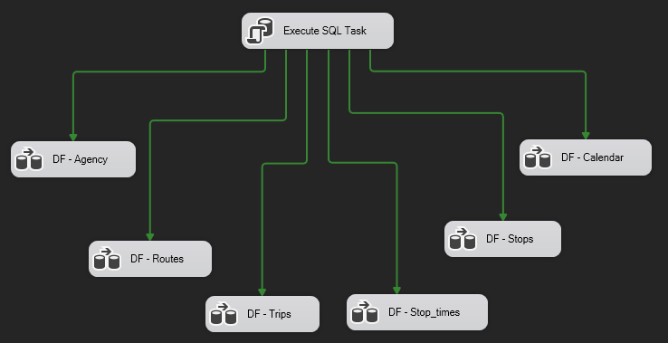
SOURCE -> STAGING

Slide 6
STORED PROCEDURES
1. Replace “null” arrival_time and departure_time (Humboldt)
2. Reset “over 24 hour” arrival_time and departure_time (Ireland)

Slide 7
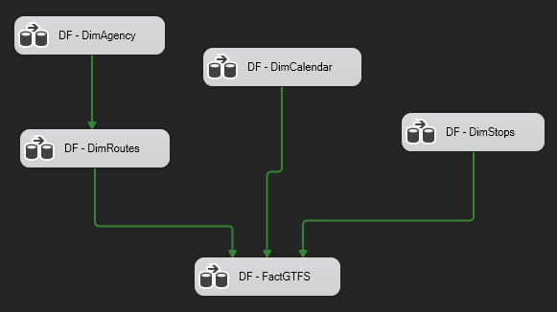
STAGING -> DATA WAREHOUSE

Slide 8
API
1. Crawl Json from API
2. Update Ireland Staging

Slide 9
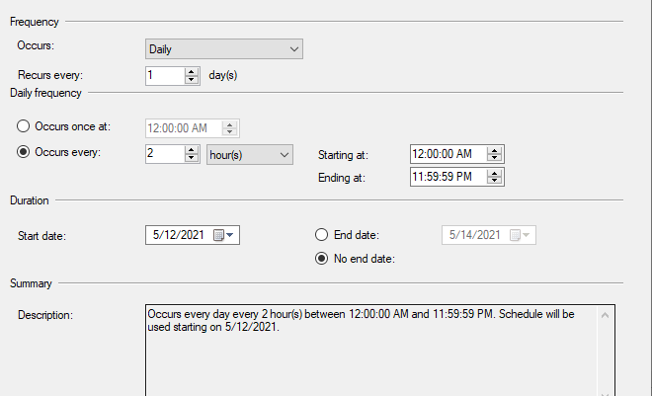
SCHEDULE

Slide 10
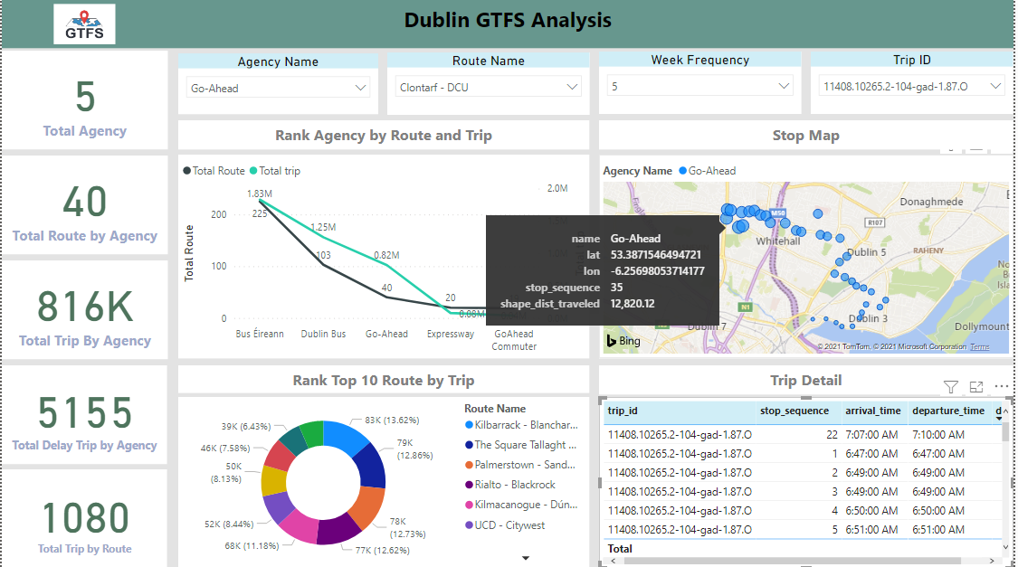
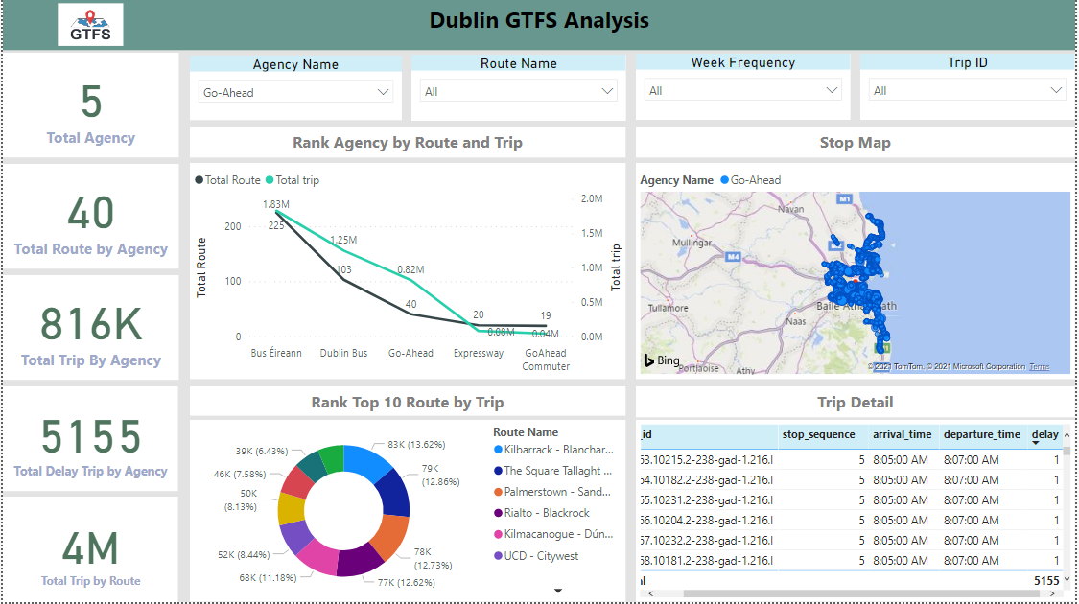
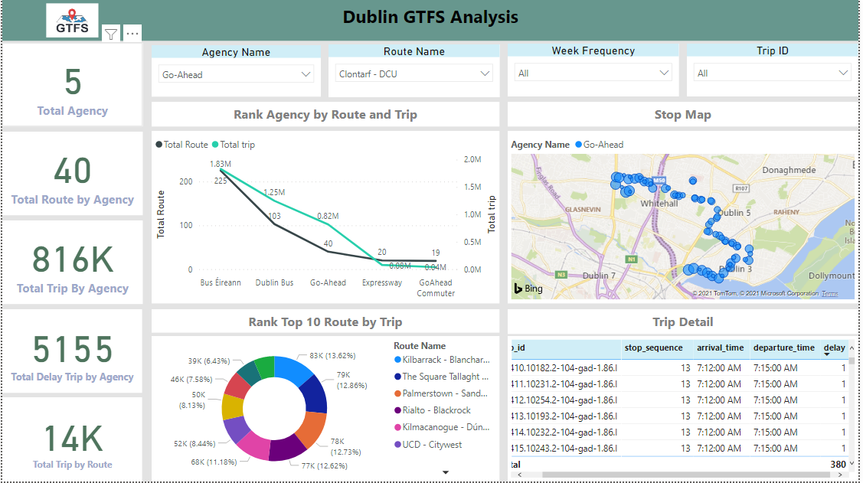
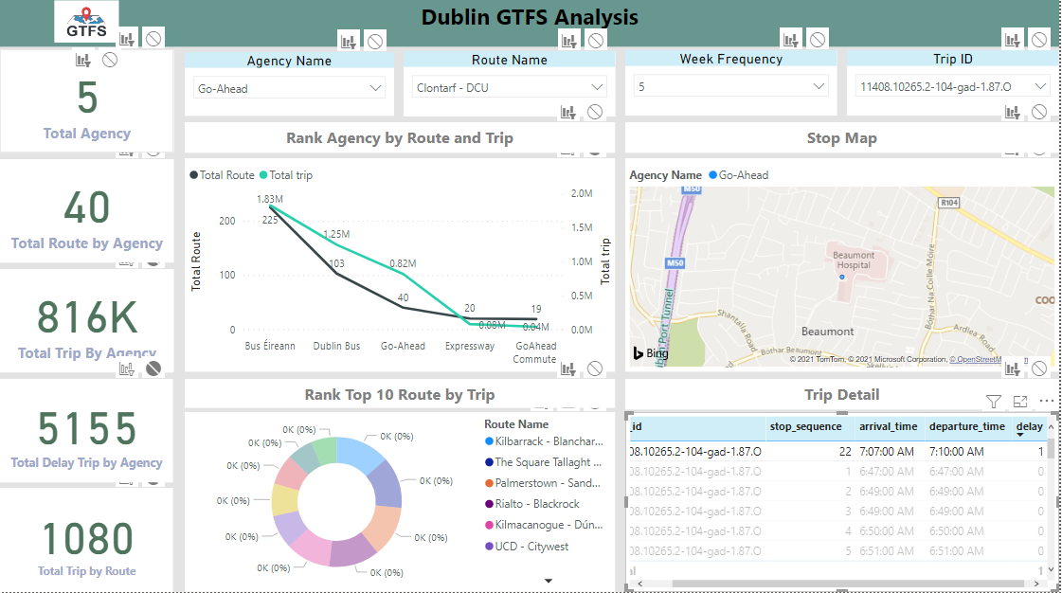
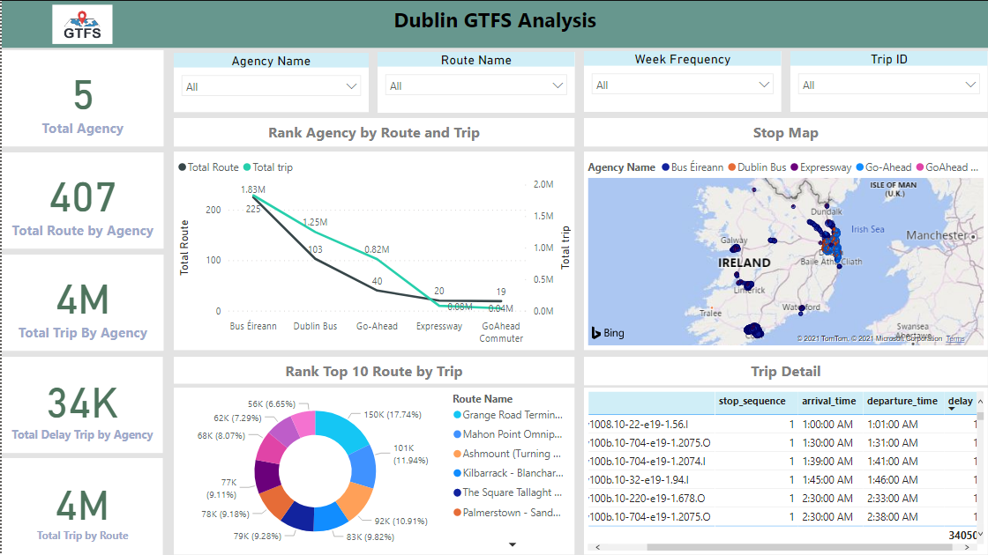
POWER BI

Slide 11
MONITOR SENSOR SIMULATE

Slide 12
CAR SENSOR
Perform a sensor simulation to store on database.
Visualize the data of sensor.

Slide 13
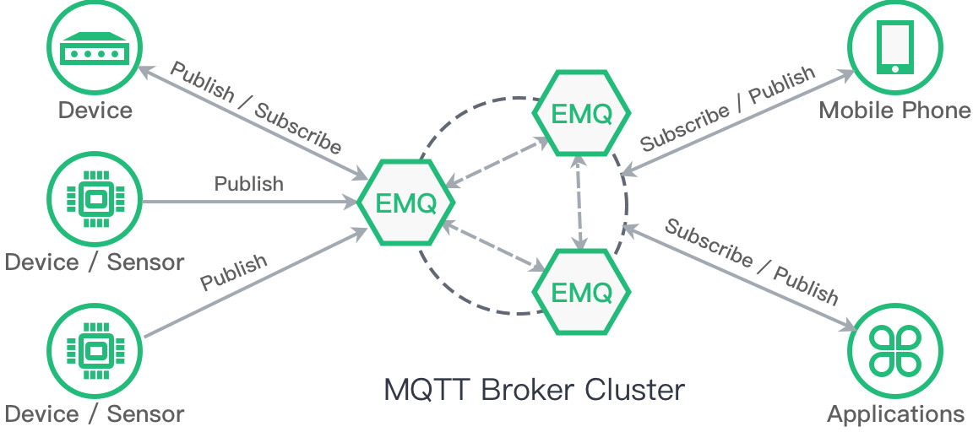
MQTT ARCHITECT

Slide 14



WORK FLOW

Slide 15
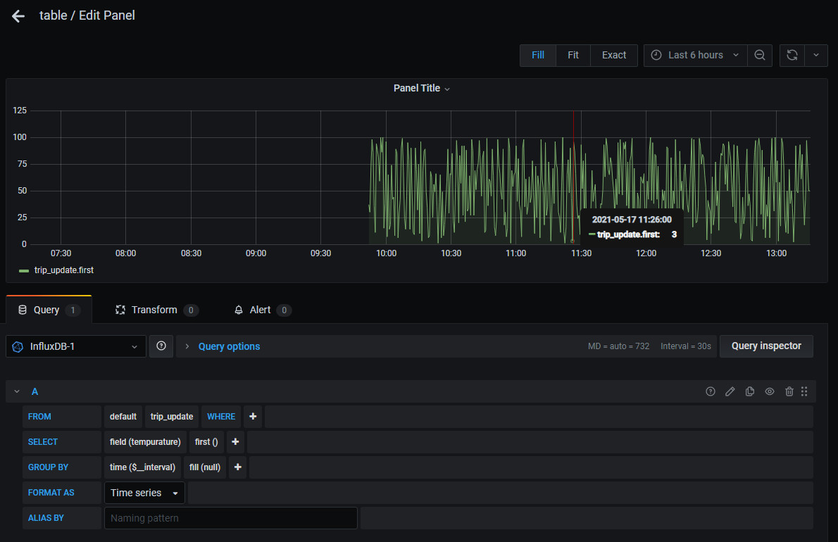
RESULT

