Slide 1
Compare SparkSQL and SQL

Slide 2
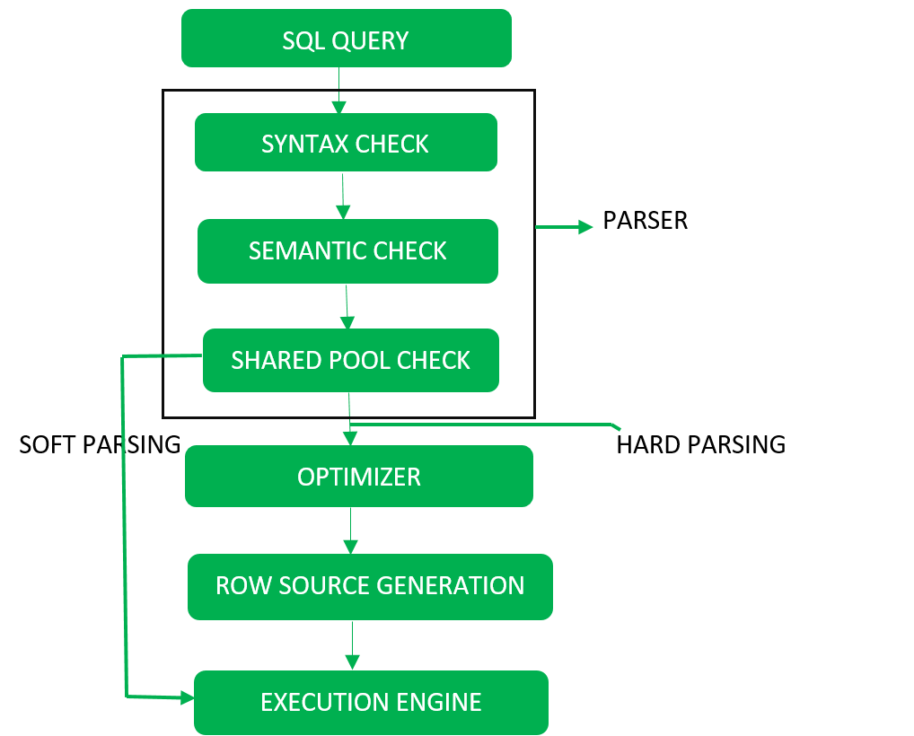
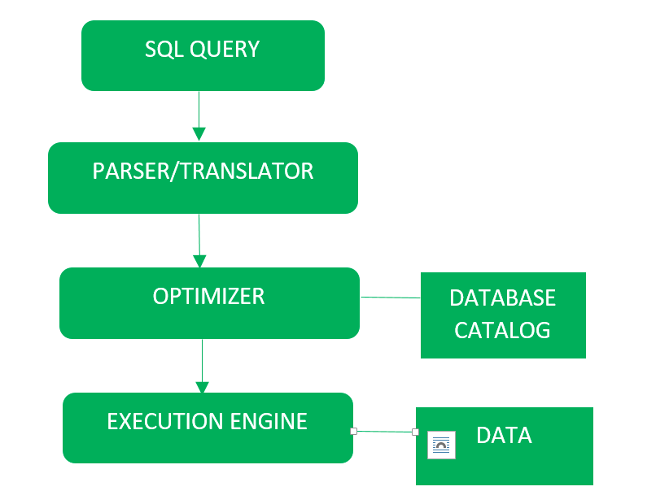
1. SQL
More detail

Slide 3
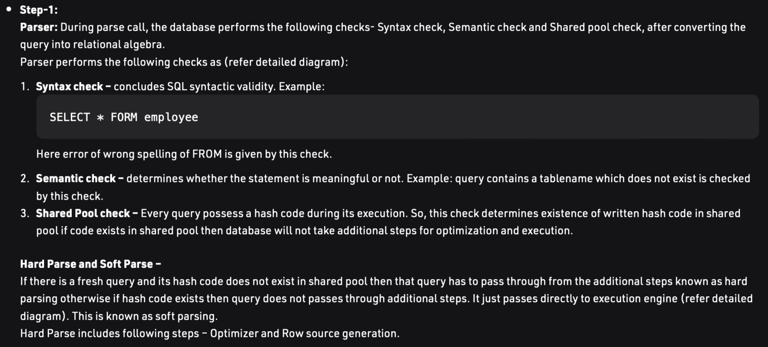
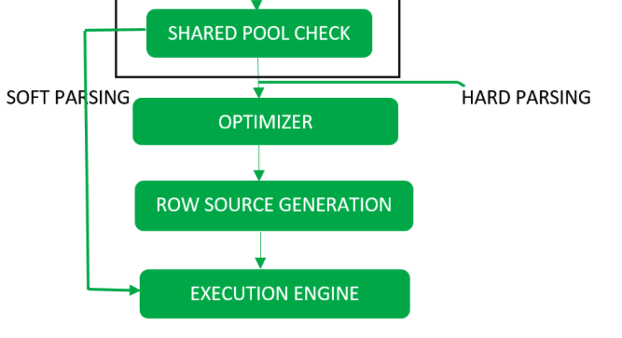
1.SQL - Step1: Parser
If fresh query → hard parsing → move to next step
Else → soft parsing → move to execution engine

Slide 4
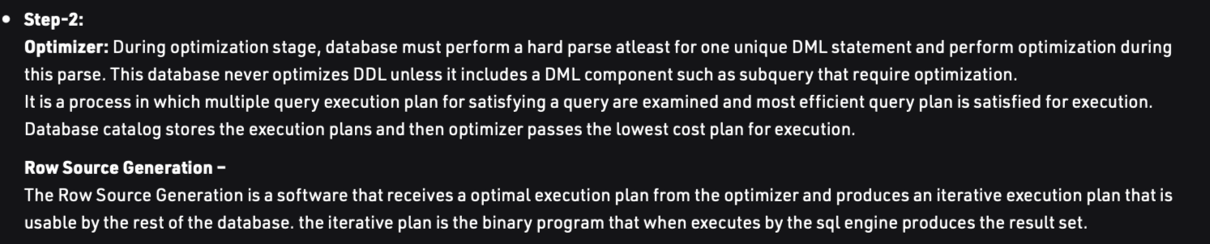
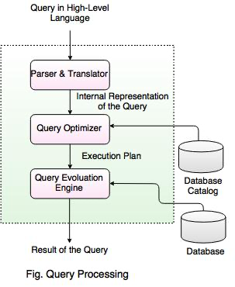
1.SQL - Step2:Optimizer

Slide 5
1.SQL - Step3: Execution
Execution Engine: Finally runs the query and display the required result

Slide 6
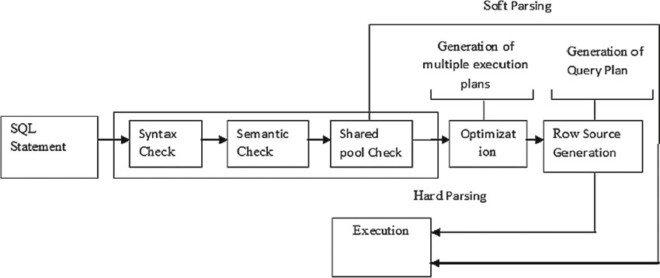
1. SQL - Summary

Slide 7
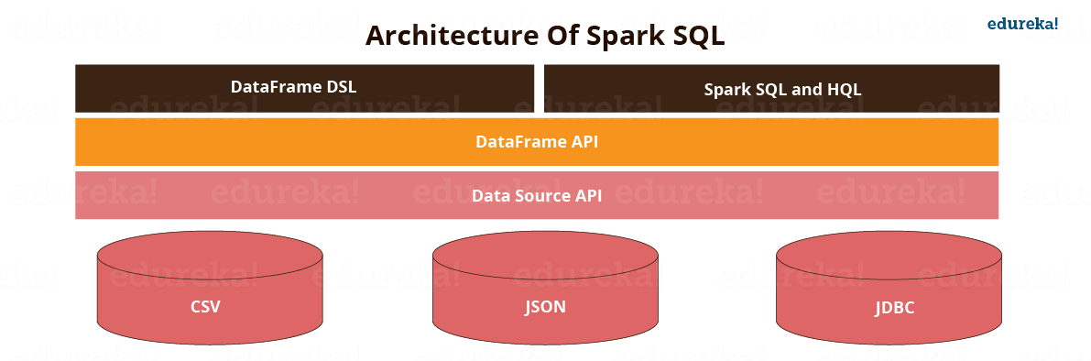
2. Spark SQL - Architecture
Spark SQL is distributed framework component that is used for structured and semi-structured data processing.
Spark SQL blurs the line between RDD and relational table.
It offers much tighter integration between relational and procedural processing, through declarative DataFrame APIs which integrates with Spark code. It also provides higher optimization.
DataFrame API and Datasets API are the ways to interact with Spark SQL

Slide 8
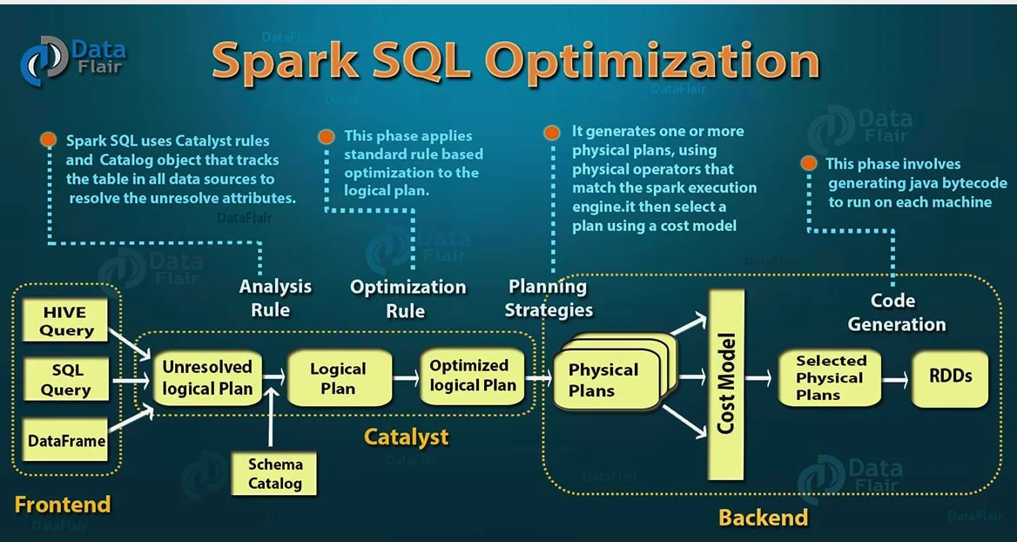
2. Spark SQL - Optimization
Spark SQL provides DataFrame APIs which perform relational operations on both external data sources and Spark’s built-in distributed collections. It introduces an extensible optimizer called Catalyst as it helps in supporting a wide range of data sources and algorithms in Big Data.

Slide 9
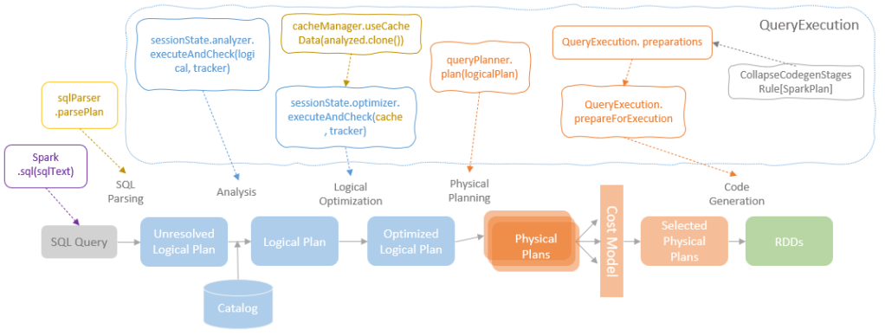
2. Spark SQL - Optimization - detail

Slide 10
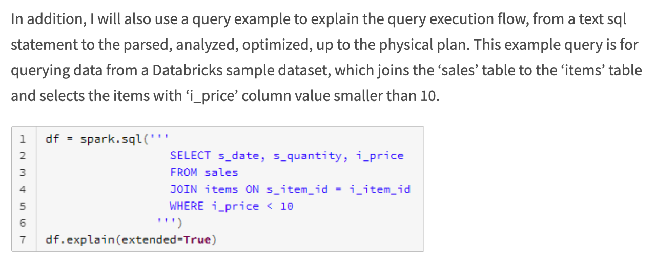
2. Spark SQL - Frontend - SQL query

Slide 11
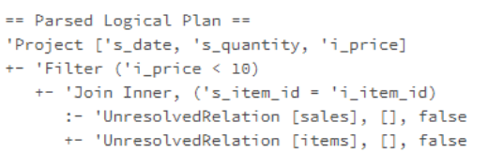
2. Spark SQL - Catalyst - SQL parsing
The internal data structure of the query plans in Catalyst is tree that is transformed by rules through each stage. The input SQL statement in text format needs first to be parsed into a tree type.

Slide 12
2. Spark SQL - Catalyst - SQL analysis
Spark SQL Catalyst provides a logical query plan analyzer, which retrieves tables and attributes information from SessionCatalog and translates UnresolvedAttributes and UnresolvedRelations into fully typed objects.
The logical query plan analyzer conducts the following actions during the analysis stage:
Looking up relations in SessionCatalog by name
Mapping the named attributes, such as column name
Determining attributes with same value and give unique id
Propagating and coercing types through expressions

Slide 13
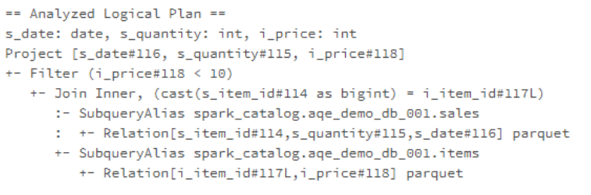
2. Spark SQL - Catalyst - SQL analysis

Slide 14
2. Spark SQL - Catalyst - Logical Optimisation
After the logical plan is analysed, the logical plan optimizer applies standard rule-based optimisation to the logical plan. Catalyst ships with around 70 pre-built logical plan optimisation rules, each of them transforming the query plan of a segment of the structured query to an optimised logical plan. The rules are grouped and executed in rule batches.

Slide 15
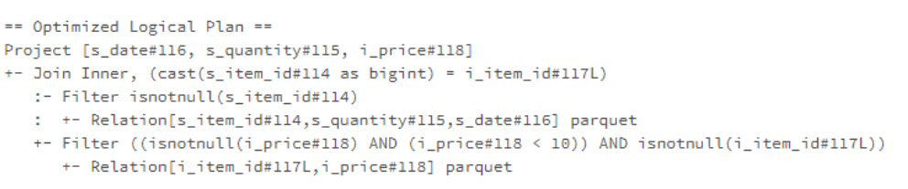
2. Spark SQL - Catalyst - Logical Optimisation
In our example, the PushDownPredicate rule is applied to the analysed logical plan and move the filter from after join action to before the join action and after data load. This optimisation is expected to reduce the size of datasets to join and ensure the predicate will be pushed down to the data source at the physical planning stage

Slide 16
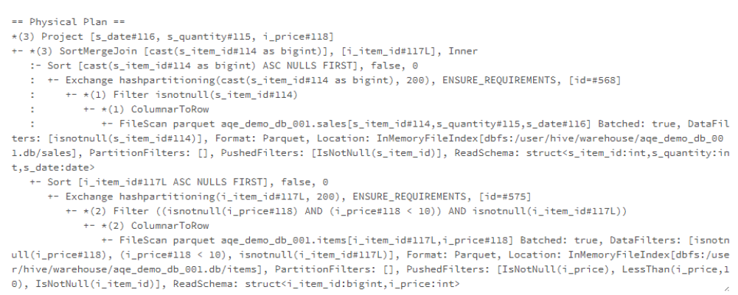
2. Spark SQL - Backend - Physical Planning
The logical plan is platform-independent that cannot be interpreted and executed by Spark. The logical plan needs to be converted to a SparkPlan by SpakerPlanner. QueryExecution provides a createSparkPlan method that takes the optimised logical plan as input and calls the plan method of SparkPlanner, which applies node-matched strategies to return a list of candidate physical plans.

Slide 17
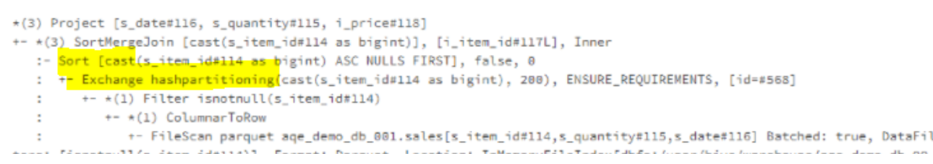
2. Spark SQL - Backend - Execution preparation
After the SparkPlanner converts the logical plan to the physical plan, a list of preparation rules need to be executed to prepare the physical plan for execution.
the EnsureRequirements rule ensures all the requirements of a physical operator are met (if no, and required actions to meet the requirements). In our example, the SortMergeJoin operator is planned for the join operation in our query. The SortMergeJoin operator requires a reshuffle and sort before its execution. The EnsureRequirements rule will add those required actions in.

Slide 18
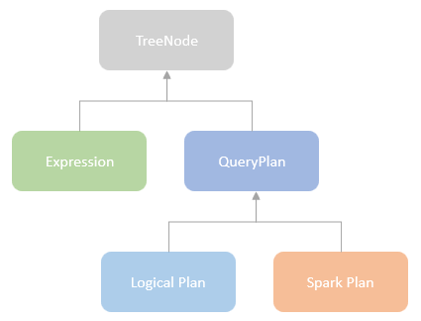
2. Spark SQL - Catalyst Rule Executor
Spark Catalyst query plan is internally represented as a tree, defined as a subclass of the TreeNode type. Each tree node can have zero or more tree node children, which makes a mutually recursive structure. TreeNode type encapsulates a list of methods for traversing the tree and transforming the nodes.
QueryPlan, the parent for both LogicalPlan and SparkPlan, is a subclass of TreeNode type. That means the logical plan and the spark plan involved in the Spark SQL query execution process are recursive tree structures. The process for transforming a query plan from one stage to another stage, e.g. from a resolved logical plan to an optimized logical plan, is the process of applying rules for transforming the nodes or subtrees.

Slide 19
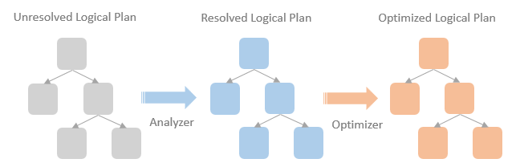
2. Spark SQL - Catalyst Rule Executor
The process for transforming a query plan from one stage to another stage, e.g. from a unresolved logical plan to an optimized logical plan, is the process of applying rules for transforming the nodes or subtrees.

Slide 20
Ref:
SQL:
https://www.geeksforgeeks.org/sql-query-processing/
Sethy, Rotsnarani & Dash, Santosh & Panda, Mrutyunjaya. (2017). Performance Comparison Between Apache Hive and Oracle SQL for Big Data Analytics. 130-141. 10.1007/978-3-319-60618-7_14.
Spark SQL:
https://www.edureka.co/blog/spark-sql-tutorial/
https://data-flair.training/blogs/spark-sql-optimization/
https://dataninjago.com/2021/12/16/spark-deep-dive-5-catalyst-queryexecution/

