Slide 1
ELECTRONIC PIANO
GROUP 12
Ngo Thi Thu Huyen 20200289: Design GUI
Vu Tan Khai 20200311 : Sound of piano
Nguyen Duy Khanh 20204914: Music recording
Nguyen Ngoc Khanh 20204915: Design GUI

Slide 2
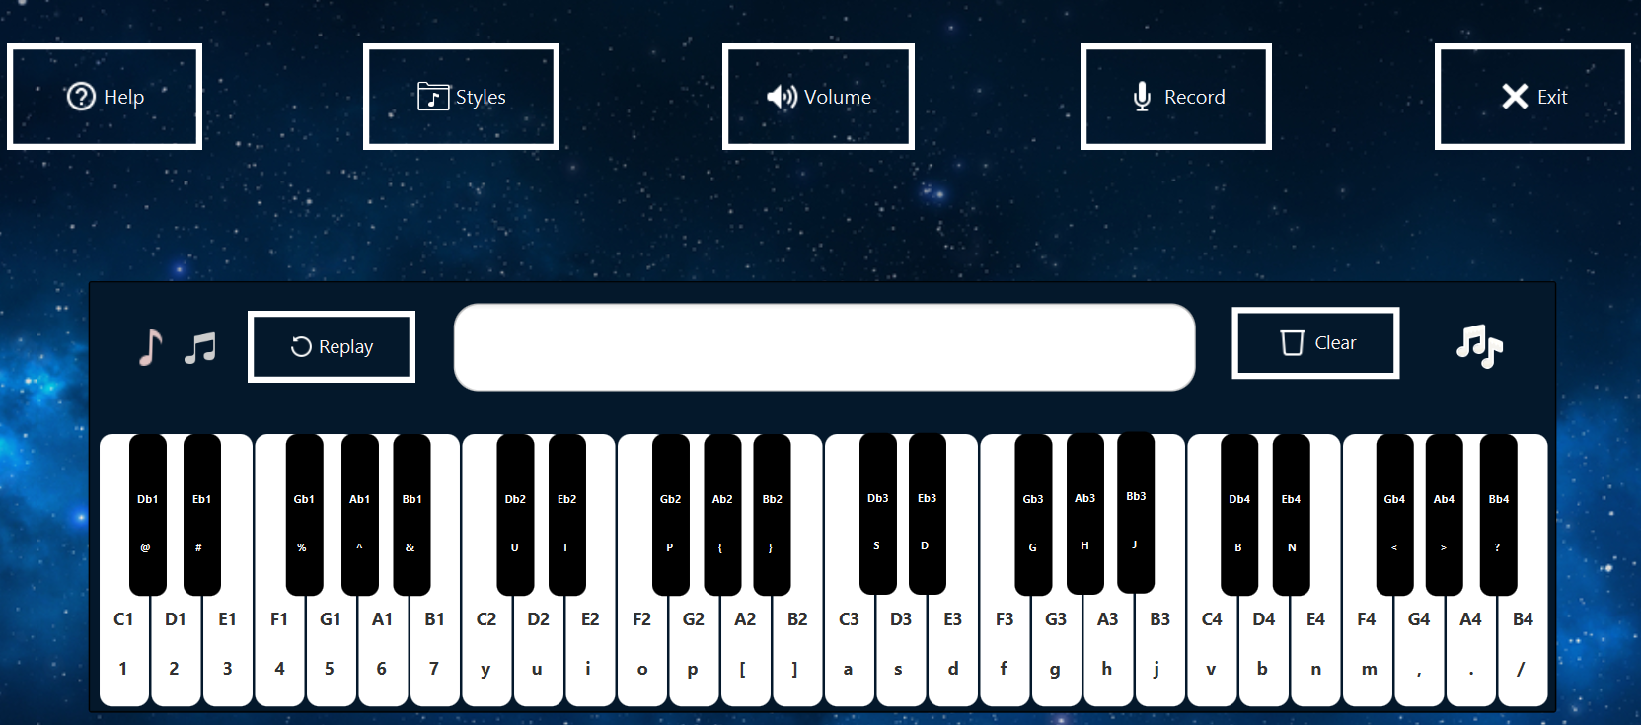
Problem Statement
Piano is a popular musical instrument. In this project, we implemented an application that provides GUI for the user to virtually play an electronic piano
On the main menu: title of the application, piano GUI , help menu, quit
User can play the piano by interacting with GUI
Help menu shows the basic usage and aim of the program
Quit exits the program. Remember to ask for confirmation
Keyboard: C (Do), D (Re), E (Mi), F (Fa), G (Sol), A (La), B (Xi), ... and other functional button:
A button for increasing/decreasing volume
A record button to record the play and play the record
A button for changing music style
Music sheet to write down notes played and replay it

Slide 3
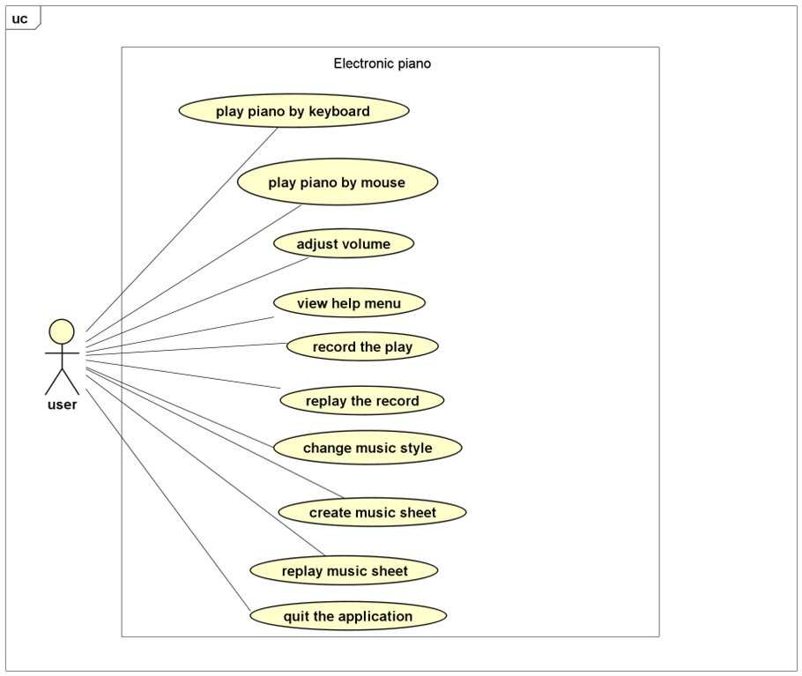
Use case diagram

Slide 4
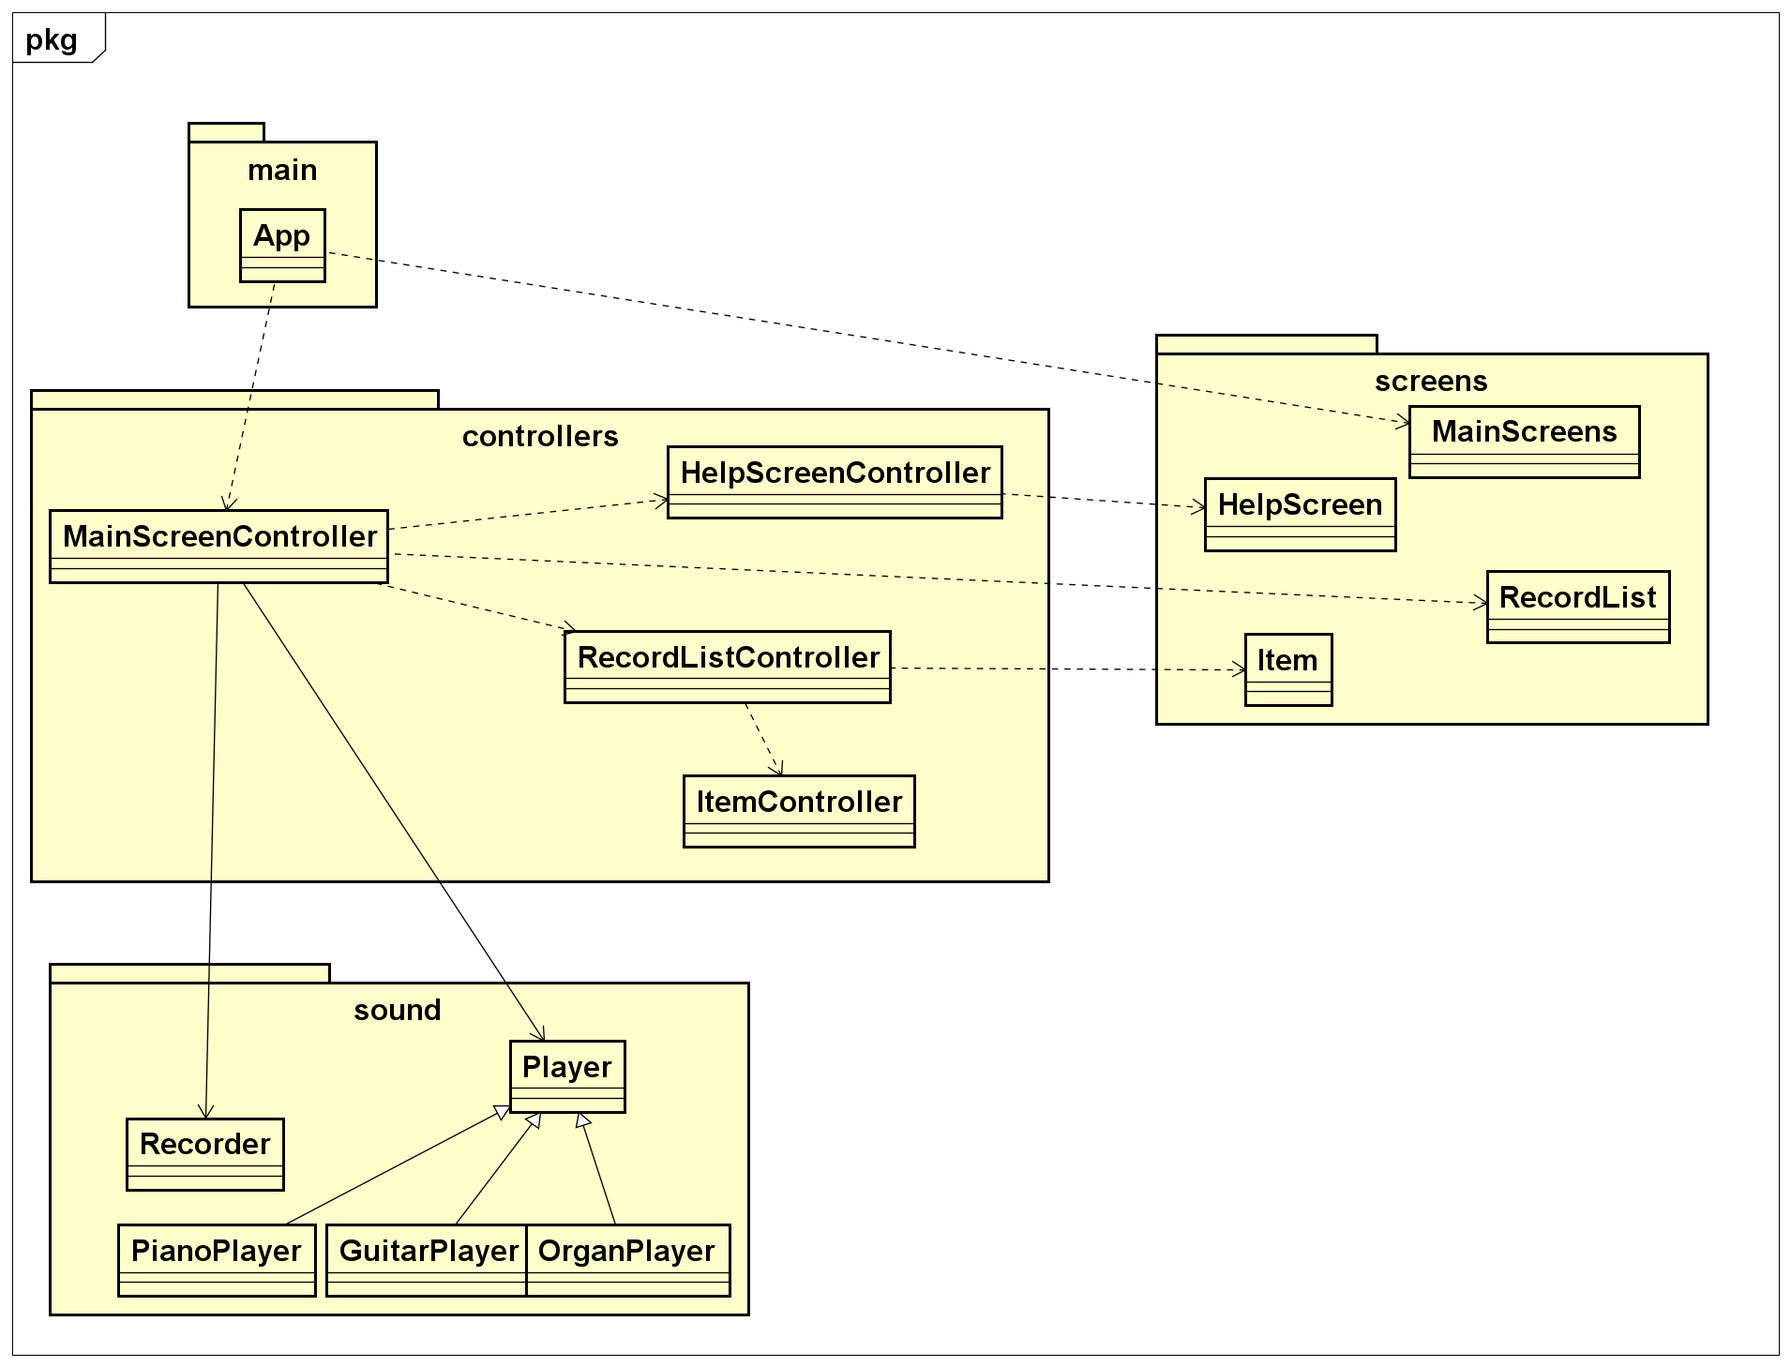
General class diagram

Slide 5
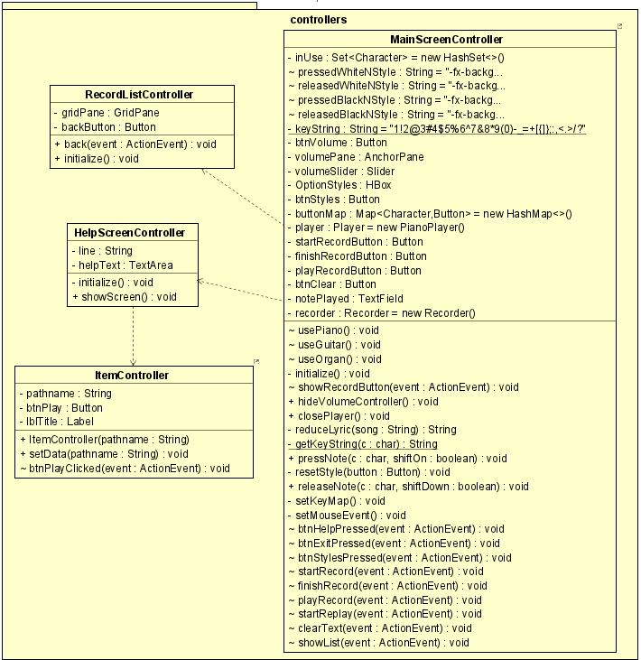
package controllers

Slide 6
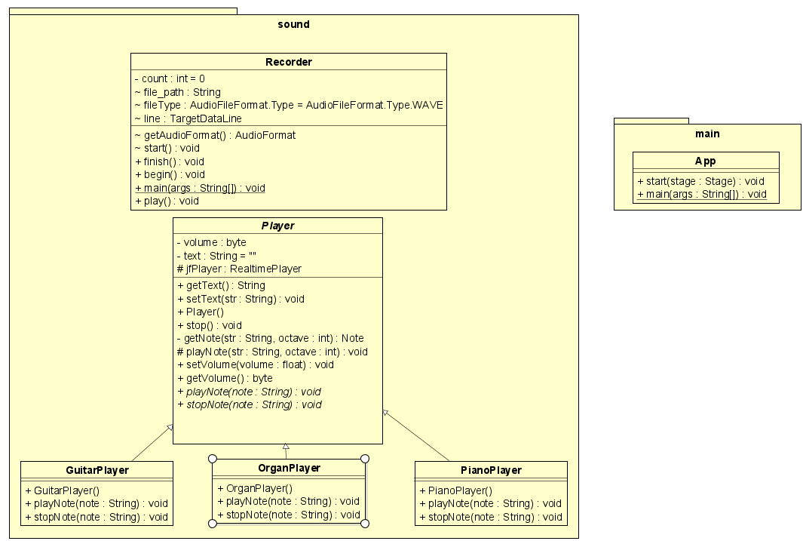
sound package and main package

Slide 7
Inheritance
Encapsulation
Fields
Player
void playNote(String);
void stop();
private byte volume;
private Player jfPlayer;
PianoPlayer
GuitarPlayer
OrganPlayer
Methods
public byte getVolume();
public void setVolume();
public void playNote();

Slide 8
Method polymorphism
Object polymorphism
public class PianoPlayer extends Player {
@Override
public void playNote(String note) {
playNote(note, 5);
}
// ...
}
public class OrganPlayer extends Player {
@Override
public void playNote(String note) {
playNote(note, 4);
}
// ...
}
void playNote(str: String, octave : int)
void playNote(str: String)
C1.setOnMousePressed(e -> {
player.playNote("C1");
});

Slide 9
Association
MainScreenController
- player : Player
- recorder : Recorder
Player
Recorder
Manage application sound
Log music sheet
Record audio
Replay recorded audio

Slide 10
Record Video Demo
https://drive.google.com/file/d/15ZqrS5VQMVxqEJqMDgXy39Y1hQuKwGFr/view?usp=sharing

