Slide 1
Digital Signal Processing
Topic: Text-To-Speech
Phung Gia Huy BI11-110

Slide 2
Content
< Definition >
< How it works >
< Text-to-speech in python >
< Text-to-speech tools >

Slide 3
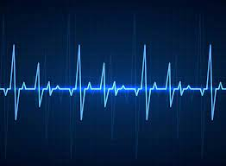
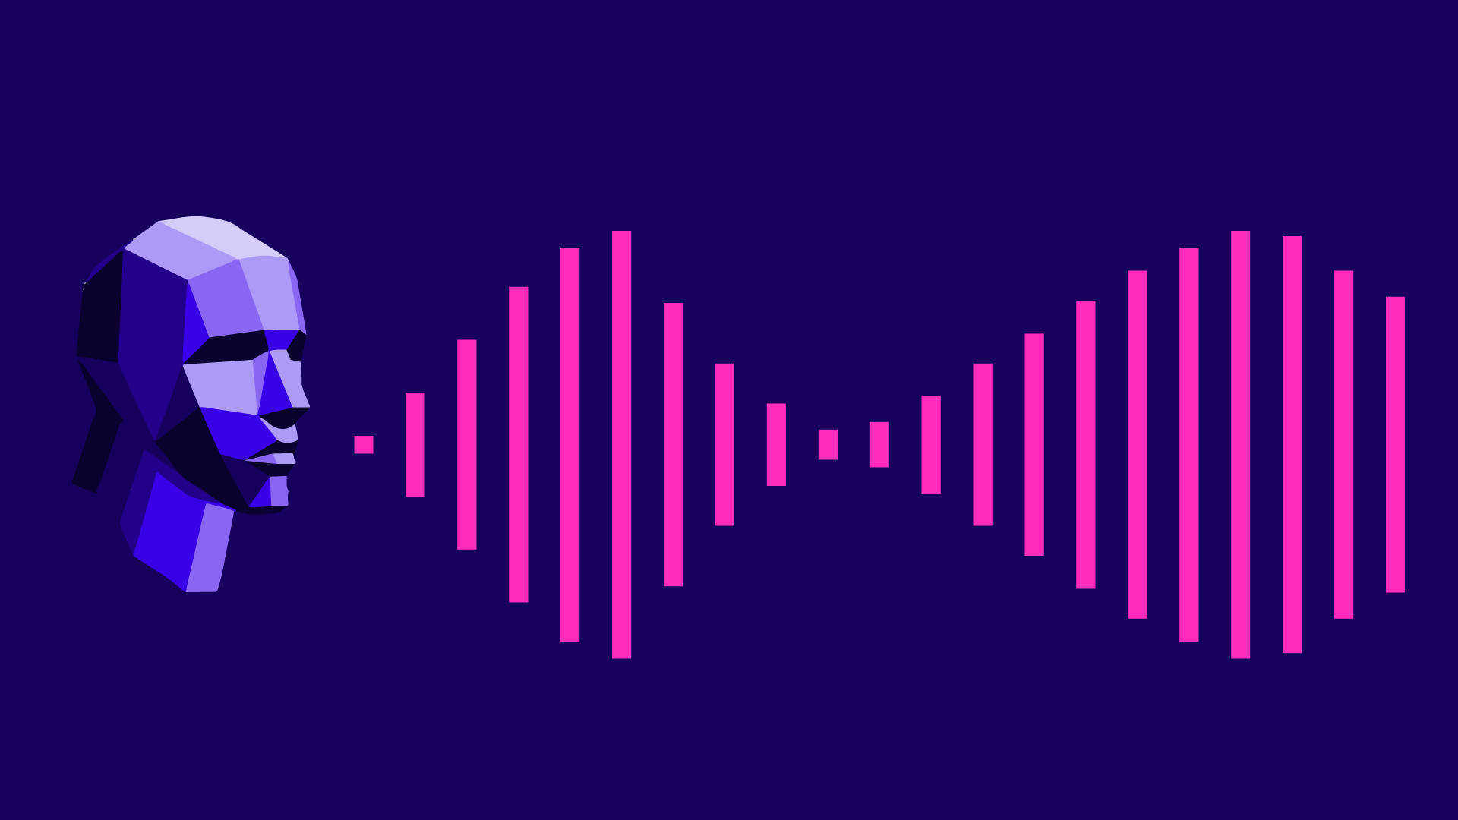
Definition
- A type of assistive technology that reads digital text aloud. It’s sometimes called “read aloud” technology.

Slide 4
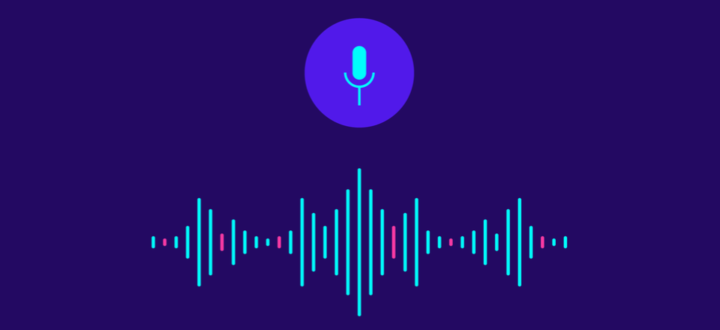
How it works ?

Slide 5
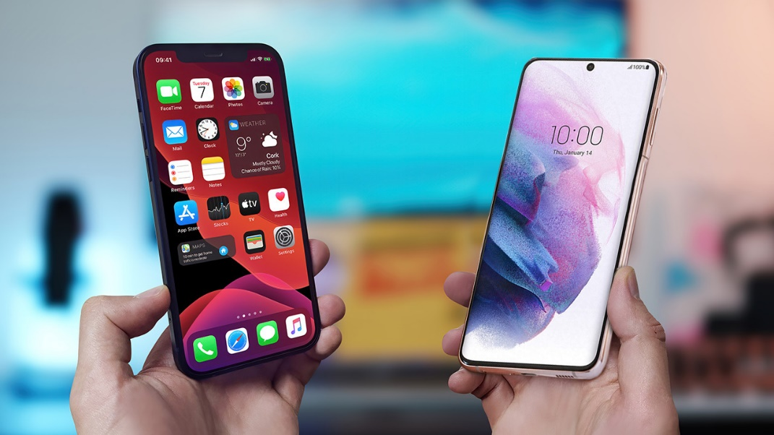

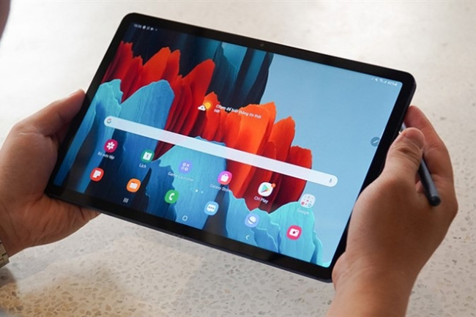
works with nearly every personal digital device

Slide 6
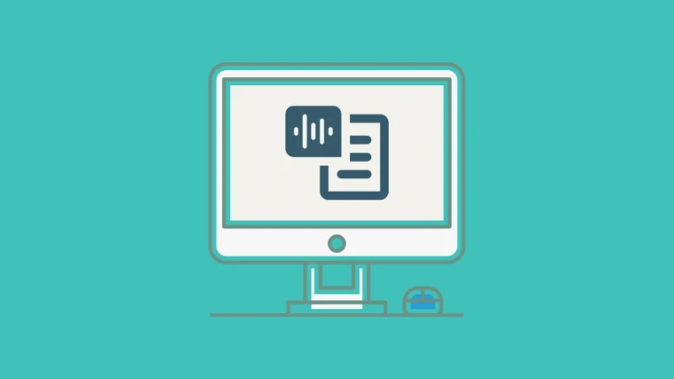
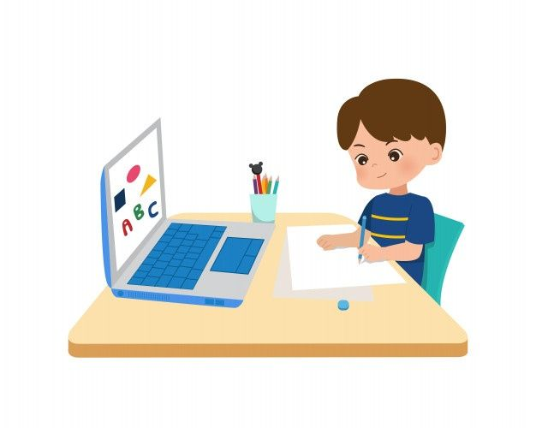

Voice quality varies, but some voices sound human
Allows kids to see text and hear it at the same time

Slide 7
Text-to-speech in python
1) Modules:
from gtts import gTTS from googletrans import Translator import numpy as np | import matplotlib.pyplot as plt from scipy.fftpack import fft from scipy.io.wavfile import read import os

Slide 8
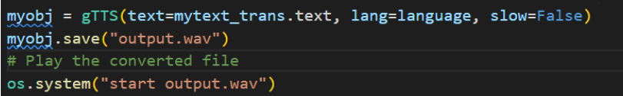
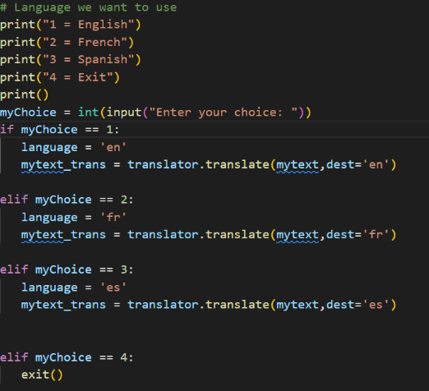
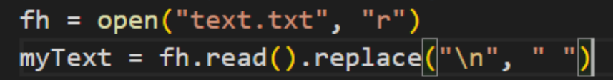

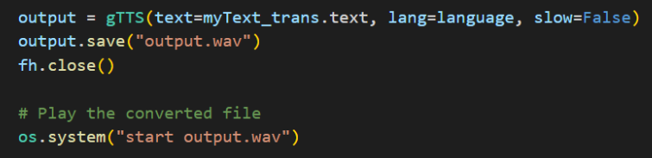
2) Codes:
3 languages: English, French and Spanish

Slide 9
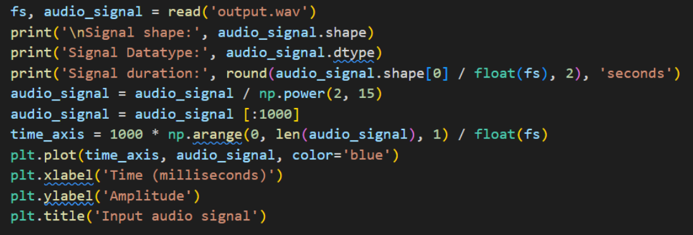
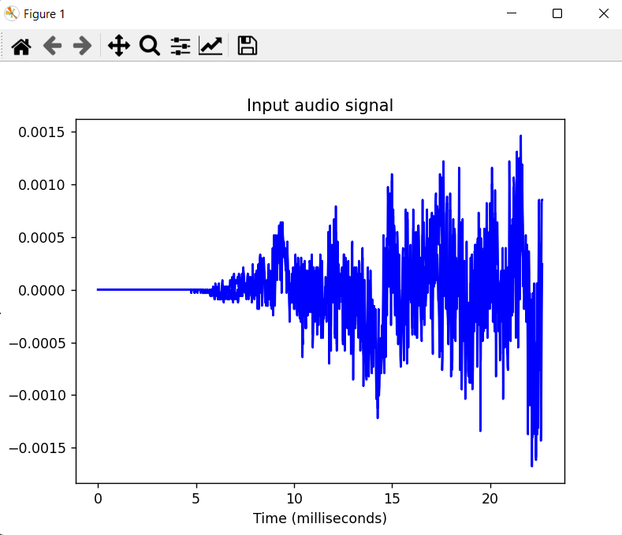
Audio signal:
Result

Slide 10
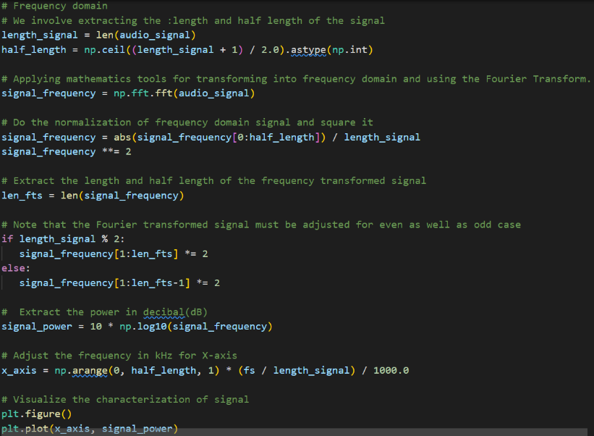
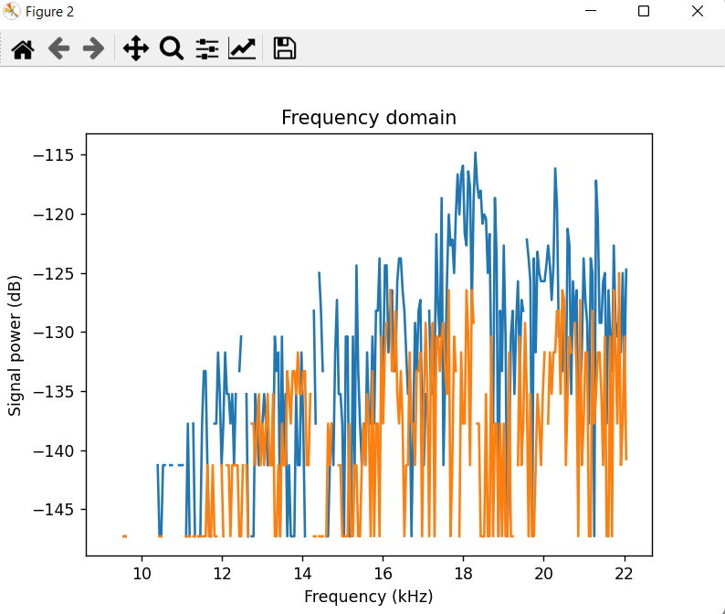
Frequency domain:
Result
#Note: More code in the report

Slide 11


Text-to-speech tools:
Built-in text-to-speech:
Web-based tools:
Text-to-speech apps:
Chrome tools:
Text-to-speech software programs:

Slide 12


