Slide 1
✓
PPE COMPLIANCE DETECTOR
Automated PPE Verification for Home Health Caregivers
ITAI 1378 — Final Presentation
MODEL TRAINED ✓ 90% mAP
Huy Nguyen
PROJECT TIER
Tier 1

Slide 2
The Problem
Home health caregivers are required to wear PPE (masks, gloves) during certain visits.
Compliance today relies on self-reporting and occasional manual supervisor spot-checks.
This does not scale across a large caregiver workforce and creates gaps during infection-control audits.
MANUAL CHECKS DON'T SCALE
1
spot-check per visit — no continuous verification
Why it matters
Who cares: Agency compliance officers, supervisors, and payer/UHC infection-control audits.
Missed PPE compliance is both a health risk and a documentation liability during audits.
PPE Compliance Detector | ITAI 1378 Final Presentation
2

Slide 3
Our Solution
An object detection system that scans a photo of a caregiver and automatically flags PPE compliance — in real time, with no manual review.
1
2
3
Capture
→
Detect
→
Flag
A photo of the caregiver is taken at check-in or during a visit.
A fine-tuned YOLOv8 model scans the image for mask presence and placement.
The system outputs a clear compliant / non-compliant result instantly.
Compliant → mask detected correctly ⚠ Non-Compliant → mask missing or worn incorrectly
PPE Compliance Detector | ITAI 1378 Final Presentation
3

Slide 4
Technical Approach
TECHNIQUE
MODEL
FRAMEWORK
Object Detection
YOLOv8n
Ultralytics (PyTorch)
Bounding boxes localize exactly where PPE is present or missing — not just a whole-image label.
Fine-tuned for 75 epochs on free Colab GPU — fast to train, strong results for its size.
Mature tooling, strong community support for PPE-style datasets, minimal boilerplate.
Why this stack: kept scope realistic for the timeline — real training and evaluation, without custom architecture design or manual labeling.
PPE Compliance Detector | ITAI 1378 Final Presentation
4

Slide 5
Data Plan
Labels (3 classes)
DATASET SIZE
4,547
with_mask
without_mask
incorrectly_worn_mask
Core deliverable: with_mask / without_mask. Incorrect-mask detection is a stretch goal.
labeled images
Preparation
Source
No manual labeling — dataset ships pre-annotated in YOLO format.
Exported directly via the Roboflow Python package.
Standard Ultralytics augmentation applied at train time (flip, mosaic, brightness).
Roboflow Universe
“Mask-Detection-YOLOv8” (AGH)
License: CC BY 4.0
PPE Compliance Detector | ITAI 1378 Final Presentation
5

Slide 6
System Diagram
1
2
3
4
Input
→
YOLOv8 Inference
→
Post-Processing
→
Output
Photo of caregiver
Detect person + PPE regions
Classify mask / no-mask
Annotated image + compliance flag
Pipeline is intentionally linear — one photo in, one clear compliance flag out. No manual review step required.
PPE Compliance Detector | ITAI 1378 Final Presentation
6

Slide 7
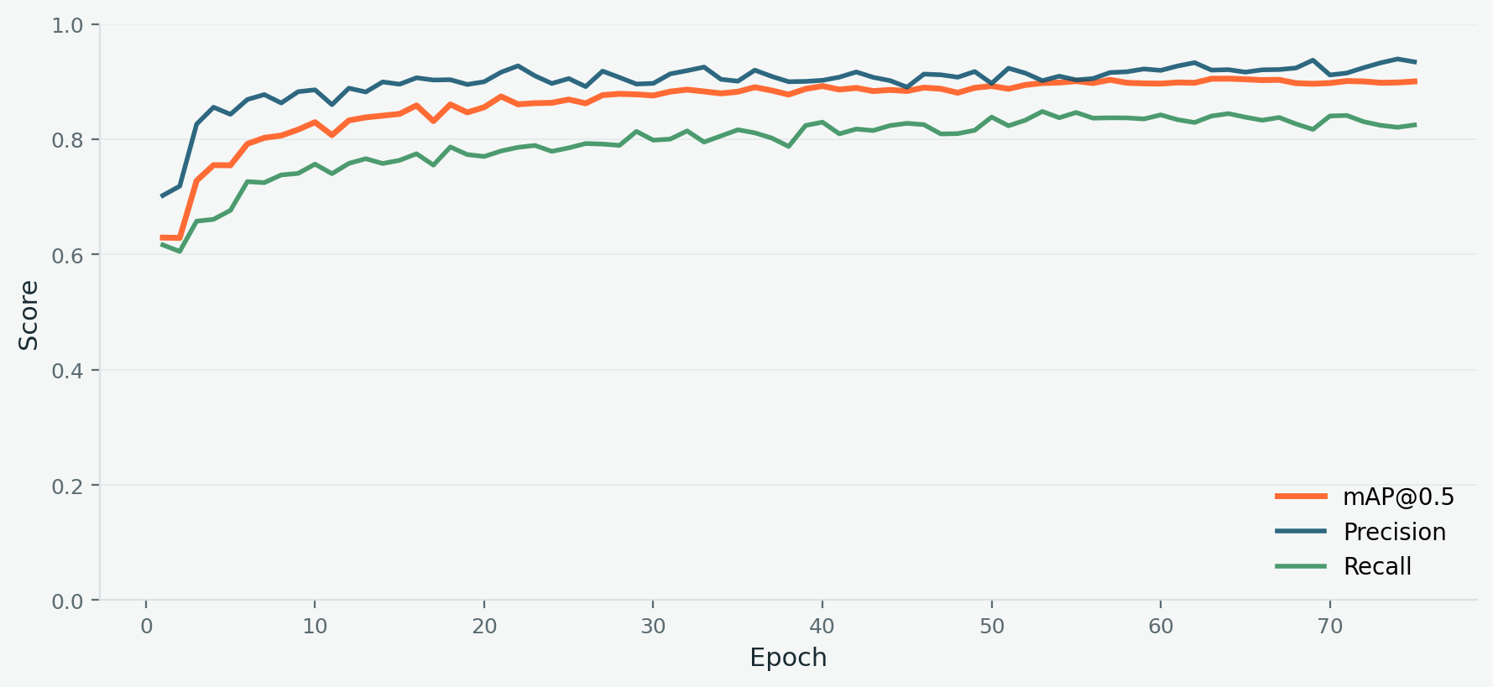
Training Results
mAP@0.5
90.0%
Precision
93.4%
Recall
82.5%
Model exceeded our 75–80% mAP target, matching published benchmarks (~91%) for similar fine-tuned models on this dataset.
75 epochs · 76.4 min total training time on Colab T4 GPU
PPE Compliance Detector | ITAI 1378 Final Presentation
7

Slide 8
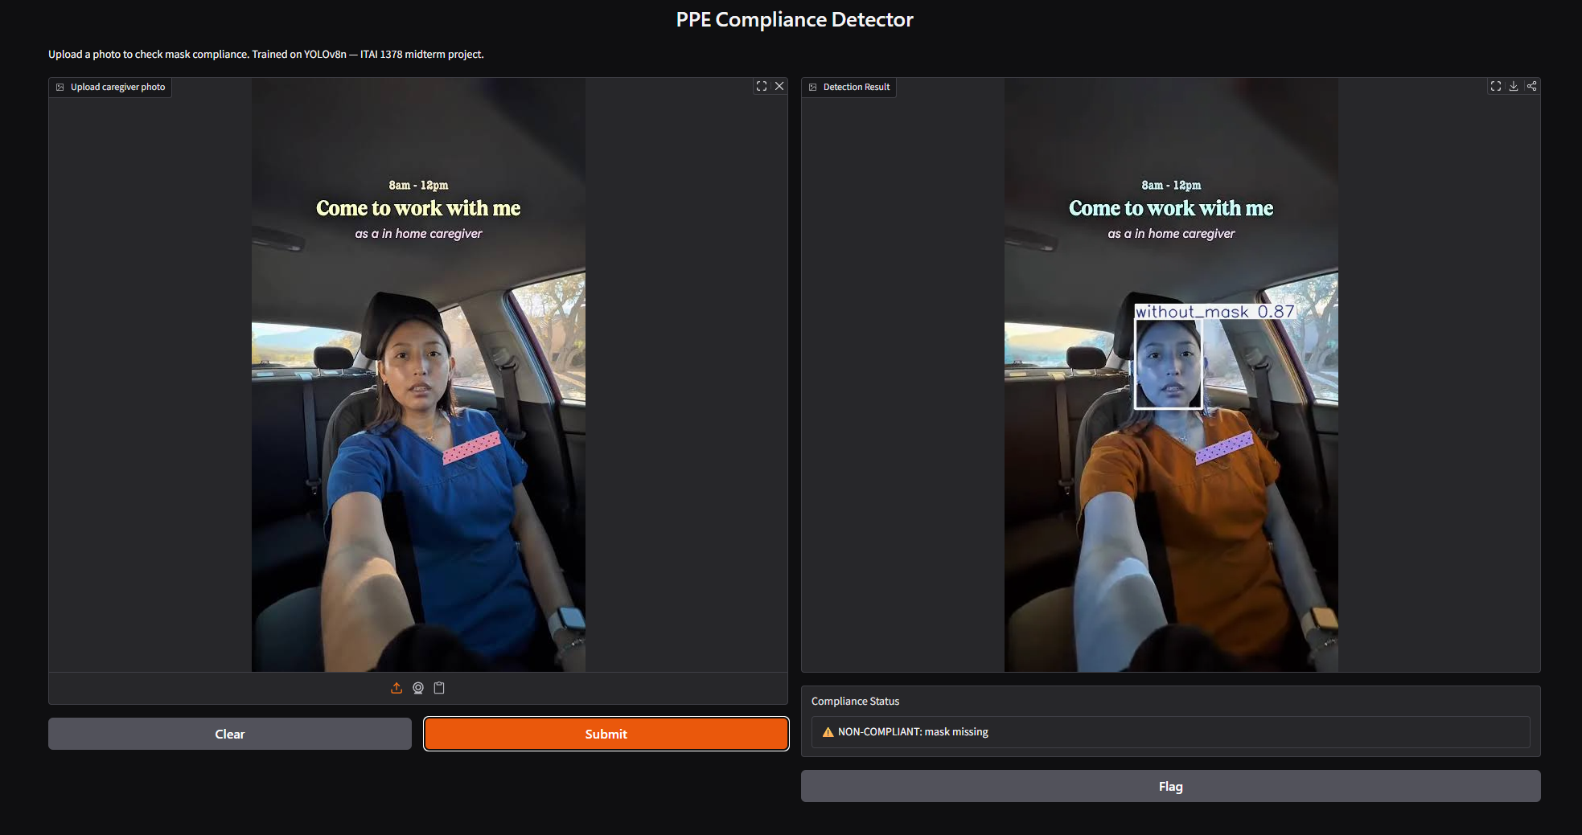
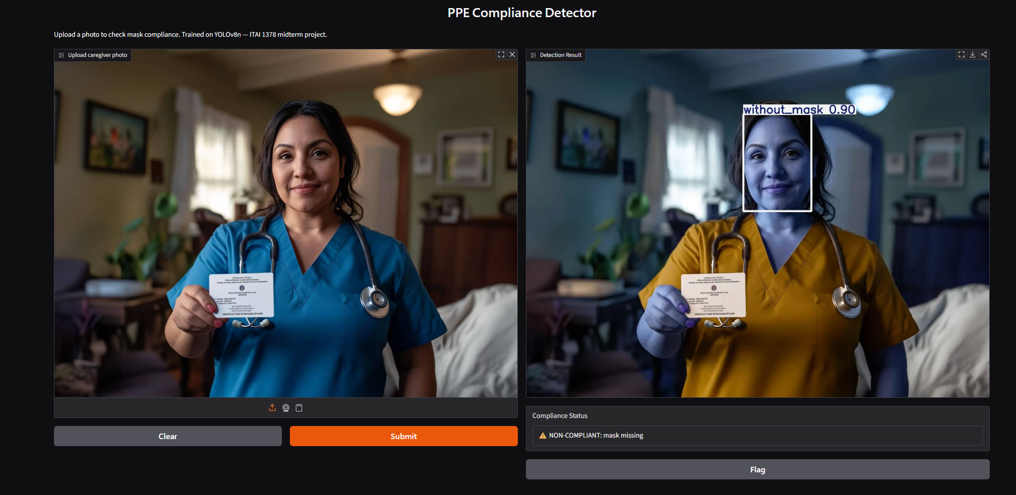
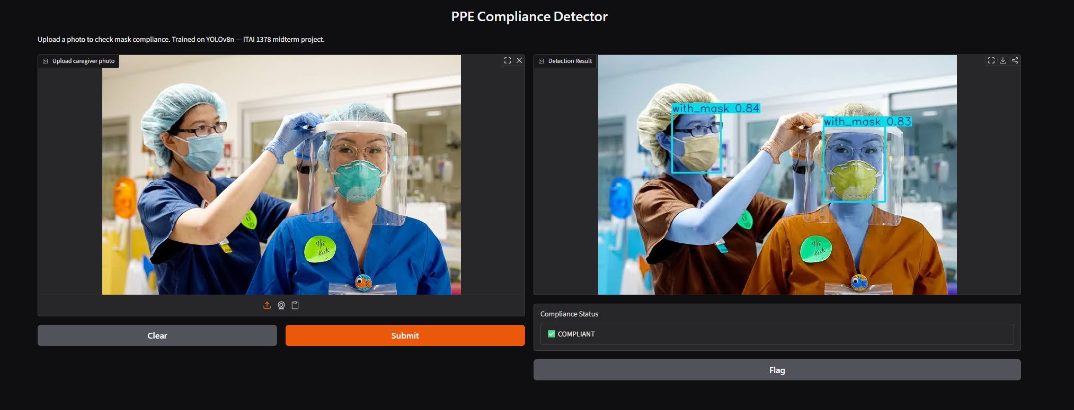
Live Demo
Interactive Gradio interface — upload a photo, get an instant compliance flag.
NON-COMPLIANT — mask missing (0.87)
NON-COMPLIANT — mask missing (0.90)
COMPLIANT — both masks detected (0.84, 0.83)
PPE Compliance Detector | ITAI 1378 Final Presentation
8

Slide 9
Success Metrics: Target vs. Actual
PRIMARY METRIC — mAP@0.5
SECONDARY METRIC — SPEED
Target: ≥ 75–80%
Target: < 0.5s / image
90.0%
Precision 93.4%
Recall 82.5%
✓ TARGET EXCEEDED
Confirmed fast, responsive inference during live Gradio demo — well under a second per image.
Best single checkpoint (epoch 64) hit 90.5% — model stayed stable through training.
PPE Compliance Detector | ITAI 1378 Final Presentation
9

Slide 10
Project Timeline
✓
✓
✓
✓
✓
✓
Dataset + environment
Sanity-check run
Full training + tuning
Build demo
Docs, slides, rehearse
Present
Complete
Complete
90% mAP reached
Gradio demo live
Complete
🎉 Today
PPE Compliance Detector | ITAI 1378 Final Presentation
10

Slide 11
Challenges & What We Learned
Challenge | How We Handled It
Full 75-epoch run took ~76 min | Used checkpointing (save_period=10) so progress was never lost to a Colab disconnect.
Domain mismatch (dataset ≠ real home visits) | Accepted as a known limitation — can't use real patient photos for privacy reasons.
Confirming target vs. actual model quality | Cross-checked our 90% mAP against a published benchmark on the same dataset (~91%) to validate the result was reasonable, not a fluke.
Turning raw detections into a usable signal | Built a simple compliance-flag function on top of raw YOLO output, then wrapped it in a Gradio UI for a real interactive demo.
PPE Compliance Detector | ITAI 1378 Final Presentation
11

Slide 12
Conclusion
COMPUTE USED
FRAMEWORKS
TOTAL COST
Colab T4 GPU
Ultralytics YOLOv8
$0
76.4 min total training
PyTorch · Roboflow · Gradio
Free tiers covered the full project
A working PPE compliance detector — 90% mAP, real-time demo, built on public data and free compute.
Thank you — questions welcome
PPE Compliance Detector | ITAI 1378 Final Presentation
12

