Slide 1
Get started with the Model Context Protocol (MCP)
modelcontextprotocol/servers: Model Context Protocol Servers

Slide 2
Introduction of MCP
Model Context Protocol (MCP) is an open protocol that standardizes how applications provide context to LLMs.
Think of MCP like a USB-C port for AI applications. Just as USB-C provides a standardized way to connect your devices to various peripherals and accessories, MCP provides a standardized way to connect AI models to different data sources and tools.
Why?
MCP helps you build agents and complex workflows on top of LLMs. LLMs frequently need to integrate with data and tools, and MCP provides:
A growing list of pre-built integrations that your LLM can directly plug into
The flexibility to switch between LLM providers and vendors
Best practices for securing your data within your infrastructure
modelcontextprotocol/servers: Model Context Protocol Servers

Slide 3
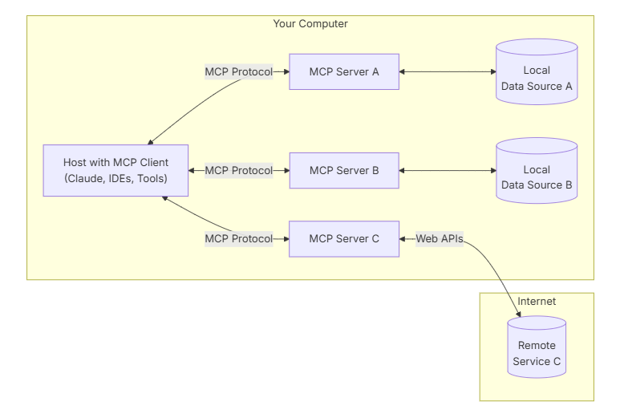
General MCP Architecture
MCP Clients: Protocol clients that maintain 1:1 connections with servers
MCP Servers: Lightweight programs that each expose specific capabilities through the standardized Model Context Protocol
MCP Host Applications: Programs like Claude Desktop, IDEs, or AI tools that want to access data through MCP
Local Resources: Your computer’s files, databases, and services that MCP servers can securely access
Remote Services: External systems available over the internet (e.g., through APIs) that MCP servers can connect to

Slide 4
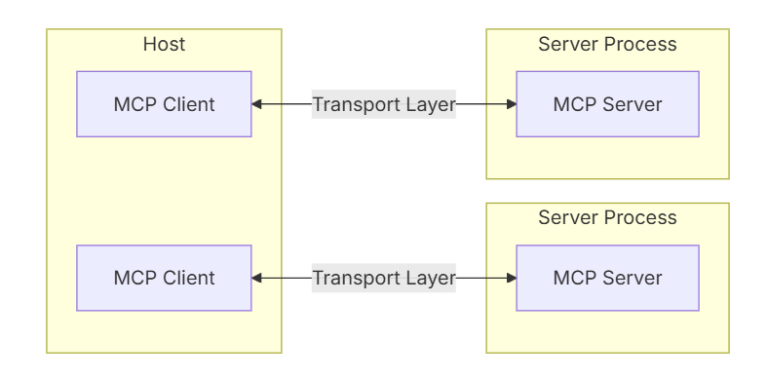
General MCP Architecture
“Decide what action to take and tools to use”
Tool description
Do the execution

Slide 5
Pros & Cons
Pros:
Like the name model context protocol, give LLM more context and space to work with
Provide a standard for to build MCP server
Build Agent solutions fast !!!
Many pre-built MCP to use
Cons:
MCP conflicts
Like a USBs or Apps, I might contain virus
Many pre-built MCP to use but most of them are garbage

