Slide 1
Software Quality Risk Manager
Center of Software Technology Excellence
Yoshio Akasofu

Slide 2
Theme: Quality Risk Manager 2018年07月27日
Team
Team: Agility Practice
Leader: Oyu Satoshi
Members: Quan(Main), Kubota, Sakai, Akasofu
Background and What to Achieve
When a software developer commits code into source code, there is possibility that the commit includes bug
If a tool can predict the commit including bug or not, the developer will review the commit and prevent from committing bugs
To reduce human effort in evaluating bug commits, our team has built a machine learning model for such cases

Slide 3
Theme: Quality Risk Manager
Prototype Assumption
Assumption
Commit that contains ‘fix’ word in commit message, is bug fix commit or non-bug commit
From non-bug commit, we trace back to the commit history and find bug commits that affected to this non-bug commit

Slide 4
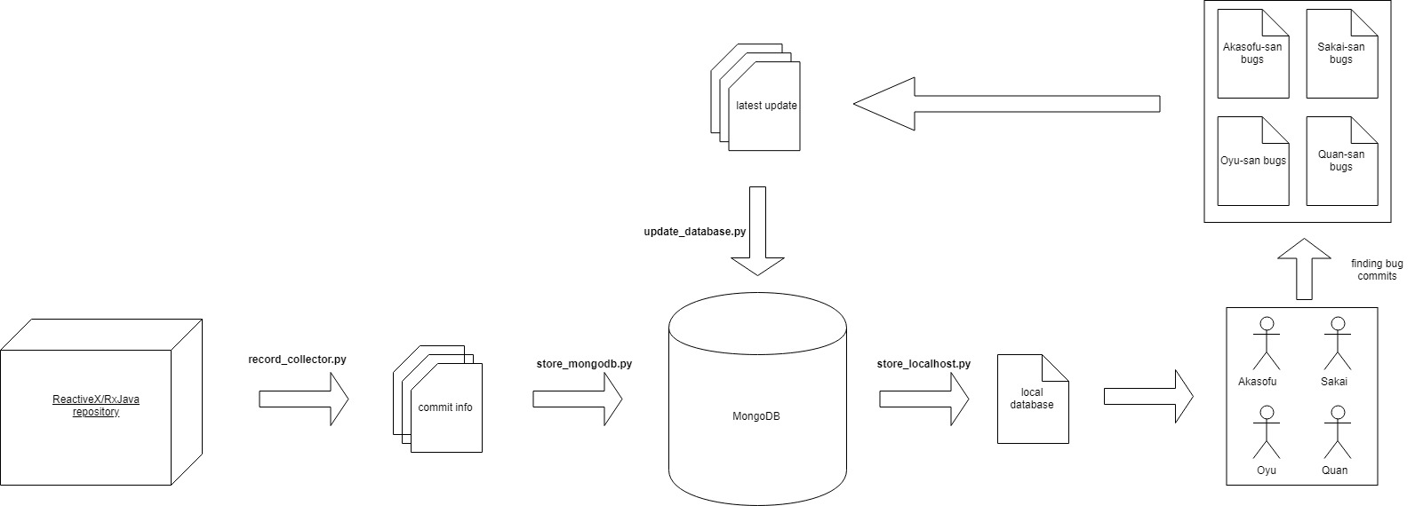
Theme: Quality Risk Manager
Circle Of Commit Evaluation

Slide 5
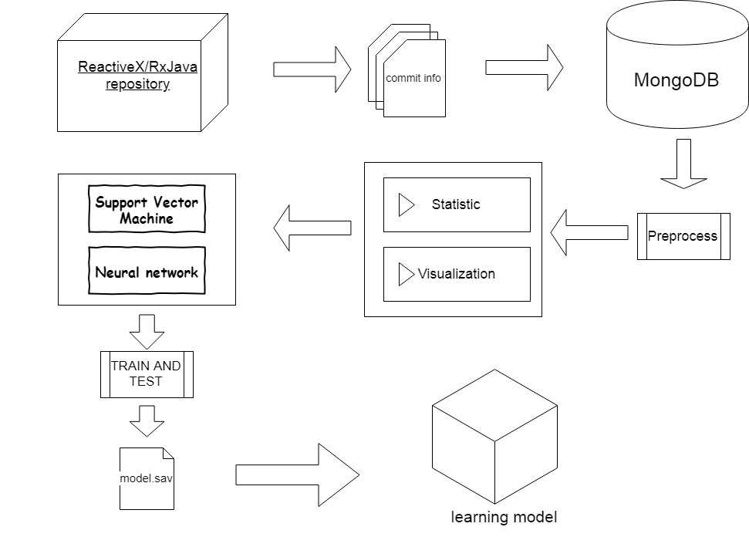
Theme: Quality Risk Manager
Image of System
RxJava – Reactive Extensions for the JVM

Slide 6
Theme: Quality Risk Manager
Used technology
We have applied SVM and MLP and received acceptable result.
NLP is a powerful technique in text analysis, however, we don’t have enough time and resource to apply it
Type of problem: Classification (bug or non-bug)
SVM ( Support Vector Machine )：it is simple and easy to use, but not good performance
MLP ( Multi Layer Perceptron)：many data is overlapped (non-linear problem) so we decided to use Neural Network
NLP ( Natural Language Processing) : commit message might have important features about bug or non-bug, this technique will take more time

Slide 7
Theme: Quality Risk Manager
Feature Selection
hash
message
num_of_files
date
total_lines
mod_lines
committer
insertions
deletions

Slide 8
Theme: Quality Risk Manager
Current Situation of evaluating
SVM
Amount of bug commits are really rare in comparison with amount of non-bug commits (ratio is 1/10)
Biased data affect into biased model (the model tends to predict data as non-bug)
High accuracy but low precision and recall (low performance)
MLP
Many data is overlapped onto the same region (SVM is not effect in such case)
This scenario is non-linear problem (complexed pattern)
Using Neural Network (MLP) is suitable for such case
Higher accuracy and higher precision and recall (higher performance)

Slide 9
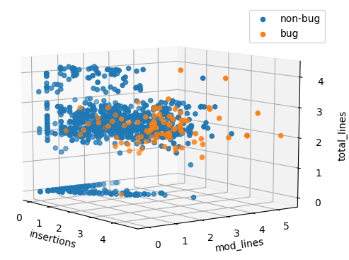
Theme: Quality Risk Manager
Overlap in data distribution

Slide 10
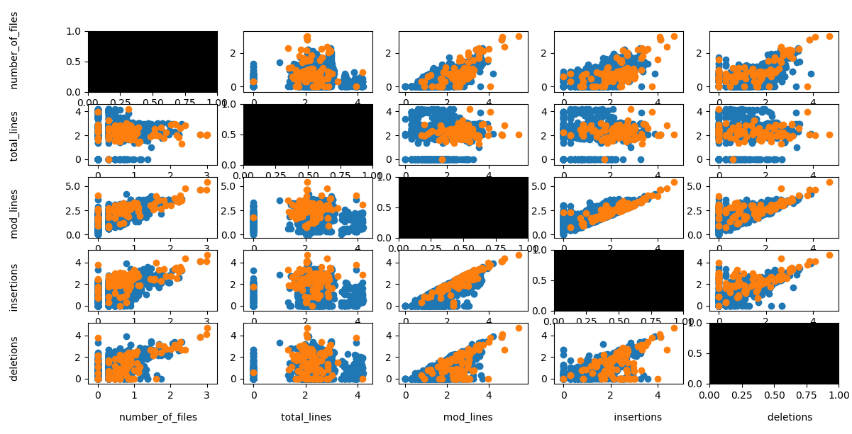
Theme: Quality Risk Manager
Used features

Slide 11
Theme: Quality Risk Manager
Result
Dataset includes
1106 non-bug commits
87 bug commits which is evaluated by human
Ratio training/test: 90/10
SVM
Precision 72.1%
Recall 52.1%
F-score 52.6%
Accuracy 93.9%
MLP
Precision 83.4%
Recall 62.5%
F-score 67.3%
Accuracy 93.4%

Slide 12
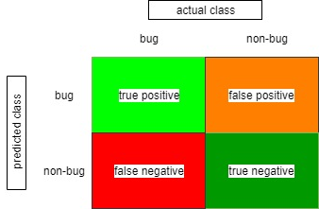
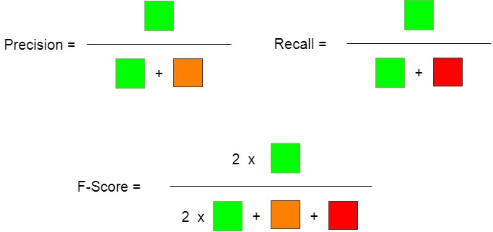
Theme: Quality Risk Manager
Meaning of values
SVM
Precision 72.1%
Recall 52.1%
F-score 52.6%
Accuracy 93.9%
MLP
Precision 83.4%
Recall 62.5%
F-score 67.3%
Accuracy 93.4%

Slide 13
Theme: Quality Risk Manager
Conclusion and Future Actions
This approach is not confident enough (because the recall is low)
Need to be improved in the future
Tuning parameters
Collect more data
NLP to find other features
Scheduled date
2018/8 Prototype
2019/1 Work in practice in Center of Software Technology Excellence
2019/4 Trial in other organizations

