Slide 1
TIMELINE
12.05
16.05
08.05
14.05
ONLINE MEETING AND WORK DISTRIBUTION
REVIEW AND EDIT CODE 2ND TIME
REVIEW AND EDIT CODE 1ST TIME
MERGE CODE AND COMPLETE

Slide 2
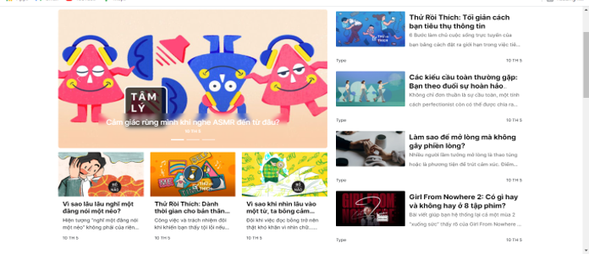
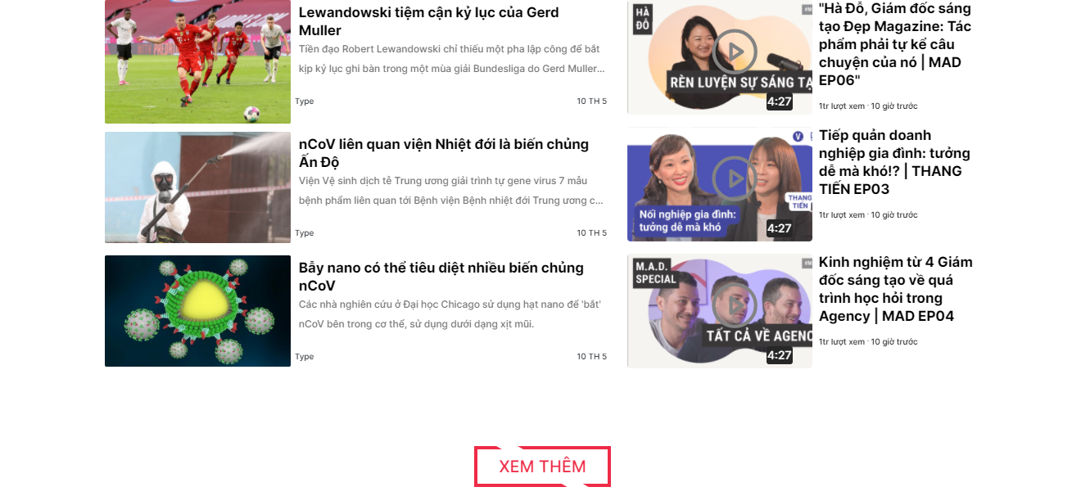
HOMEPAGE
DESCRIPTION
UI:
Like Layout Image
All post component have :image , title , type, a piece of content, time(? hours ago)
Logic:
Carousel : Just Display Top 3 News ( Read Owl Carousel 2 Or Slick Carousel)
Click on post -> Go to page details
Click see more => Display more post

