Slide 1
DIY low cost Smart Home
SM
RT

Slide 2
What are the main requirements ?
Communication
Main controller
A way to control the appliance

Slide 3
Communication & Main controller
NodeMCU – ESP8266 based microcontroller
Works with the familiar Arduino IDE
Have a lot of RAM memory ( 96KB vs 2KB @ Arduino nano)
Have a lot of Flash memory ( 512KB vs 32KB @ Arduino nano)

Slide 4
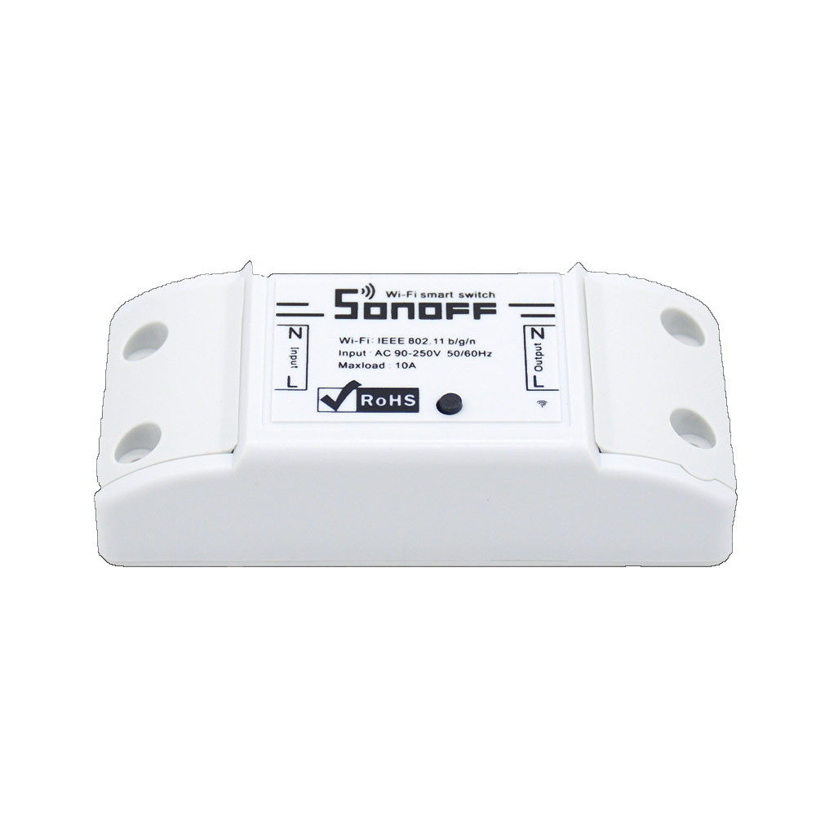

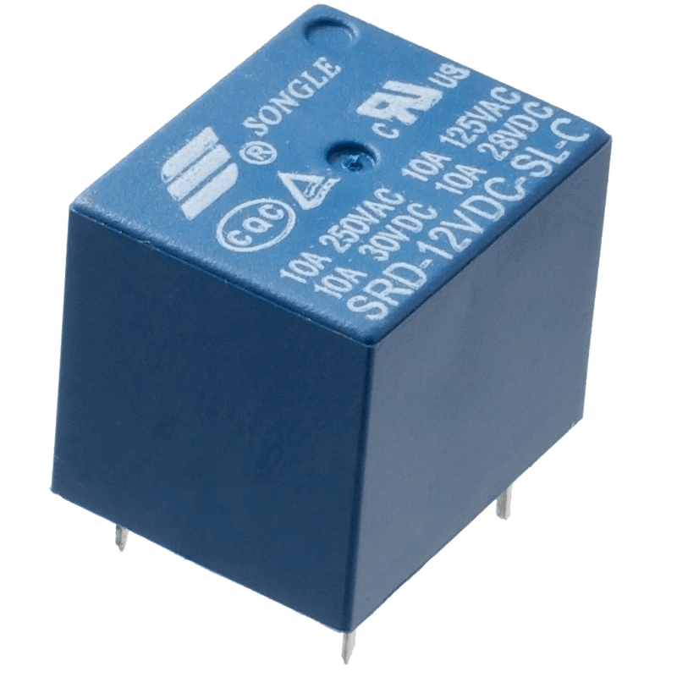
Control a “dump” devices
2 common methods
Clone the remote signal
Using a relay

Slide 5
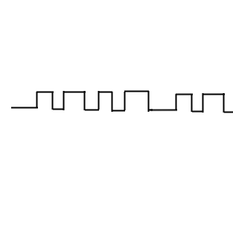

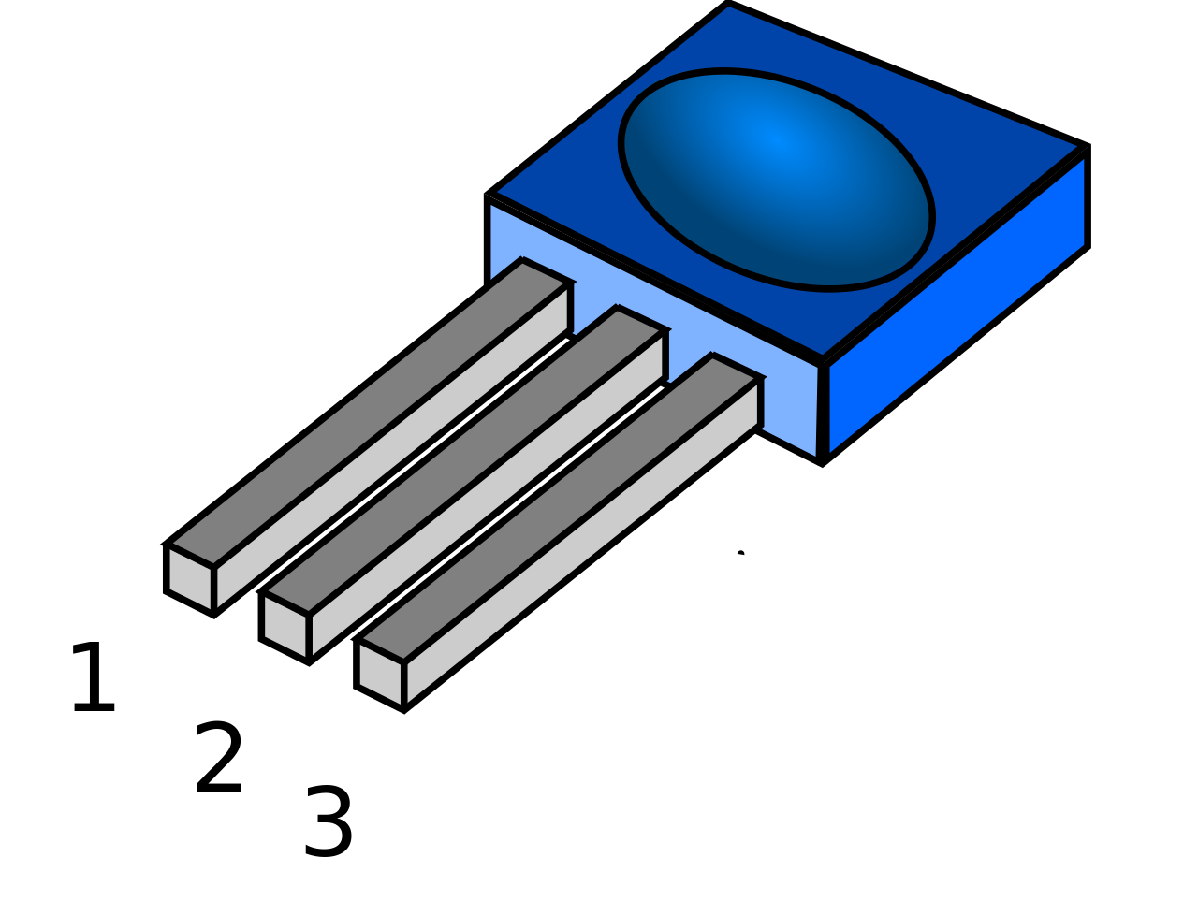
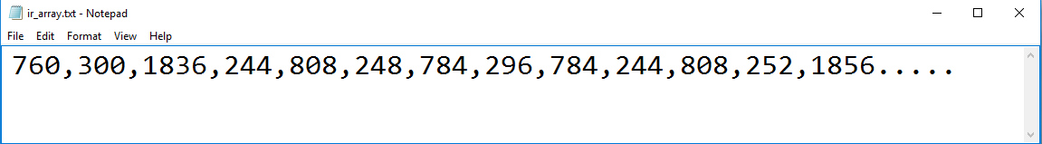
Clone the remote signal
Remote
Electrical appliance
Infra-red Signal
How to clone the signal ?
Infra-red Receiver
Micro-controller
Signal data

Slide 6
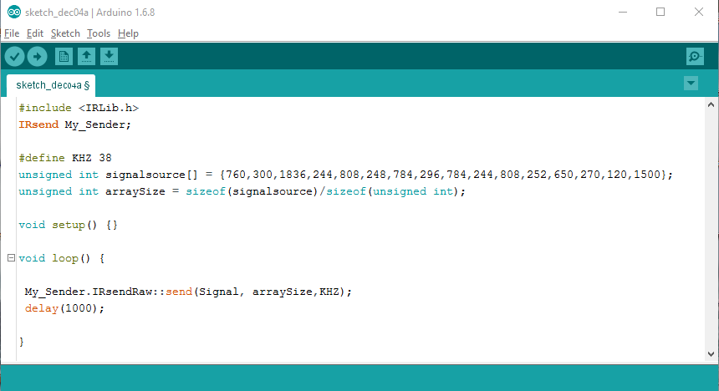
Clone the remote signal
In software manner:

Slide 7
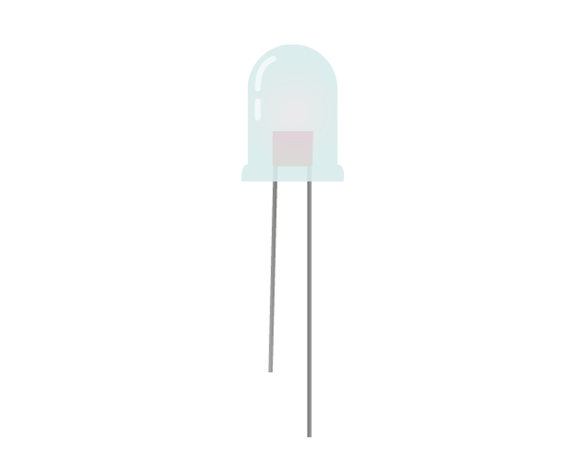
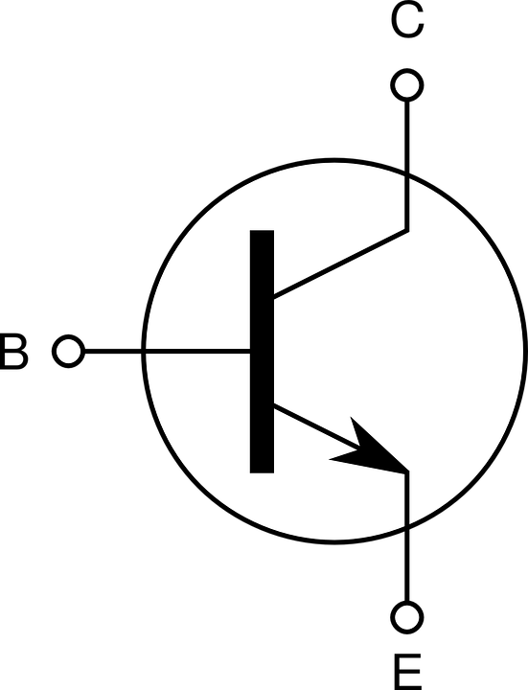
Clone the remote signal
In hardware manner :
Infra-red Diode 5mm
VCC
1K resistor
NPN Transistor
GND

Slide 8


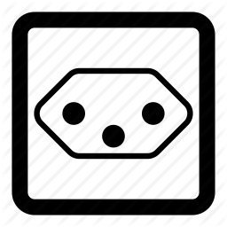
Using a Relay
Electrical appliance
AC Socket
Sonoff switch

Slide 9


Sending remote commands
What is the best way ?
MQTT
broker
Remote application
Smart home system
Subscribe
Publish

Slide 10
END
Any questions?

