Slide 1
Introduction to Android Development Environment
ECOD - Aug 2015

Slide 2
What is Android?
A software stack for mobile devices that includes
An operating system
Middleware
Key Applications
Uses Linux to provide core system services
Security
Memory management
Process management
Power management
Hardware drivers

Slide 3
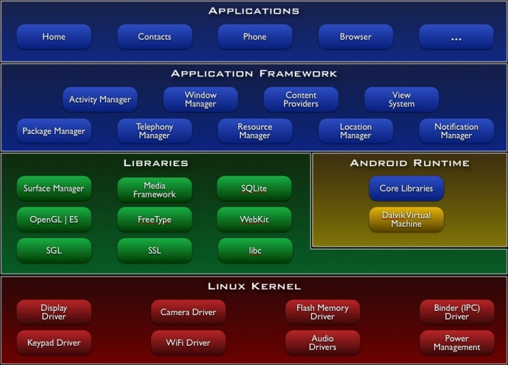
http://developer.android.com/guide/basics/what-is-android.html

Slide 4
Android Features
Application framework enabling reuse and replacement of components
Dalvik virtual machine optimized for mobile devices
Integrated browser based on the open source WebKit engine
Optimized graphics powered by a custom 2D graphics library; 3D graphics based on the OpenGL ES 1.0 specification (hardware acceleration optional)
SQLite for structured data storage
Media support for common audio, video, and still image formats (MPEG4, H.264, MP3, AAC, AMR, JPG, PNG, GIF)
GSM Telephony (hardware dependent)
Bluetooth, EDGE, 3G, and WiFi (hardware dependent)
Camera, GPS, compass, and accelerometer (hardware dependent)
Rich development environment including a device emulator, tools for debugging, memory and performance profiling, and a plugin for the Eclipse IDE
http://developer.android.com/guide/basics/what-is-android.html

Slide 5
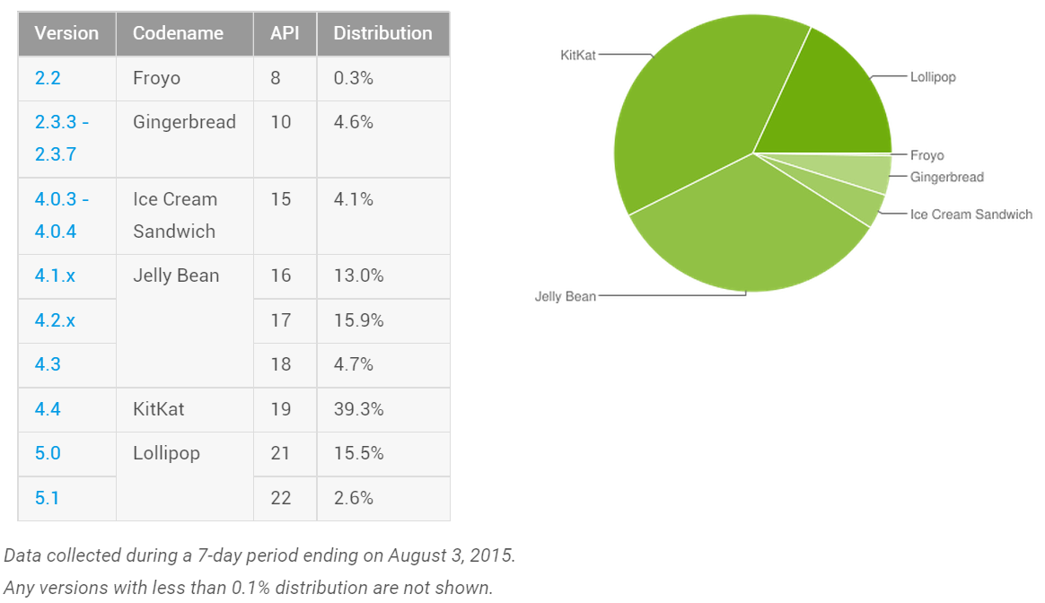
Android Distribution Aug 2015
https://developer.android.com/about/dashboards/index.html

Slide 6
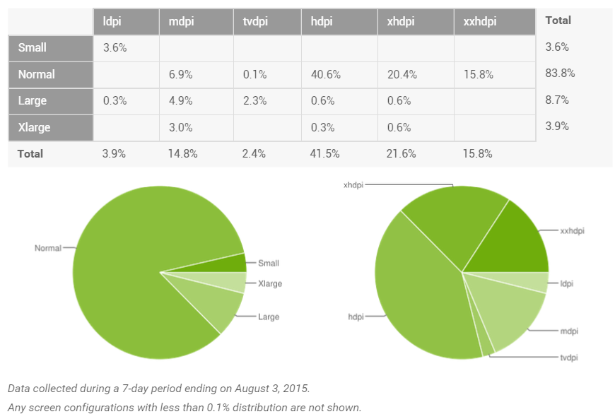
Screen Densities as of August 2015
~120dpi ~160dpi ~240dpi ~320dpi ~480dpi ~640dpi

Slide 7
Android Runtime

Slide 8
Android Runtime: Dalvik VM
Subset of Java developed by Google
Optimized for mobile devices (better memory management, battery utilization, etc.)
Dalvik runs .dex files that are compiled from .class files
Introduces new libraries
Does not support some Java libraries like AWT, Swing
http://developer.android.com/reference/packages.html

Slide 9
Applications Are Boxed
By default, each app is run in its own Linux process
Process started when app’s code needs to be executed
Threads can be started to handle time-consuming operations
Each process has its own Dalvik VM
By default, each app is assigned unique Linux ID
Permissions are set so app’s files are only visible to that app

Slide 10

Producing an Android App
Java code
javac
Byte code
Dalvik exe
dx
.java
.class
classes.dex
aapt
Byte code
<xml>
Other .class files
AndroidManifest.xml
.apk
<str>
Resources
Notes:
Every application must have an AndroidManifest.xml file (with precisely that name) in its root directory. The manifest presents essential information about the application to the Android system, information the system must have before it can run any of the application's code. Among other things, the manifest does the following:
It names the Java package for the application. The package name serves as a unique identifier for the application.
It describes the components of the application — the activities, services, broadcast receivers, and content providers that the application is composed of. It names the classes that implement each of the components and publishes their capabilities (for example, which Intent messages they can handle). These declarations let the Android system know what the components are and under what conditions they can be launched.
It determines which processes will host application components.
It declares which permissions the application must have in order to access protected parts of the API and interact with other applications.
It also declares the permissions that others are required to have in order to interact with the application's components.
It lists the Instrumentation classes that provide profiling and other information as the application is running. These declarations are present in the manifest only while the application is being developed and tested; they're removed before the application is published.
It declares the minimum level of the Android API that the application requires.
It lists the libraries that the application must be linked against.

Slide 11

Creating Hello Android App
Live Lab
Create an Activity
Demonstrate resources created
show the Activity lifecycle within the Android OS
show the various debugging tools available
show how to start one Activity from another

Slide 12
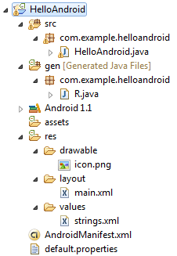
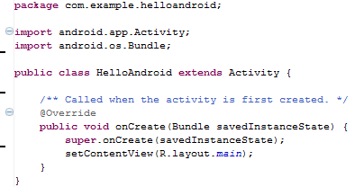
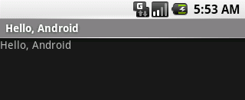
Hello Android
http://developer.android.com/resources/tutorials/hello-world.html

Slide 13
Important Files
src/HelloAndroid.java
Activity which is started when app executes
gen/R.java (DO NOT MODIFY!)
Auto-generated, auto-updated file with identifiers from main.xml, strings.xml, and elsewhere
res/layout/main.xml
Defines & lays out widgets for the activity
res/values/strings.xml
String constants used by app
AndroidManifest.xml
Declares all the app’s components
Names libraries app needs to be linked against
Identifies permissions the app expects to be granted

Slide 14
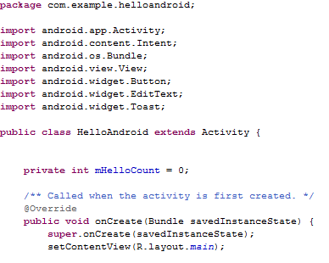
1 - src/HelloAndroid.java
Activity which is started when app executes

Slide 15
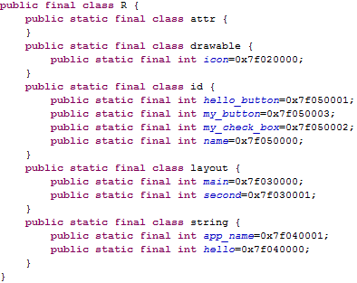
2 - gen/R.java
Auto-generated file with identifiers from main.xml, strings.xml, and elsewhere
Do not modify!

Slide 16
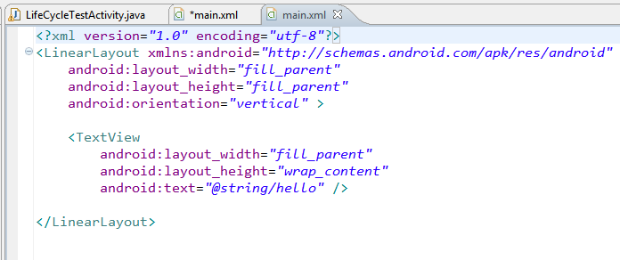
3 - res/layout/main.xml
layout of main activity
xml view

Slide 17
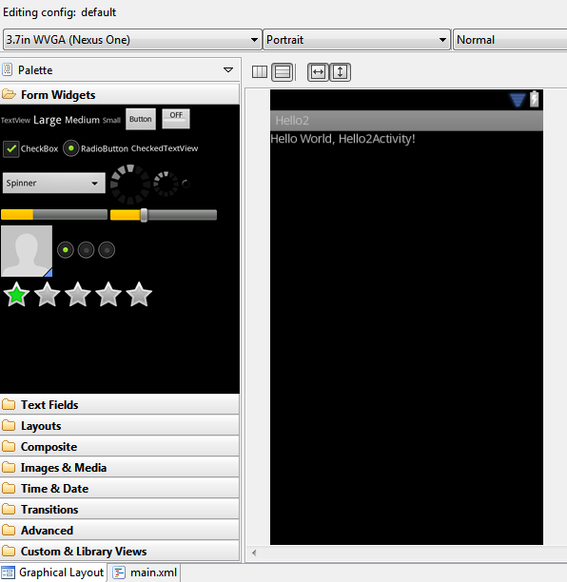
3 contd. - res/layout/main.xml

Slide 18
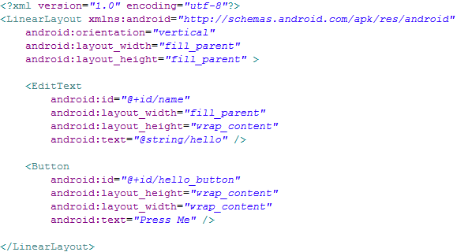
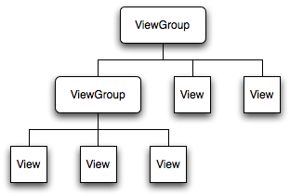
3 contd. - res/layout/main.xml
Declares layouts & widgets for the activity
Tree from: http://developer.android.com/guide/topics/ui/index.html
Notes:
A ViewGroup is a special view that can contain other views (called children.) The view group is the base class for layouts and views containers. The ViewGroup subclass is the base class for layouts, which are invisible containers that hold other Views (or other ViewGroups) and define their layout properties. LinearLayout is a subclass of ViewGroup.
The View class represents the basic building block for user interface components. A View occupies a rectangular area on the screen and is responsible for drawing and event handling. View is the base class for widgets, which are used to create interactive UI components (buttons, text fields, etc.).

Slide 19
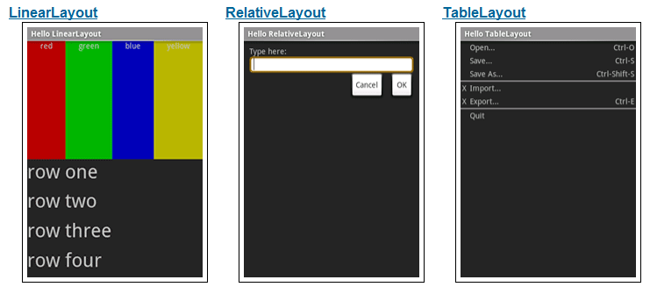
3 Contd - Available Layouts
http://developer.android.com/resources/tutorials/views/index.html

Slide 20
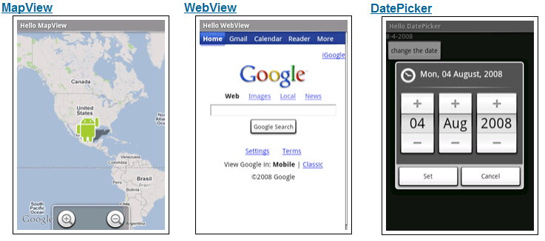
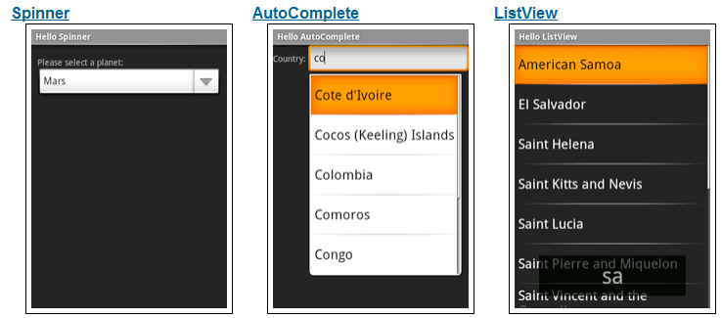
3 contd - Available Widgets
http://developer.android.com/resources/tutorials/views/index.html

Slide 21

4 - res/values/strings.xml
String constants used by app
Used for supporting Localization
res/values-es/values/strings.xml to support Spanish
res/values-fr/values/strings.xml to support French
Etc.

Slide 22
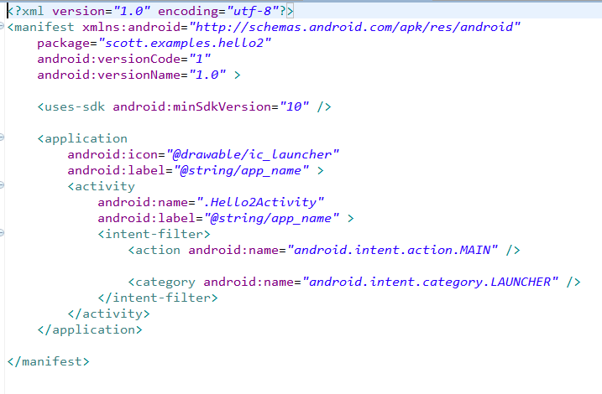
5 - AndroidManifest.xml
Declares all the app’s components
Names libraries app needs to be linked against
Identifies permissions the app expects to be granted
min sdk version
Notes:
This is the most common IntentFilter seen in Android applications. The action android.intent.action.MAIN indicates that this is the first activity that should be executed when starting this app. The category android.intent.category.LAUNCHER places this Activity in
the launcher window (the window that lists all the available apps).

Slide 23
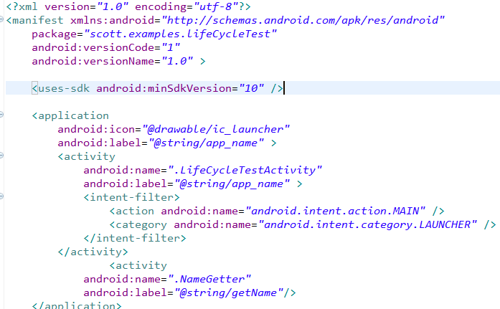
5 contd - AndroidManifest.xml
All Activities that are part of application must be registered in Manifest
Specify Activity to start with
Notes:
This is the most common IntentFilter seen in Android applications. The action android.intent.action.MAIN indicates that this is the first activity that should be executed when starting this app. The category android.intent.category.LAUNCHER places this Activity in
the launcher window (the window that lists all the available apps).

Slide 24
Running and Debugging the Application
Using the Emulator

Slide 25
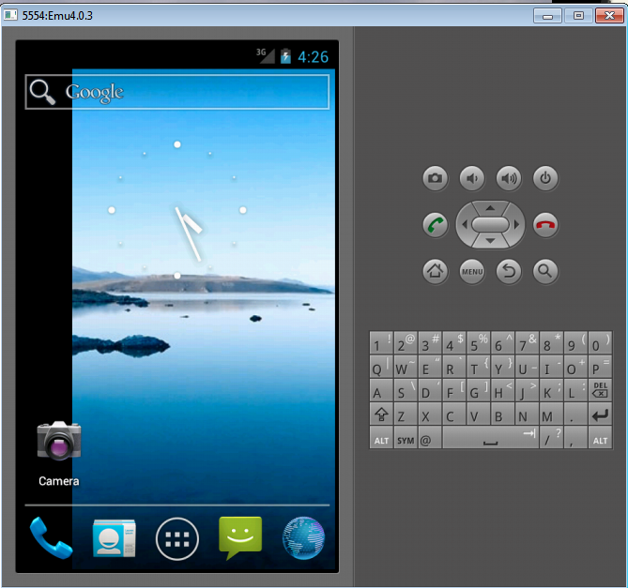
Sample Android Emulator 4.0 look and feel

Slide 26
Emulator Basics
Host computer’s keyboard works
Host’s mouse acts as finger
Uses host’s Internet connection
Other buttons work: Home, Menu, Back, Search, volume up and down, etc.
Ctrl-F11 toggle landscape → portrait
Alt-Enter toggle full-screen mode
More info at http://developer.android.com/guide/developing/devices/emulator.html

Slide 27
Emulator Limitations
No support for placing or receiving actual phone calls
Simulate phone calls (placed and received) through the emulator console
No support for USB connections
No support for camera/video capture (input)
No support for device-attached headphones
No support for determining connected state
No support for determining battery charge level and AC charging state
No support for determining SD card insert/eject
No support for Bluetooth
No support for simulating the accelerometer
Use OpenIntents’s Sensor Simulator
That's why we need the real devices - phones and tablets!

Slide 28
Android Emulator or AVD
Emulator is essential to testing app but is not a substitute for a real device
Emulators are called Android Virtual Devices (AVDs)
Android SDK and AVD Manager allows you to create AVDs that target any Android API level
AVD have configurable resolutions, RAM, SD cards, skins, and other hardware

Slide 29
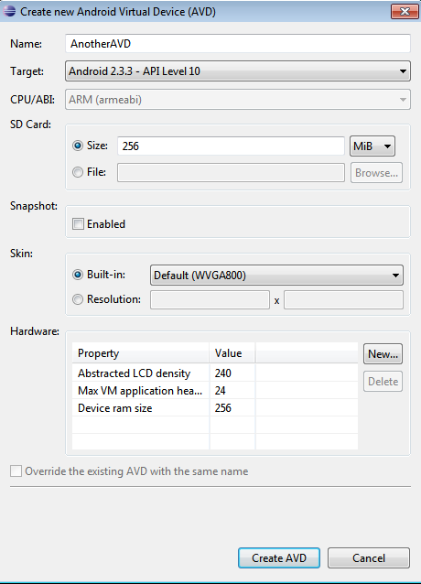
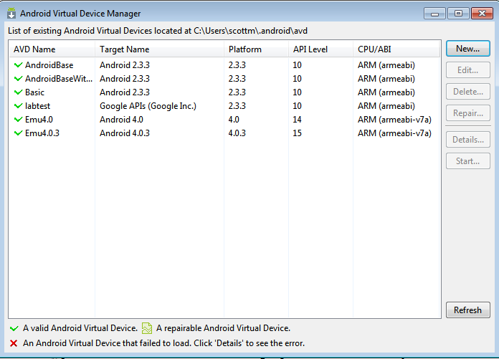
Create an AVD using AVD Manager
or use the command line http://developer.android.com/guide/developing/devices/managing-avds-cmdline.html

Slide 30
Application Components
Section 2

Slide 31
Application Components List
five primary components - different purposes
Activity
single screen with a user interface, app may have several activities, subclass of Activity
Most of early examples will be activities
Intents
used to pass information between applications
Service
Application component that performs long-running operations in background with no UI
example, an application that automatically responds to texts when driving

Slide 32
Application Components List..contd
Content Providers
a bridge between applications to share data
for example the devices contacts information
we tend to use these, but not create new ones
Broadcast Receivers
component that responds to system wide announcements
battery low, screen off, date changed
also possible to initiate broadcasts from within an application

Slide 33
Understanding Activity Stack

Slide 34
Activity Stack
Most recently created is at Top
Activity 1
User currently interacting with me
Activity 2
Pressing Back or destroying A1 will bring me to the top
Activity 3
Activity N
If Activities above me use too many resources, I’ll be destroyed!

Slide 35
Typical Game
High Scores
Activity
Splash Screen
Activity
Main Menu
Activity
Game Play
Activity
Settings
Activity
Conder & Darcey (2010), Fig 4.1, p. 74

Slide 36
Understanding the Essence of Lifecycle
Necessary to overload callback methods so you app behaves well:
App should not crash if the user receives a phone call or switches to another app while using your app.
App should not consume valuable system resources when the user is not actively using it.
App should not lose the user's progress if they leave your app and return to it at a later time.
App should not crash or lose the user's progress when the screen rotates between landscape and portrait orientation.
http://developer.android.com/training/basics/activity-lifecycle/starting.html

Slide 37
Starting Activities
Android applications don't start with a call to main(String[])
instead a series of callback methods are invoked
each corresponds to specific stage of the Activity / application lifecycle
callback methods also used to tear down Activity / application

Slide 38
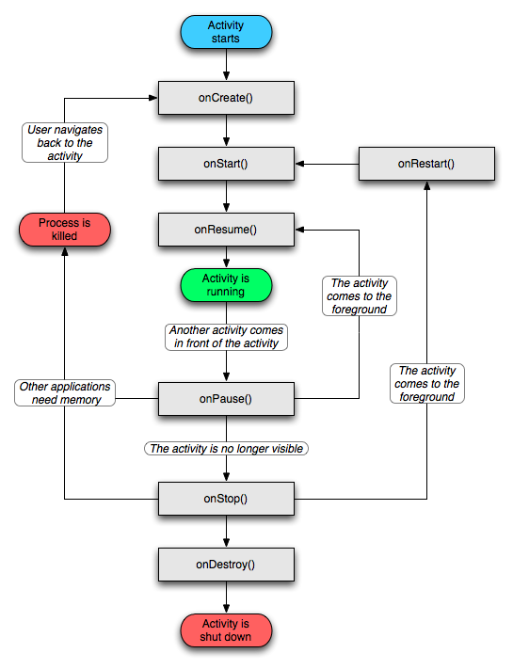
Activity Lifecycle (Beyond scope of current lecture)
http://developer.android.com/reference/android/app/Activity.html

Slide 39
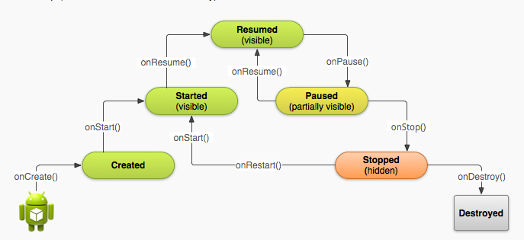
Simplified Lifecycle Diagram
ready to interact with user

Slide 40
Primary States
Active
activity is in the foreground and user can interact with it
Paused
activity partially obscured by another activity and user cannot interact with it (for example when working with a menu or dialog)
Stopped
activity completely hidden and not visible to user. It is in the background.
Activity instance and variables are retained but no code is being executed by the activity
Dead, activity terminated (or never started)
Two other states, Created and Started, but they are transitory onCreate -> onStart -> onResume

Slide 41
What is used for what?
Entire lifetime: onCreate / onDestroy
Load UI
Could start and stop threads that should always be running
Visible lifetime: onStart / onStop
Access or release resources that influence UI
Foreground lifetime: onResume / onPause
Restore state and save state
Start and stop audio, video, animations

Slide 42
Pausing - onPause method
when activity paused you should
stop animations of other CPU intensive tasks
release resources such as broadcast receivers (app stops listening for broadcast info) and handles to sensors such as GPS device or handles to the camera
stop audio and video if appropriate

Slide 43
Stopping - onStop()
Many scenarios cause activity to be stopped
Well behaved apps save progress and restart seamlessly
Activity stopped when:
user performs action in activity that starts another activity in the application
user opens Recent Apps window and starts a new application
user receives phone call
use onStop to release all resources and save information (persistence)

Slide 44
Saving State
activities that are paused or stopped the state (instance vars) of the activity are retained
even if not in foreground
When activity destroyed the Activity object is destroyed
can save information via onSaveInstanceState method. Write data to Bundle, Bundle given back when restarted

Slide 45
Activity Destruction
app may be destroyed under normal circumstances
on its own by calling finish or user pressing the back button to navigate away from app
normal lifecycle methods handle this onPause() -> onStop() -> onDestroy
If the system must destroy the activity (to recover resources or on an orientation change) must be able to recreate Activity

Slide 46
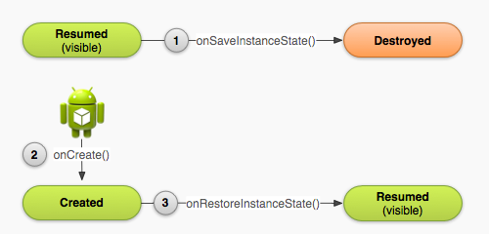
Activity Destruction

Slide 47
Activity Destruction
If Activity destroyed with potential to be recreate later
system calls the onSaveInstanceState (Bundle outState) method
Bundle is a data structure like a Map
String keys
put methods for primitives, arrays, Strings, Serializables (Java), and Parcels (android)

Slide 48
onSaveInstanceState onRestoreInstanceState()
systems write info about views to Bundle
other information must be added by programmer
example, board state for mastermind
When Activity recreated Bundle sent to onCreate and onRestoreInstanceState()
use either method to restore state data / instance variables

Slide 49
Starting You Own Activities
You will often start new Activities within your Activity
accomplish a task
get some data
Click Button to get name
on button click (look at xml)
create an intent
call startActivityForResult
override onActivityResult()
add new Activity to Manifest
add data to intent, setResult, finish
http://developer.android.com/guide/topics/fundamentals/activities.html#StartingAnActivity

Slide 50
Understanding LifeCycle – Lab 2
overload these methods from Activity:
onCreate(), onStart(), onResume(), onPause(), onStop(), onRestart(), onDestroy()
Use the Log class to log activity
methods: v, d, i, w, e
VERBOSE, DEBUG, INFO, WARN, ERROR
Create a TAG so we can filter
Toast a message (if time permits)

Slide 51
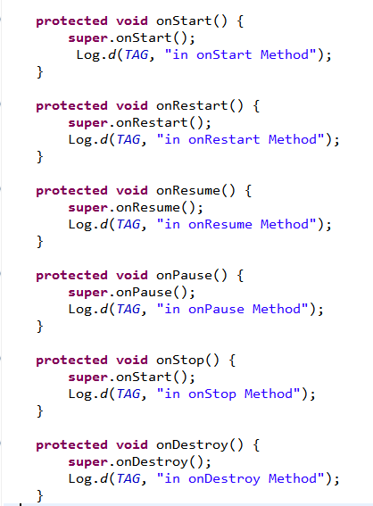
Logging
Run the app and open the Logcat view.
Eclipse Window-> Show View -> Other -> Android -> Logcat or via DDMS

Slide 52
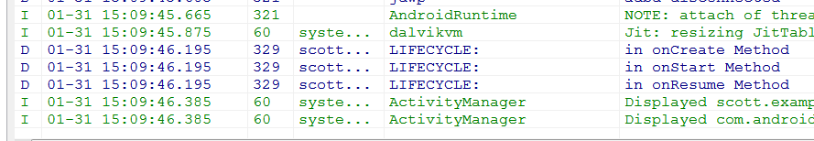
Logcat
After app started

Slide 53
Dalvik Debug Monitor Server
DDMS
debugging tool
"provides, screen capture on the device, thread and heap information on the device, logcat, process, and radio state information, incoming call and SMS spoofing, location data spoofing, and more."
can interact with DDMS via Eclipse plugin, another view in Eclipse

Slide 54
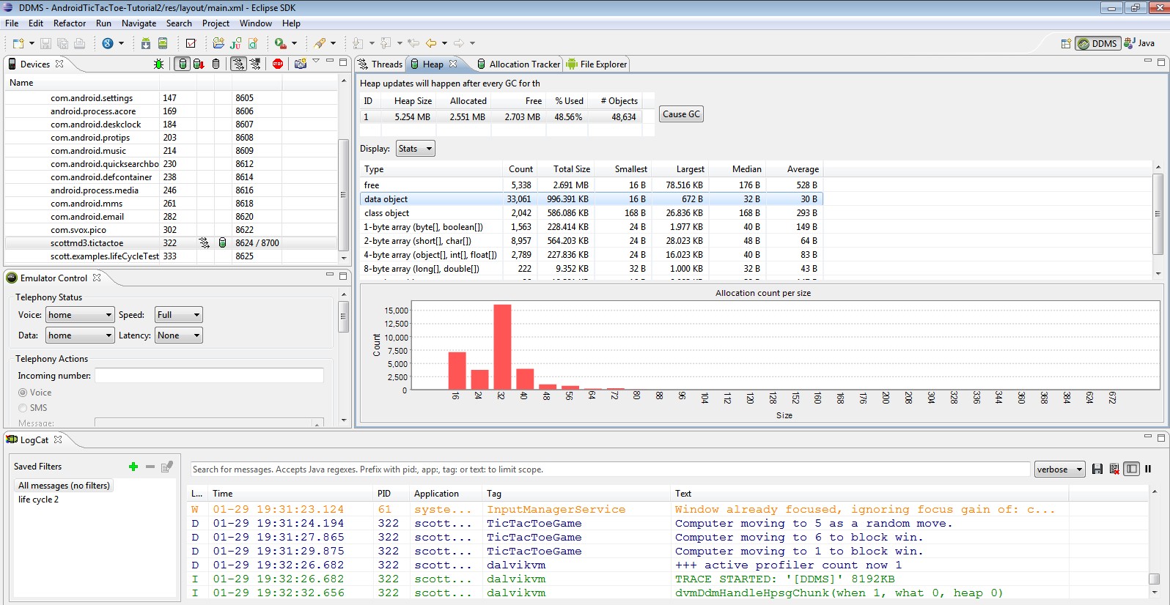
DDMS

Slide 55
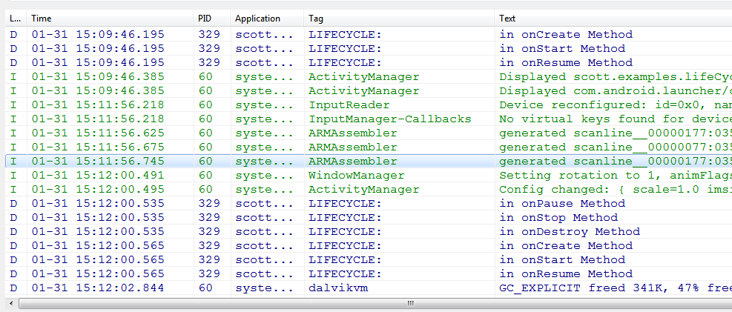
Logcat
Rotate emulator with CTRL+F-11

Slide 56
References
Android Dev Guide http://developer.android.com/guide/topics/fundamentals.html
http://developer.android.com/guide/topics/fundamentals/activities.html

