Slide 1

INTRUSION DETECTION
Eman Khan 22969, Huzaifa Kashif 22945 & Ahsant Shahid 22974

Slide 2
Abstract
Our aim was to develop a network security intrusion detection system.
We acquired a synthetic dataset with 25 parameters and 40000 records concerning the malicious traffic on a network.
Some key parameters in the data are, Source/Destination IP Address, Timestamps, Protocol, Packet length, Port Information.
Our plan was to implement ML models to classify and predict network security threats.
We trained our model to detect and classify intrusion in the network through our dataset which could then be applied on real data to classify intrusion in the network

Slide 3
Literature review
"Machine Learning in Network Security“
Emphasizes the role of ML in neutralizing network attacks.
Discusses security threats and limitations of traditional measures.
Anticipates a future where ML plays a crucial role alongside human expertise.
"A Lightweight Model for DDoS Attack Detection"
Addresses the threat of DDoS attacks on IoT devices.
Proposes ML and DL techniques for effective DDoS detection.
Introduces unconventional data pre-processing for anomaly detection in IoT traffic.
"Visualizing Malicious File Detection Data"
Proposes a static-analysis-based ML algorithm to visualize malicious file detection data.
Maps visualization to the MITRE ATTACK framework for comprehensive threat identification.
Explores ML methods including Random Forest, Adaboost, and Gradient Boosting.

Slide 4
methodology
The primary goal was to develop a robust network security threat detection system through the application of machine learning models.
This involves the development of machine learning models capable of accurately detecting and classifying security threats.
We conducted comprehensive data preprocessing. This involves handling missing values, normalizing data, and modifying formats to render them suitable for subsequent analysis.
We also carried out feature selection to identify the most pertinent parameters for our analysis, focusing on elements like protocol, packet length, and traffic type.

Slide 5
XGBOOst model
Preprocessing:
Use OneHotEncoder to convert categorical columns to numerical format.
Implement Synthetic Minority Over-sampling Technique (SMOTE) to address class imbalance.
Apply Truncated Singular Value Decomposition (TruncatedSVD) for dimensionality reduction in specific models.

Slide 6
Random forest
Preprocessing:
Concatenate the training and test sets for consistency.
Use OneHotEncoder to convert categorical columns to numerical format.
Implement SMOTE on the resampled training data to address class imbalance.
Optionally, explore combining SMOTE with other classifiers, like Support Vector Machine (SVM).

Slide 7
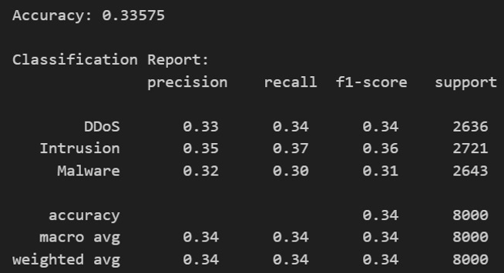
Model evaluation (xgboost)
The XGBoost classifier yields insights into its performance in classifying different attack types. The following evaluation metrics provide a comprehensive overview of the model's effectiveness. The overall accuracy of the XGBoost model on the test data is 33.58%.
While accuracy is a fundamental metric, further examination of class specific metrics is crucial for a more nuanced assessment.
The classification report presents precision, recall, and F1-score for each attack type, offering a detailed perspective on the model's strengths and weaknesses.

Slide 8
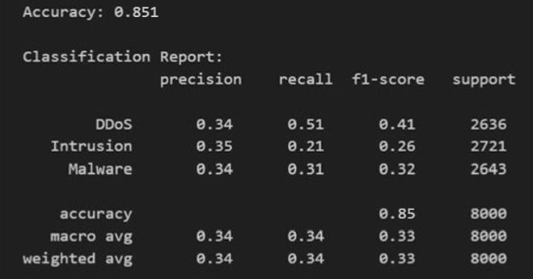
Model evaluation (Random forest)
The Random Forest classifier is configured to address imbalanced data through the implementation of over-sampling techniques.
The following evaluation metrics show the effectiveness of the model in classifying different attack types.
The overall accuracy of the Random Forest model on the test data is 85.1%. While accuracy provides a ge-eral measure of the model's correctness, it is essential to delve into class-specific metrics for a more comprehensive assessment.
The classification report outlines precision, recall, and F1-score for each attack type, offering a nuanced perspective on the model's strengths and weak-nesses.

Slide 9
improvements
Random Forest:
Parameter Tuning: Experiment with different hyperparameter values for the Random Forest model to optimize its performance. Adjusting parameters such as the number of trees and maximum depth could potentially enhance predictive accuracy.
Feature Importance: Investigate feature im-portance to identify which features contribute significantly to the model's decision-making process.
Ensemble Methods: Explore the implementation of ensemble methods, such as bagging or boosting, to harness the strengths of multiple models for improved classification performance.
XGBoost:
Feature Engineering: Explore the possibility of incorporating additional relevant features into the model to enhance its discriminatory power.
Ensemble Methods: Consider leveraging ensemble methods, such as stacking, to combine the strengths of multiple models and improve overall predictive accuracy.

Slide 10
conclusion
The project lays the groundwork for an adaptive network security infrastructure.
Future work involves continuous refinement of models, exploration of advanced techniques, and adaptation to emerging cyber threats.
The project underscores the importance of leveraging machine learning for effective network security, contributing to the ongoing efforts to secure digital ecosystems.

Slide 11
references
Incribo. (2023, November 14). Cyber security at-tacks. Kaggle. https://www.kaggle.com/datasets/teamincribo/cyber-security-attacks
[Sadhwani, S., Manibalan, B., Muthalagu, R., &amp; Pawar, P. (2023, September 2). A light-weight model for ddos attack detection using ma-chine learning techniques. MDPI. https://www.mdpi.com/2076-3417/13/17/9937
(PDF) machine learning on Network Security - ResearchGate. (n.d.). https://www.researchgate.net/publication/343558218_MACHINE_LEARNING_ON_NETWORK_SECURITY
Ahn, G., Kim, K., Park, W., &amp; Shin, D. (2022, October 24). Malicious file detection method using machine learning and interworking with Mitre ATT&amp; CK framework. MDPI. https://www.mdpi.com/2076-3417/12/21/10761

