Slide 1

E-Library
Submitted By: Group # 1
Muhammad Huzaifa Rashid (183203)
Ahsan-ul-Haq (183227)
Mahum Sajjad (183200)
Rosheen Amjad (183162)
Ansar Alam Khan (183161)

Slide 2
THE PROBLEM
Many Libraries using the manual library system for handling different activities of the library. We can simply say that the system has been running totally in a paper based. The libraries do not have any online system to enable librarians to manage and handle activities of library.

Slide 3
PROJECT GOALS AND OBJECTIVES
The main goals and objectives of this project are to develop a system that should automate all the manual difficulties in managing the Library by implementing computerization
The system should be capable of books stock management, book issuing, members management, search books and add/remove, and assign selected books.

Slide 4
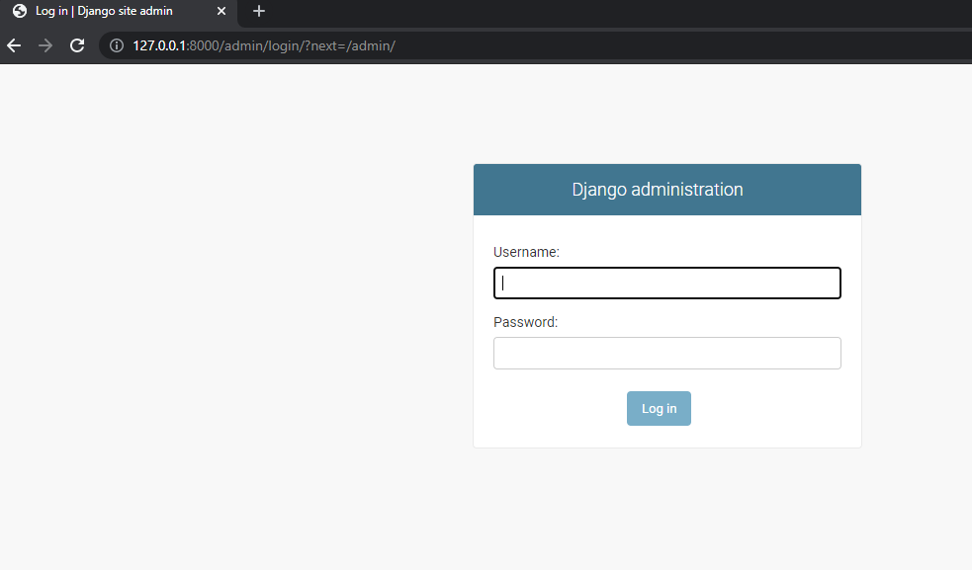
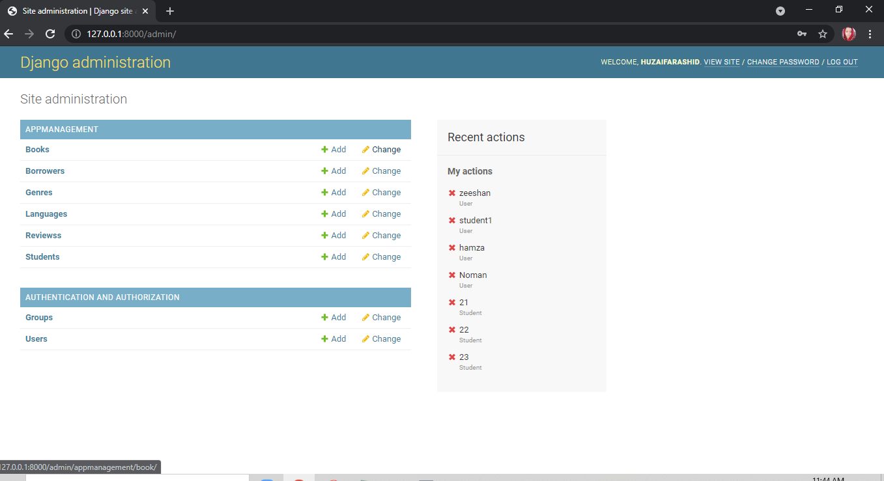

Slide 5
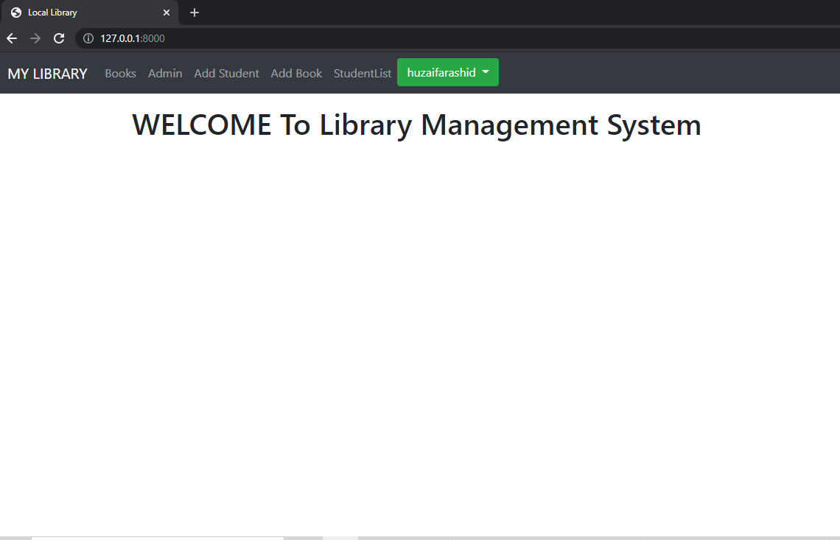
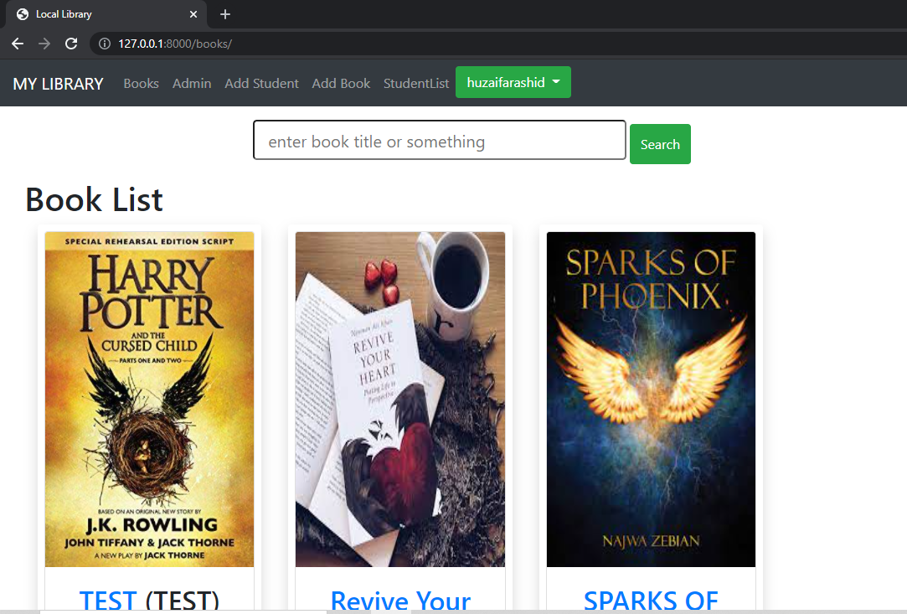

Slide 6
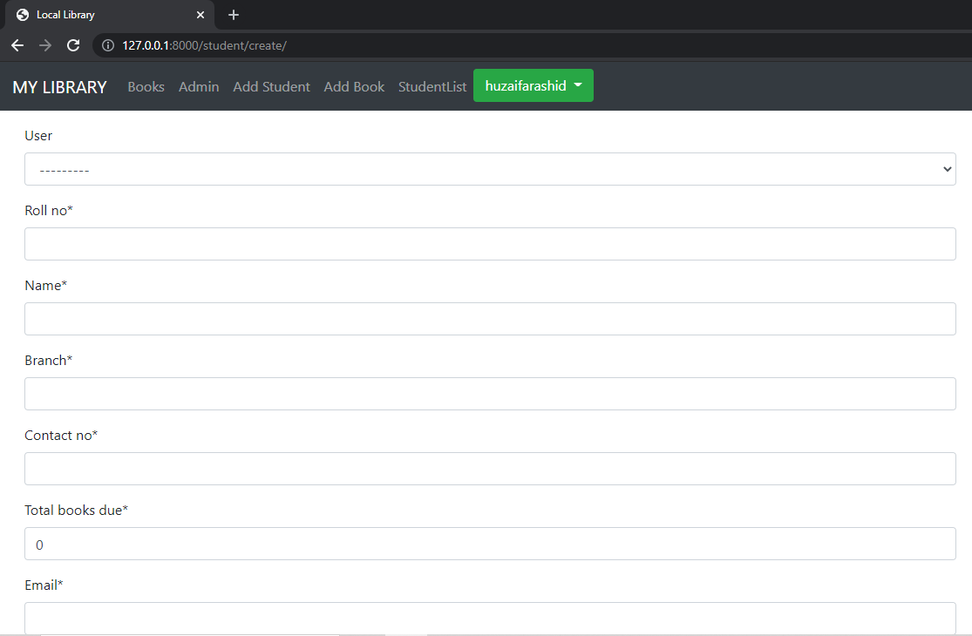
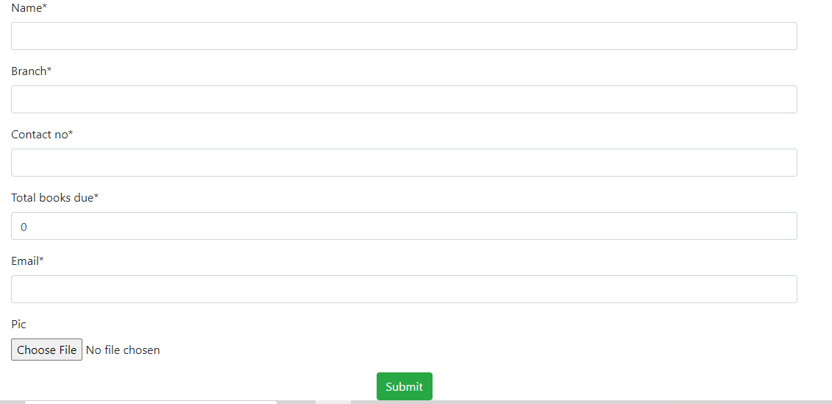

Slide 7

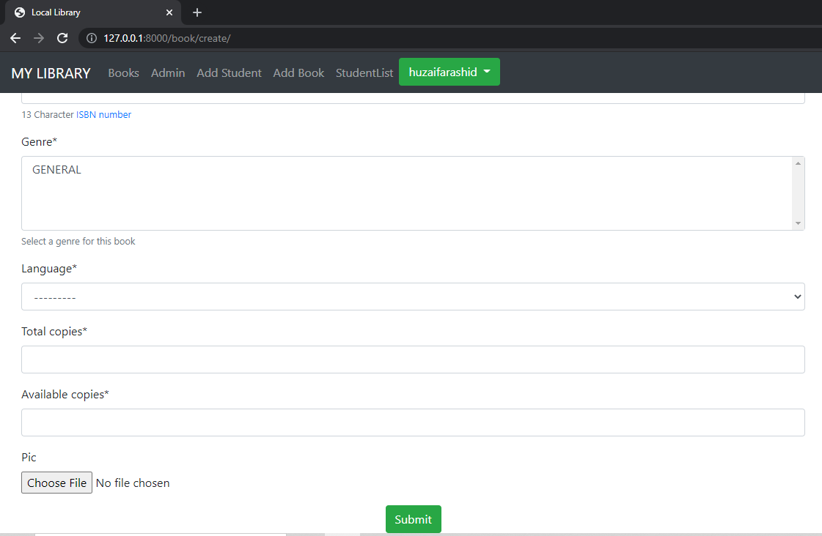

Slide 8
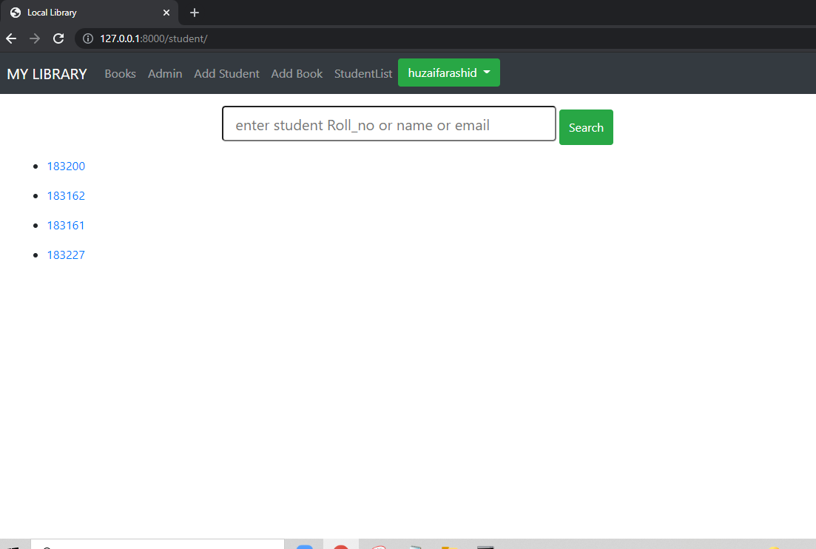
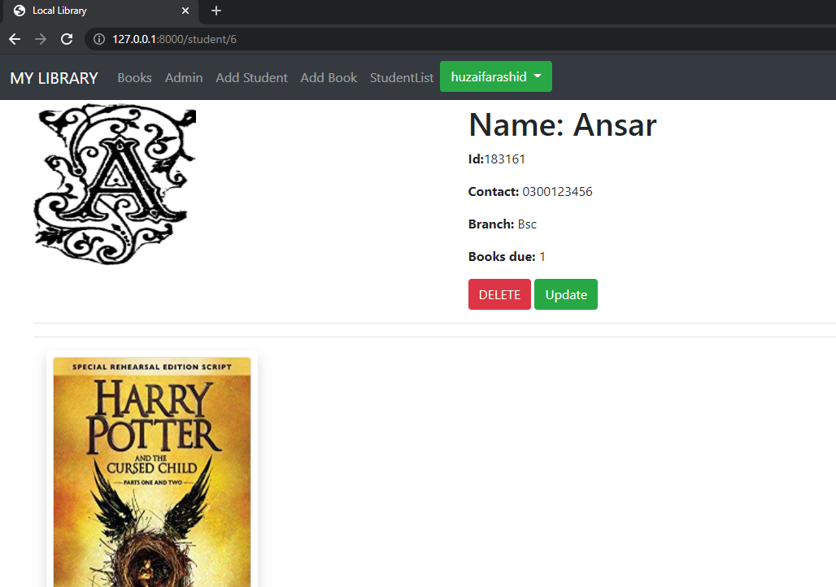

Slide 9
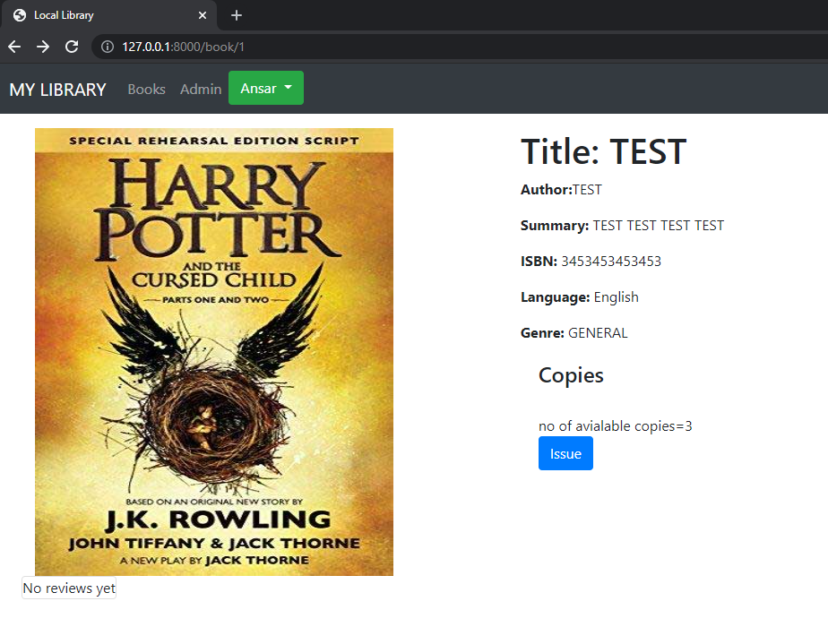
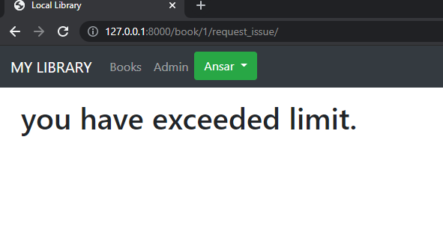


Slide 10


