Slide 1
Material selection
Material selection is the basic and most important step for the making or formation of any kind of device.
For material selection it must be kept in mind that the selected material must be reliable, cheap and effective.
The cheap material will help in more production of the device and is easily available.
For the “line launcher” project our group also selected material that is efficient in working it is and also very cheap.

Slide 2
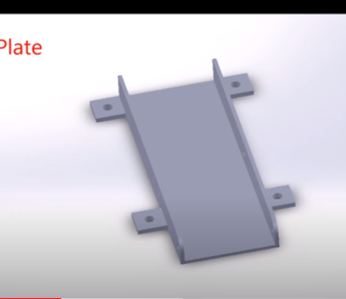
Selected material
Base plate:
The base plate is made up of hard steel sheet which is curved from the sides to support the movable plate and also to support the launching assembly.

Slide 3
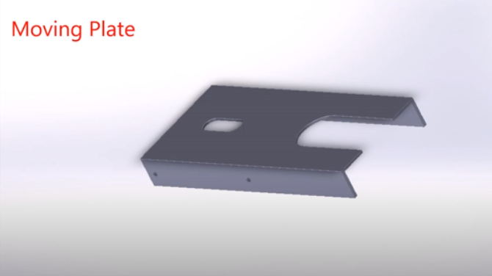
Moving plate:
Moving plate will be fixed on base plate. It is also made up of steel..

Slide 4
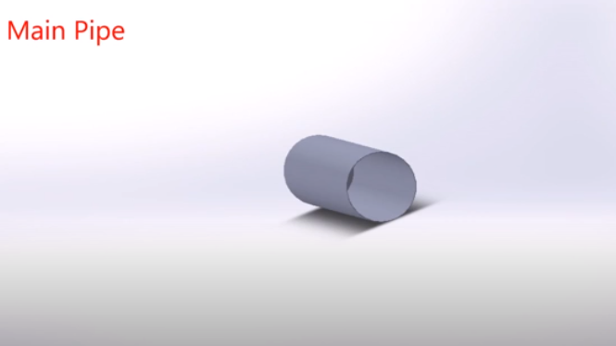
Main pipe:
A pipe is used for the projection of ball. The material of pipe is hard
steel of hard plastic depending on the material which is easily available. .

Slide 5
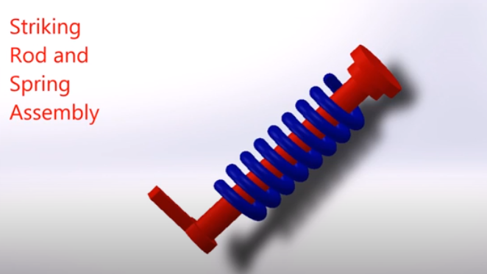
Striking rod and spring assembly:
Force is applied with the help of striking rod and spring help in
application of force.

Slide 6
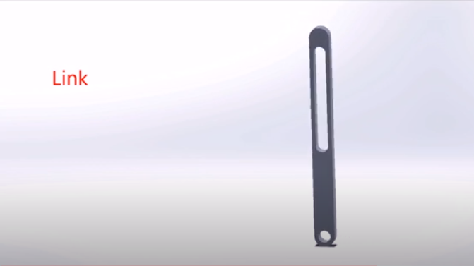
Link:
Link is also present for support made up of hard plastic or steel.
Electric switch: Used to control projection.

