Slide 1
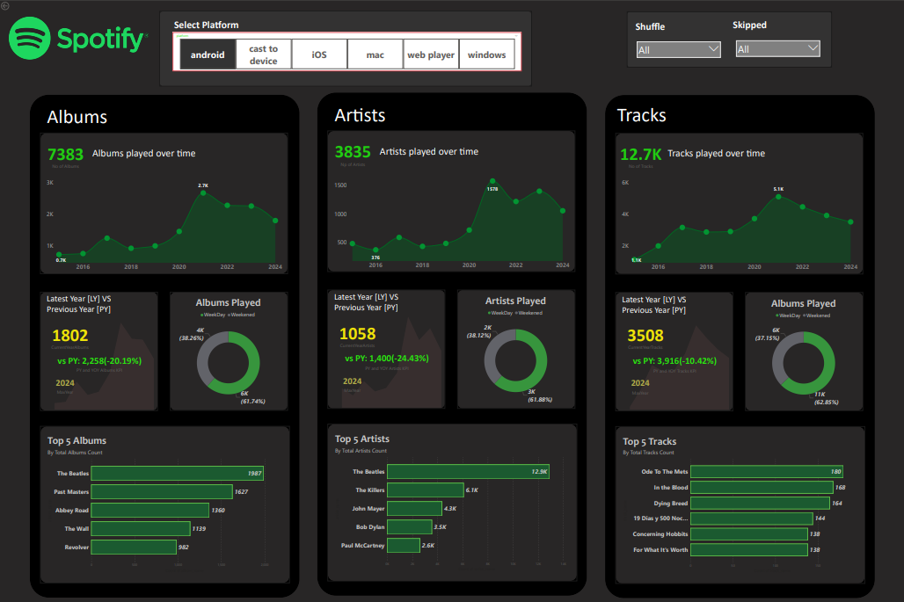
SPOTIFY ANALYSIS PROJECT

Slide 2
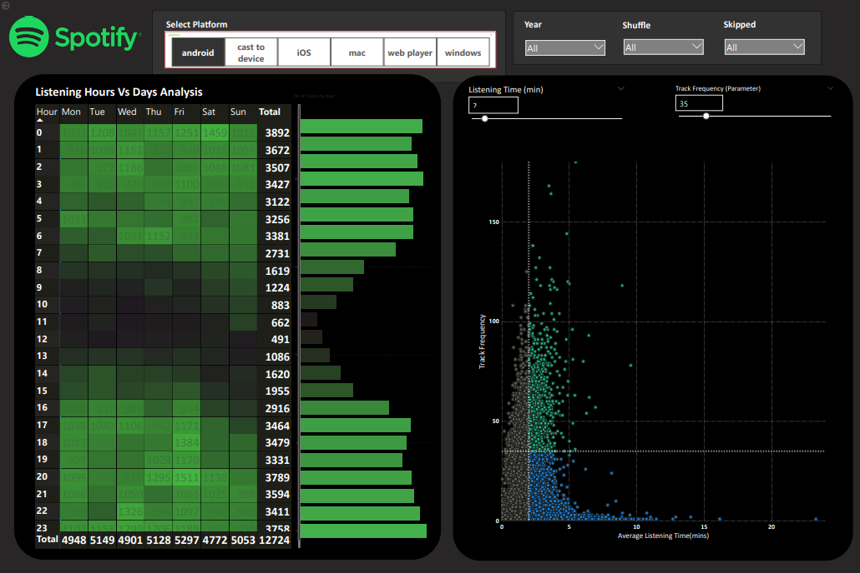
SPOTIFY ANALYSIS PROJECT

Slide 3
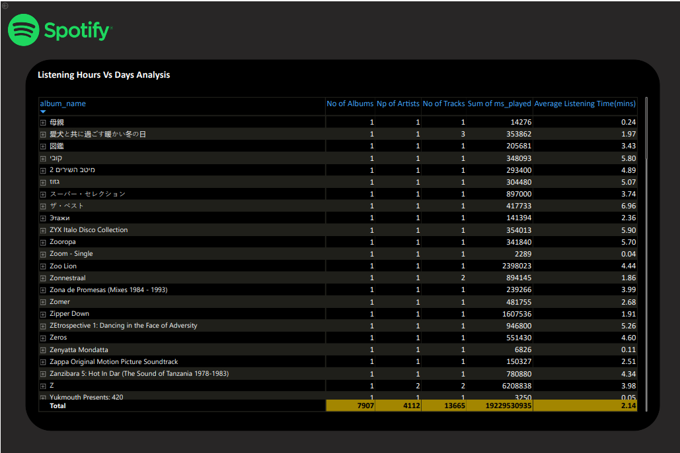
SPOTIFY ANALYSIS PROJECT

Slide 4
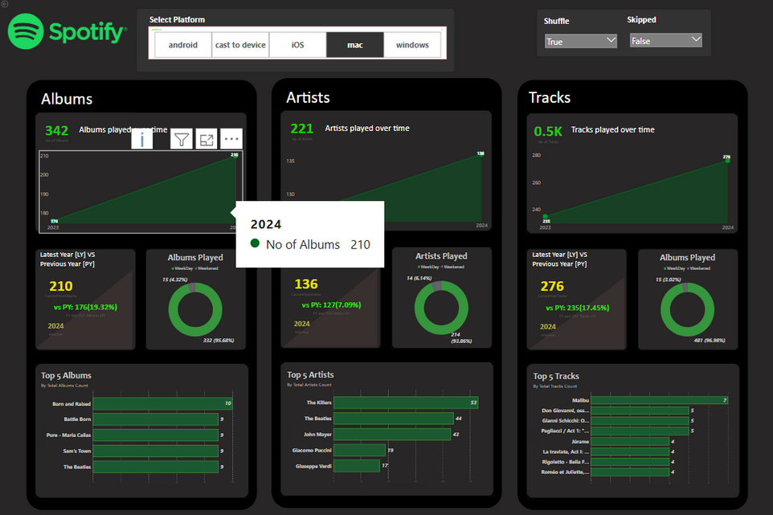
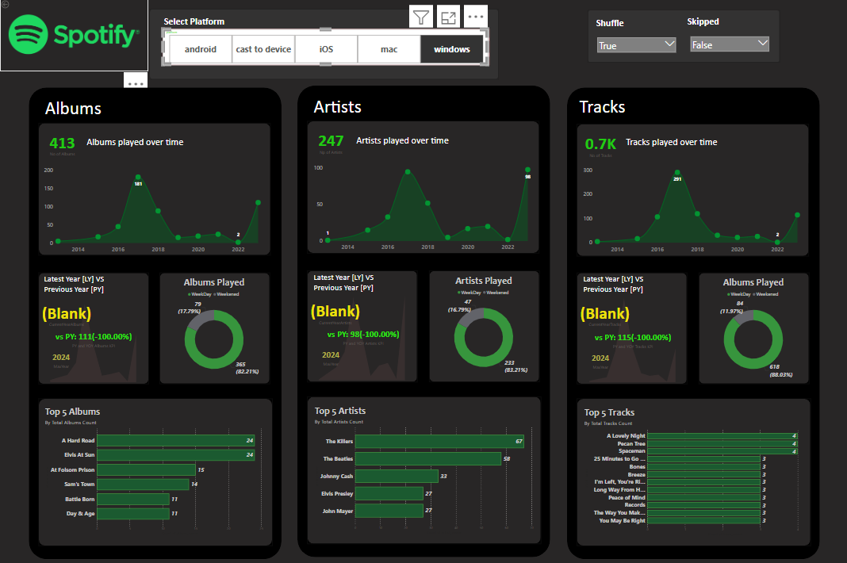
SPOTIFY ANALYSIS PROJECT

Slide 5
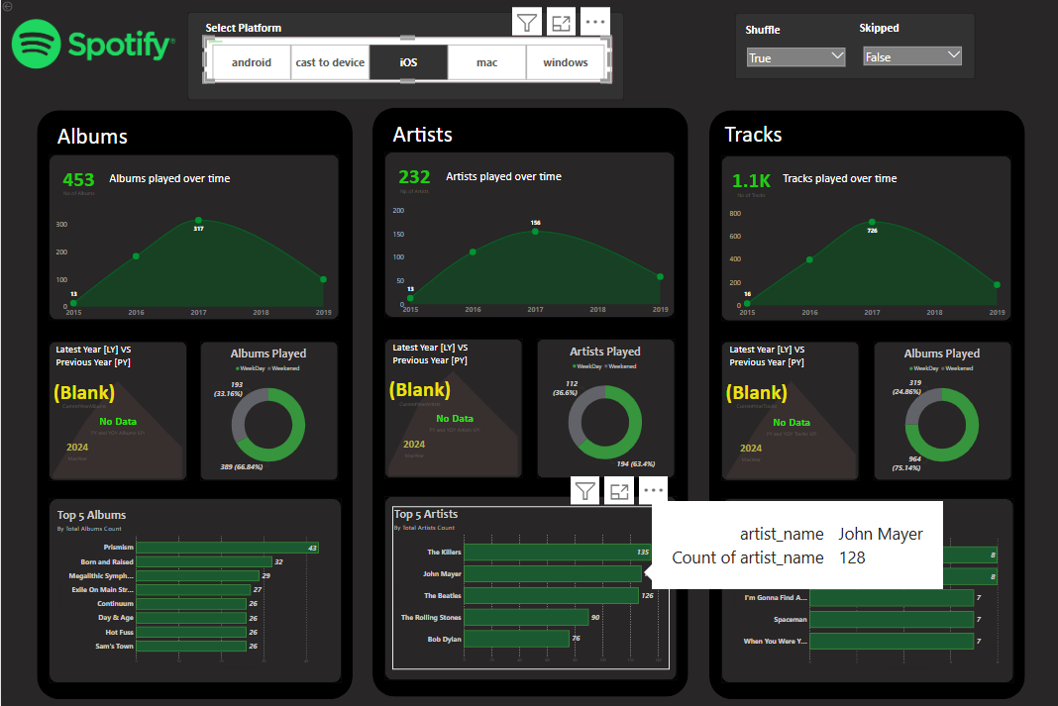
SPOTIFY ANALYSIS PROJECT

Slide 6
SPOTIFY DASHBOARD OVERVIEW
Implemented In-Depth Analysis Features in Spotify Dashboard.
📀 Albums Analysis
Track trends across years, weekdays, weekends
Identify Top 5 Albums
Compare Latest vs Previous Year (LY vs PY)
Monitor Year-over-Year (YoY) Growth
🎤 Artists Analysis
Visualize artist listening behavior over time
View patterns by year, weekday, weekend
Top 5 most played artists
LY vs PY and YoY growth metrics
🎵 Tracks Analysis
Monthly & yearly listening trends
Usage across weekdays vs weekends
Discover Top 5 Tracks
Compare LY vs PY + YoY analysis

Slide 7
LISTENING PATTERNS OVERVIEW
Listening Hours (Heat Map)
Analyze peak listening times
Color intensity highlights hours & days with highest activity
📊 Track Frequency vs Avg Listening Time (Scatter Plot)
Quadrant Analysis:
High Frequency + High Time → Most Engaging
Low Frequency + High Time → Niche, Deep Listening
High Frequency + Low Time → Short, Quick Plays
Low Frequency + Low Time → Least Popular
Developed Listening Pattern Visualizations to Uncover User Behavior

Slide 8

Spotify Visualization Project
Thank You For Attention
Let’s connect! Explore more of my work:
swehuzaifa.vercel.app

