Slide 1

شُروع اَللہ کے نام سے جو بڑا مہربان نہايت رحم والا ہے
Department of Computer Science
Muhammad Nawaz Sharif
University of Engineering & Technology, Multan

Slide 2

Final year project
Huzaifa Tahir 2019-cs-114
Zeeshan Ahmad 2019-cs-111
Ata-ul-Wahab 2019-cs-115
PROJECT SUPERVISOR:
Eng. M Kashan Basit
Lecturer
MNSUET, Multan

Slide 3
PROJECT TITLE:
SRCND
Software for Remote Configuration of Network Devices

Slide 4

The reason for creating this project
Cost & Time effective
Can operate by novice user
Provide ease in configuration using GUI
No need of extra ordinary level of knowledge
Any one can use it with a basic knowledge of Networking

Slide 5

Who will use our Software
Who benefits from this software? Why?
Network Administrators
Network Engineers
A man with basic knowledge of networking can use it
Organizations those cannot afford highly paid network engineer for the configuration of Network devices.

Slide 6
Strengths of our project
Remotely configure the setting of Cisco Network Equipment’s such as Routers and Switches.
It provide secure connection to configure devices using SSH protocol.
Provide user friendly GUI.
Provide support of both Telnet and SSH.
Support Advance level configuration such as ROS, Inter-VLAN Routing, NAT/PAT etc.

Slide 7
Protocols to access devices remotely
Telnet | SSH
Telecommunication and Network | Secure Shell
Not secure | Too secure
Stores data in Plain Text | It encrypts data
Use in LAN | Use in WAN
Use port:23 | Use port:22

Slide 8
Features of srcnd
Configure the device remotely
Support both Telnet and SSH
Configure network device in a network
Time saving
No need to remember the commands just simply click on the require setting and hit execute
Cost saving
No extra training needed
Configure the device from anywhere in the earth
Easy to use
Easy to understand • User Friendly

Slide 9
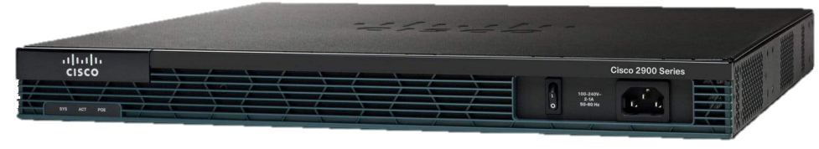
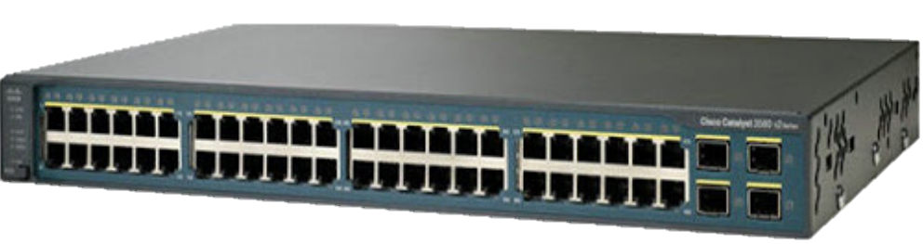
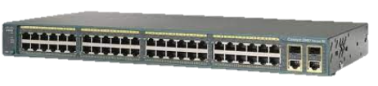
Supported vendor & devices
CISCO
Router (L3 switch)
Multi Layer Switch (MLS)
Switch (L2 switch)

Slide 10


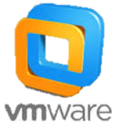
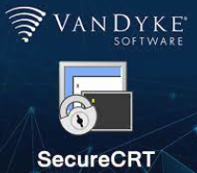


Tools used in development
Network Simulation
GNS3
VMware
SecureCRT
Cisco IOU images
Software Development
PyCharm
Python
Tkinter
APIs
Netmiko
Telnetlib

Slide 11
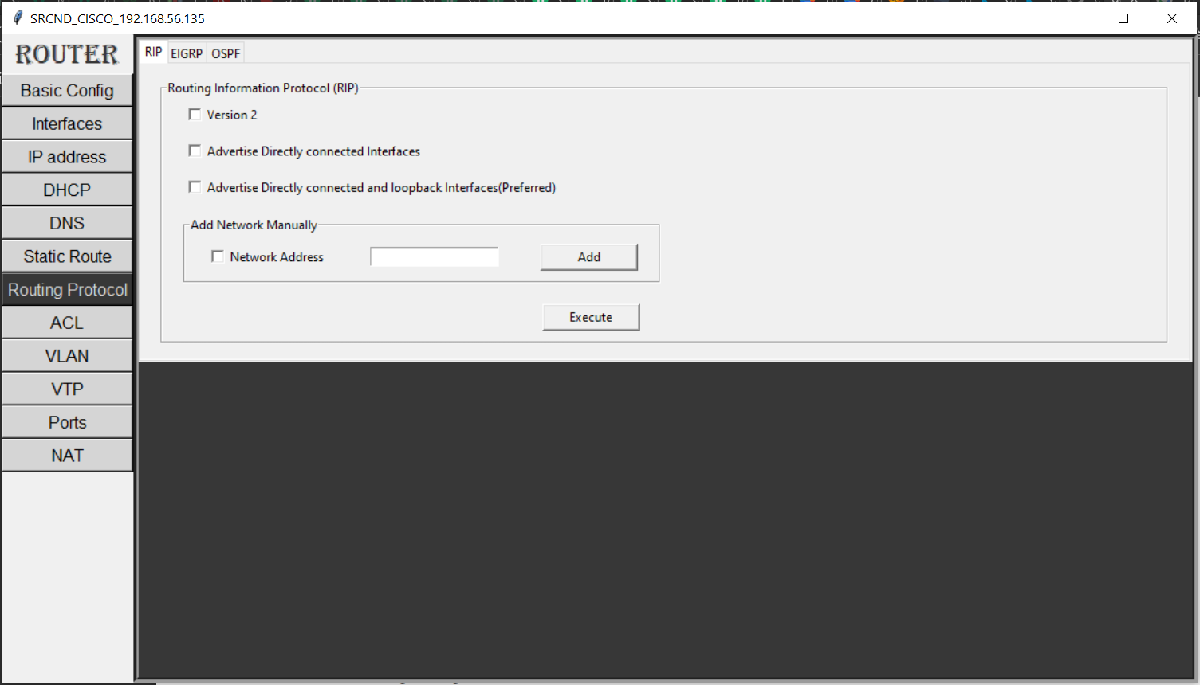
Functionalities
DNS
VLAN
DHCP
NAT/PAT
Switchport
IP Addresses
Device Backup
Virtual Interfaces
Static/Dynamic Routing
Support classful/classless IP Addresses

Slide 12
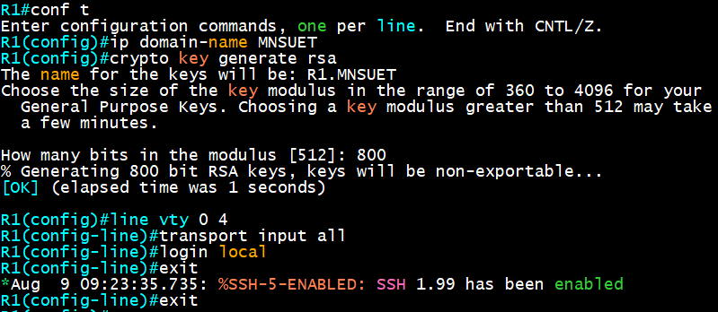
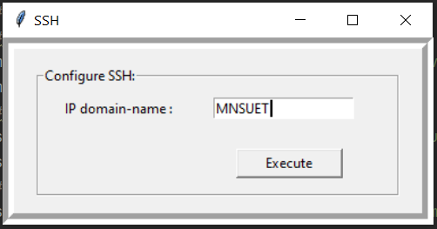
Traditional Configuration
V/S
SRCND
How our software provide the ease in configuration?

Slide 13
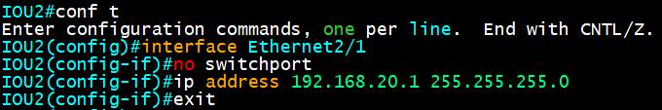
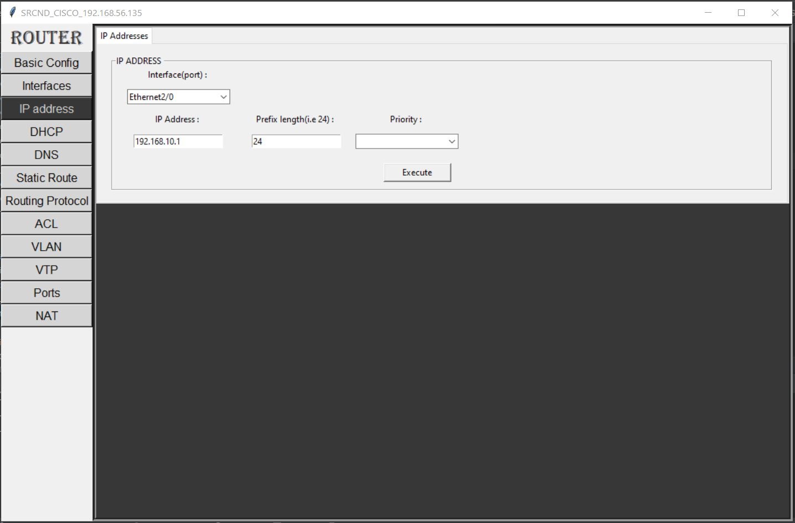
Assigning ip-address
Manual | Using SRCND
Need to calculate or remember subnet mask Old Fashioned CLI Check/Get the name of interface using other commands | Software provide facility to enter prefix length Easily understandable GUI All interfaces provide in a single Dropdown L3 or MLS handle automatically by software

Slide 14
Limitations of srcnd
Vendors Specific
No Monitoring System
Less Control than CLI

Slide 15
Future Scope of the Project
We can add other vendors also like Huawei, Juniper etc.
We can add More devices such as Firewalls etc.
We can add BGP configurations
We can configure VPNs with point and click only
We can add Monitoring as well
We can add IPv6 configuration

Slide 16
Thank you

