Slide 1

Bee Guardian 2.0
A Smart Beehive Health Monitoring System Using Embedded Multimodal Technology
Final Year Project – Proposal Presentation
By
Huzaira Sultan – NUM-BSCS-2023-07
Aiman Malik – NUM-BSCS-2023-26
Supervisor: Dr. Shafiq-ur-Rehman
Industrial Partner: National Agricultural Research Centre Islamabad

Slide 2
Existing Work vs. Our Contribution
Existing Work (Prior, Published)
Sound-based module: a CNN model that classifies colony health from buzzing patterns (published)
Image-based module: a vision model that detects visible issues such as mites and damaged wings
Both modules relied on manual, single-shot capture through a mobile app — no automatic or continuous data collection
No sensor data (temperature, humidity, weight) was used in either module

Slide 3
Related Work in Literature
System | Sensors / Data | Limitation
Beemon / BeeLive | Camera, microphone, temperature, humidity, weight | Monitoring and data collection; limited on-board analysis
MSPB dataset | Audio features, temperature, humidity | No image data; a dataset, not a deployed system
BHiveSense | Temperature, humidity, weight, lid status, sound | No image modality; no deep-learning fusion reported
Commercial (3Bee Hive-Tech, Arnia) | Weight, temperature, humidity, sound | Sensor tracking only; no vision-based health detection
Gap: no reported system fuses sound, image, and sensor evidence into one unified health score.

Slide 4
Existing Work vs. Our Contribution
Our Contribution (Bee Guardian 2.0)
Automatic, hive-mounted hardware unit (camera, microphone, sensors) — continuous, hands-free data capture
Retraining and adapting both existing models for the new hardware and data conditions
New sensor integration: temperature, humidity, and weight data
A novel fusion model combining sound, image, and sensor evidence into one unified health score
Backend server and mobile application for real-time alerts and monitoring
Field evaluation of the fully integrated system on a live hive
Prior work addressed sound and image separately; Bee Guardian 2.0 is the first system to fuse sound, image, and sensor data into one automated pipeline.

Slide 5
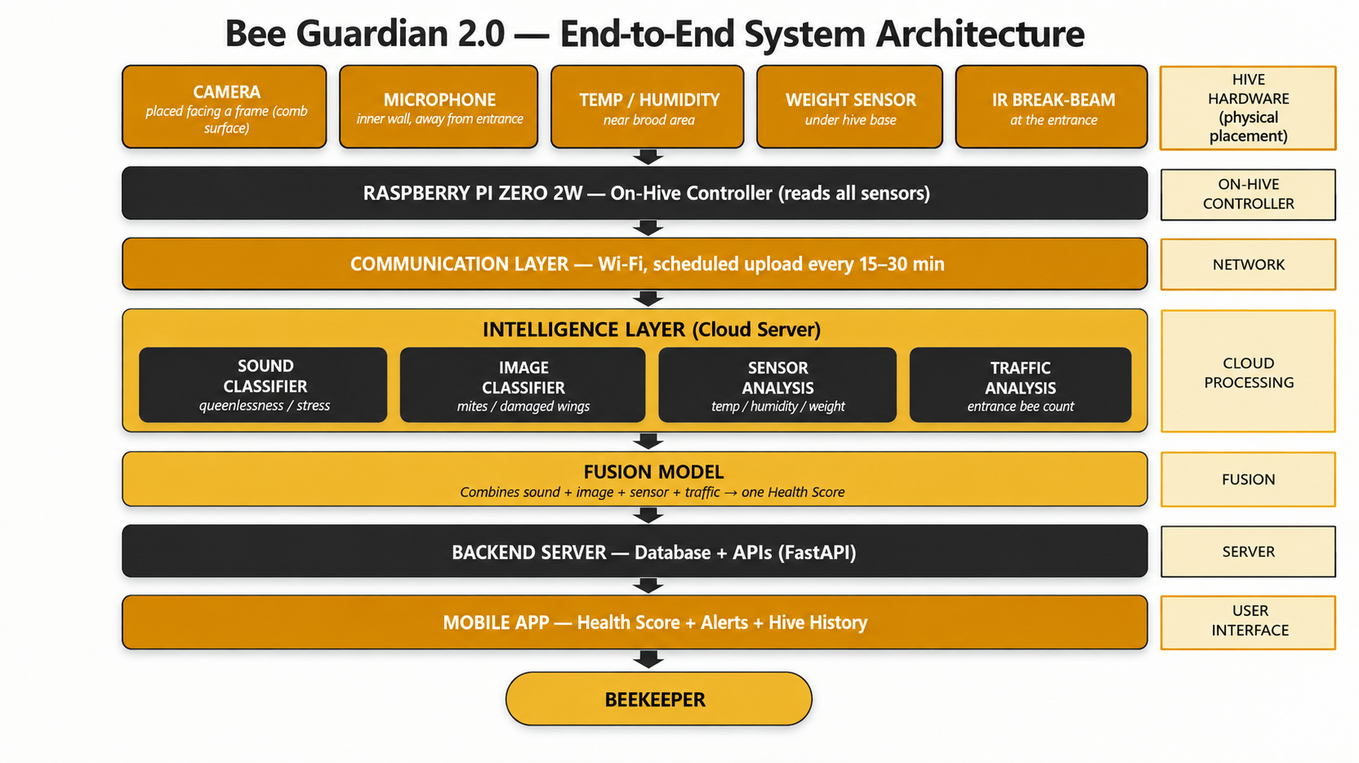
Bee Guardian 2.0- System Architecture

