Slide 1

Bee Guardian 2.0
A Smart Beehive Health Monitoring System Using Embedded Multimodal Technology
Final Year Project – Proposal Presentation
By
Huzaira Sultan – NUM-BSCS-2023-07
Aiman Malik – NUM-BSCS-2023-26
Supervisor: Dr. Shafiq-ur-Rehman
Industrial Partner: National Agricultural Research Centre Islamabad

Slide 2
Outline
Introduction
Problem Statement and Objectives
Related Work
Proposed Design Methodology
Software Tools
Proposed Work Plan (Gantt Chart)

Slide 3
Introduction
Beekeeping supports agriculture and livelihoods, but hive monitoring is still manual and disturbs the bees. Problems like mites and queen loss are detected late. Earlier work developed separate sound-based and image-based health detection modules.
Our Solution, Bee Guardian 2.0:
Integrates the audio and image modules.
Adds an automatic hive unit with sensors.
Provides one health score with mobile alerts.

Slide 4
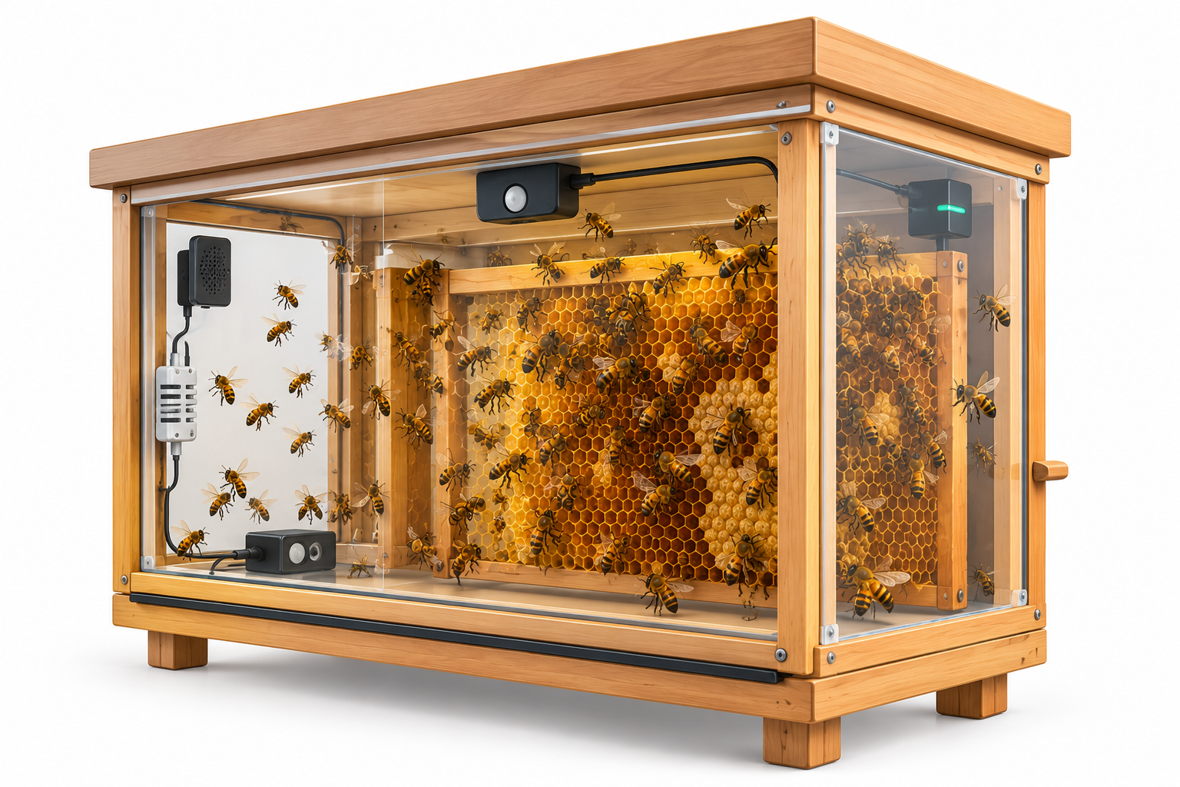
Problem Statement
Currently, honeybee health detection relies on separate sound-based and image-based modules, each capturing only part of the picture, and data collection still depends on manual hive inspection. A low-cost automatic system is needed that integrates both modules, adds hive sensors (temperature, humidity, weight), and combines all evidence into a single health score with timely alerts to the beekeeper.

Slide 5
Objectives
Integrate the existing sound-based and image-based modules into a single pipeline.
Build an automatic hive unit (camera, microphone, temperature/humidity and weight sensors) that sends data to a server.
Design a fusion model that combines all outputs into one health score.
Deliver the score and alerts through a mobile app.
Evaluate the system on a real hive and publish the results as a research paper.

Slide 6
Literature Review/Related
Study | Modality | Approach / Strength | Limitation
Khan et al. [1] | Sound | Spectrogram-based deep learning identifies bee sound in noisy environments | Audio only, no visual or sensor data
Sad et al. [7] | Sound | Low-power edge device detects queenless hives | Audio only, one condition
Bjerge et al. [8] | Image | Entrance camera and tunnels estimate Varroa mite level | Image only, needs special setup
Voudiotis et al. [9] | Image | In-hive camera with deep learning for early mite detection | Mites only, no sound or sensors

Slide 7
Proposed Methodology
Development Methodology
Requirements & Data Foundation – Gather beekeepers' needs and consolidate existing audio and image datasets.
Module Integration – Merge sound and image modules into one pipeline with a shared data format.
Hive Unit Development – Assemble the camera, microphone and sensors, and program scheduled capture and upload.
Fusion & Backend – Combine all outputs into one health score with confidence, served through APIs.
App Development – Build the mobile app for health score, hive history and alerts.
Field Deployment & Evaluation – Test on a live hive and refine using the success criteria.

Slide 8
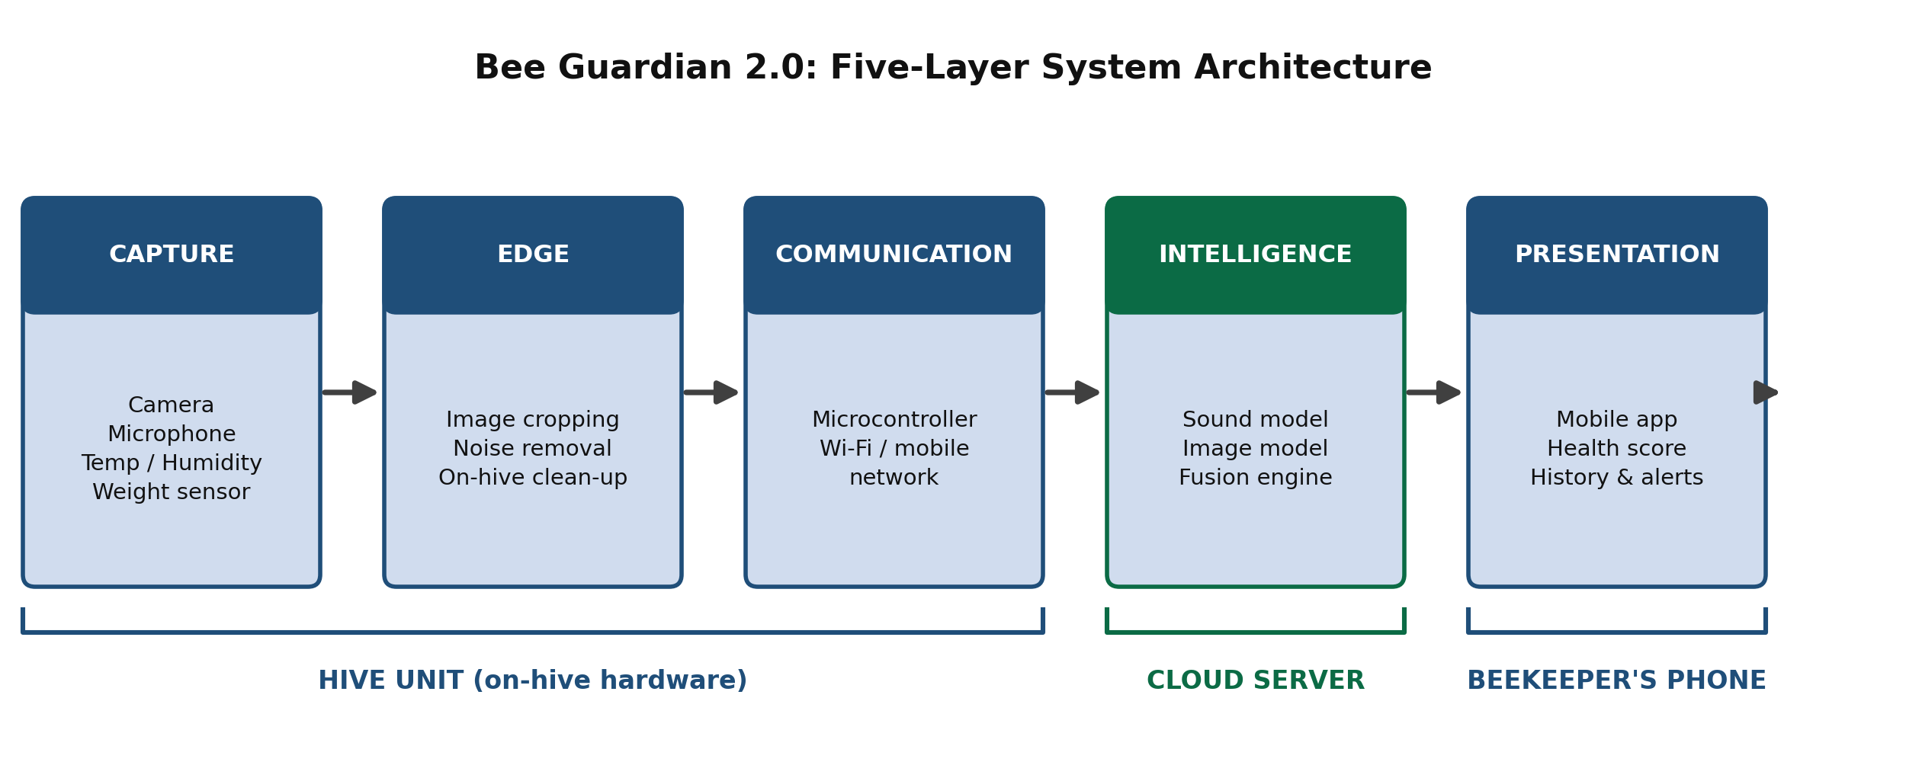
Abstract System Design

Slide 9
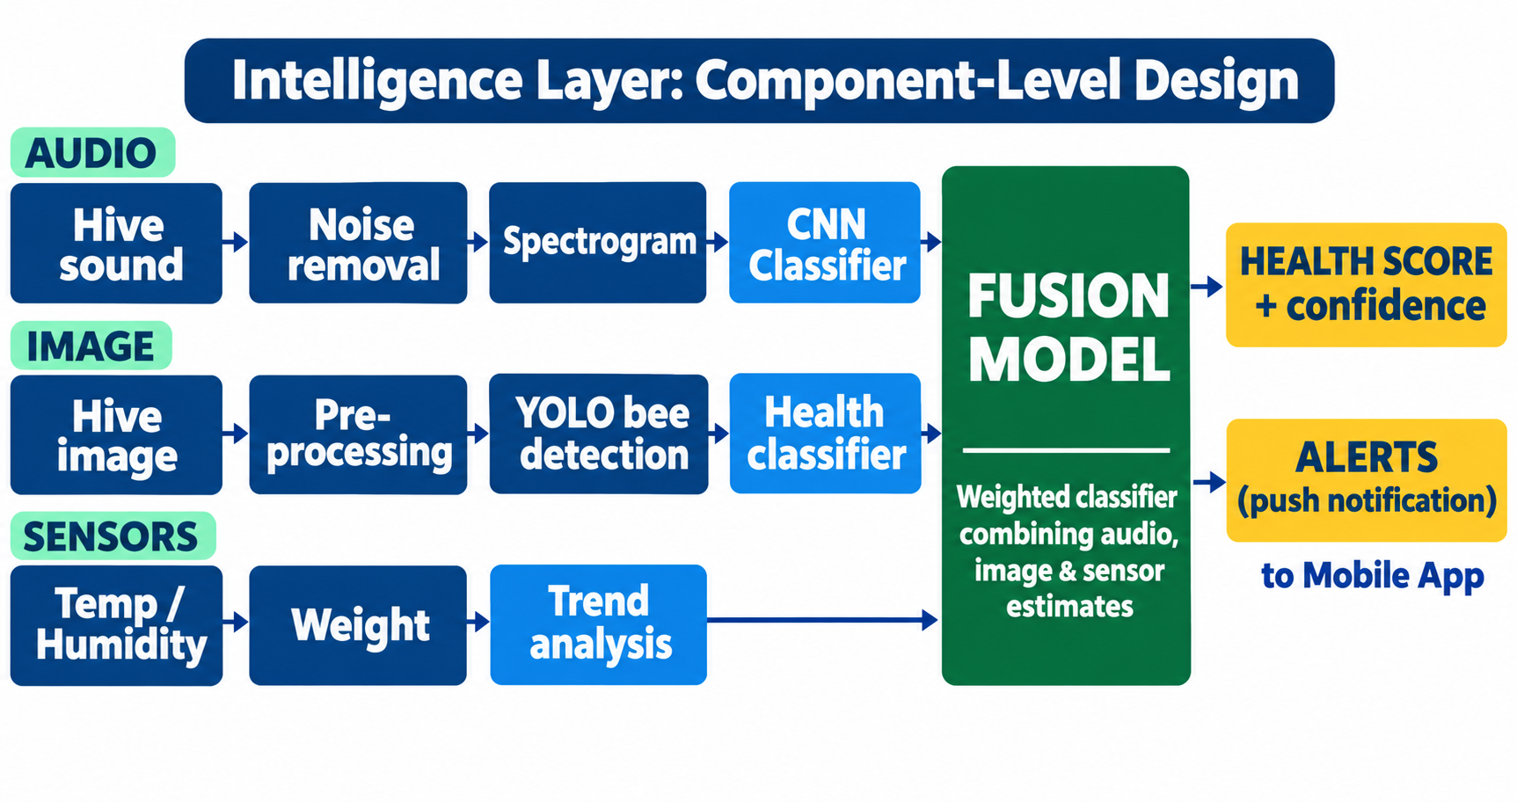
Intelligence Layer: Component-Level Design

Slide 10
Hardware/Software Tools
Category | Tool | Why we chose it
Hardware | Low-cost embedded camera and microcontroller board | Affordable, captures images and audio, sends data over Wi-Fi
Hardware | Sensors (microphone, temperature/humidity, weight) | Cheap, readily available, track hive condition continuously
Software | Python, TensorFlow/Keras (CNN) | Well suited to spectrogram-based sound classification
Software | PyTorch, YOLO, OpenCV | Fast bee detection, counting and pest classification
Software | FastAPI and database | Lightweight APIs for inference, storage and alerts
Software | Flutter (Android) | Single codebase with easy dashboards and push notifications
Software | Docker and cloud server | Portable, reproducible deployment of the server
Software | Git/GitHub, Google Colab | Version control and free GPU for model training

Slide 11
Proposed Work Plan
Team Member | Activity | Tentative Duration
Both | Requirement gathering, related work study and system design | Week 1 – 4
Both | Collecting and labelling audio and image dataset | Week 5 – 12
Aiman Malik | Integrating the existing sound-based module | Week 13 – 18
Huzaira Sultan | Integrating the existing image-based module | Week 13 – 20
Aiman Malik | Building the hive sensor unit and connecting it to the server | Week 19 – 26
Huzaira Sultan | Building the backend server, database and alert system | Week 21 – 27
Both | Fusing audio, image and sensor results into one health score | Week 27 – 32
Huzaira Sultan | Building the mobile app | Week 28 – 34
Both | Testing the full system on a real hive and fixing issues | Week 33 – 38
Both | Final testing, documentation and report writing | Week 39 – 40

Slide 12
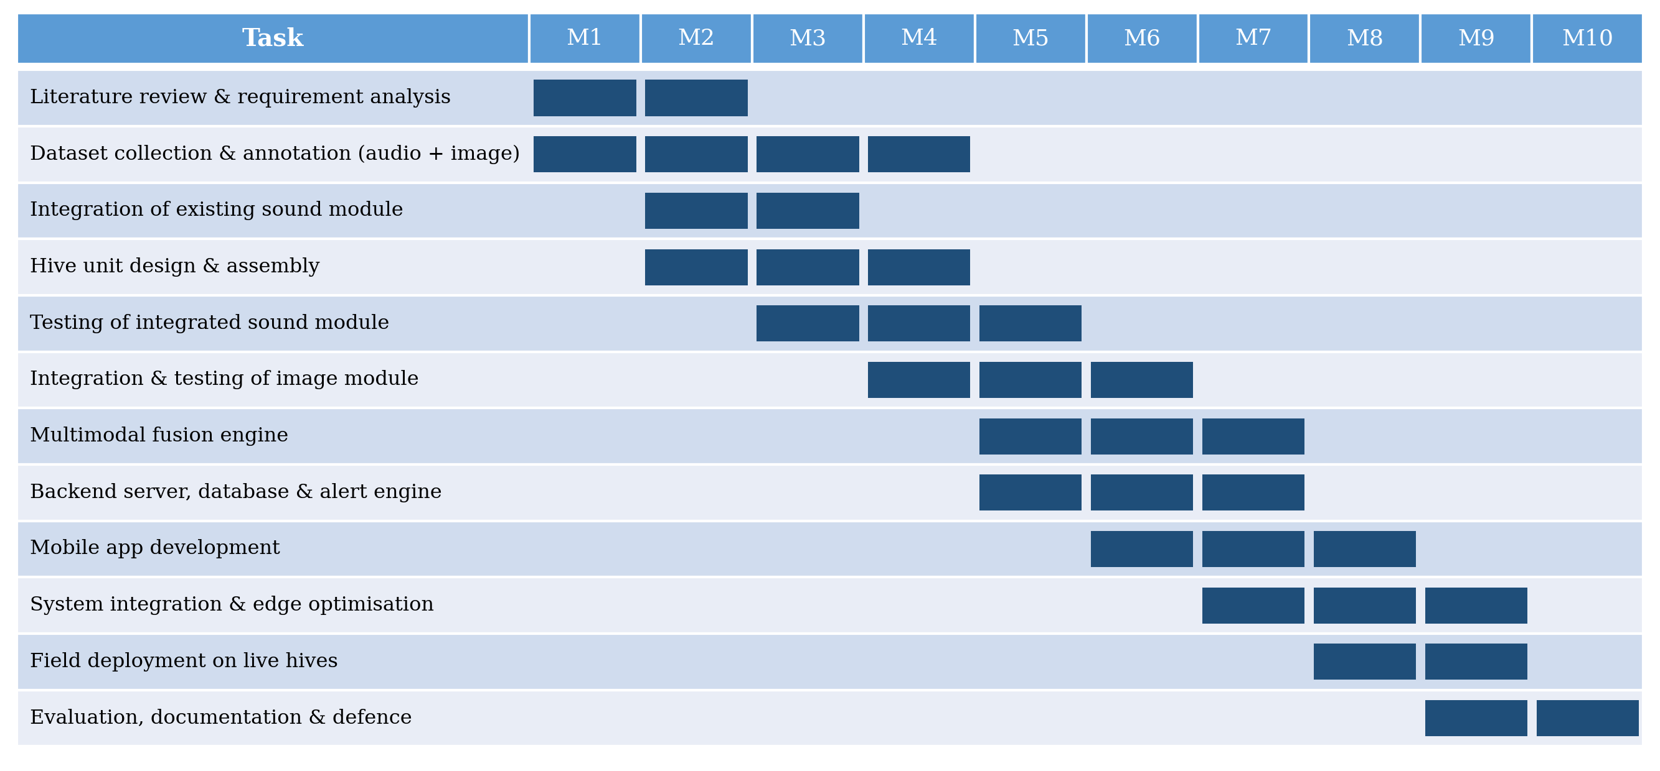
Proposed Work Plan
Gantt Chart

Slide 13
Thank You

