Slide 1

Introducing Sustain Mart
Sustain Mart is a sustainable e-commerce brand offering premium personal care products made with natural ingredients. Our mission is to promote healthier lifestyles while protecting the environment through ethical and responsible business practices.

Slide 2
The Problem We Identified
1
2
3
Chemical-based personal care products harm skin and environment
Limited sustainable options in the local market
Imported organic brands are expensive
4
Lack of consumer trust and transparency
Conclusion: Consumers want safe, affordable, and ethical alternatives.

Slide 3
Uniqueness of Sustain Mart
1
2
3
Combines sustainability with affordability
Designed for Pakistani climate and consumer needs
Ethical sourcing and eco-friendly packaging
4
Premium digital shopping experience
👉 Sustain Mart is not just a product-based business, but a purpose-driven brand.

Slide 4
Target Market
Age Group: 18–35 years
Urban population of Pakistan
Middle to upper-middle income
Eco-conscious and online shoppers
Market Trend: Growing awareness of self-care and sustainability.

Slide 5
Our Value Proposition
Natural & chemical-free products
Premium quality at affordable prices
Convenient online experience
Ethical, transparent, and trustworthy brand
Brand Promise:
“Sustainable personal care made accessible.”

Slide 6
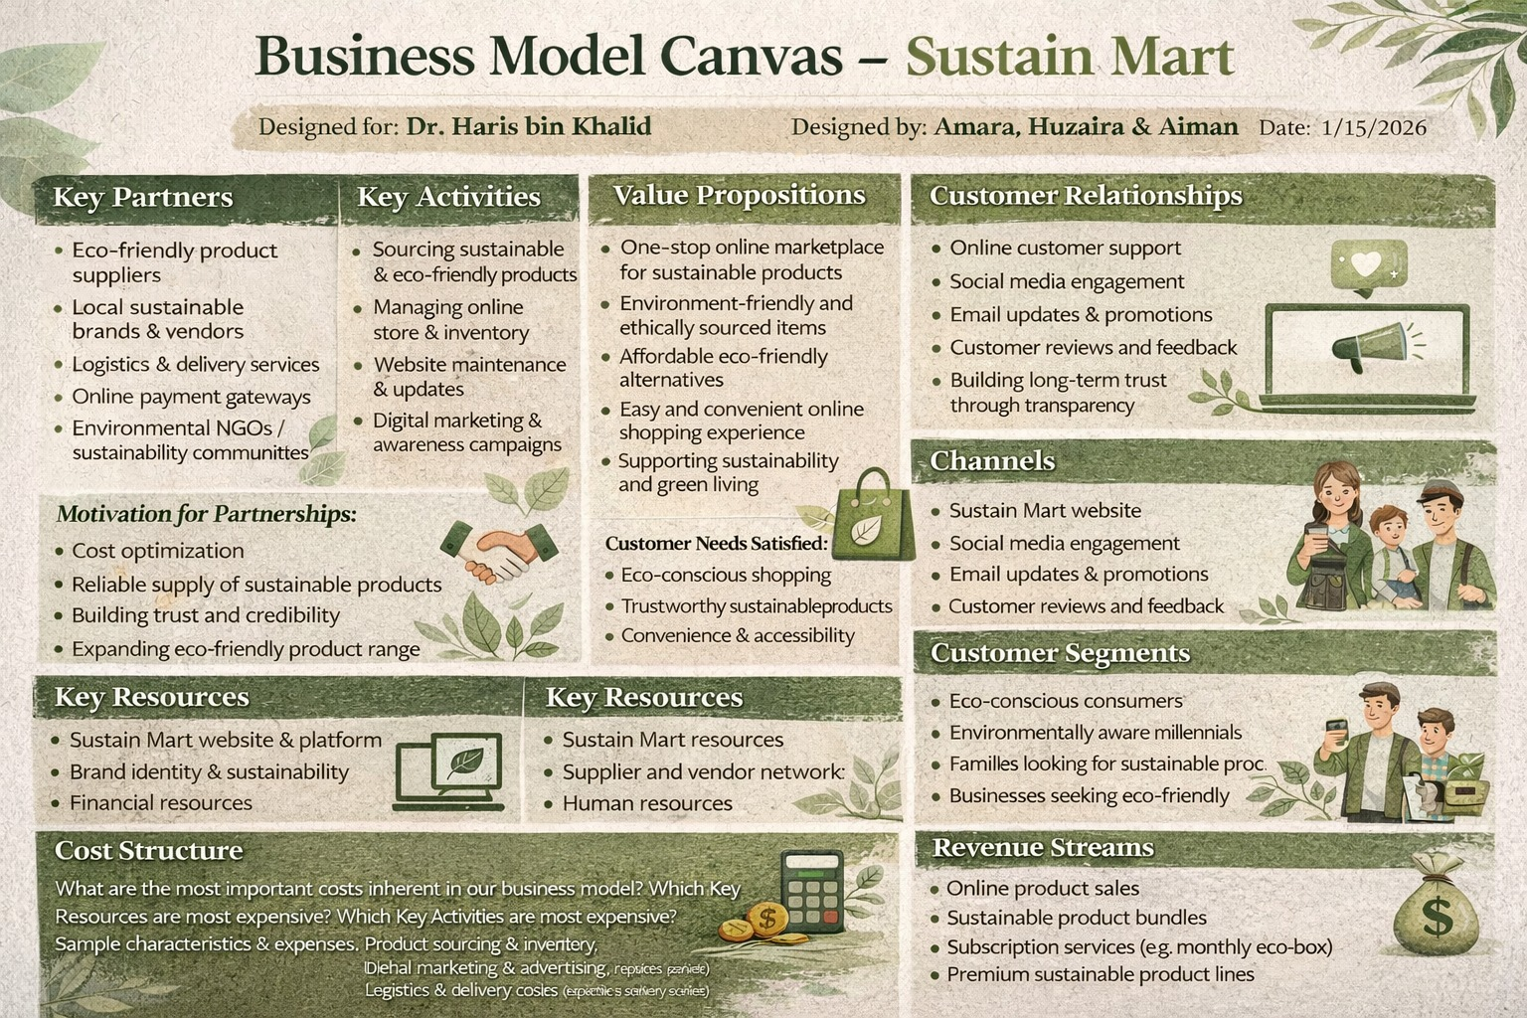
Business Model & Canvas

